Slide 1
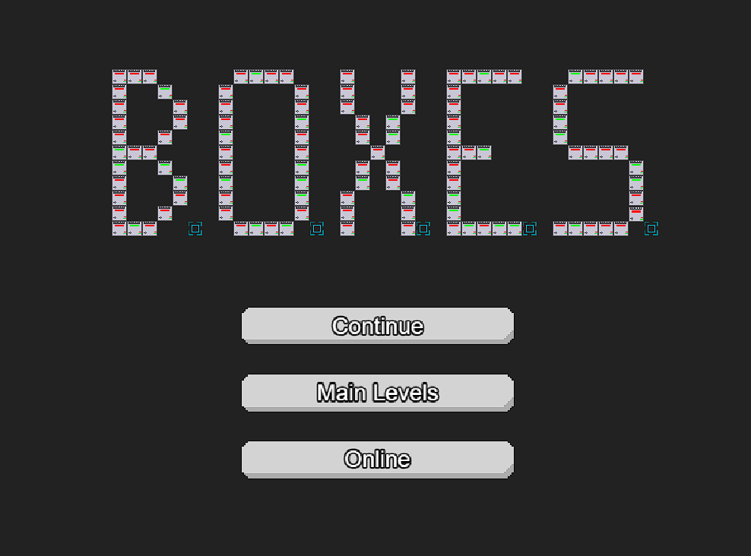

A CMSC 447 Project By:
Abdulrahman Almuwarraee
Aidan Brown
Joss Blumberg
Jonathan Andersen-Taylor
Jet Thompson

Slide 2
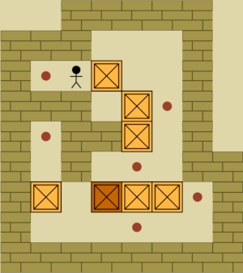
Welcome to "B.O.X.E.S."!
Our team drew inspiration from the classic game Sokoban.
We chose to keep the original strategic gameplay
Added our own twists to provide a new challenges

Slide 3
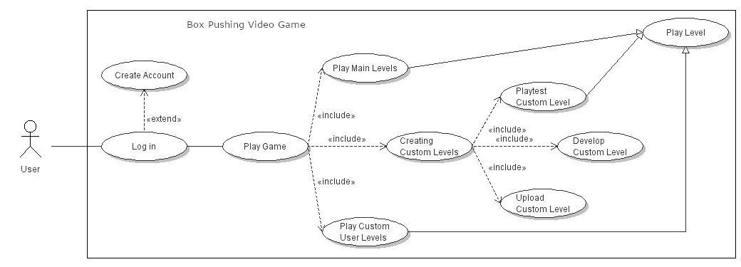
Early Planning

Slide 4
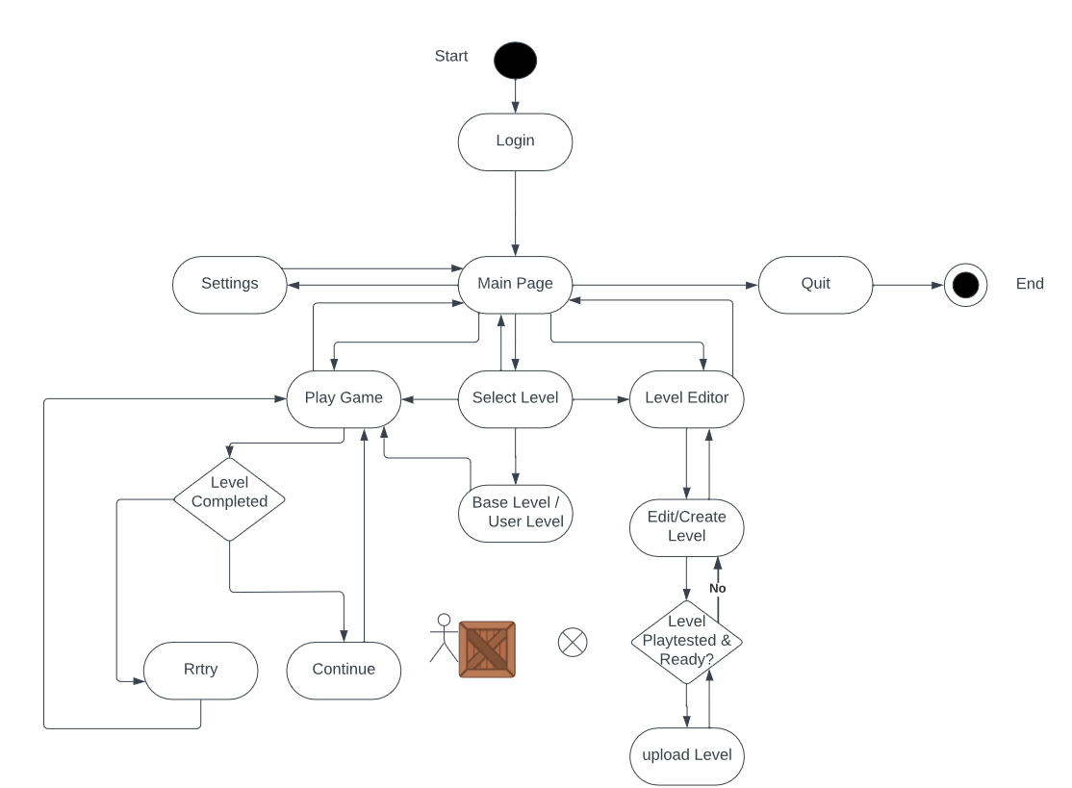
Activity Diagram

Slide 5
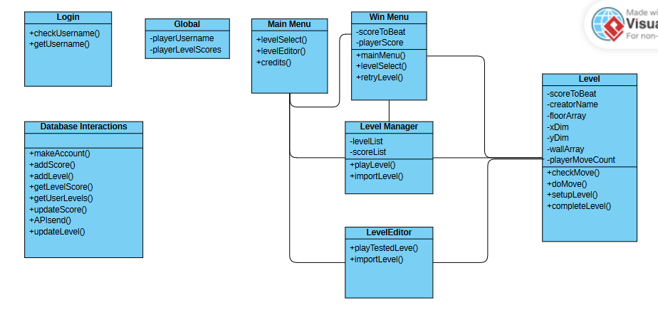
Class Diagram

Slide 6
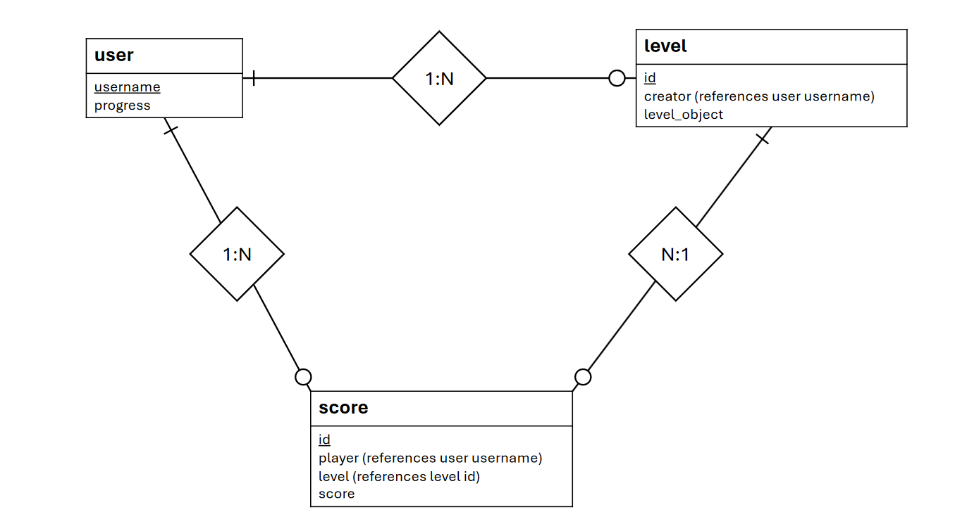
E-R Diagram
Original E-R Diagram
As project advanced, we made changes
Stopped using score table
Scores for our levels moved to user table
Added creator score
Added user id

Slide 7


The Demo
If you would like to test or play the project yourself, follow this QR code!

Slide 8
The Demo
If you would like to test or play the project yourself, follow this QR code!

Slide 9
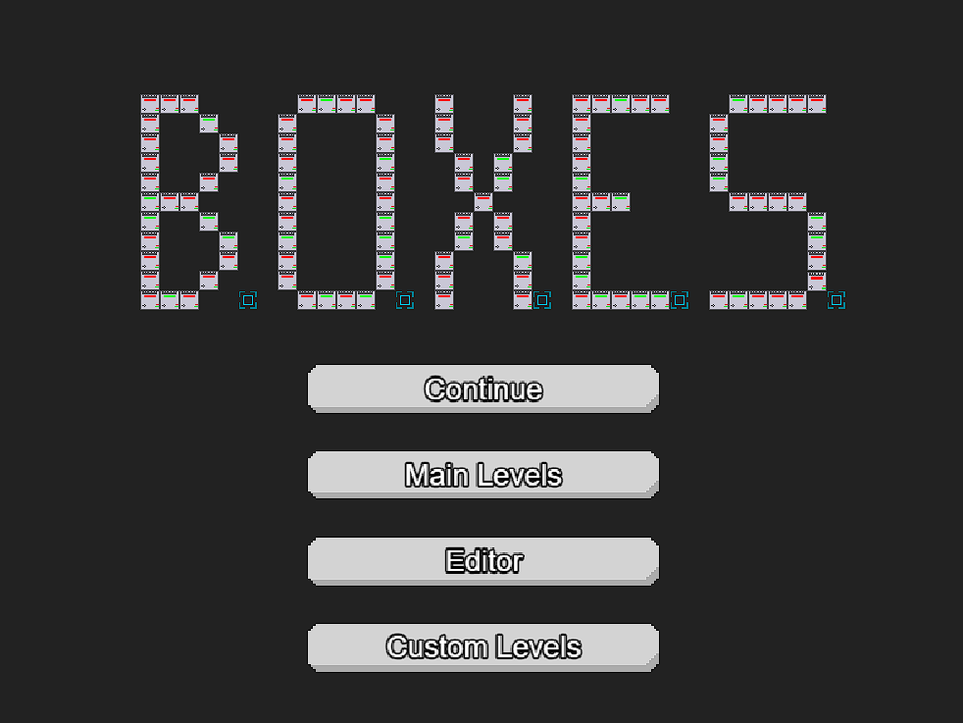
Menu Implementation
Our game menu is the first interaction players have with BOXES.

Slide 10

Database
Python sqlite3 module
Manages database file
Lets us write commands in SQL
In-game actions send requests to web server
Web server then interacts with database through sqlite3
This helps separate front end from back end

Slide 11
Flask Integration
Database development split into multiple parts
Login flow can both create and read users
Index/DBHome controls access to CRUD for the backend
Database
Login
Index / Dhome
Create
Update / Delete
Read

Slide 12
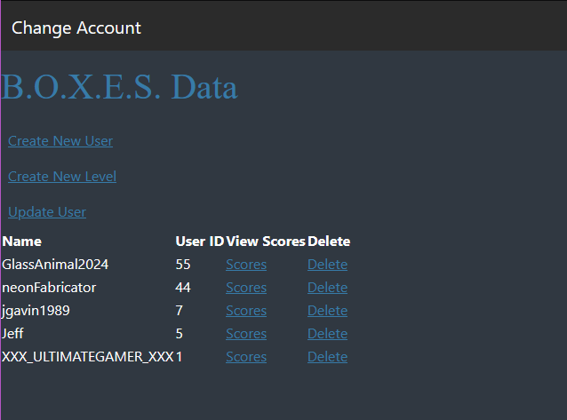
Simple Function, Simple Design
Backend provides all necessary functionality
CRUD, All contained in one simple page
Who needs fancy styling?

Slide 13
Adapting the Database
Users
Levels
Original structure became unnecessarily complex for our uses
Changed from a Three-Table database to Two-Table
Stored main level scores within the table
Kept custom levels attached to users
Adapting was necessary very late in the project
Always ensure that integration works early on
Scores
Users
Levels

Slide 14
What We Learned
Databases :(
Flask can be frustrating, with multiple layers of interaction required
Everything takes a lot of time
Budgeting how long is spent on each section is challenging
Integration requires early implementation and consideration, hooking parts together late is difficult when design paradigms do not match
Consistent code style can save lives
Sticking to design documents saves time and effort, but being flexible can make development easier late in the project
Developing good, new puzzles is hard, nothing new under the sun

Slide 15
Thank you!
Any questions?

