Slide 1

Phidata Agent with MCP Performance Analysis
Evaluating MongoDB integration approaches for enterprise-scale intelligent agents Text to SQL case study. with mongodb tools access over REST API over mongodb tools access over Model Context Protocol access over REST API

Slide 2
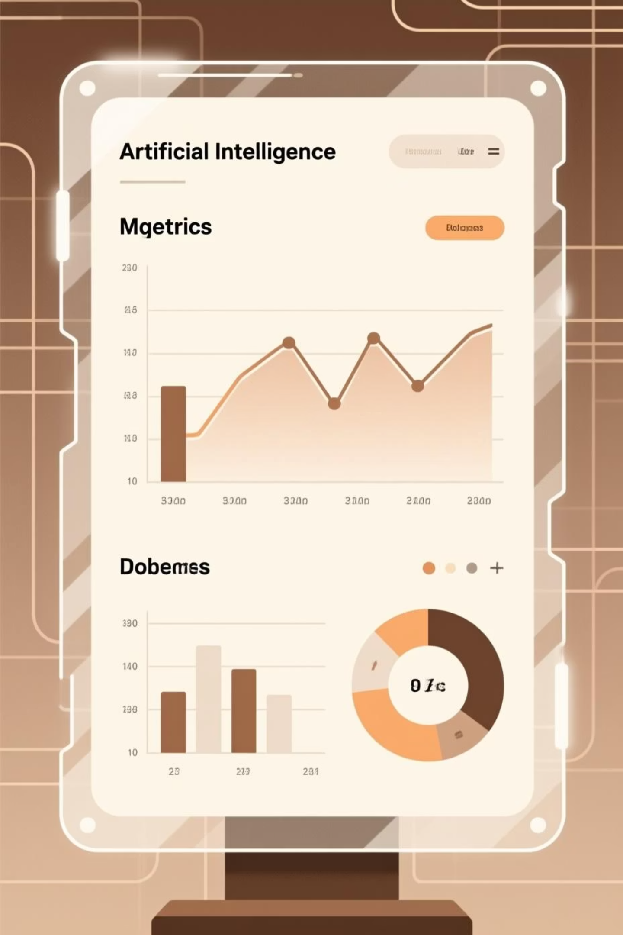
Executive Summary
Strategic Objective
Key Findings
Comprehensive evaluation of Phidata Agent performance comparing two distinct MongoDB integration architectures:
Analysis reveals substantial performance advantages with MCP implementation:
Significant latency reduction across all query types
REST API tools – Traditional endpoint approach
Enhanced natural language comprehension
Model Context Protocol (MCP) – Advanced contextual layer
Superior operational efficiency metrics

Slide 3
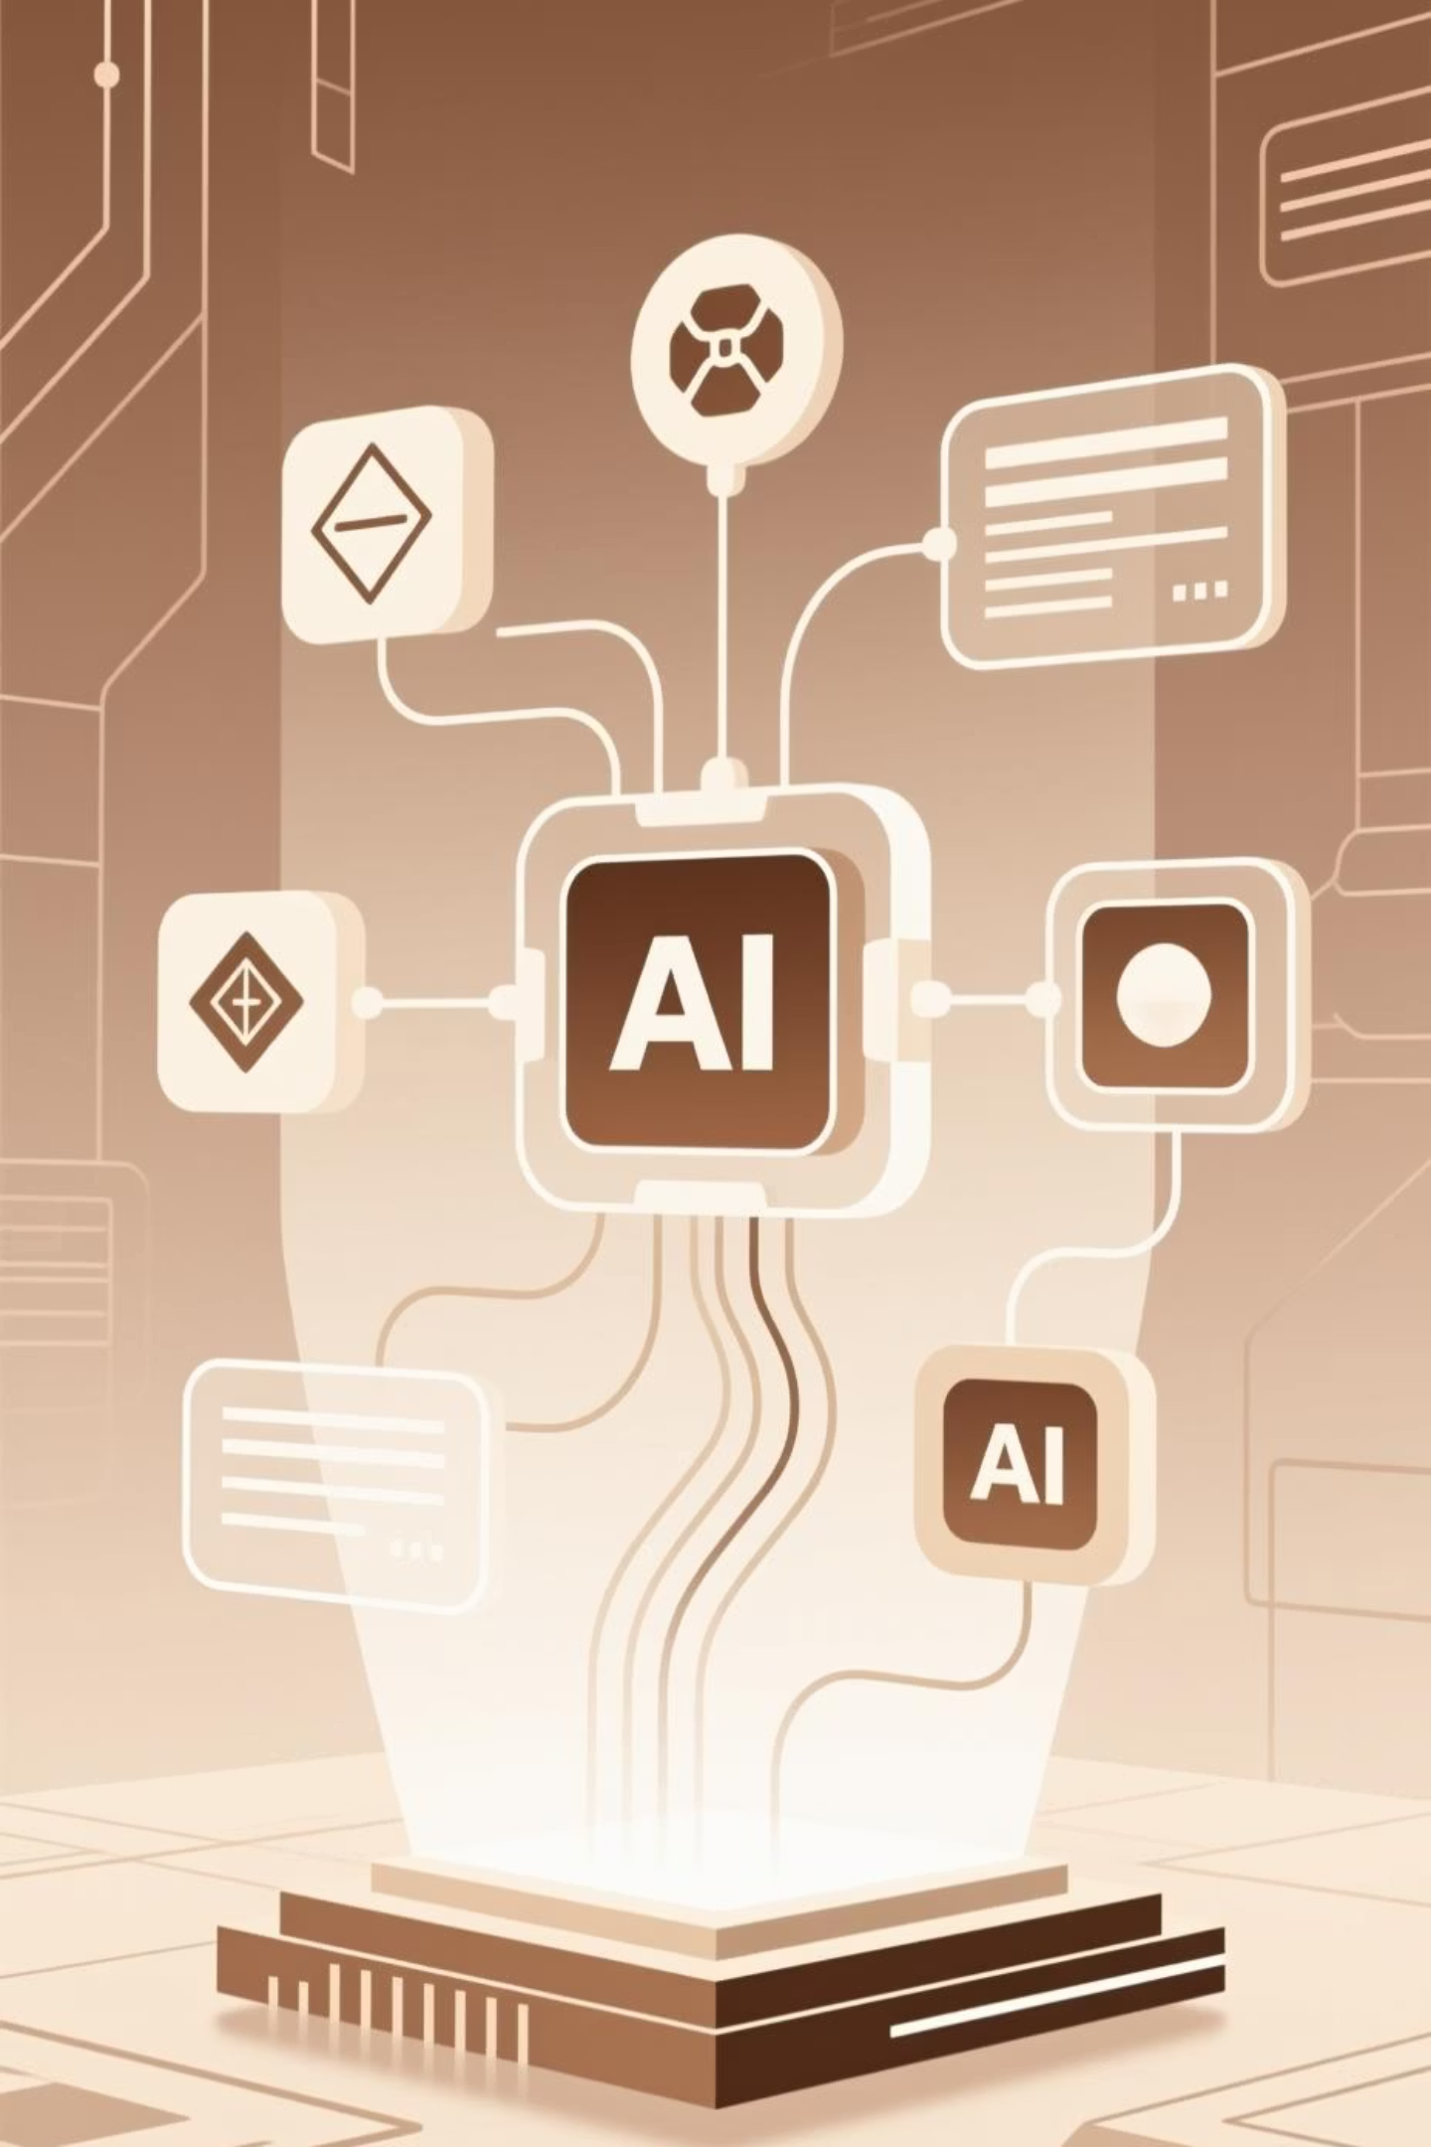


Architecture Overview
Case 1: REST API Tools
Traditional architecture with REST endpoints for tool invocation. Each natural language query triggers serialisation, HTTP transmission, tool execution, and response handling.
Challenge: Multiple round-trips between LLM and tool layer increase latency
Case 2: MCP over REST
Advanced implementation with tools defined in Model Context Protocol layer. LLM interacts through contextual tool registry over REST.
Advantage: Reduced serialisation overhead with enhanced tool awareness

Slide 4

Experimental Design
01
02
Dataset Composition
Complexity Tiers
Natural language queries engineered to access MongoDB through Phidata Agent, categorised by computational complexity
Low: Simple filter/read operations | Medium: Multi-field filters with aggregation | High: Nested conditions and cross-collection joins
03
Performance Metrics
Response time measurement (seconds) and query complexity classification across both implementation approaches

Slide 5
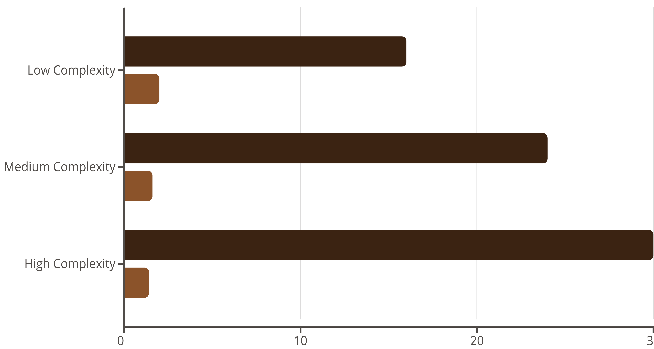
Performance Comparison Results
REST API Tools (seconds)
MCP Tools over REST (seconds)
8×
15×
20×
Low Complexity
Medium Complexity
High Complexity
Performance improvement factor
Performance improvement factor
Performance improvement factor
MCP tools consistently outperform REST tools across all complexity tiers, with improvement scaling as query complexity increases

Slide 6

Latency Analysis Deep Dive
Critical Performance Patterns
REST API tools demonstrate exponential latency growth as query complexity increases, creating scalability concerns for enterprise deployments.
Conversely, MCP tools exhibit linear scaling characteristics with minimal latency increase from low to high complexity queries.
Root Cause Factors
Substantially fewer HTTP round-trips
Intelligent context caching in MCP layer
Optimised serialisation and deserialisation protocols

Slide 7





Natural Language Processing Capabilities
Superior Context Retention
MCP implementation maintains conversational context across sequential queries, enabling more sophisticated multi-turn interactions
Enhanced Query Accuracy
Higher precision in interpreting multi-field MongoDB queries with complex filtering requirements and aggregation pipelines
Reduced Error Rates
Fewer ambiguous tool selection errors and improved handling of query chaining scenarios
REST API Limitations: Traditional tools struggle with query chaining and exhibit context loss between sequential calls, impacting user experience quality

Slide 8

Strategic Business Impact
Enhanced User Experience
Dramatic response time improvements translate directly to superior end-user satisfaction and engagement metrics
Cost Optimisation
Reduced API compute costs through lower latency and more efficient resource utilisation across infrastructure
Operational Reliability
Greater system reliability through structured tool invocation patterns and reduced error propagation
Scalability Framework
Simplified scaling operations through MCP standardisation across diverse tool ecosystems

Slide 9




Executive Recommendations
Immediate Implementation
Adopt MCP-based tool integration for production Phidata agents to capitalise on demonstrated performance advantages
Optimisation Priority
Prioritise complex query optimisation strategies to fully leverage MCP efficiency gains in high-value use cases
Continuous Monitoring
Establish metrics tracking framework: average response time, error rate distribution, and latency percentiles
Ecosystem Extension
Expand MCP integration to non-MongoDB tools including RESTful microservices and data analytics APIs
Future-Proof Architecture
Build strategic advantage through standardised model-context interoperability and vendor-agnostic integration patterns

