Slide 1

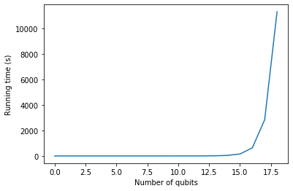
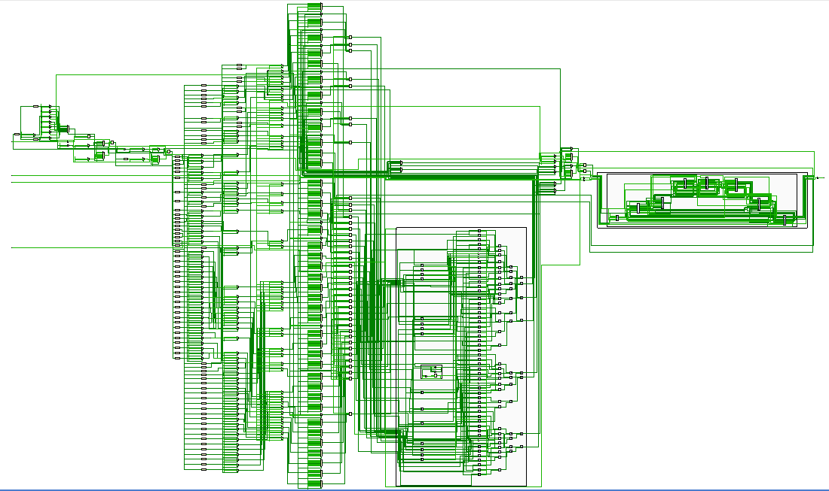
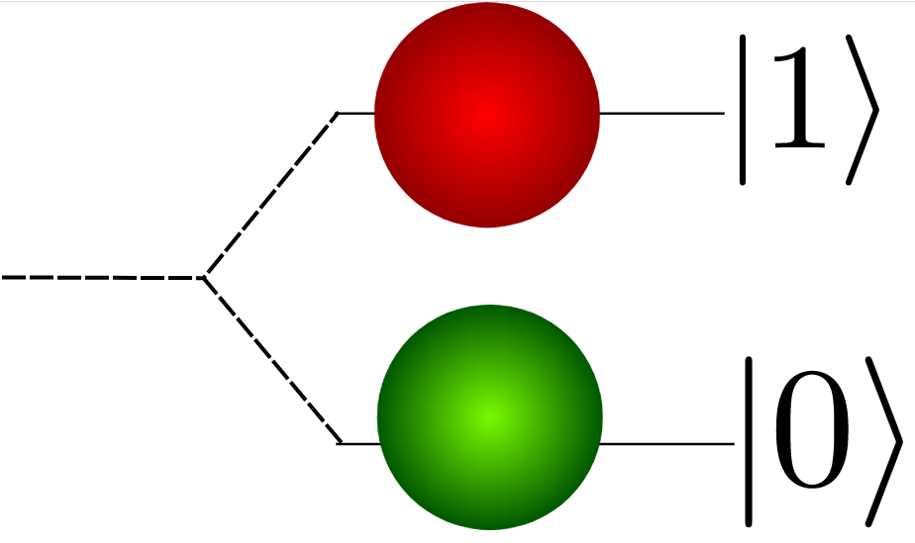
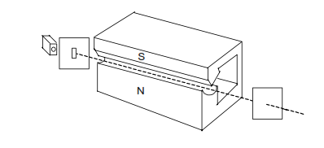
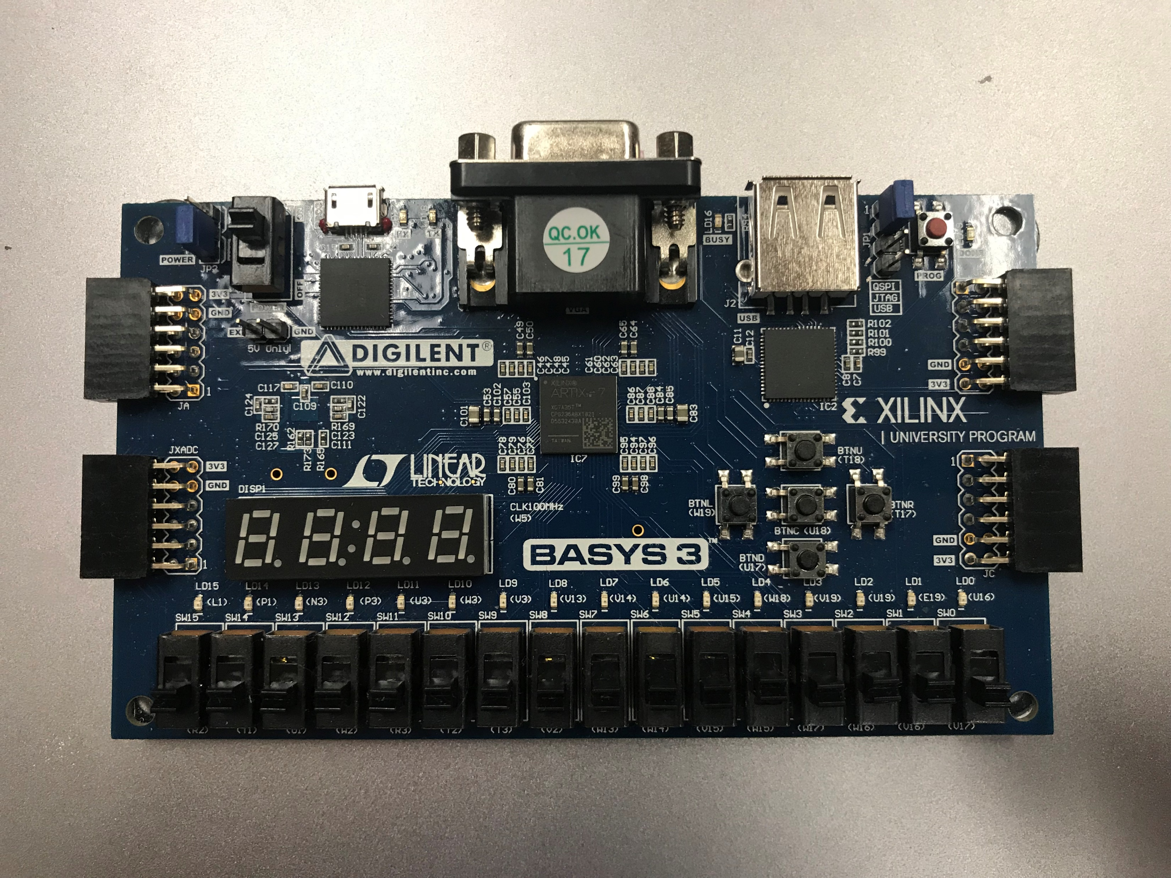
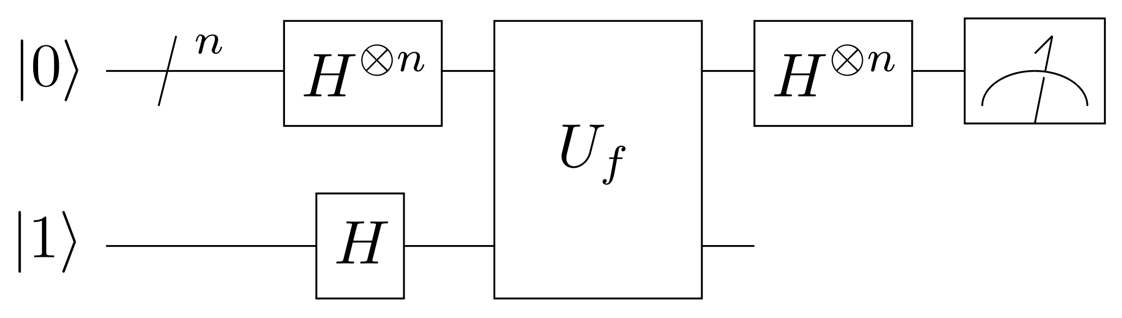
Emulating a Quantum Computer with an FPGA Jackson Davis and Dr. Charles Collett Department of Physics, Muhlenberg College Funded By: Muhlenberg Dean of Academic Life
Introduction
Procedure
Exponential runtime growth of state measurement
Conclusions
Quantum computing is one of the most promising modern applications of quantum mechanics, which could be used for cryptography, quantum simulation, and other tasks
Currently, quantum computers are quite difficult to build, but emulators could be valuable for those wishing to familiarize themselves with how they work
Emulating a quantum computer grows exponentially with the number of qubits
An FPGA can shift this growth from time to hardware, as it builds a circuit rather than performing sequential computations
For more expensive FPGAs, emulating a quantum computer is a viable task and much simpler than creating a real quantum computer
This work can be adapted into a CUE-like project for anyone interested in quantum information
Possibilities for further work include optimization to fit more qubits on a smaller board and testing larger algorithms (e.g. Shor’s) on a larger board
A quantum computer consists of a series of gates acting on an input state
We can emulate this behavior with a circuit on the FPGA that multiplies a matrix (gate) by a vector (state)
Using a Field-Programmable Gate Array rather than a classical computer can create a faster emulator
Source: Clemens Adolphs,
https://commons.wikimedia.org/wiki/File:Simple_qubits.svg
We then must emulate the process of measuring the output state
I chose to do this on the PC to save space on the FPGA and fit a larger emulator on it
Results
I was able to fit a 2-qubit emulator on my FPGA, or a 3-qubit emulator under the assumption that all the elements in the input state and gates are real numbers, not complex
My emulator successfully performed the Deutsch-Josza Algorithm for both 2 and 3 qubits
Source: André Luis Bonfim Bathista e Silva,
https://commons.wikimedia.org/wiki/File:Aparelho_de_Stern-Gerlach.png
References
Pilch, J., Długopolski, J. An FPGA-based real quantum computer emulator. J Comput Electron 18, 329–342 (2019). https://doi.org/10.1007/s10825-018-1287-5
Wick, K. (2017). Applied Digital Logic Exercises Using FPGAs. San Rafael (40 Oak Drive, San Rafael, CA, 94903, USA): Morgan & Claypool Publishers.
J. R. Johansson, P. D. Nation, and F. Nori: "QuTiP: An open-source Python framework for the dynamics of open quantum systems.", Comp. Phys. Comm. 183, 1760–1772 (2012) [DOI: 10.1016/j.cpc.2012.02.021].
https://github.com/freecores/verilog_fixed_point_math_library
Finally, I had to communicate between the PC and FPGA to send gate/state data back and forth
I used UART communication with a finite state machine on the FPGA to handle this
Acknowledgments
Alexander Gardner, Jose Maldonado
Source: Skippydo, https://commons.wikimedia.org/wiki/File:Deutsch-Jozsa_Algorithm.svg
Notes:
Did you have a summer research photo shoot? Use the pictures from that on your poster.
This template option has “boundary boxes” around the sections. This is one way of organizing the poster – but the boxes are not required. See the slide that follows.

