Slide 1

DELIVERABLE 2 · HUMAN CAPITAL VALUATION
Valuing Human Capital
at CACEIS
From cost center to value driver; A 5-KPI framework powered by AI
AlbertSchool Hackathon · CACEIS Investor Services
By Mohamed Jad KABBAJ, Femi FACIA, Jean-Baptiste BRUN, Ilyes KABBOUR

Slide 2
01 · PROBLEM
Reported as a cost. Should be valued as an asset.
Why standard HR reporting hides the financial value created by people ? And what changes when we measure it properly ?
TODAY · COST CENTER LENS
OUR FRAMEWORK · VALUE LENS
People appear as expenses
People as a measurable asset
Headcount, payroll, absenteeism reported in isolation
No link between training spend and performance
Attrition seen after the fact, never anticipated
Compensation managed without efficiency benchmark
Financial value created per FTE (HCVA, HCROI)
Forward-looking attrition risk, not just turnover
Training measured against actual performance
Absence and role cost converted into euros lost / gained
Result: HR is a budget line, not a strategic lever.
Result: every HR decision can be priced and prioritized.
CACEIS x AlbertSchool · Deliverable 2 · Human Capital Valuation
2

Slide 3
02 · PIPELINE
From raw CACEIS sources to governed gold tables.
A reproducible Python pipeline standardizes employee IDs, periods and entities, then feeds every KPI from a single source of truth.
STEP 1
STEP 2
STEP 3
STEP 4
RAW SOURCES
CLEAN & STANDARDIZE
GOLD TABLES
KPIs & DASHBOARD
Finance P&L · FTE
HR Master Panel
Absence (FR/LU)
Training + Reviews
EAE Performance
Compensation FR/LU
Header auto-detection
ID & period harmonization
FR/LU schema unification
Reason / status coding
Missing-value strategy
gold_finance_kpis
gold_employee_month
gold_learning_perf
gold_absence_drag
gold_role_cost_eff
5 KPIs computed
Streamlit dashboard
Drill-down by entity
Job · country · year
Export-ready outputs
GOVERNANCE BUILT IN
GDPR — pseudonymized employee IDs, role-level (not individual) compensation, no PII in dashboard outputs. Every KPI is reproducible from the same gold tables.
CACEIS x AlbertSchool · Deliverable 2 · Human Capital Valuation
3

Slide 4
03 · FRAMEWORK
Five KPIs. Five lenses on human capital value.
Each KPI answers a distinct value question. Together they cover financial output, retention risk, capability building, productivity loss and pay efficiency.
01
VALUE CREATION
02
RETENTION RISK
03
CAPABILITY
HCVA / HCROI per FTE
Workforce Value-at-Risk
Learning-to-Performance Index
Are employees creating more financial value?
Where do we risk losing human capital?
Does training translate into performance?
DATA · Finance × FTE
DATA · Tenure × EAE × Absence × Training
DATA · Training × Reviews × EAE
04
PRODUCTIVITY
05
PAY EFFICIENCY
Absence Productivity Drag
Role Cost Efficiency Index
How much value do we lose to absence?
Is role cost aligned with role performance?
DATA · Absence × HCVA per FTE
DATA · Compensation × EAE
CACEIS x AlbertSchool · Deliverable 2 · Human Capital Valuation
4

Slide 5
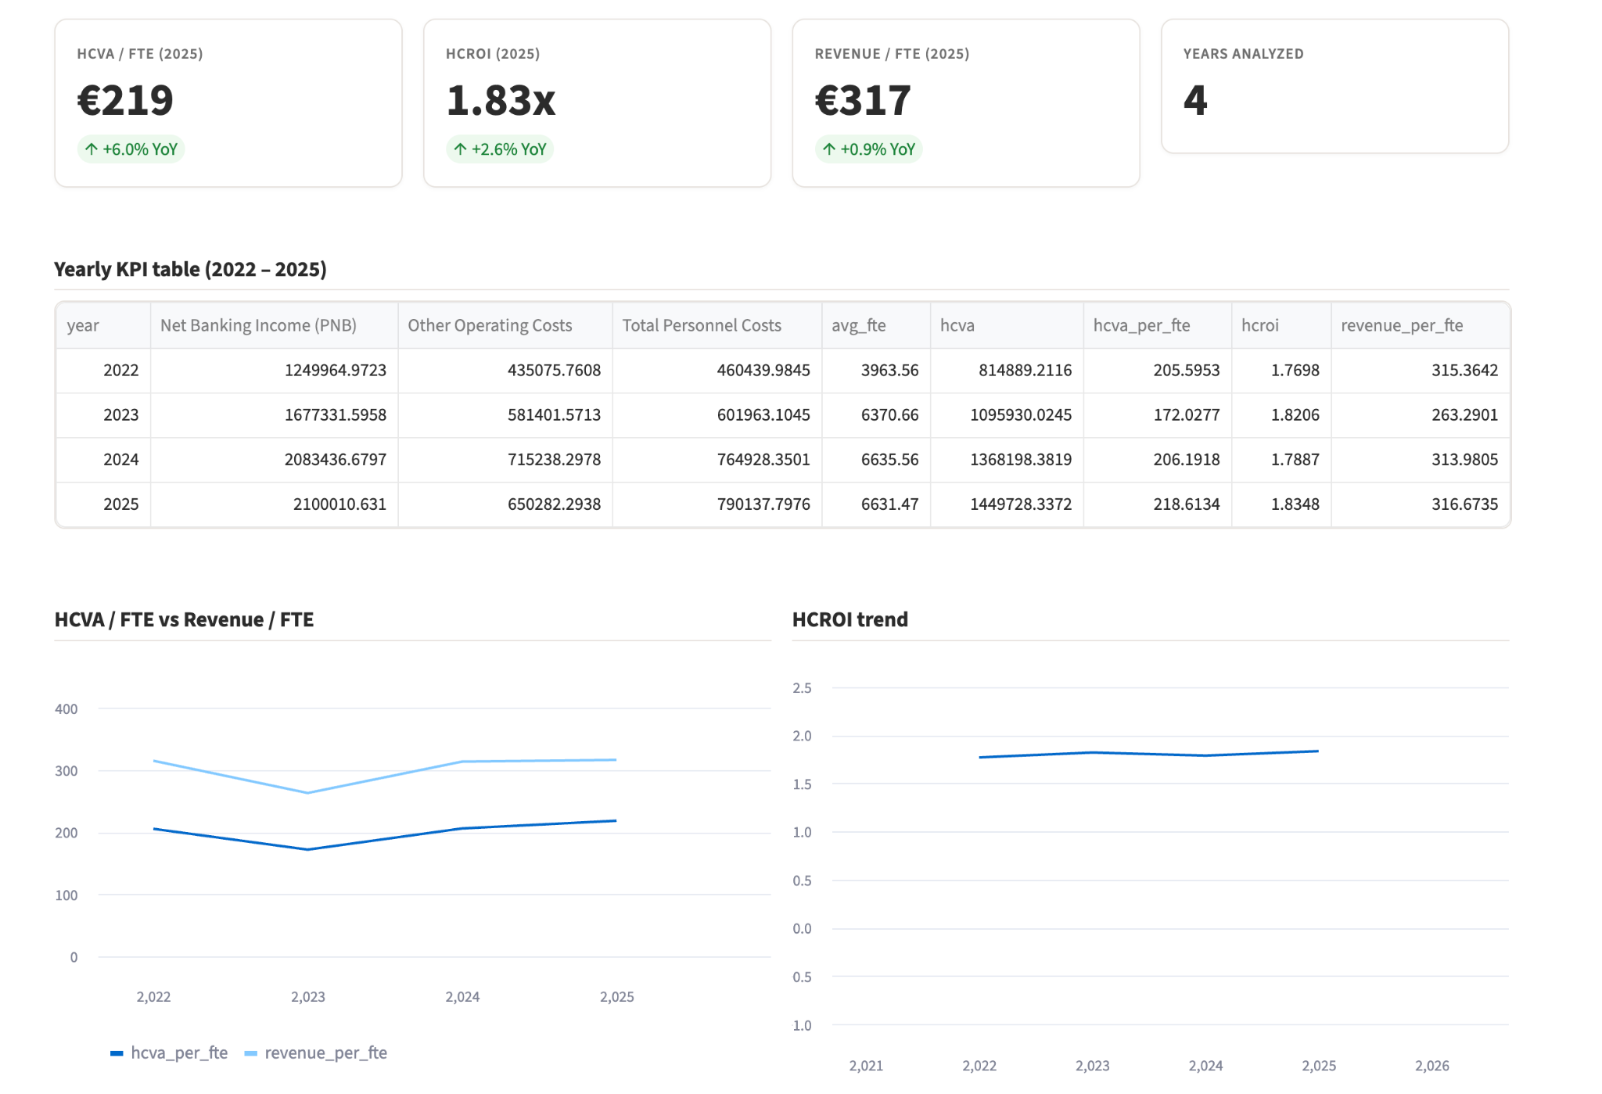
KPI 01
HCVA / HCROI per FTE
Financial value created by the workforce:
the foundation of every other KPI.
FORMULA
HCVA = PNB − Other Operating Costs
HCVA per FTE = HCVA / Average FTE
HCROI = HCVA / Total Personnel Costs
Revenue per FTE = PNB / Average FTE
WHY IT MATTERS
Translates the P&L into a per-employee value metric, comparable across years and entities.
HCROI > 1 means every euro of personnel cost generates more than one of value.
Sets the unit price used in KPI 4 to convert lost workdays into euros.
Reframes payroll from a cost to minimize into a return to maximize.
KEY INSIGHT
Yearly HCVA per FTE and HCROI computed for 2022-2025 on Group and European scope — a workforce productivity baseline tracked annually.
CACEIS x AlbertSchool · Deliverable 2 · Human Capital Valuation
5

Slide 6
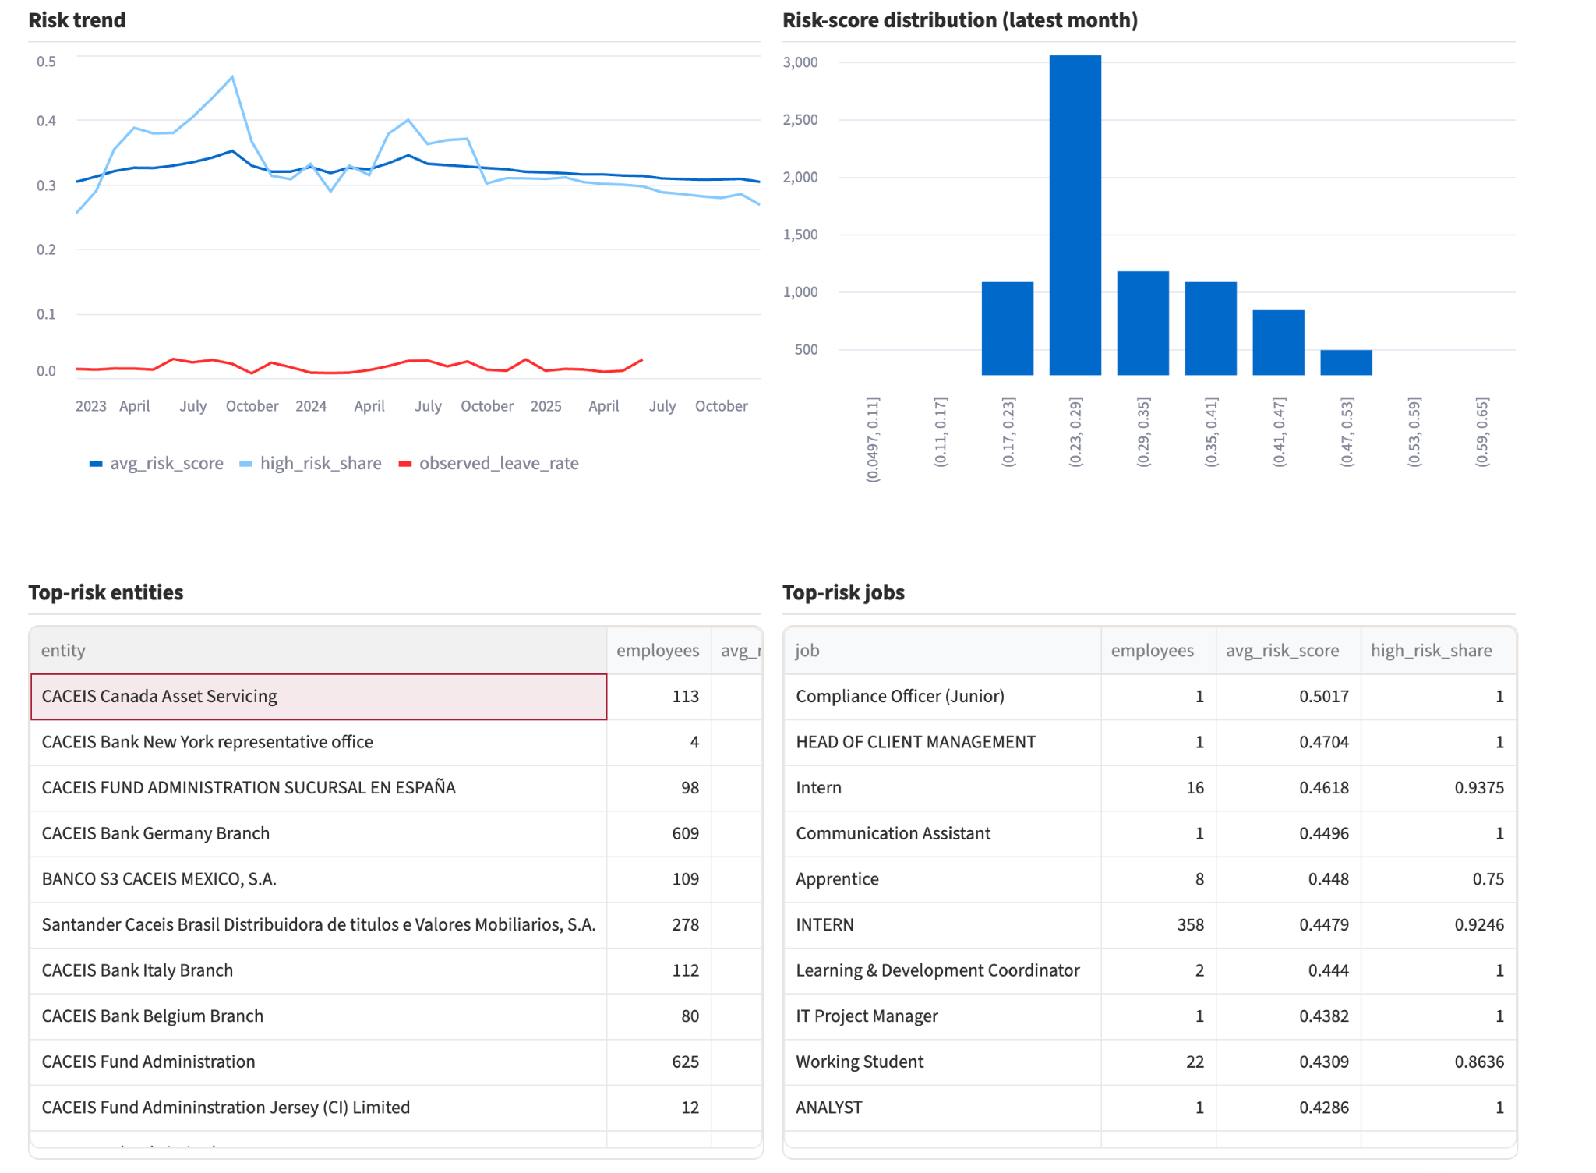
KPI 02
Workforce Value-at-Risk
Forward-looking risk score flagging employees
and segments most likely to leave or underperform.
FORMULA
Risk Score =
0.25 · New Joiner
+ 0.20 · Low Performance
+ 0.20 · High Absence
+ 0.15 · Low Training
+ 0.10 · Long Time-in-Post
+ 0.10 · Segment Risk
WHY DOES IT MATTER ?
Anticipates attrition before notice periods — turnover becomes a managed risk, not a surprise.
Multi-factor: blends tenure, EAE performance, absence and training signals.
Surfaces the entities, jobs and segments where retention investment will pay back fastest.
Interpretable weights — every risk component can be challenged by HRBPs.
KEY INSIGHT
Risk score computed on the latest observable employee-month panel; top-risk lists exposed by entity, job family and tenure band.
CACEIS x AlbertSchool · Deliverable 2 · Human Capital Valuation
6

Slide 7
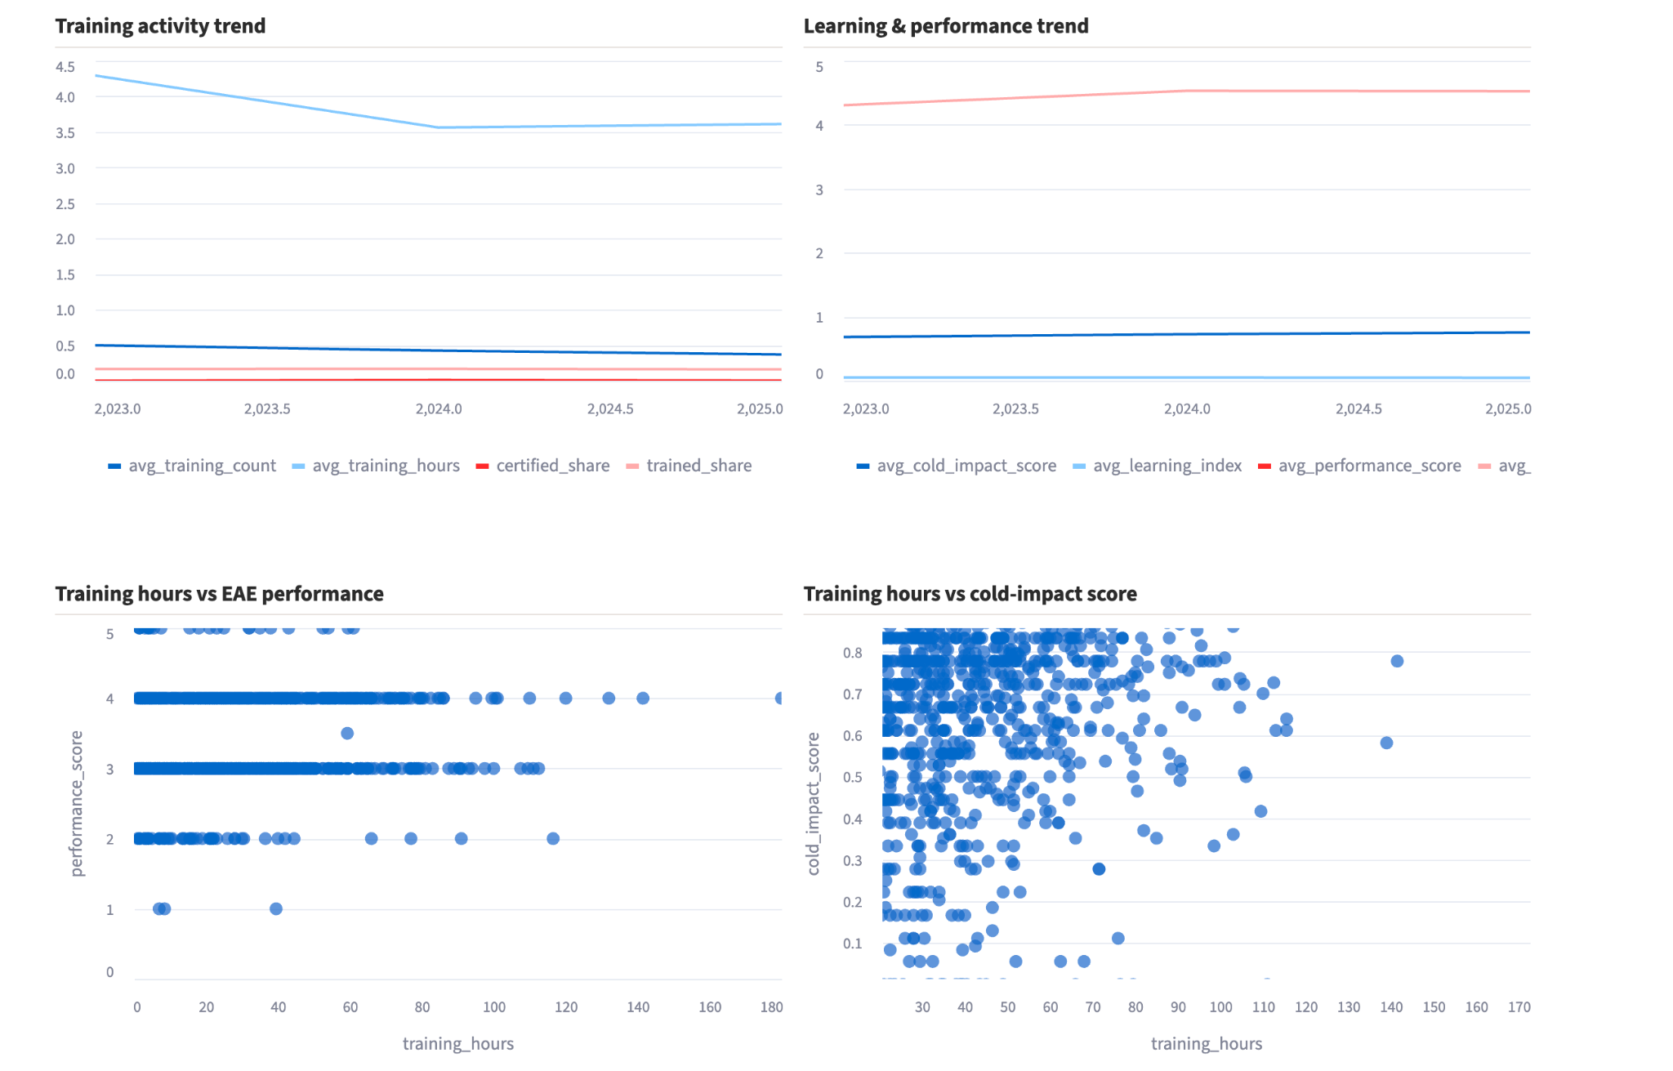
KPI 03
Learning-to-Performance Index
Whether training spend translates into
measurable capability and performance.
FORMULA
L2P Index =
0.40 · Norm. Training Hours
+ 0.30 · Norm. Cold Impact
+ 0.20 · Norm. Quick Review
+ 0.10 · Certification Flag
WHY DOES IT MATTER ?
Goes beyond hours-trained vanity metrics by integrating learner satisfaction, cold-impact survey and EAE performance.
Compares trained vs. non-trained employees on the same population.
Identifies which training programs actually move the performance needle.
Justifies L&D budget in financial terms, not headcount of attendees.
KEY INSIGHT
Aggregated by employee-year on completed training only; outliers clipped at the year-level P95 to prevent a few power-users from skewing results.
CACEIS x AlbertSchool · Deliverable 2 · Human Capital Valuation
7

Slide 8
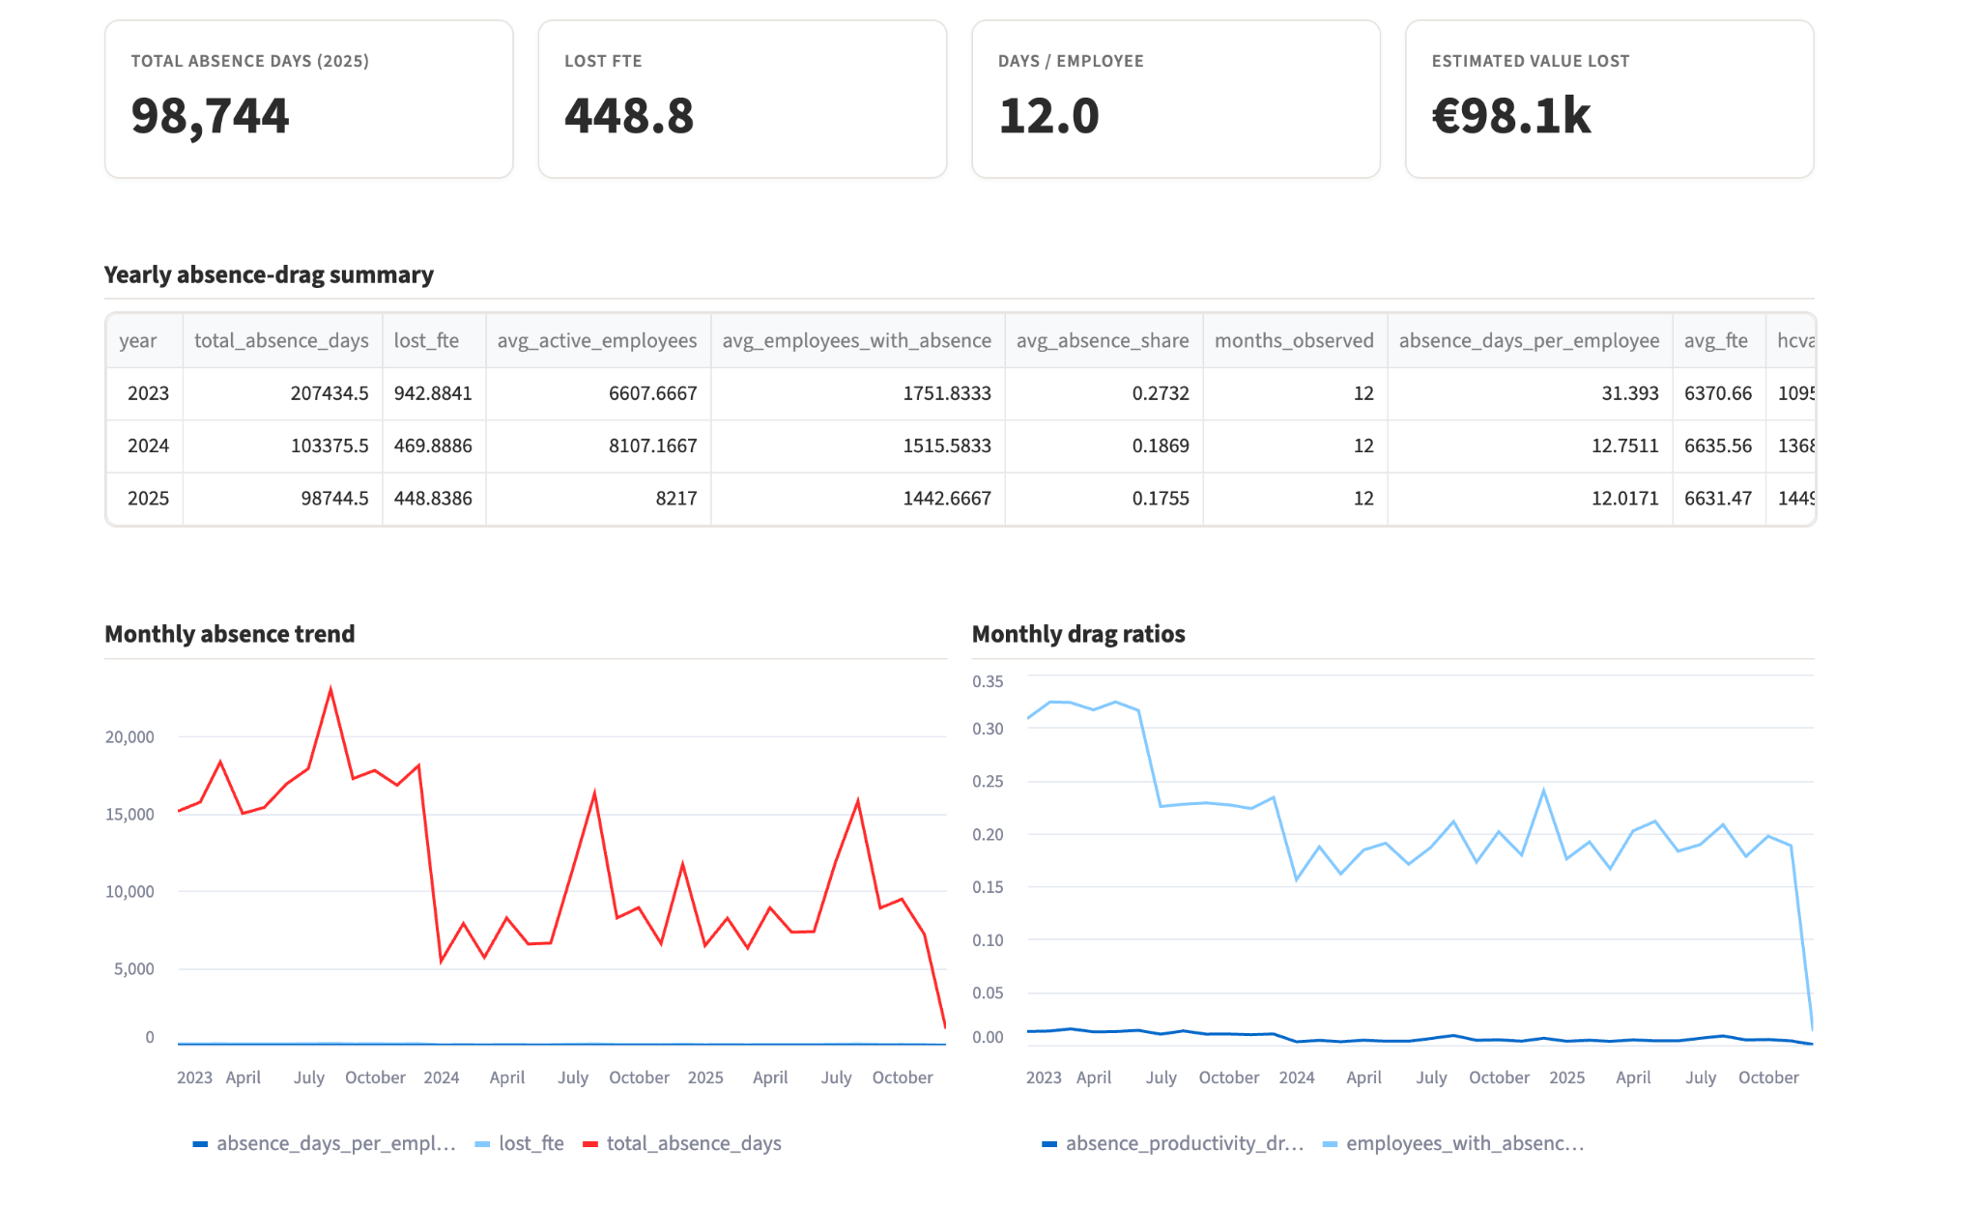
KPI 04
Absence Productivity Drag
Translating absenteeism days into lost productive
capacity and euros of value lost.
FORMULA
Lost FTE = Absence Days / 220
Drag = Lost FTE / Average FTE
Value Lost (€) = Lost FTE × HCVA per FTE
Aggregated by month, entity, reason, employee.
WHY DOES IT MATTER
Bridges HR (absence days) and Finance (HCVA per FTE) into a single euro number leadership can act on.
Splits drag by reason — sickness, parental, work-related — so action plans target the right driver.
Reveals the true cost of a 1-percentage-point change in absence rate.
Inputs feed sizing of replacement, prevention and well-being investments.
KEY INSIGHT
Absence loaders auto-detect sheet/header variations across 2023, 2024 and 2025 files — the same drag definition is applied consistently across all three years.
CACEIS x AlbertSchool · Deliverable 2 · Human Capital Valuation
8

Slide 9
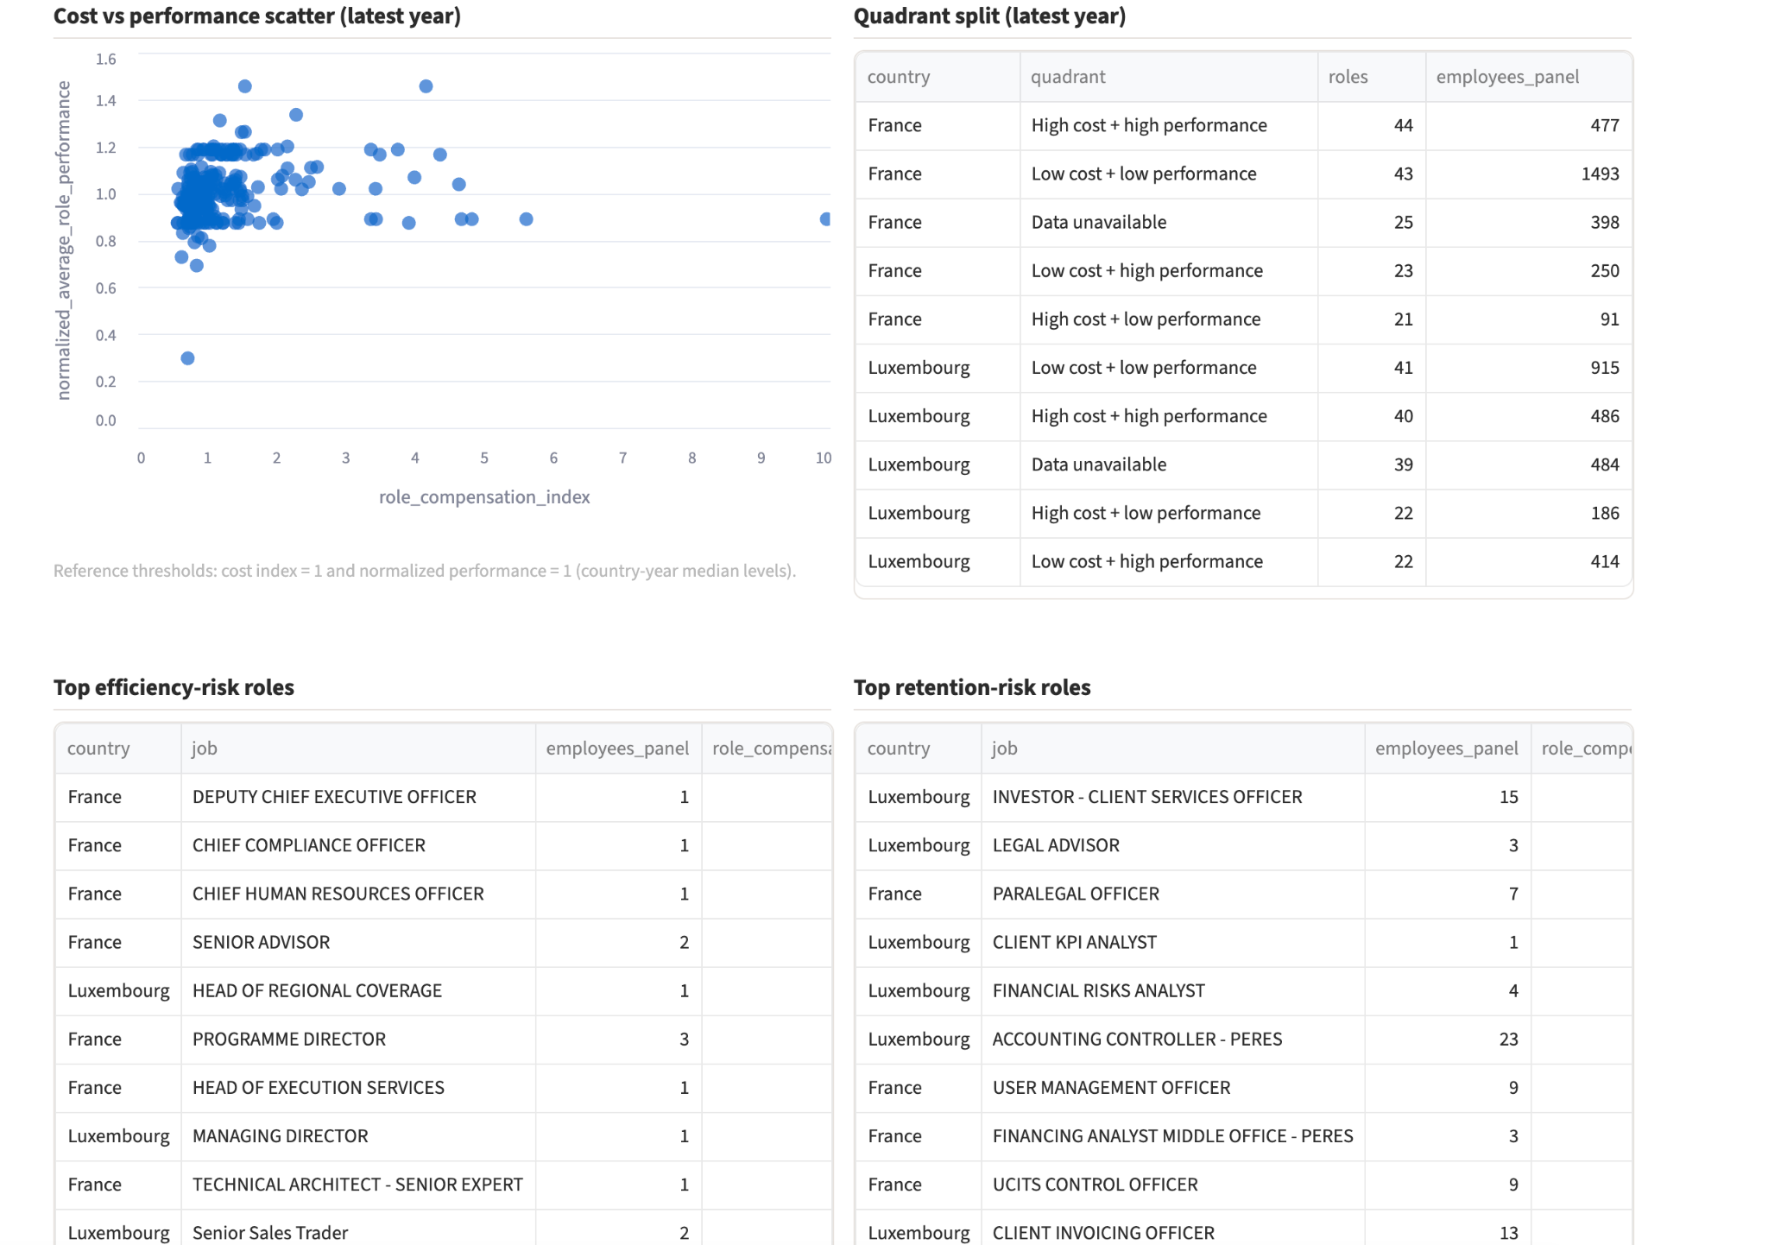
KPI 05
Role Cost Efficiency Index
Are we paying the right price for the performance each
role delivers?
FORMULA
Role Comp Index =
Avg Total Comp / Median Comp (country-year)
Role Cost Efficiency =
Normalized Performance / Role Comp Index
Quadrants:
Strategic · Efficiency · Retention · Low-Impact
WHY DOES IT MATTER ?
Detects pay/performance misalignments at role level without ever touching individual salaries.
Retention-risk roles (low cost · high performance) flagged before they leave for competitors.
Efficiency-risk roles (high cost · low performance) flagged for re-scoping or repricing.
Comparable across France and Luxembourg via country-year median normalization.
KEY INSIGHT
Compensation is treated as a role-level benchmark, never as individual salary — a deliberate ethical and GDPR boundary.
CACEIS x AlbertSchool · Deliverable 2 · Human Capital Valuation
9

Slide 10
04 · NEXT STEPS
Governance, AI roadmap and recommendations.
How we keep the framework trustworthy, how AI extends it, and what CACEIS should do with the first findings.
GOVERNANCE & ETHICS
AI ROADMAP
KEY INSIGHTS
Trust by design
From rules to learning
What CACEIS should do
GDPR: pseudonymized IDs, role-level compensation only, no PII in outputs
Data quality framework: schema validation, freshness checks, missing-value rules
Bias mitigation: country-year normalization, P95 clipping, fairness checks across gender/age
Explainability: every score decomposable into named risk components
Human-in-the-loop: HR validates flagged employees before any action
Attrition model: gradient boosting on Left_Next_6M, calibrated probabilities replacing the rule-based score
SHAP explanations: per-employee drivers exposed to HRBPs, no black box
Training-impact uplift: causal model isolating training effect on performance vs. selection bias
Forecasting: HCVA / FTE projection under absence and attrition scenarios
LLM-assisted insight layer: natural-language summaries for the dashboard
HCVA per FTE trend establishes a productivity baseline: track quarterly, not yearly
Attrition risk is concentrated in identifiable segments: target retention spend, don't spread it
Training shows non-zero, non-uniform impact on performance: double down on programs that move the needle
Absence drag is large enough to reframe well-being investment as ROI-positive
Role cost quadrants reveal repricing and retention opportunities at role, not employee, level
CACEIS x AlbertSchool · Deliverable 2 · Human Capital Valuation
10

