Slide 1
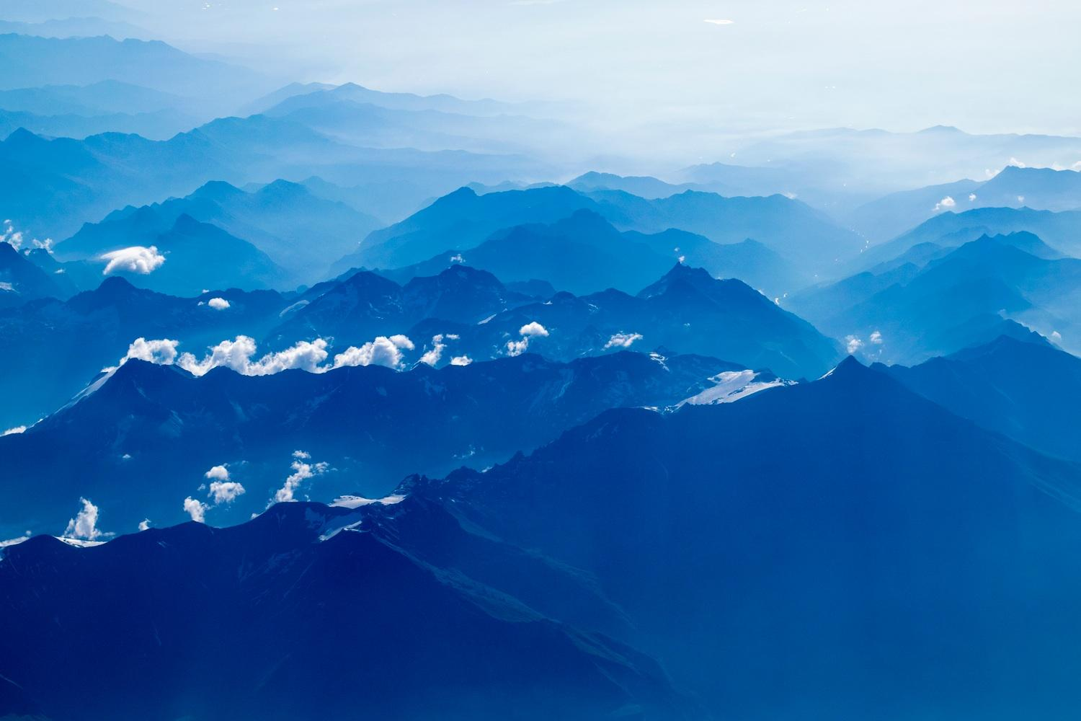
This is your presentation title

Slide 2
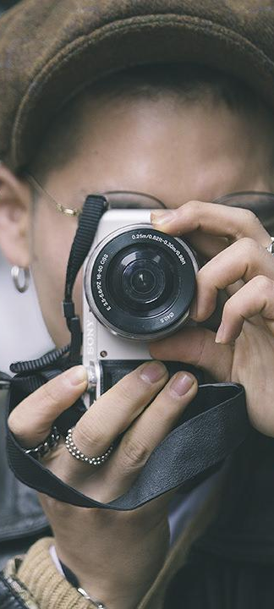
Hello!
I am Jayden Smith
I am here because I love to give presentations.
You can find me at @username

Slide 3
Transition headline
1
Let’s start with the first set of slides

Slide 4
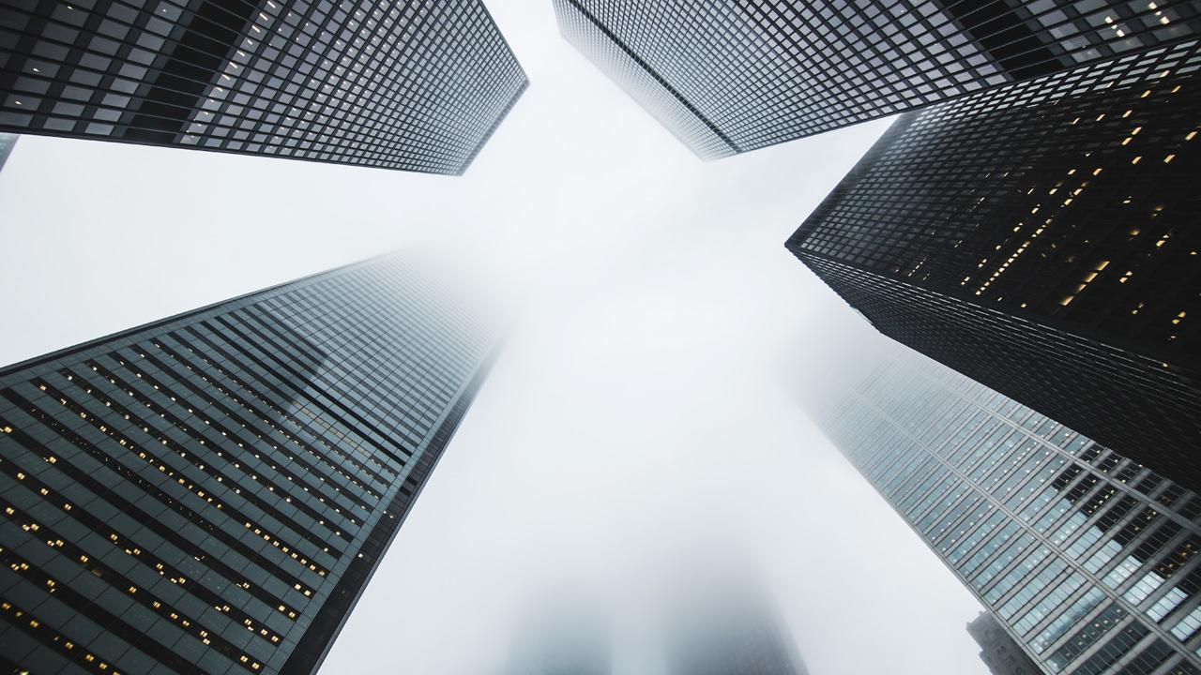
Quotations are commonly printed as a means of inspiration and to invoke philosophical thoughts from the reader.

Slide 5
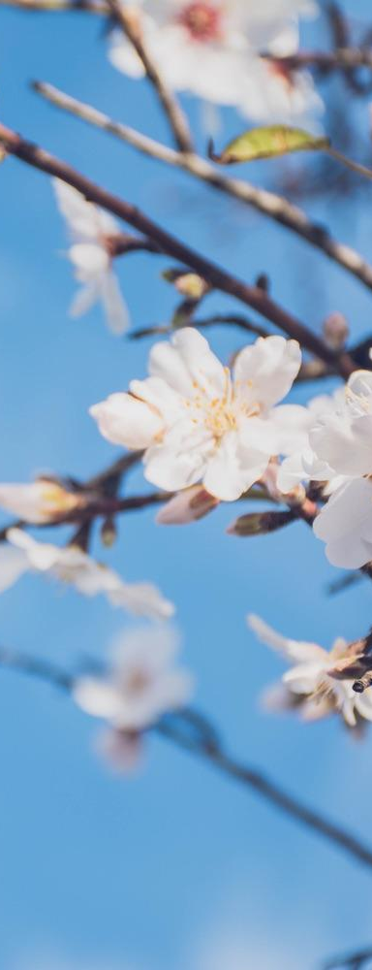
This is a slide title
Here you have a list of items
And some text
But remember not to overload your slides with content
Your audience will listen to you or read the content, but won’t do both.

Slide 6
Big concept
Bring the attention of your audience over a key concept using icons or illustrations

Slide 7
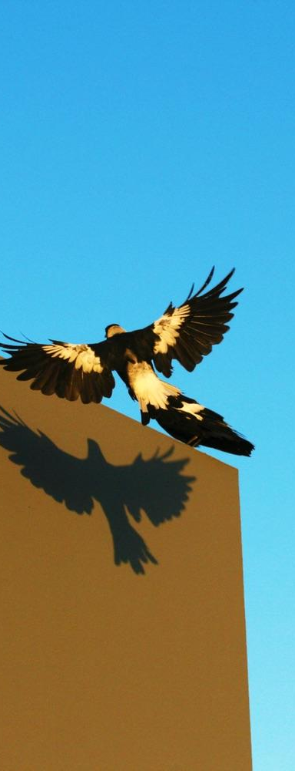
You can also split your content
White
Is the color of milk and fresh snow, the color produced by the combination of all the colors of the visible spectrum.
Black
Is the color of coal, ebony, and of outer space. It is the darkest color, the result of the absence of or complete absorption of light.

Slide 8
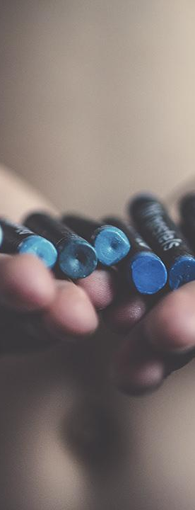
In two or three columns
Yellow
Is the color of gold, butter and ripe lemons. In the spectrum of visible light, yellow is found between green and orange.
Blue
Is the colour of the clear sky and the deep sea. It is located between violet and green on the optical spectrum.
Red
Is the color of blood, and because of this it has historically been associated with sacrifice, danger and courage.

Slide 9
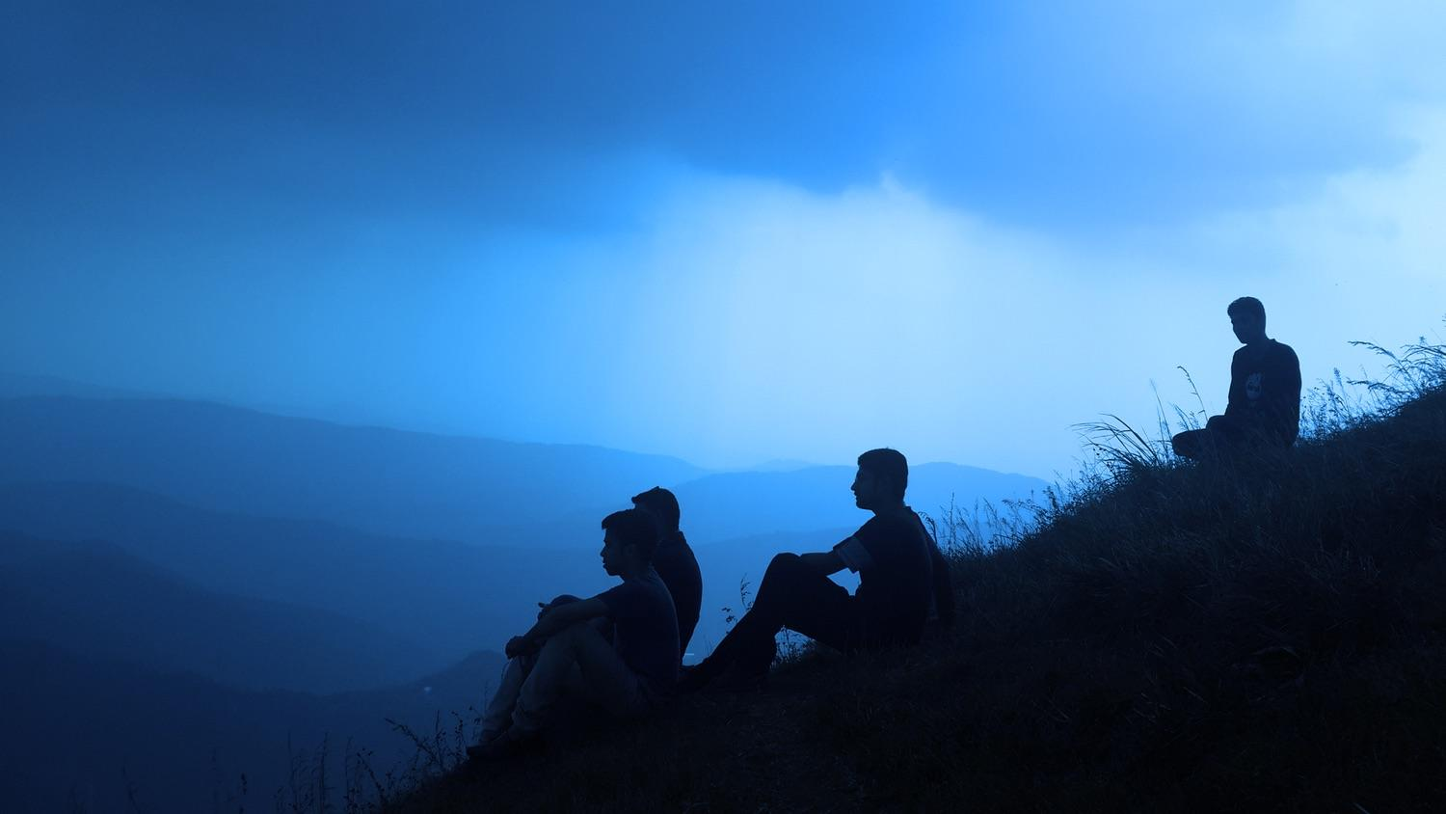
A picture is worth a thousand words
A complex idea can be conveyed with just a single still image, namely making it possible to absorb large amounts of data quickly.

Slide 10
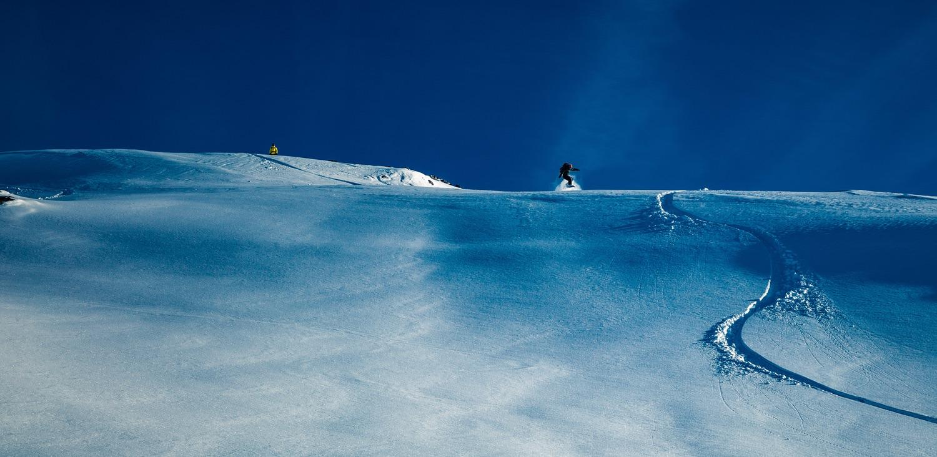
Want big impact?
Use big image.

Slide 11
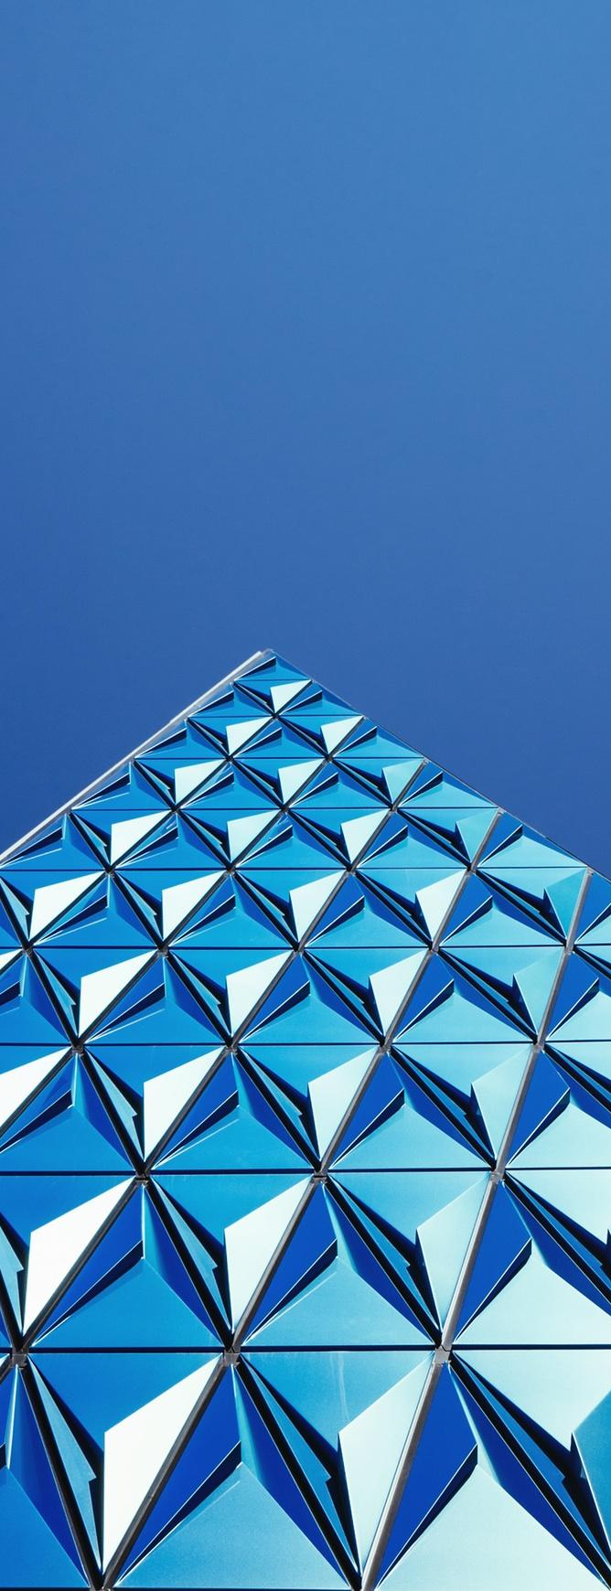
Use charts to explain your ideas
Item 1
Item 2
THE
CONCEPT
Item 3
Item 4

Slide 12

And tables to compare data
 | A | B | C
Yellow | 10 | 20 | 7
Blue | 30 | 15 | 10
Orange | 5 | 24 | 16

Slide 13
Maps
our office

Slide 14
89,526,124
Whoa! That’s a big number, aren’t you proud?

Slide 15
89,526,124$
185,244 users
100%
That’s a lot of money
And a lot of users
Total success!

Slide 16
Our process is easy
first
last
second

Slide 17
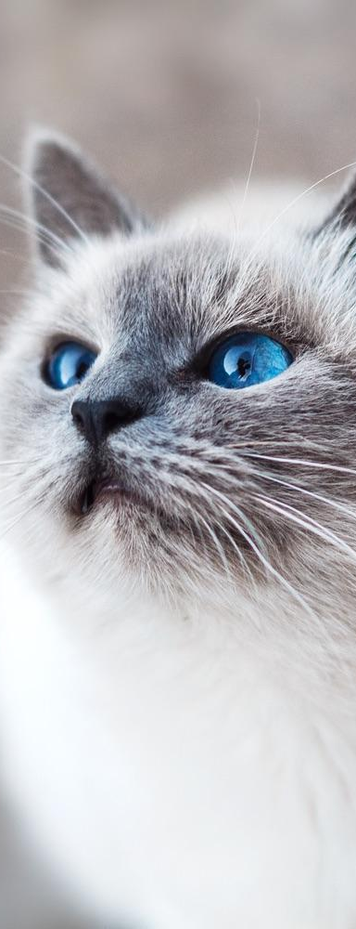
Let’s review some concepts
Yellow
Is the color of gold, butter and ripe lemons. In the spectrum of visible light, yellow is found between green and orange.
Blue
Is the colour of the clear sky and the deep sea. It is located between violet and green on the optical spectrum.
Red
Is the color of blood, and because of this it has historically been associated with sacrifice, danger and courage.
Yellow
Is the color of gold, butter and ripe lemons. In the spectrum of visible light, yellow is found between green and orange.
Blue
Is the colour of the clear sky and the deep sea. It is located between violet and green on the optical spectrum.
Red
Is the color of blood, and because of this it has historically been associated with sacrifice, danger and courage.

Slide 18
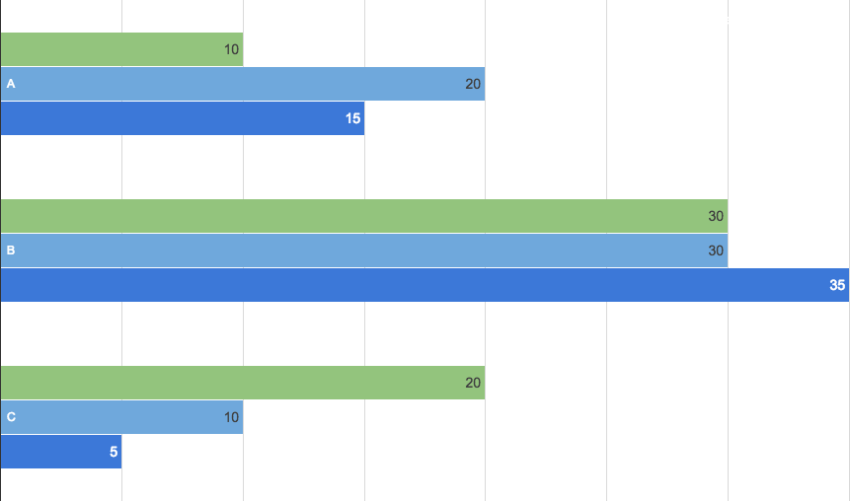
You can insert graphs from Google Sheets

Slide 19
Android project
Show and explain your web, app or software projects using these gadget templates.
Place your screenshot here

Slide 20
iPhone project
Show and explain your web, app or software projects using these gadget templates.
Place your screenshot here

Slide 21
Tablet project
Show and explain your web, app or software projects using these gadget templates.
Place your screenshot here

Slide 22
Desktop project
Show and explain your web, app or software projects using these gadget templates.
Place your screenshot here

Slide 23
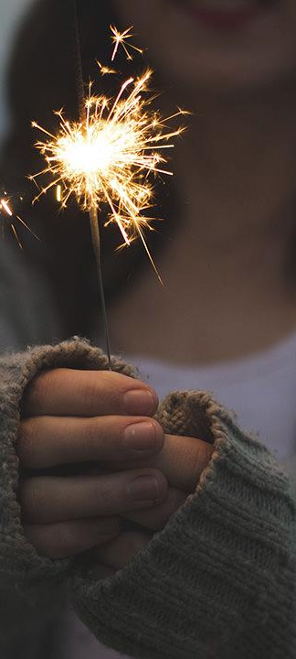
Thanks!
Any questions?
You can find me at
@username
user@mail.me

Slide 24
Credits
Special thanks to all the people who made and released these awesome resources for free:
Presentation template by SlidesCarnival
Photographs by Unsplash

Slide 25
Presentation design
You don’t need to keep this slide in your presentation. It’s only here to serve you as a design guide if you need to create new slides or download the fonts to edit the presentation in PowerPoint®
This presentation uses the following typographies and colors:
Titles: Droid serif
Body copy: Pontano Sans
You can download the fonts on these pages:
https://www.fontsquirrel.com/fonts/droid-serif
http://www.1001fonts.com/pontano-sans-font.html
Cyan #33ccff
Navy #162d5a
Turquoise #33cccc
Fluor green #a7ea52

Slide 26
SlidesCarnival icons are editable shapes.
This means that you can:
Resize them without losing quality.
Change fill color and opacity.
Change line color, width and style.
Isn’t that nice? :)
Examples:

Slide 27
😉
Now you can use any emoji as an icon!
And of course it resizes without losing quality and you can change the color.
How? Follow Google instructions https://twitter.com/googledocs/status/730087240156643328
✋👆👉👍👤👦👧👨👩👪💃🏃💑❤😂😉😋😒😭👶😸🐟🍒🍔💣📌📖🔨🎃🎈🎨🏈🏰🌏🔌🔑 and many more...

