Slide 1
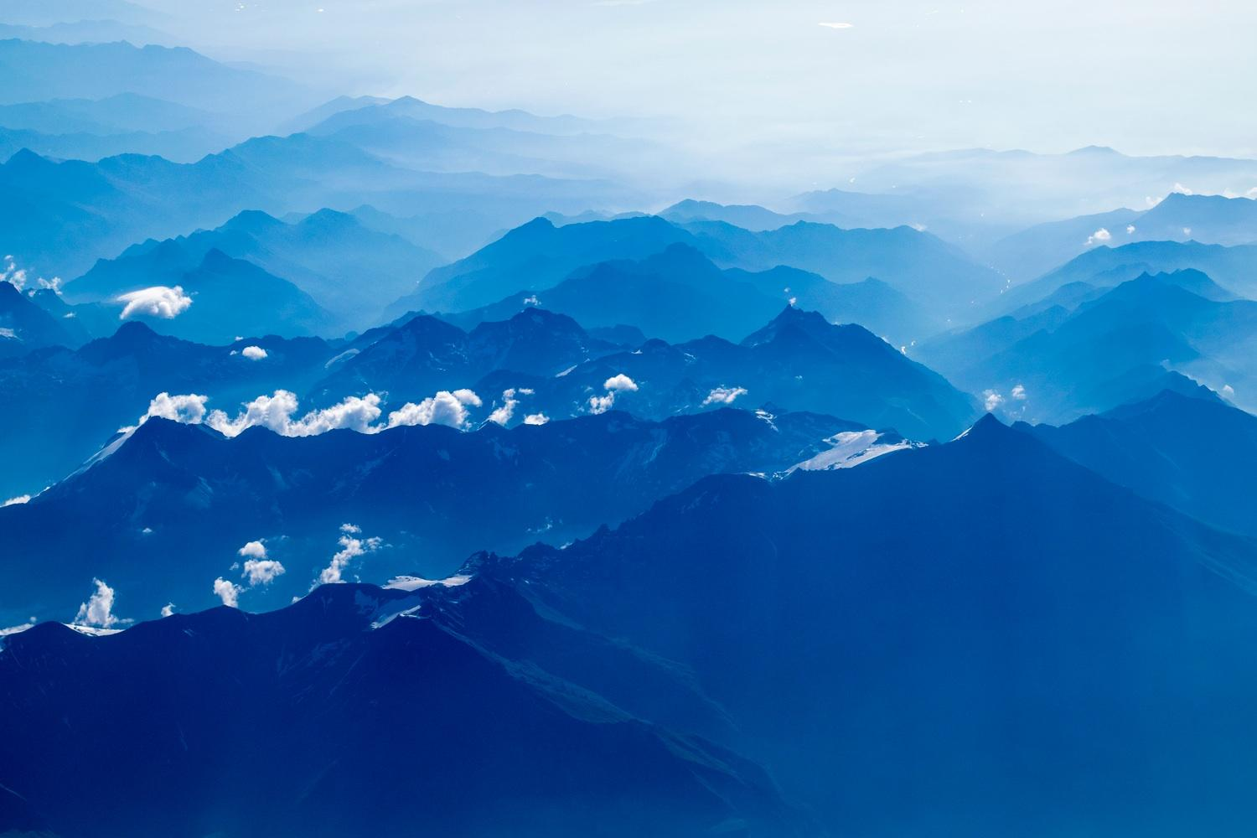
Procedural city generation using Perlin noise
Notes:
Procedural city generation using Perlin noise

Slide 2

Welcome!
Presented by:
Niclas Olsson
Elias Frank
Notes:
Present ourselves

Slide 3
Introduction
1
Motivation and summary
Notes:
This will be in the introduction:
Motivation of work
Motivation of Perlin noise
Video
Summarize the work

Slide 4
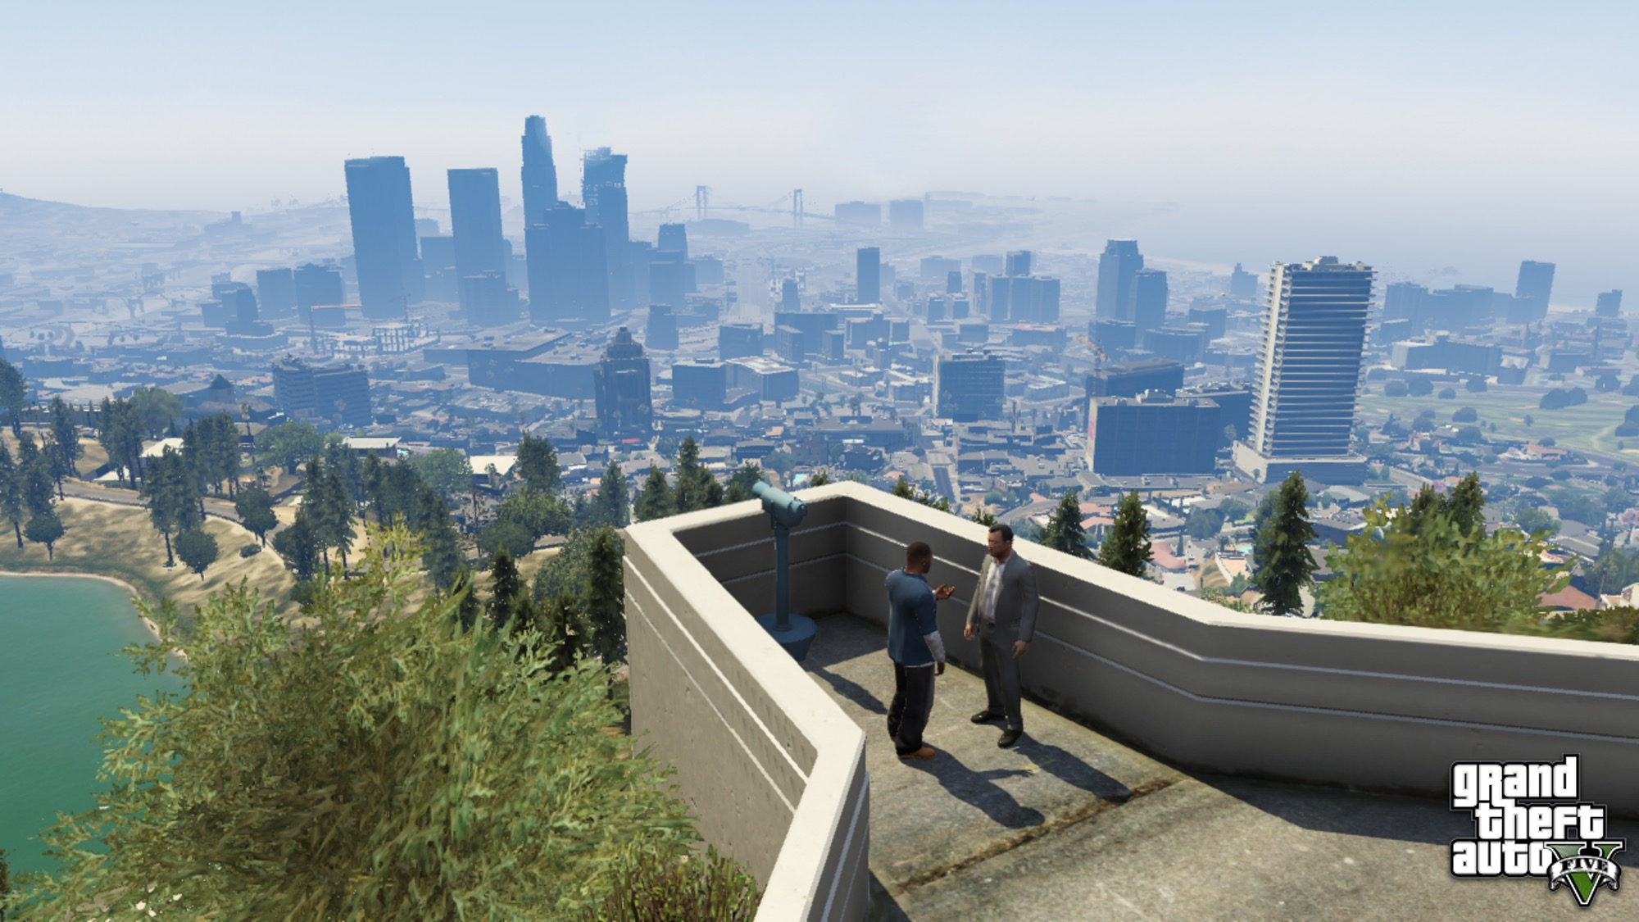
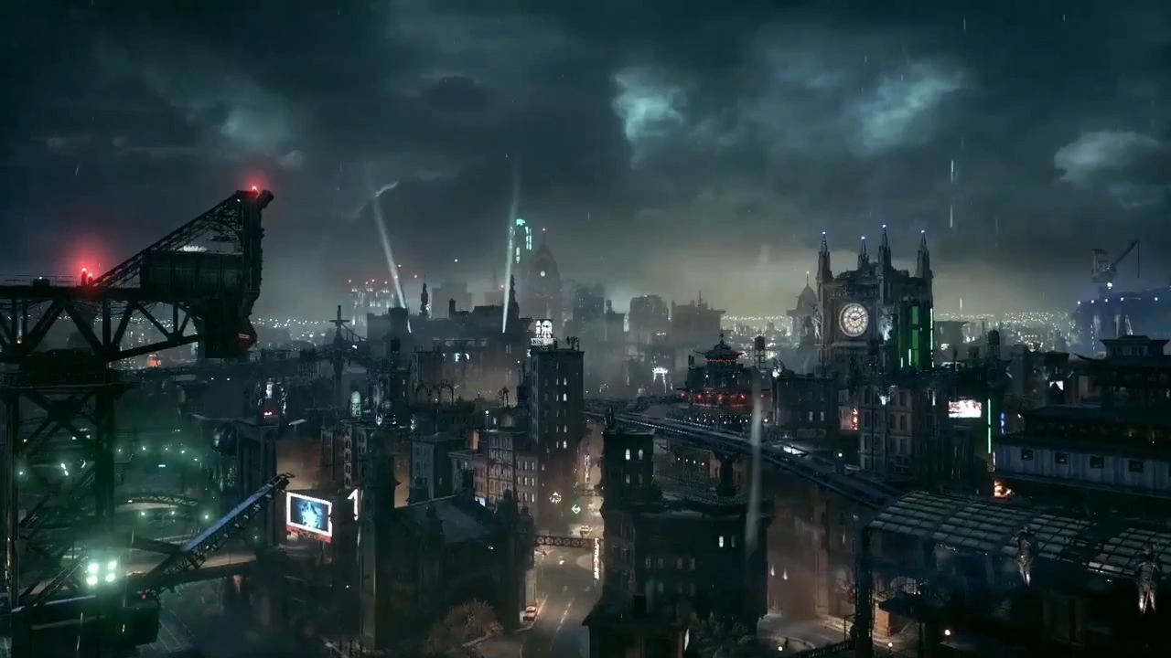
Successful games
GTA V
Batman Arkham city
Notes:
GTA V budget 137 million $
Estimated 4-5 years
More than 1000 developers during that time
Batman Arkham city
At least 2 years
https://en.wikipedia.org/wiki/Development_of_Grand_Theft_Auto_V
https://www.gamespot.com/articles/rockstar-more-than-1000-people-made-gtav/1100-6415330/

Slide 5
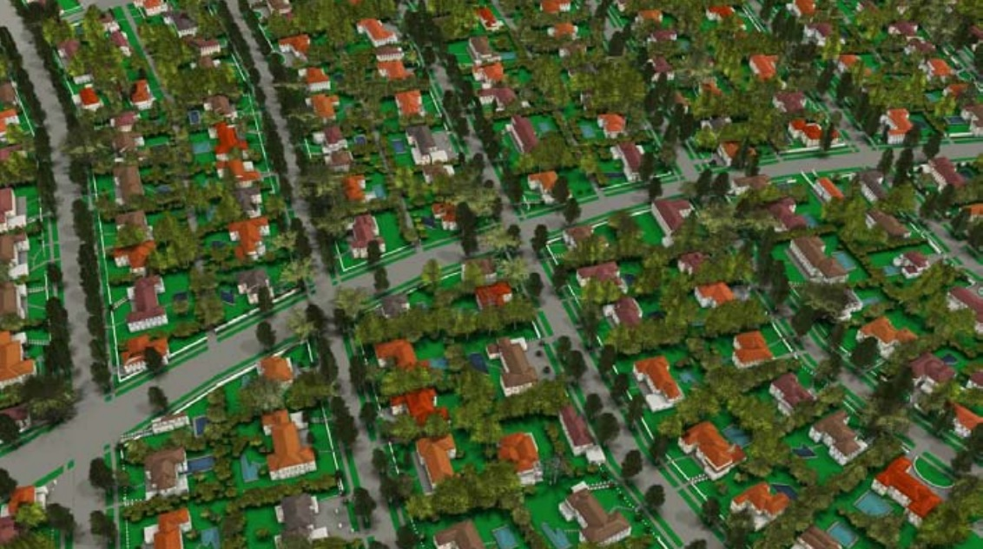
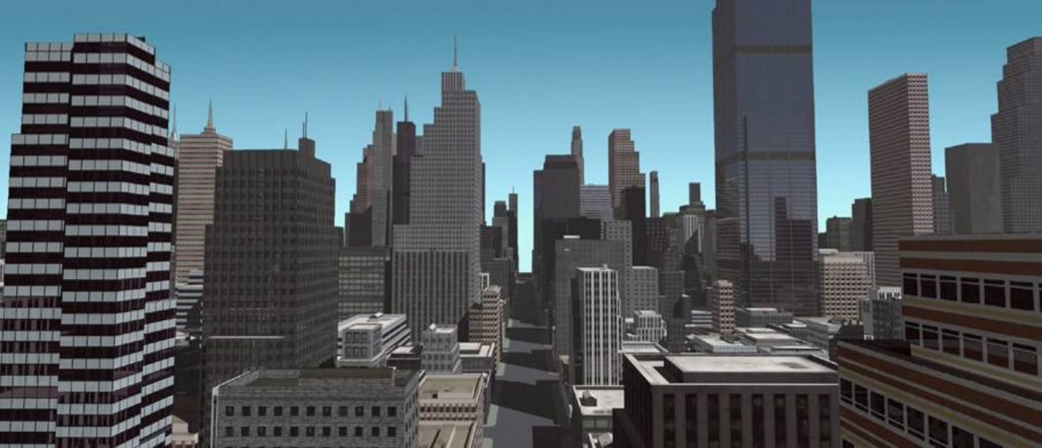
Procedural generation
L-System
CGA – Shape Grammar
Notes:
Procedural modeling of cities part vi
L-System
CGA – Shape Grammar
97.000 lines of code
6 man years of work

Slide 6
Hand crafting vs Procedural generation
Time
Money
Small companies
Notes:
Why procedural?
Making content cost:
Time
Money
Small companies
Prove PCG helps with content creation
No mans sky 18 quintillion planets
Borderlands over 17 million guns

Slide 7
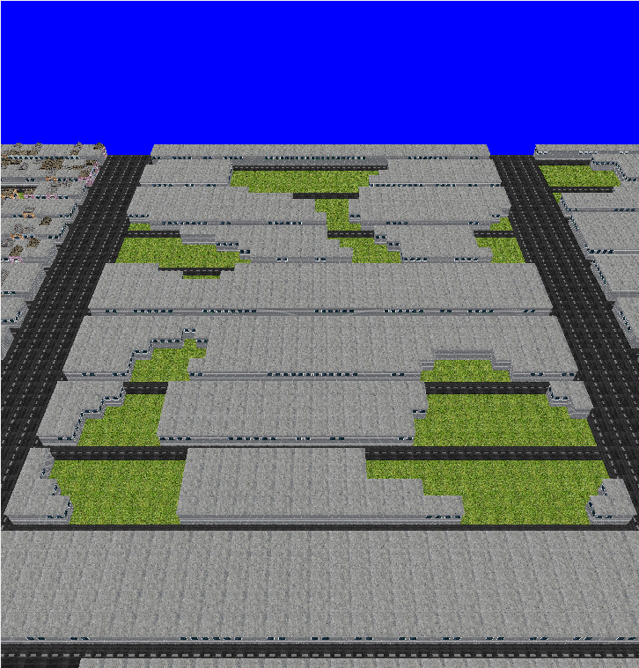
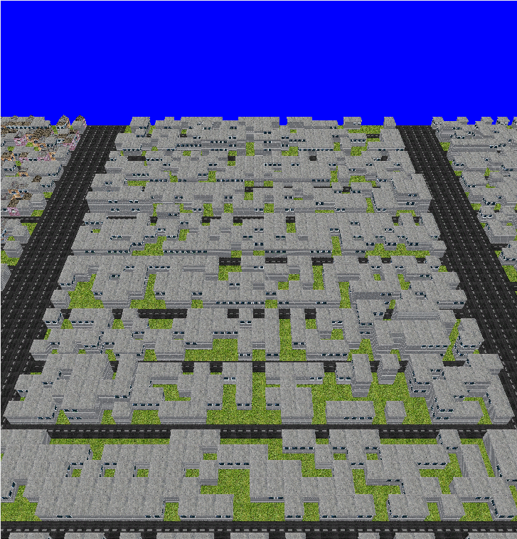
Why Perlin noise?
More natural shapes?
Documentation
Implementation
Notes:
Top Perlin noise
Bot random
Which is more natural?
Fast to implement
3 days vs 6 man years
Perlin noise:
Famous
A lot of documentation

Slide 8
Video of implementation
Try to notice what is happening.
Interface
Changing of parameters
Notes:
Video
Right – Parameters and seed
Left – Data from generated city
Middle – graphical interface
Things to notice:
Different seeds
Height of buildings
Building density, grass

Slide 9

Thanks!
Any questions?
You can find me at
@username
user@mail.me

Slide 10
References
GTA V image: https://disegnodaily.imgix.net/system/dragonfly/production/2013/10/02/12_32_29_314_481_1280.jpg?w=2000
Batman image: http://vignette1.wikia.nocookie.net/batman/images/3/32/BatmanArkhamKnightGothamCity.jpg/revision/latest?cb=20140530010522

Slide 11
Big concept
Bring the attention of your audience over a key concept using icons or illustrations

Slide 12
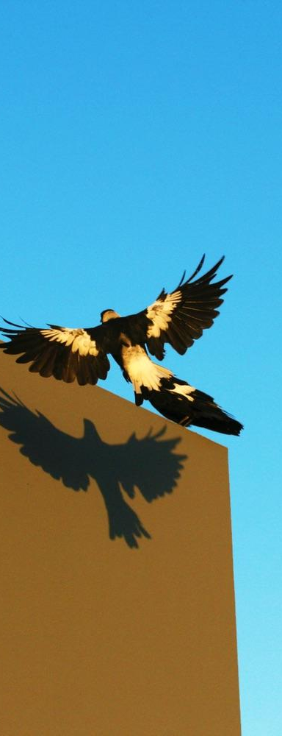
You can also split your content
White
Is the color of milk and fresh snow, the color produced by the combination of all the colors of the visible spectrum.
Black
Is the color of coal, ebony, and of outer space. It is the darkest color, the result of the absence of or complete absorption of light.

Slide 13
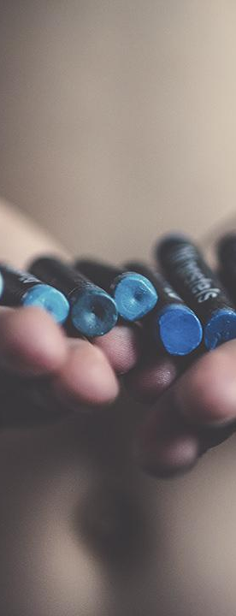
In two or three columns
Yellow
Is the color of gold, butter and ripe lemons. In the spectrum of visible light, yellow is found between green and orange.
Blue
Is the colour of the clear sky and the deep sea. It is located between violet and green on the optical spectrum.
Red
Is the color of blood, and because of this it has historically been associated with sacrifice, danger and courage.

