Slide 1
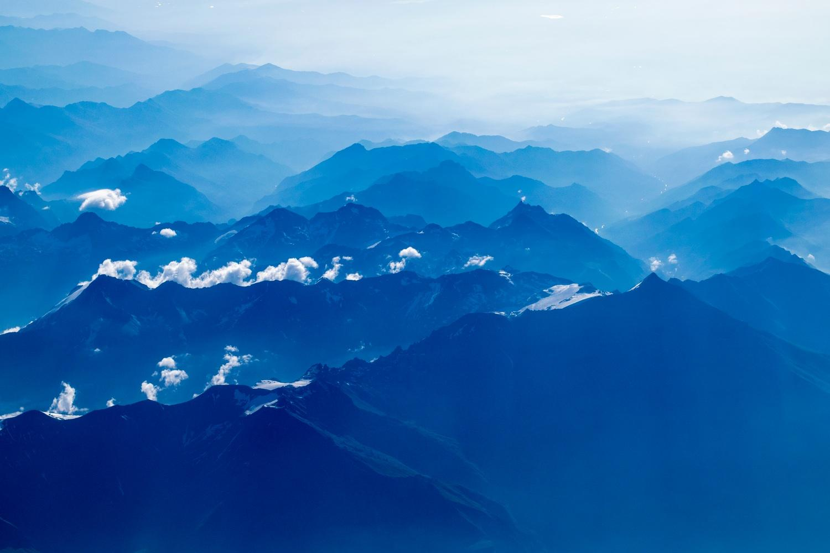
Procedural city generation using Perlin noise

Slide 2

Welcome!
Presented by:
Niclas Olsson
Elias Frank
Notes:
Present ourselves

Slide 3
Introduction
1
Motivation and summary
Notes:
This will be in the introduction:
Motivation of work
Motivation of Perlin noise
Video
Summarize the work

Slide 4
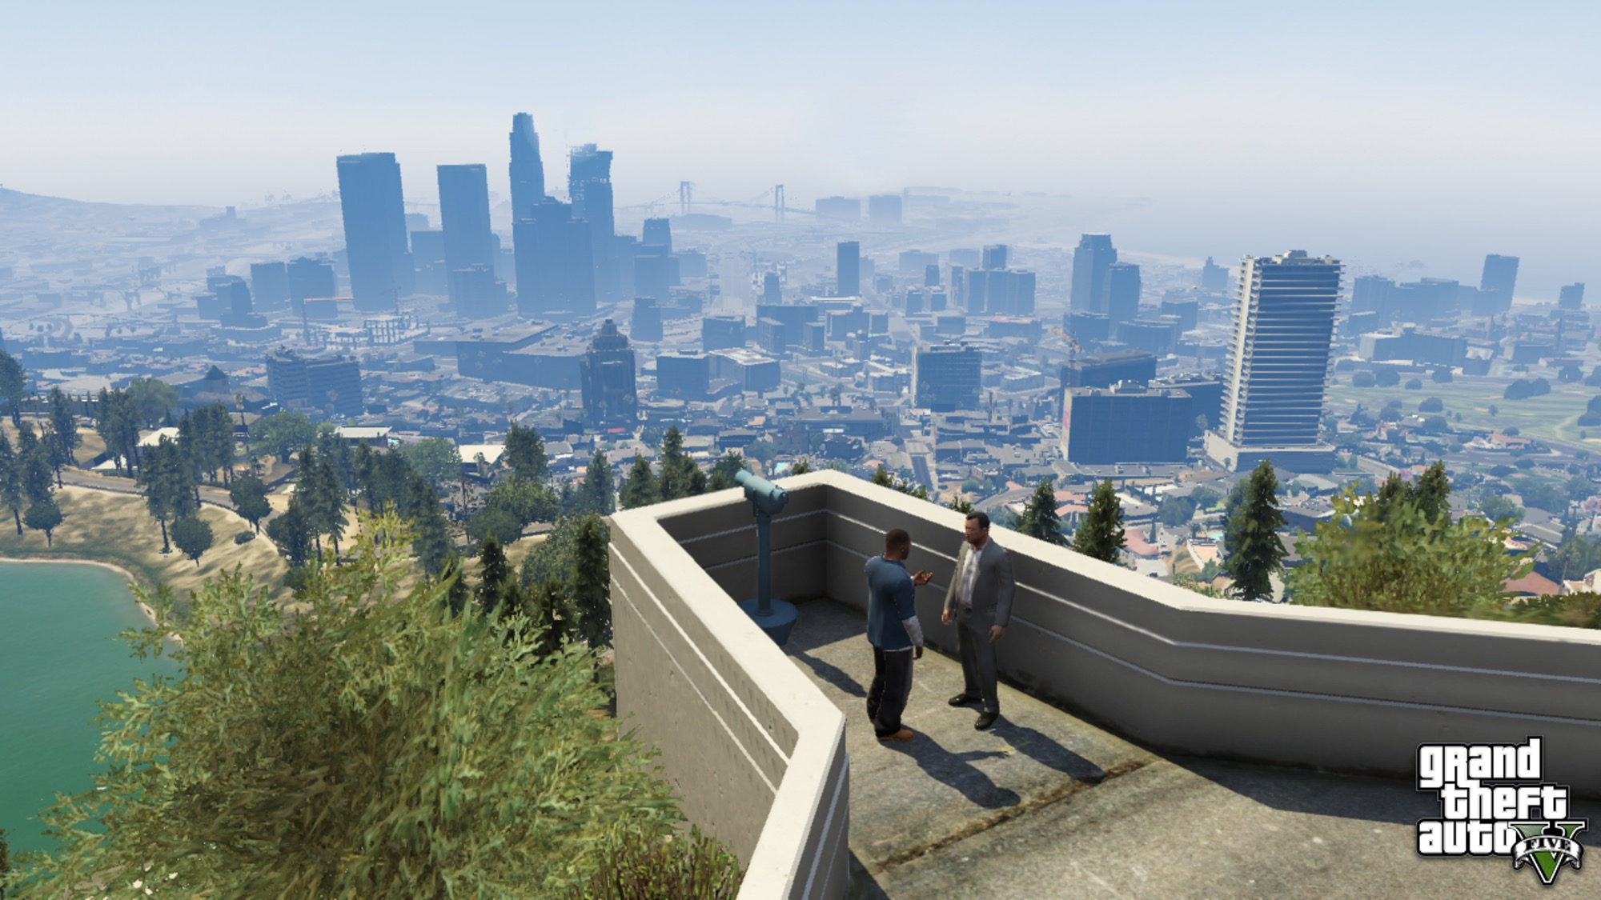
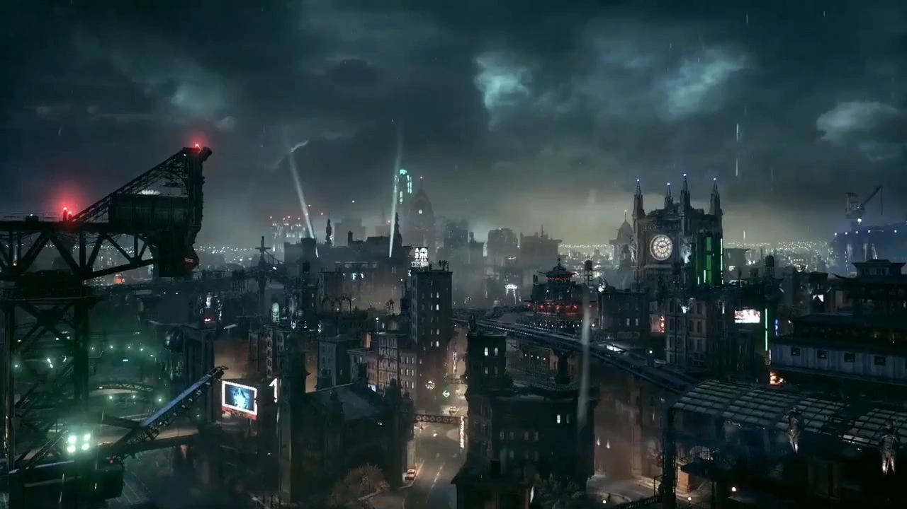
Successful games
GTA V
Batman Arkham city

Slide 5
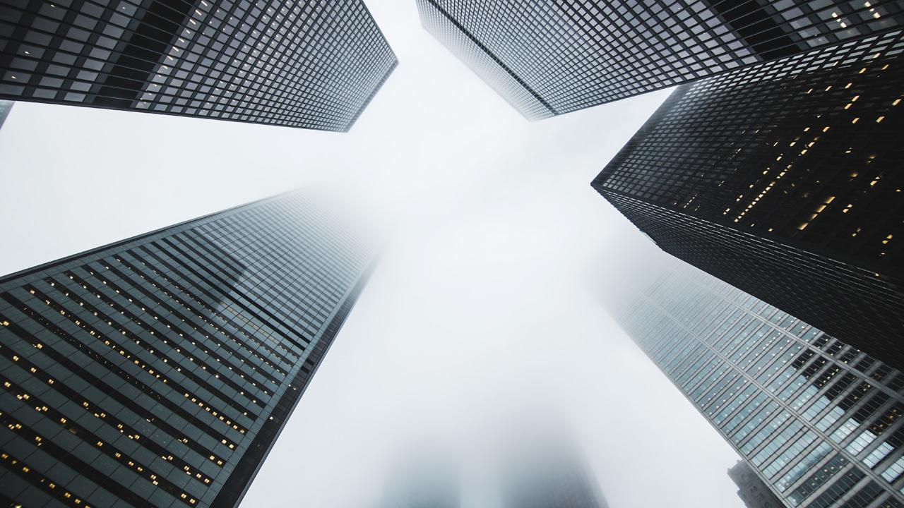
Quotations are commonly printed as a means of inspiration and to invoke philosophical thoughts from the reader.

Slide 6
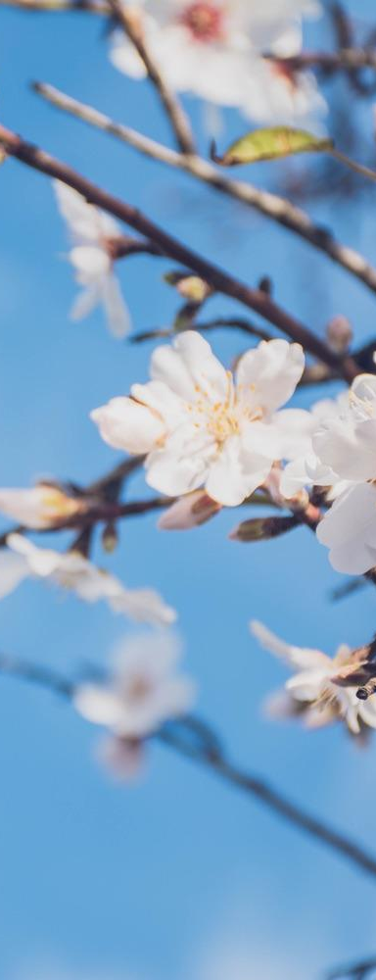
This is a slide title
Here you have a list of items
And some text
But remember not to overload your slides with content
Your audience will listen to you or read the content, but won’t do both.

Slide 7
Big concept
Bring the attention of your audience over a key concept using icons or illustrations

Slide 8
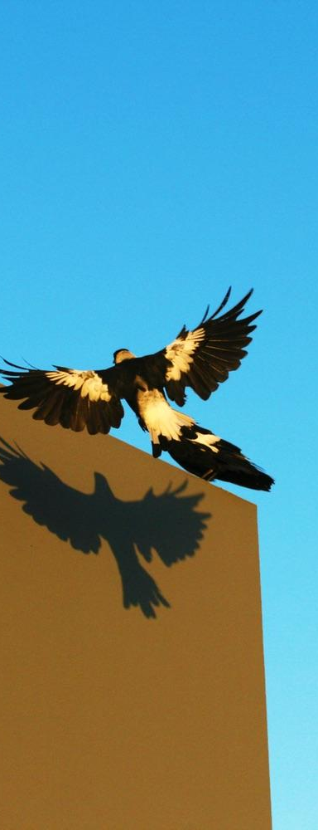
You can also split your content
White
Is the color of milk and fresh snow, the color produced by the combination of all the colors of the visible spectrum.
Black
Is the color of coal, ebony, and of outer space. It is the darkest color, the result of the absence of or complete absorption of light.

Slide 9
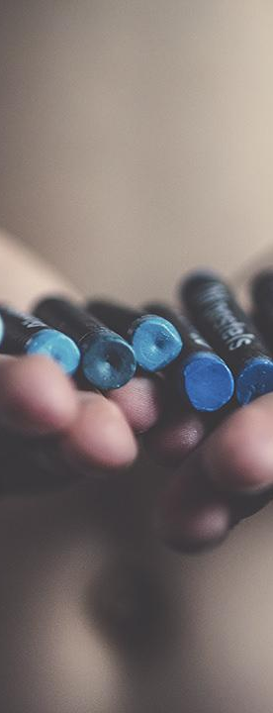
In two or three columns
Yellow
Is the color of gold, butter and ripe lemons. In the spectrum of visible light, yellow is found between green and orange.
Blue
Is the colour of the clear sky and the deep sea. It is located between violet and green on the optical spectrum.
Red
Is the color of blood, and because of this it has historically been associated with sacrifice, danger and courage.

Slide 10
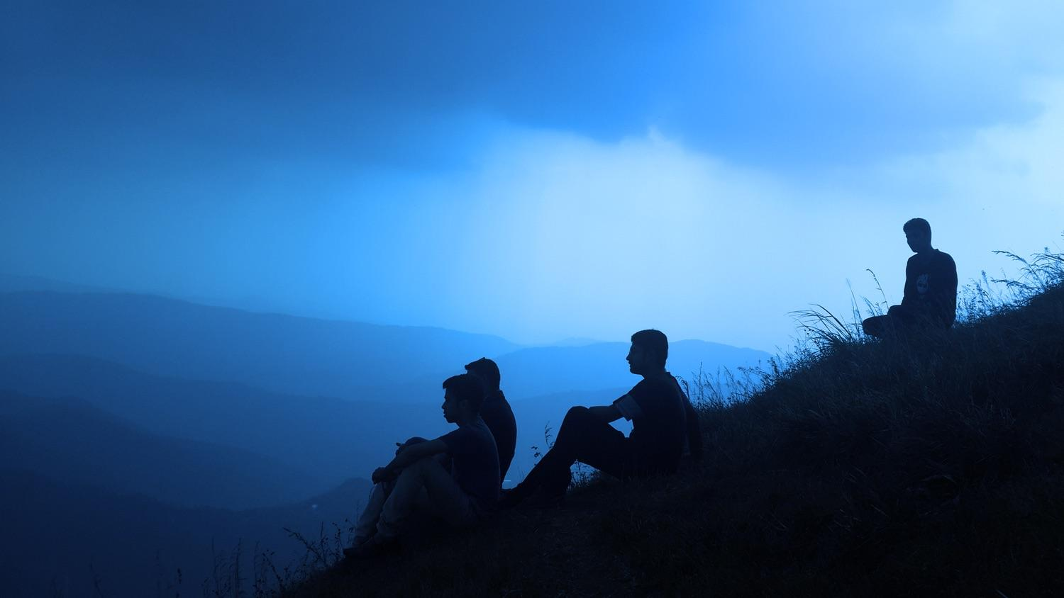
A picture is worth a thousand words
A complex idea can be conveyed with just a single still image, namely making it possible to absorb large amounts of data quickly.

Slide 11
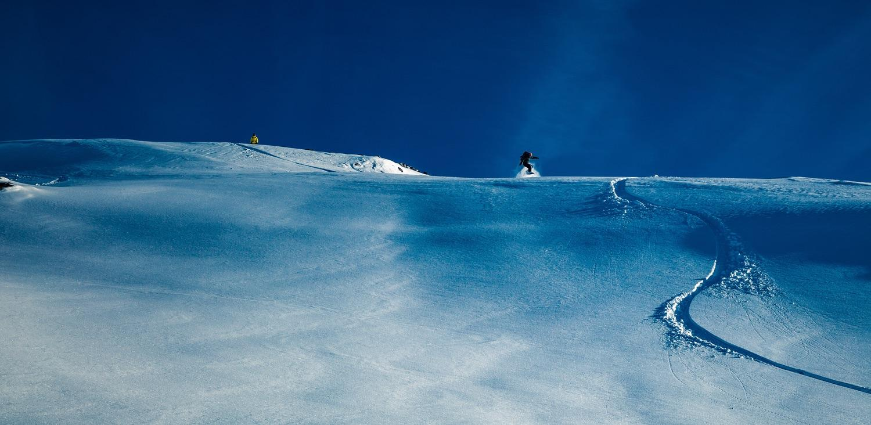
Want big impact?
Use big image.

Slide 12
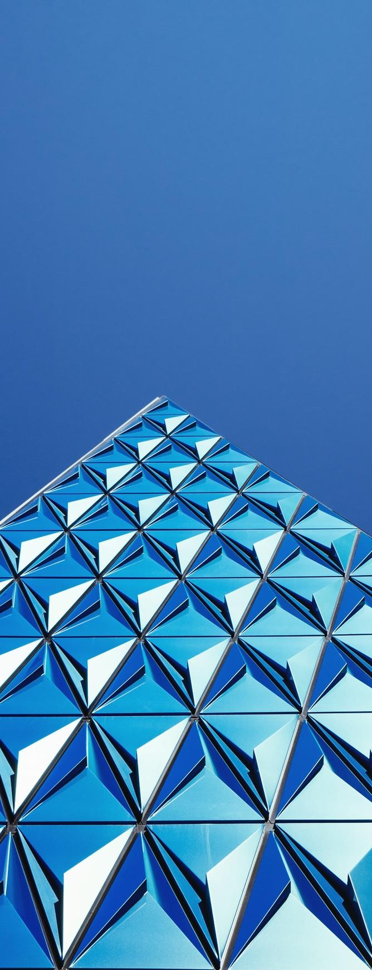
Use charts to explain your ideas
Item 1
Item 2
THE
CONCEPT
Item 3
Item 4

Slide 13
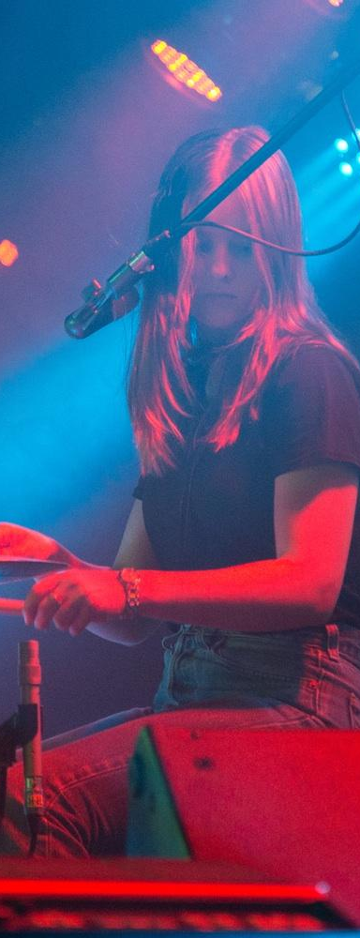
And tables to compare data
 | A | B | C
Yellow | 10 | 20 | 7
Blue | 30 | 15 | 10
Orange | 5 | 24 | 16

Slide 14
Maps
our office

Slide 15
89,526,124
Whoa! That’s a big number, aren’t you proud?

Slide 16
89,526,124$
185,244 users
100%
That’s a lot of money
And a lot of users
Total success!

Slide 17
Our process is easy
first
last
second

Slide 18
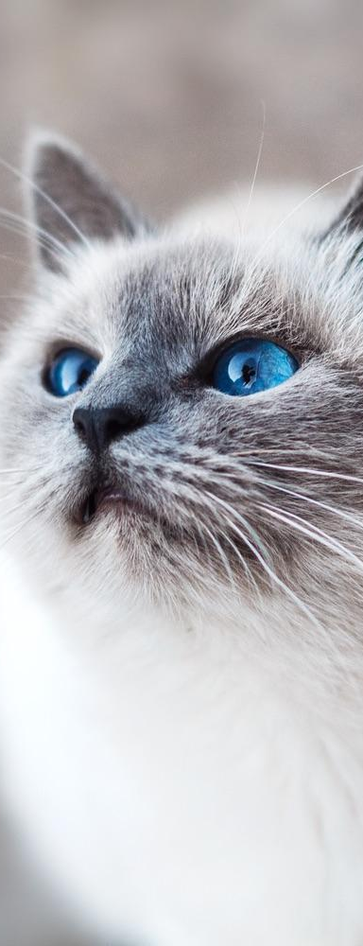
Let’s review some concepts
Yellow
Is the color of gold, butter and ripe lemons. In the spectrum of visible light, yellow is found between green and orange.
Blue
Is the colour of the clear sky and the deep sea. It is located between violet and green on the optical spectrum.
Red
Is the color of blood, and because of this it has historically been associated with sacrifice, danger and courage.
Yellow
Is the color of gold, butter and ripe lemons. In the spectrum of visible light, yellow is found between green and orange.
Blue
Is the colour of the clear sky and the deep sea. It is located between violet and green on the optical spectrum.
Red
Is the color of blood, and because of this it has historically been associated with sacrifice, danger and courage.

Slide 19
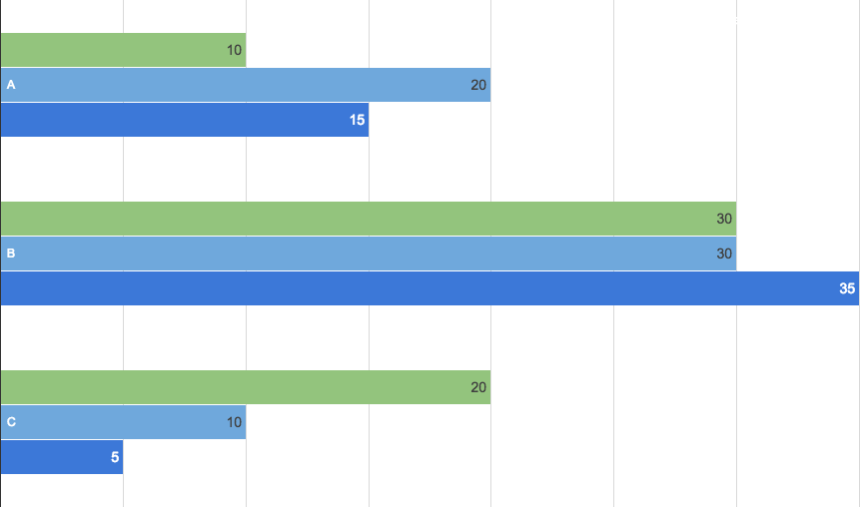
You can insert graphs from Google Sheets

Slide 20
Android project
Show and explain your web, app or software projects using these gadget templates.
Place your screenshot here

Slide 21
iPhone project
Show and explain your web, app or software projects using these gadget templates.
Place your screenshot here

Slide 22
Tablet project
Show and explain your web, app or software projects using these gadget templates.
Place your screenshot here

Slide 23
Desktop project
Show and explain your web, app or software projects using these gadget templates.
Place your screenshot here

Slide 24
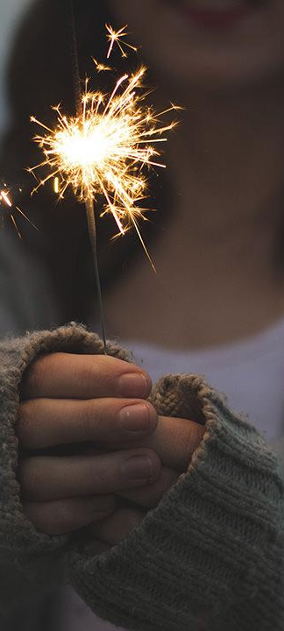
Thanks!
Any questions?
You can find me at
@username
user@mail.me

Slide 25
Credits
Special thanks to all the people who made and released these awesome resources for free:
Presentation template by SlidesCarnival
Photographs by Unsplash

Slide 26
Presentation design
You don’t need to keep this slide in your presentation. It’s only here to serve you as a design guide if you need to create new slides or download the fonts to edit the presentation in PowerPoint®
This presentation uses the following typographies and colors:
Titles: Droid serif
Body copy: Pontano Sans
You can download the fonts on these pages:
https://www.fontsquirrel.com/fonts/droid-serif
http://www.1001fonts.com/pontano-sans-font.html
Cyan #33ccff
Navy #162d5a
Turquoise #33cccc
Fluor green #a7ea52

Slide 27
SlidesCarnival icons are editable shapes.
This means that you can:
Resize them without losing quality.
Change fill color and opacity.
Change line color, width and style.
Isn’t that nice? :)
Examples:

Slide 28
😉
Now you can use any emoji as an icon!
And of course it resizes without losing quality and you can change the color.
How? Follow Google instructions https://twitter.com/googledocs/status/730087240156643328
✋👆👉👍👤👦👧👨👩👪💃🏃💑❤😂😉😋😒😭👶😸🐟🍒🍔💣📌📖🔨🎃🎈🎨🏈🏰🌏🔌🔑 and many more...

Slide 29
References
GTA V image: https://disegnodaily.imgix.net/system/dragonfly/production/2013/10/02/12_32_29_314_481_1280.jpg?w=2000
Batman image: http://vignette1.wikia.nocookie.net/batman/images/3/32/BatmanArkhamKnightGothamCity.jpg/revision/latest?cb=20140530010522

