Slide 1
天然萃取物 R1晶片分析
2017/08/09
Jade

Slide 2

天山雪蓮已知功效
功效
祛濕
腰膝痠痛
痛經
增強免疫
類風濕性關節炎
延緩人體衰老:
皮膚暗沉
防紫外線侵害
Notes:
https://kknews.cc/zh-tw/health/paqjve.html

Slide 3
天山雪蓮可能功效(基因表現量上升)
功效 | Pathway
免疫 | TNF signaling pathway
 | Malaria
 | Chemokine signaling pathway
 | NF-kappa B signaling pathway
 | Rheumatoid arthritis
 | Legionellosis
 | Cytokine-cytokine receptor interaction
 | Tuberculosis
 | Complement and coagulation cascades
代謝 | Tryptophan metabolism
神經 | Axon guidance
Notes:
TNF signaling pathway
Malaria
Chemokine signaling pathway
Tryptophan metabolism
NF-kappa B signaling pathway
Rheumatoid arthritis
Legionellosis
Complement and coagulation cascades
Cytokine-cytokine receptor interaction
Tuberculosis
Axon guidance

Slide 4
天山雪蓮可能功效(基因表現量下降)
功效 | Pathway
造血 | Hematopoietic cell lineage
免疫 | Asthma
 | Cytokine-cytokine receptor interaction
 | Inflammatory bowel disease
訊息傳遞 | Cell adhesion molecules
 | cGMP-PKG signaling pathway
Notes:
Hematopoietic cell lineage
Cell adhesion molecules (CAMs)
Asthma
cGMP-PKG signaling pathway
Cytokine-cytokine receptor interaction
Inflammatory bowel disease (IBD)

Slide 5
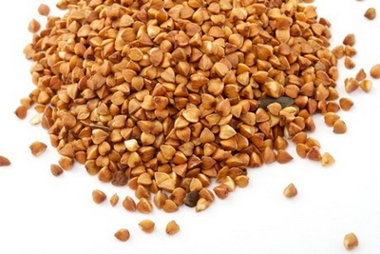
蕎麥
功效
防高血壓
防心血管疾病
降血脂
防便祕
養顏美容
幫助吸收維生素C
Notes:
http://www.jiankanghou.com/yinshi/33765.html

Slide 6
蕎麥可能功效(基因表現量上升)
功效 | Pathway
免疫 | TNF signaling pathway
 | Chemokine signaling pathway
 | NF-kappa B signaling pathway
 | Rheumatoid arthritis
 | Inflammatory mediator regulation of TRP channels
代謝 | Arachidonic acid metabolism
 | Ovarian steroidogenesis
心血管 | VEGF signaling pathway
神經 | Serotonergic synpase
Notes:
TNF signaling pathway
Serotonergic synapse
Ovarian steroidogenesis
VEGF signaling pathway
Arachidonic acid metabolism
Chemokine signaling pathway
NF-kappa B signaling pathway
Rheumatoid arthritis
Inflammatory mediator regulation of TRP channels

Slide 7
蕎麥可能功效(基因表現量下降)
功效 | Pathway
神經 | Neuroactive ligand-receptor interaction
 | Glutamatergic synapse
幹細胞多效性 | Signaling pathways regulating pluripotency of stem cells
Notes:
Neuroactive ligand-receptor interaction
Glutamatergic synapse
Signaling pathways regulating pluripotency of stem cells

Slide 8
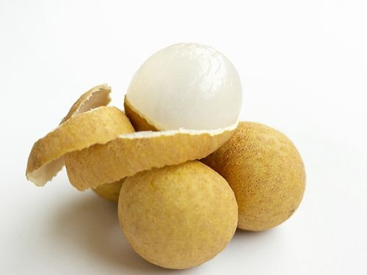
龍眼殼
功效
治心虛頭暈
散邪祛風
聰耳明目
Notes:
https://read01.com/zh-tw/nLnODm.html#.WYqk04SGOpo

Slide 9
龍眼殼可能功效(基因表現量上升)
功效 | Pathway
免疫 | Cytokine-cytokine receptor interaction
消化與吸收 | Protein digestion and absorption
 | Mineral absorption
Notes:
Cytokine-cytokine receptor interaction
Protein digestion and absorption
Mineral absorption

Slide 10
龍眼殼可能功效(基因表現量下降)
功效 | Pathway
神經 | Neuroactive ligand-receptor interaction
心血管 | Hypertrophic cariomyopathy
 | Renin-angiotensin systems
代謝 | Steroid hormone biosynthesis
 | PPAR signaling pathway
 | Pentose and glucuronate interconversions
Notes:
Neuroactive ligand-receptor interaction
Hypertrophic cardiomyopathy (HCM)
Renin-angiotensin system
Steroid hormone biosynthesis
PPAR signaling pathway
Pentose and glucuronate interconversions

Slide 11
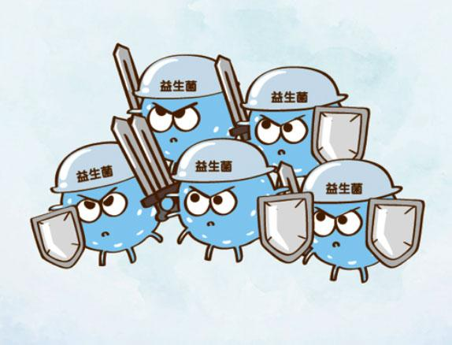
母乳益生菌
功效
改善過敏
幫助減肥
改善便秘
減少感冒次數
預防大腸癌
Notes:
http://puresbio.pixnet.net/blog/post/213975064-%E7%9B%8A%E7%94%9F%E8%8F%8C%E5%8A%9F%E6%95%88%E5%B0%8D%E4%BA%BA%E9%AB%94%E7%9A%84%E5%A5%BD%E8%99%95%EF%BD%9E%E7%9E%AD%E8%A7%A3%E7%9B%8A%E7%94%9F%E8%8F%8C%E8%88%87%E7%9B%8A%E7%94%9F

Slide 12
母乳益生菌可能功效(基因表現量上升)
功效 | Pathway
免疫 | TNF signaling pathway
 | Rheumatoid arthritis
 | Cytokine-cytokine receptor interaction
 | NF-kappa B signaling pathway
 | Salmonella infection
 | Legionellosis
 | Malaria
 | Tuberculosis
 | Chemokine signaling pathway
Notes:
TNF signaling pathway
Rheumatoid arthritis
Cytokine-cytokine receptor interaction
Salmonella infection
Malaria
Legionellosis
Chemokine signaling pathway
Graft-versus-host disease
Tuberculosis
Fc gamma R-mediated phagocytosis
Hematopoietic cell lineage
NF-kappa B signaling pathway
Amoebiasis
Pertussis
African trypanosomiasis
Prion diseases
Proteoglycans in cancer
Focal adhesion
PI3K-Akt signaling pathway
ECM-receptor interaction
Jak-STAT signaling pathway
Type I diabetes mellitus

Slide 13
母乳益生菌可能功效(基因表現量下降)
功效 | Pathway
免疫 | Malaria
 | Legionellosis
 | Toll-like receptor signaling pathway
細胞運輸 | Phagosome
Notes:
Malaria
Legionellosis
Phagosome
Toll-like receptor signaling pathway

