Slide 1
Handshake Protocol
Spring, 2009
TA: Junyoung Park

Slide 2
Handshake Process
Master
VALID
Slave
DATA [31:0]
FSM
FSM
READY
RESPONSE
The master generates the VALID signal to indicate when the data is available.
The slave generates the READY signal to indicate that it accepts the data.
Transfer occurs only when both the VALID and READY signals are HIGH.
RESPONSE signal indicates one transaction is completed.

Slide 3
Waveform
CLK
Valid data
Invalid data
Valid data
DATA
VALID
READY
Response

Slide 4
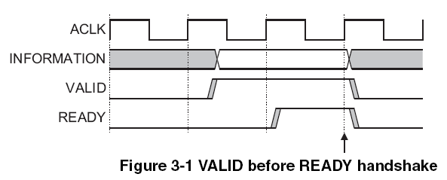
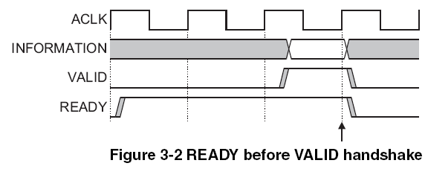
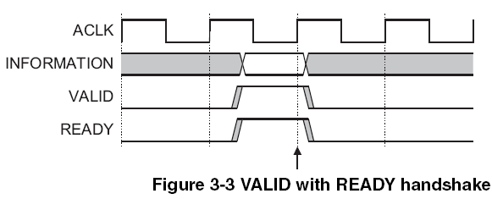
EXAMPLE
AMBA 3.0 AXI protocol

Slide 5
FSM of MASTER
IDLE: idle state
VALID: the state where master sends valid data and waits for ready signal
RESP: waiting state for response signal
valid=0
IDLE
valid = 1
data = valid
valid=1
response=1
VALID
RESP
valid = 0
Data = Z
ready=0
response=0
ready=1

Slide 6
FSM of SLAVE
IDLE: idle state
READY: the state where slave is ready to get new valid data from master
RESP: response signal indicates that transaction is completed. (We assume that slave gives OK response signal after receiving valid data.)
ready=0
IDLE
response = 0
ready=1
response=1
READY
RESP
ready = 0
response = 1
valid=0
valid=1
response=0

Slide 7
Simulation
Go down to your ‘vlsi1’ directory
Make your simulation directory
  user@sunapp1> mkdir handshake
Copy handshake.tar file to your simulation directory.
(http://www.cerc.utexas.edu/~jypark/2009_spring_VLSI_I/Lab3/handshake/handshake.tar)
Extract the file by using ‘tar’
  user@sunapp1> tar –xvf handshake.tar
Modify ‘USER DEFINED VALUE’ section in the handshake.v as a test situation what you want to simulate.
user@sunapp1> source :synopsys
user@sunapp1> make run
Due to the behavior simulation of master and slave models, this handshake.v file has some un-synthesizable codes (e.g. repeat statement, testbench, initial code).
You can get a synthesizable code here (http://www.cerc.utexas.edu/~jypark/2009_spring_VLSI_I/Lab3/handshake/syn/handshake.v)

Slide 8
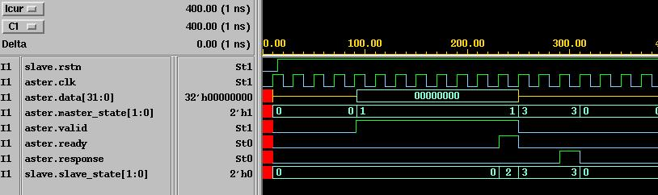
Waveform
USER DEFINED VALUE
- SLAVE_READY 10
- MASTER_VALID 3
- SLAVE_RESPONSE 2
MASTER
  IDLE: 2’b00
  VALID: 2’b01
  RESP: 2’b11
SLAVE
  IDLE: 2’b00
  READY: 2’b10
  RESP: 2’b11

