Slide 1

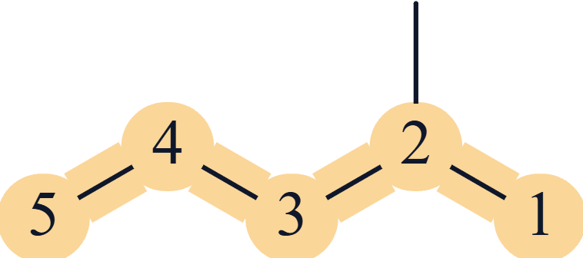
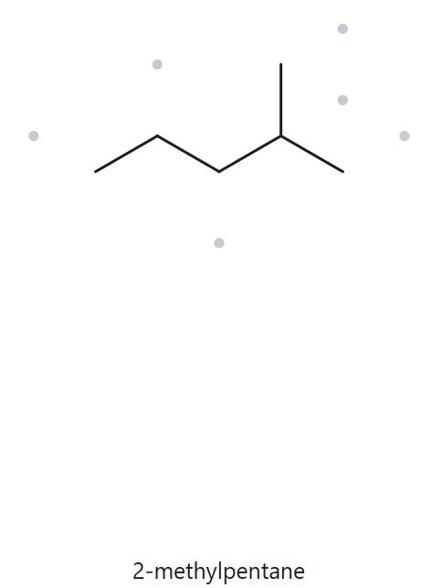
A01
Molecular formula (counted): C6H14
FOUNDATION
1 · NUMBERED PARENT
2 · NAMING TRAIL
Parent: longest chain = 5 C → pentane.
Numbering: right → left gives 2; left → right gives 4. First point of difference: 2 < 4, so number from the right.
Substituents: methyl on C2 → 2-methyl.
3 · MY NAME (WRITTEN FIRST)
4 · THE ALKANE CHECK
Returned name: 2-methylpentane
Verdict: ✓ match ☐ mismatch
2-methylpentane
✓ longest chain/ring ✓ lowest locants ✓ alphabetical order ✓ punctuation ✓ formula counted
CHEM 13 · Asynchronous Activity No. 3 · Name It, Draw It | Bicol University · College of Engineering · Department of Chemical Engineering
Notes:
1

Slide 2
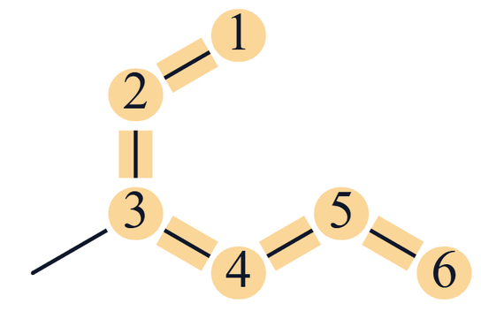
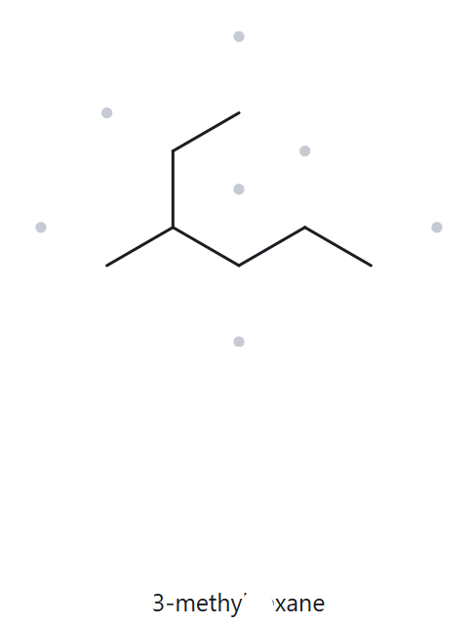
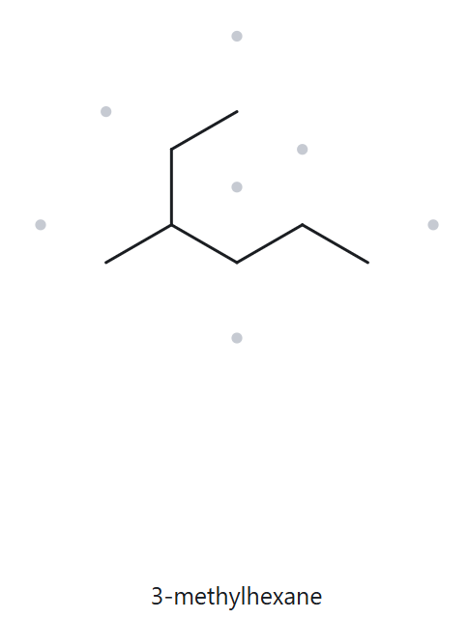
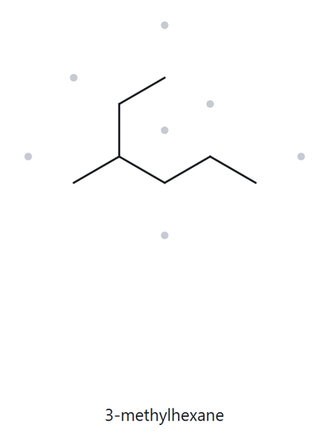
A02
Molecular formula (counted): C7H16
FOUNDATION
1 · NUMBERED PARENT
2 · NAMING TRAIL
Parent: longest chain = 6 C → hexane (a bent chain, traced through the branch point).
Numbering: from the top end gives 3; from the right end gives 4. First point of difference: 3 < 4, so number from the top.
Substituents: methyl on C3 → 3-methyl.
3 · MY NAME (WRITTEN FIRST)
4 · THE ALKANE CHECK
Returned name: 3-methylhexane
Verdict: ✓ match ☐ mismatch
3-methylhexane
✓ longest chain/ring ✓ lowest locants ✓ alphabetical order ✓ punctuation ✓ formula counted
CHEM 13 · Asynchronous Activity No. 3 · Name It, Draw It | Bicol University · College of Engineering · Department of Chemical Engineering
Notes:
2

Slide 3
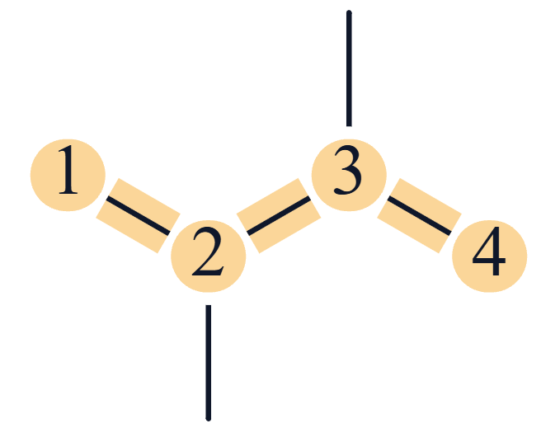
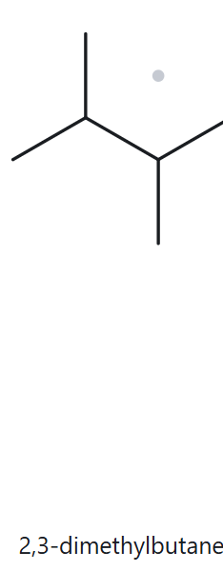
A03
Molecular formula (counted): C6H14
FOUNDATION
1 · NUMBERED PARENT
2 · NAMING TRAIL
Parent: longest chain = 4 C → butane.
Numbering: both directions give 2,3, so either direction works.
Substituents (A→Z): two identical methyl groups on C2 and C3 → 2,3-dimethyl.
3 · MY NAME (WRITTEN FIRST)
4 · THE ALKANE CHECK
Returned name: 2,3-dimethylbutane
Verdict: ✓ match ☐ mismatch
2,3-dimethylbutane
✓ longest chain/ring ✓ lowest locants ✓ alphabetical order ✓ punctuation ✓ formula counted
CHEM 13 · Asynchronous Activity No. 3 · Name It, Draw It | Bicol University · College of Engineering · Department of Chemical Engineering
Notes:
4

Slide 4
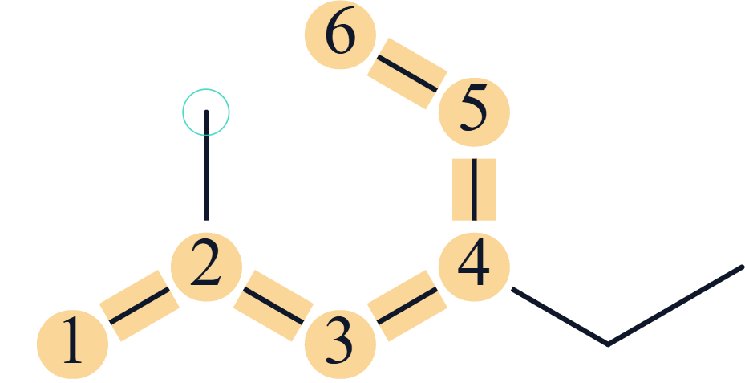
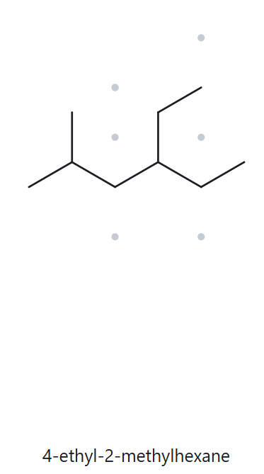
A04
Molecular formula (counted): C9H20
DEVELOPING
1 · NUMBERED PARENT
2 · NAMING TRAIL
Parent: longest chain = 6 C → hexane. Two 6-C paths exist (through either two-carbon arm on C4), but both give the same name.
Numbering: lower left → upper right gives 2,4; the reverse gives 3,5. First point of difference: 2 < 3, so number from the lower left.
Substituents (A→Z): ethyl on C4, methyl on C2 → 4-ethyl-2-methyl (ethyl is cited first alphabetically).
3 · MY NAME (WRITTEN FIRST)
4 · THE ALKANE CHECK
Returned name: 4-ethyl-2-methylhexane
Verdict: ✓ match ☐ mismatch
4-ethyl-2-methylhexane
✓ longest chain/ring ✓ lowest locants ✓ alphabetical order ✓ punctuation ✓ formula counted
CHEM 13 · Asynchronous Activity No. 3 · Name It, Draw It | Bicol University · College of Engineering · Department of Chemical Engineering
Notes:
5

Slide 5
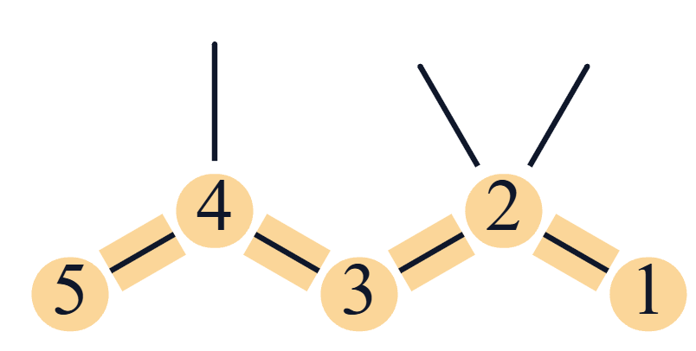
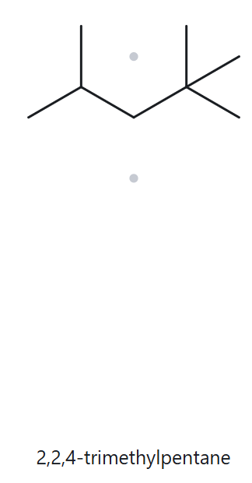
A05
Molecular formula (counted): C8H18
DEVELOPING
1 · NUMBERED PARENT
2 · NAMING TRAIL
Parent: longest chain = 5 C → pentane.
Numbering: right → left gives 2,2,4; left → right gives 2,4,4. First point of difference: the second locant, 2 < 4, so number from the right.
Substituents: three methyl groups on C2, C2 and C4 → 2,2,4-trimethyl.
3 · MY NAME (WRITTEN FIRST)
4 · THE ALKANE CHECK
Returned name:
2,2,4-trimethylpentane
Verdict: ✓ match ☐ mismatch
2,2,4-trimethylpentane
✓ longest chain/ring ✓ lowest locants ✓ alphabetical order ✓ punctuation ✓ formula counted
CHEM 13 · Asynchronous Activity No. 3 · Name It, Draw It | Bicol University · College of Engineering · Department of Chemical Engineering
Notes:
5

Slide 6
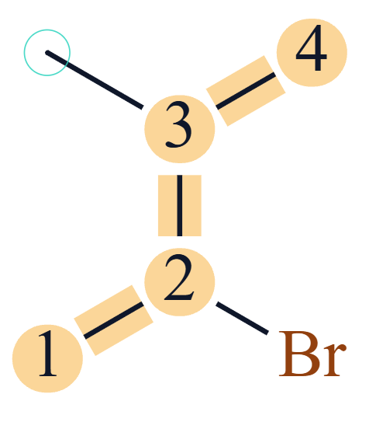
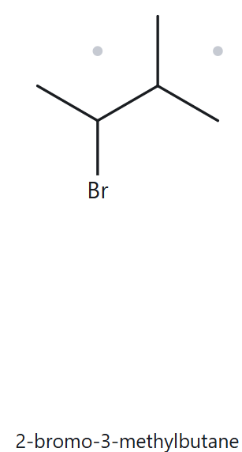
A06
Molecular formula (counted): C5H11Br
DEVELOPING
1 · NUMBERED PARENT
2 · NAMING TRAIL
Parent: longest chain = 4 C → butane.
Numbering: bottom → top gives 2,3 (Br on C2, methyl on C3); top → bottom also gives 2,3. The locant sets tie, so the alphabetical tie-break applies: bromo comes before methyl, so Br gets the lower number.
Substituents (A→Z): bromo on C2, methyl on C3 → 2-bromo-3-methyl.
3 · MY NAME (WRITTEN FIRST)
4 · THE ALKANE CHECK
Returned name:
2-bromo-3-methylbutane
Verdict: ✓ match ☐ mismatch
2-bromo-3-methylbutane
✓ longest chain/ring ✓ lowest locants ✓ alphabetical order ✓ punctuation ✓ formula counted
CHEM 13 · Asynchronous Activity No. 3 · Name It, Draw It | Bicol University · College of Engineering · Department of Chemical Engineering
Notes:
6

Slide 7
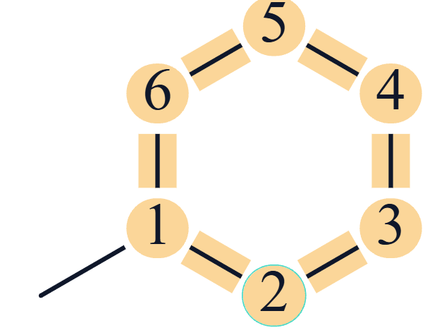
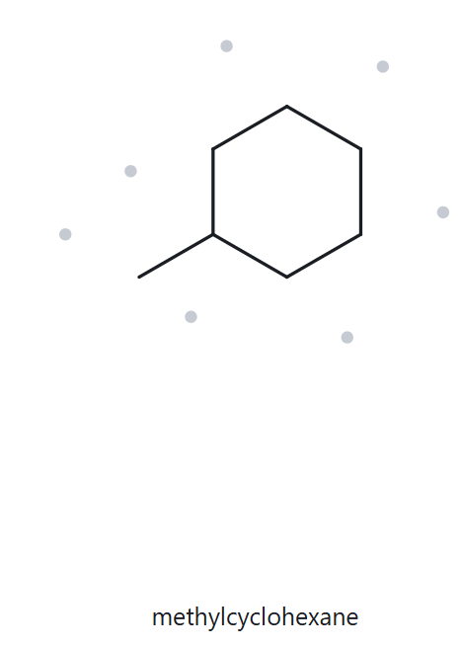
A07
Molecular formula (counted): C7H14
DEVELOPING
1 · NUMBERED PARENT
2 · NAMING TRAIL
Parent: ring of 6 C → cyclohexane (the ring is the parent).
Numbering: with one substituent, the ring carbon bearing the methyl is C1 and the locant is not written.
Substituents: methyl → methylcyclohexane.
3 · MY NAME (WRITTEN FIRST)
4 · THE ALKANE CHECK
Returned name:
methylcyclohexane
Verdict: ✓ match ☐ mismatch
methylcyclohexane
✓ longest chain/ring ✓ lowest locants ✓ alphabetical order ✓ punctuation ✓ formula counted
CHEM 13 · Asynchronous Activity No. 3 · Name It, Draw It | Bicol University · College of Engineering · Department of Chemical Engineering
Notes:
7

Slide 8
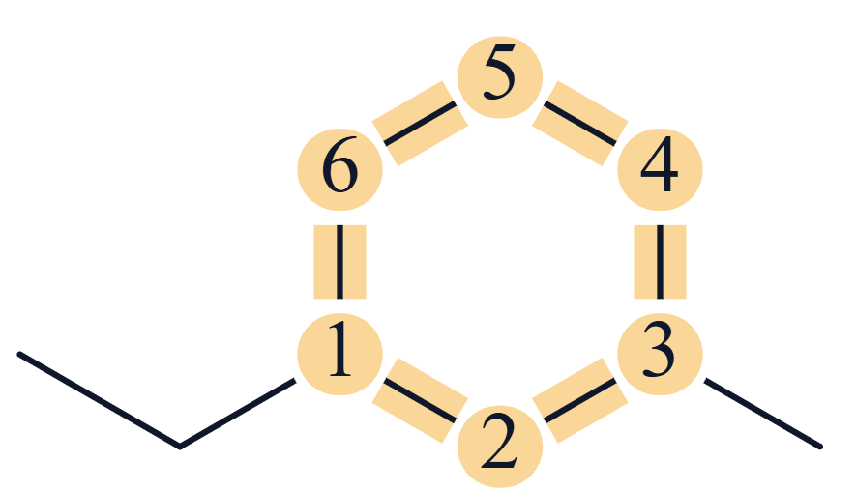
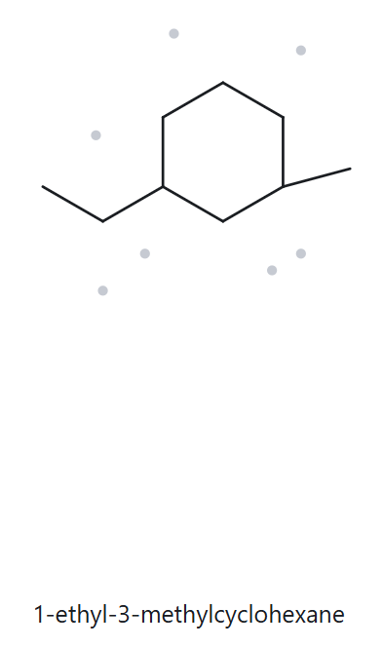
A08
Molecular formula (counted): C9H18
CHALLENGE
1 · NUMBERED PARENT
2 · NAMING TRAIL
Parent: ring of 6 C → cyclohexane.
Numbering: either direction (the short way round) gives 1,3, so the locant sets tie. Alphabetical tie-break: ethyl comes before methyl, so ethyl is C1.
Substituents (A→Z): ethyl on C1, methyl on C3 → 1-ethyl-3-methyl.
3 · MY NAME (WRITTEN FIRST)
4 · THE ALKANE CHECK
Returned name:
1-ethyl-3-methylcyclohexane
Verdict: ✓ match ☐ mismatch
1-ethyl-3-methylcyclohexane
✓ longest chain/ring ✓ lowest locants ✓ alphabetical order ✓ punctuation ✓ formula counted
CHEM 13 · Asynchronous Activity No. 3 · Name It, Draw It | Bicol University · College of Engineering · Department of Chemical Engineering
Notes:
8

Slide 9
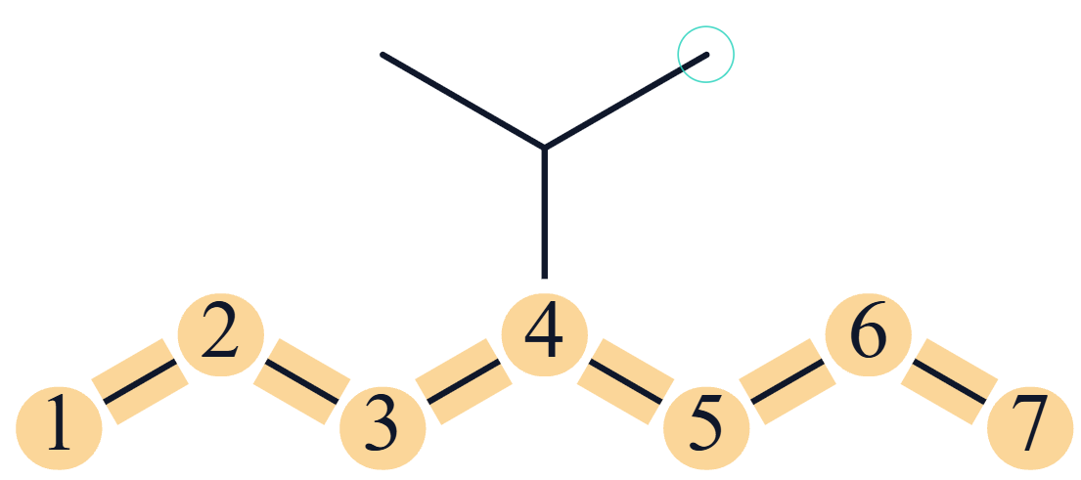
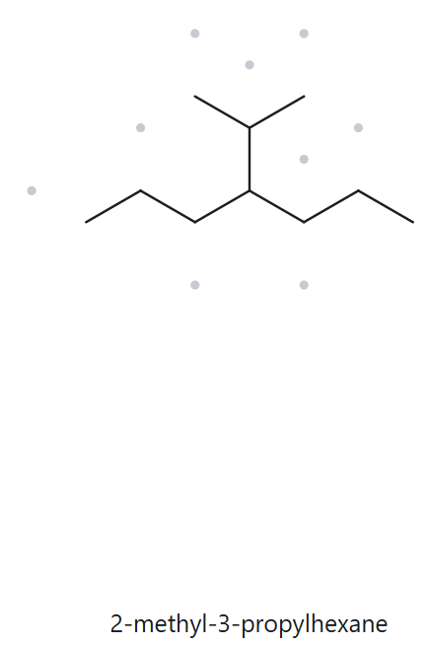
A09
Molecular formula (counted): C10H22
CHALLENGE
1 · NUMBERED PARENT
2 · NAMING TRAIL
Parent: longest chain = 7 C, traced through the branch point (a path through the branch gives only 6 C) → heptane.
Numbering: either end gives 4, since the branch is on the central carbon.
Substituents: isopropyl, written (1-methylethyl), on C4 → 4-isopropyl.
3 · MY NAME (WRITTEN FIRST)
4 · THE ALKANE CHECK
Returned name:
2-methyl-3-propylhexane
Verdict: ☐ match ✗ mismatch
If ✗: correct name 4-isopropylheptane; rule that decides: longest chain (7 C, not the 6-C parent the tool gave). Same compound, different parent.
4-isopropylheptane
✓ longest chain/ring ✓ lowest locants ✓ alphabetical order ✓ punctuation ✓ formula counted
CHEM 13 · Asynchronous Activity No. 3 · Name It, Draw It | Bicol University · College of Engineering · Department of Chemical Engineering
Notes:
9

Slide 10
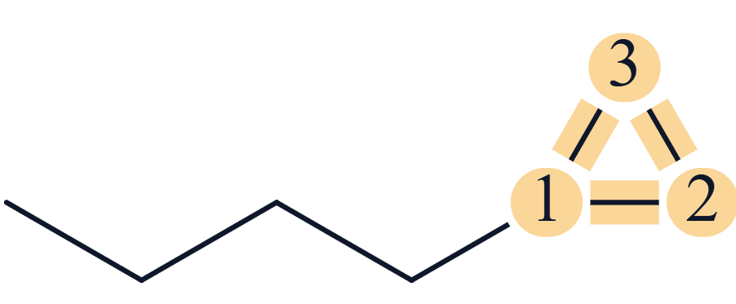
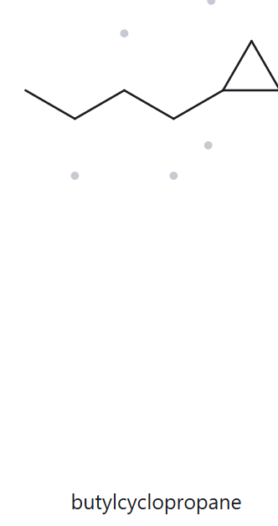
A10
Molecular formula (counted): C7H14
CHALLENGE
1 · NUMBERED PARENT
2 · NAMING TRAIL
Parent: the ring is the parent in this activity (current IUPAC rule), even though the chain has 4 C and the ring 3 C → cyclopropane.
Numbering: C1 is the ring carbon bonded to the chain; with one substituent the locant is not written.
Substituents: butyl (the 4-carbon chain) → butylcyclopropane.
3 · MY NAME (WRITTEN FIRST)
4 · THE ALKANE CHECK
Returned name:
butylcyclopropane
Verdict: ✓ match ☐ mismatch
butylcyclopropane
✓ longest chain/ring ✓ lowest locants ✓ alphabetical order ✓ punctuation ✓ formula counted
CHEM 13 · Asynchronous Activity No. 3 · Name It, Draw It | Bicol University · College of Engineering · Department of Chemical Engineering
Notes:
10

Slide 11
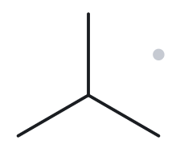
B01
Given name: 2-methylpropane
FOUNDATION
1 · NAME DECODED
2 · BOND-LINE STRUCTURE (THE ALKANE)
Parent: Propane → Three (3) single-bonded C; chain
Substituents: methyl on C2
Expected formula: worked out from the name before drawing: C4H10
3 · FORMULA CHECK
4 · BACK-CHECK
Counted from drawing: C4H10
General formula: CnH2n+2 (open chain) = C4H10
Agrees? ✓ yes ☐ no
Returned name: 2-methylpropane
Verdict: ✓ same as given ☐ differs
✓ parent length ✓ substituent positions ✓ formula agrees ✓ back-check recorded
CHEM 13 · Asynchronous Activity No. 3 · Name It, Draw It | Bicol University · College of Engineering · Department of Chemical Engineering
Notes:
11

Slide 12
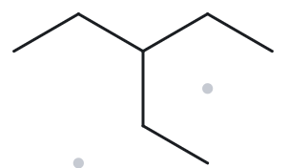
B02
Given name: 3-ethylpentane
FOUNDATION
1 · NAME DECODED
2 · BOND-LINE STRUCTURE (THE ALKANE)
Parent: Pentane → Five (5) single-bonded C; chain
Substituents: Ethyl on C3
Expected formula: worked out from the name before drawing: C7H16
3 · FORMULA CHECK
4 · BACK-CHECK
Counted from drawing: C7H16
General formula: CnH2n+2 (open chain) = C7H16
Agrees? ✓ yes ☐ no
Returned name: 3-ethylpentane
Verdict: ✓ same as given ☐ differs
✓ parent length ✓ substituent positions ✓ formula agrees ✓ back-check recorded
CHEM 13 · Asynchronous Activity No. 3 · Name It, Draw It | Bicol University · College of Engineering · Department of Chemical Engineering
Notes:
12

Slide 13
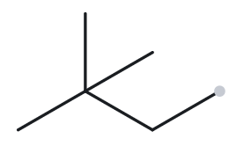
B03
Given name: 2,2-dimethylbutane
FOUNDATION
1 · NAME DECODED
2 · BOND-LINE STRUCTURE (THE ALKANE)
Parent: Butane → Four (4) single-bonded C; chain
Substituents: methyl on C2 ; methyl on C2
Expected formula: worked out from the name before drawing: C6H14
3 · FORMULA CHECK
4 · BACK-CHECK
Counted from drawing: C6H14
General formula: CnH2n+2 (open chain) = C6H14
Agrees? ✓ yes ☐ no
Returned name: 2,2-dimethylbutane
Verdict: ✓ same as given ☐ differs
✓ parent length ✓ substituent positions ✓ formula agrees ✓ back-check recorded
CHEM 13 · Asynchronous Activity No. 3 · Name It, Draw It | Bicol University · College of Engineering · Department of Chemical Engineering
Notes:
13

Slide 14
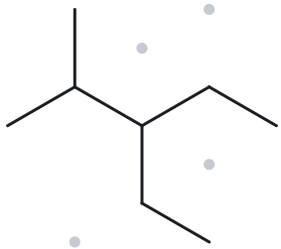
B04
Given name: 3-ethyl-2-methylpentane
DEVELOPING
1 · NAME DECODED
2 · BOND-LINE STRUCTURE (THE ALKANE)
Parent: Pentane → Five (5) single-bonded C; chain
Substituents: Ethyl on C3 ; methyl on C2
Expected formula: worked out from the name before drawing: C8H18
3 · FORMULA CHECK
4 · BACK-CHECK
Counted from drawing: C8H18
General formula: CnH2n+2 (open chain) = C8H18
Agrees? ✓ yes ☐ no
Returned name: 3-ethyl-2-methylpentane
Verdict: ✓ same as given ☐ differs
✓ parent length ✓ substituent positions ✓ formula agrees ✓ back-check recorded
CHEM 13 · Asynchronous Activity No. 3 · Name It, Draw It | Bicol University · College of Engineering · Department of Chemical Engineering
Notes:
14

Slide 15
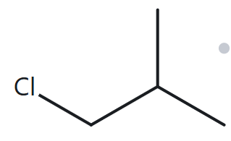
B05
Given name: 1-chloro-2-methylpropane
DEVELOPING
1 · NAME DECODED
2 · BOND-LINE STRUCTURE (THE ALKANE)
Parent: Propane → Three (3) single-bonded C; chain
Substituents: Chloro on C1 ; methyl on C2
Expected formula: worked out from the name before drawing: C4H9Cl
3 · FORMULA CHECK
4 · BACK-CHECK
Counted from drawing: C4H9Cl
General formula: CnH2n+2 (open chain) = C4H10; each halogen replaces one H = C4H9Cl
Agrees? ✓ yes ☐ no
Returned name: 1-chloro-2-methylpropane
Verdict: ✓ same as given ☐ differs
✓ parent length ✓ substituent positions ✓ formula agrees ✓ back-check recorded
CHEM 13 · Asynchronous Activity No. 3 · Name It, Draw It | Bicol University · College of Engineering · Department of Chemical Engineering
Notes:
15

Slide 16
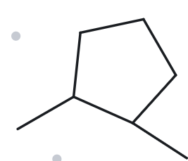
B06
Given name: 1,2-dimethylcyclopentane
DEVELOPING
1 · NAME DECODED
2 · BOND-LINE STRUCTURE (THE ALKANE)
Parent: Cyclopentane→ Five (5) single-bonded C; ring
Substituents: Methyl on C1 and C2
Expected formula: worked out from the name before drawing: C7H14
3 · FORMULA CHECK
4 · BACK-CHECK
Counted from drawing: C7H14
General formula: CnH2n (one ring) = C7H14
Agrees? ✓ yes ☐ no
Returned name: 1,2-dimethylcyclopentane
Verdict: ✓ same as given ☐ differs
✓ parent length ✓ substituent positions ✓ formula agrees ✓ back-check recorded
CHEM 13 · Asynchronous Activity No. 3 · Name It, Draw It | Bicol University · College of Engineering · Department of Chemical Engineering
Notes:
16

Slide 17
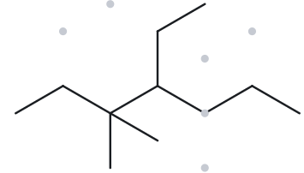
B07
Given name: 4-ethyl-3,3-dimethylheptane
DEVELOPING
1 · NAME DECODED
2 · BOND-LINE STRUCTURE (THE ALKANE)
Parent: Heptane → Seven (7) single-bonded C; chain
Substituents: Ethyl on C4 ; methyl on C3 (two)
Expected formula: worked out from the name before drawing: C11H24
3 · FORMULA CHECK
4 · BACK-CHECK
Counted from drawing: C11H24
General formula: CnH2n+2 (open chain) = C11H24
Agrees? ✓ yes ☐ no
Returned name: 4-ethyl-3,3-dimethylheptane
Verdict: ✓ same as given ☐ differs
✓ parent length ✓ substituent positions ✓ formula agrees ✓ back-check recorded
CHEM 13 · Asynchronous Activity No. 3 · Name It, Draw It | Bicol University · College of Engineering · Department of Chemical Engineering
Notes:
17

Slide 18
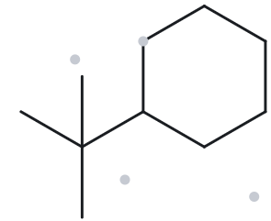
B08
Given name: tert-butylcyclohexane
CHALLENGE
1 · NAME DECODED
2 · BOND-LINE STRUCTURE (THE ALKANE)
Parent: Cyclohexane→ Six (6) single-bonded C; ring
Substituents: tert-butyl on C1
Expected formula: worked out from the name before drawing: C10H20
3 · FORMULA CHECK
4 · BACK-CHECK
Counted from drawing: C10H20
General formula: CnH2n (one ring) = C10H20
Agrees? ✓ yes ☐ no
Returned name: (1,1-dimethylethyl)cyclohexane
Verdict: ☐ same as given ✗ differs
Explanation: same compound, written with a different accepted substituent name. tert-butyl = (1,1-dimethylethyl) (Appendix B.3). No drawing error.
✓ parent length ✓ substituent positions ✓ formula agrees ✓ back-check recorded
CHEM 13 · Asynchronous Activity No. 3 · Name It, Draw It | Bicol University · College of Engineering · Department of Chemical Engineering
Notes:
18

Slide 19
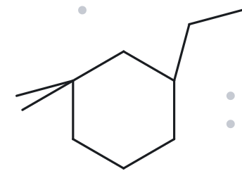
B09
Given name: 3-ethyl-1,1-dimethylcyclohexane
CHALLENGE
1 · NAME DECODED
2 · BOND-LINE STRUCTURE (THE ALKANE)
Parent: Cyclohexane → Six (6) single-bonded C; ring
Substituents: Ethyl on C3 ; dimethyl on C1
Expected formula: worked out from the name before drawing: C10H20
3 · FORMULA CHECK
4 · BACK-CHECK
Counted from drawing: C10H20
General formula: CnH2n (one ring) = C10H20
Agrees? ✓ yes ☐ no
Returned name: 3-ethyl-1,1-dimethylcyclohexane
Verdict: ✓ same as given ☐ differs
✓ parent length ✓ substituent positions ✓ formula agrees ✓ back-check recorded
CHEM 13 · Asynchronous Activity No. 3 · Name It, Draw It | Bicol University · College of Engineering · Department of Chemical Engineering
Notes:
19

Slide 20
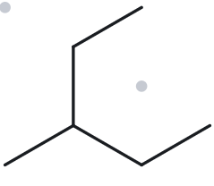
B10
Given name: 2-ethylbutane
CHALLENGE
1 · NAME DECODED
2 · BOND-LINE STRUCTURE (THE ALKANE)
Parent: Butane → Four (4) single-bonded C; chain
Substituents: Ethyl on C2
Expected formula: worked out from the name before drawing: C6H14
3 · FORMULA CHECK
4 · BACK-CHECK
Counted from drawing: C6H14
General formula: CnH2n+2 (open chain) = C6H14
Agrees? ✓ yes ☐ no
Returned name: 3-methylpentane
Verdict: ☐ same as given ✗ differs
Explanation: This given name is deliberately incorrect.
Correct name: 3-methylpentane;
rule broken: the parent must be the longest continuous chain (the ethyl on C2 extends the chain to 5 C).
✓ parent length ✓ substituent positions ✓ formula agrees ✓ back-check recorded
CHEM 13 · Asynchronous Activity No. 3 · Name It, Draw It | Bicol University · College of Engineering · Department of Chemical Engineering
Notes:
20

