Slide 1
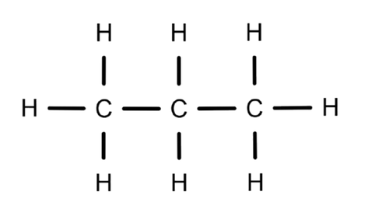
CARD # 01
PROPANE
One molecule represented in four different chemical languages
C3H8
MOLECULAR FORMULA
LEWIS STRUCTURE
CH3CH2CH3
CONDENSED STRUCTURAL FORMULA
BOND-LINE FORMULA
Atom count verified | valence checked | same connectivity across all representations.

Slide 2
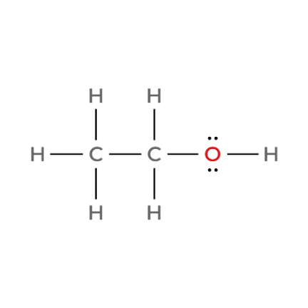

CARD # 02
ETHANOL
One molecule represented in four different chemical languages
C2H6O
MOLECULAR FORMULA
LEWIS STRUCTURE
CH3CH2OH
CONDENSED STRUCTURAL FORMULA
BOND-LINE FORMULA
Atom count verified | valence checked | same connectivity across all representations.

Slide 3
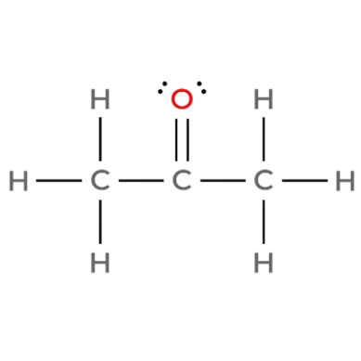

CARD # 03
ACETONE (Propan-2-one)
One molecule represented in four different chemical languages
C3H6O
MOLECULAR FORMULA
LEWIS STRUCTURE
CH3COCH3
CONDENSED STRUCTURAL FORMULA
BOND-LINE FORMULA
Atom count verified | valence checked | same connectivity across all representations.

Slide 4
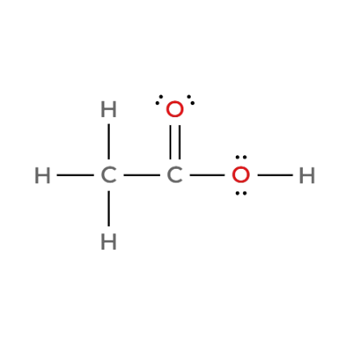
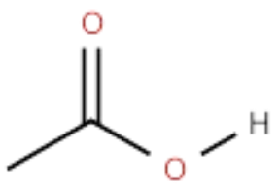
CARD # 04
ACETIC ACID (Ethanoic acid)
One molecule represented in four different chemical languages
C2H4O2
MOLECULAR FORMULA
LEWIS STRUCTURE
CH3COOH
CONDENSED STRUCTURAL FORMULA
BOND-LINE FORMULA
Atom count verified | valence checked | same connectivity across all representations.

Slide 5
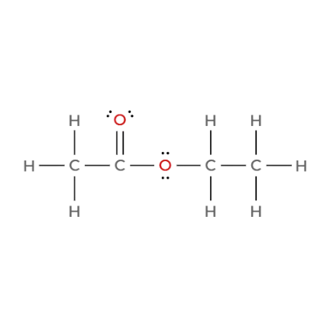
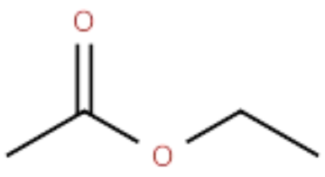
CARD # 05
ETHYL ACETATE (Ethyl ethanoate)
One molecule represented in four different chemical languages
C4H8O2
MOLECULAR FORMULA
LEWIS STRUCTURE
CH3COOCH2CH3
CONDENSED STRUCTURAL FORMULA
BOND-LINE FORMULA
Atom count verified | valence checked | same connectivity across all representations.

Slide 6
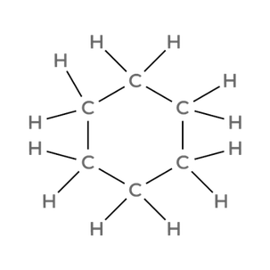
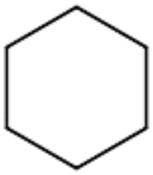
CARD # 06
CYCLOHEXANE
One molecule represented in four different chemical languages
C6H12
MOLECULAR FORMULA
LEWIS STRUCTURE
(CH2)6
CONDENSED STRUCTURAL FORMULA
BOND-LINE FORMULA
Atom count verified | valence checked | same connectivity across all representations.

Slide 7
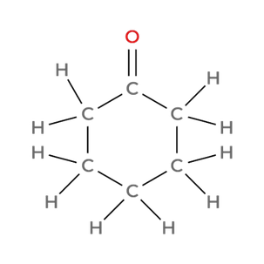
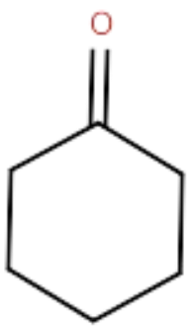
CARD # 07
CYCLOHEXANONE
One molecule represented in four different chemical languages
C6H10O
MOLECULAR FORMULA
LEWIS STRUCTURE
(CH2)5CO
CONDENSED STRUCTURAL FORMULA
BOND-LINE FORMULA
Atom count verified | valence checked | same connectivity across all representations.

Slide 8
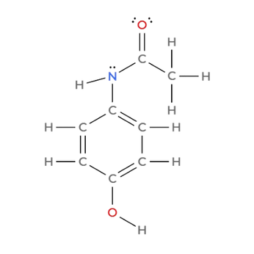
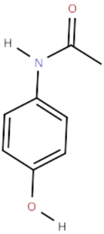
CARD # 08
ACETAMINOPHEN (Paracetamol)
One molecule represented in four different chemical languages
C8H9NO2
MOLECULAR FORMULA
LEWIS STRUCTURE
HOC6H6NHCOCH3
BOND-LINE FORMULA
CONDENSED STRUCTURAL FORMULA
Atom count verified | valence checked | same connectivity across all representations.

Slide 9
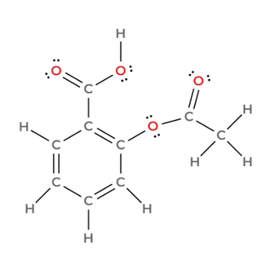
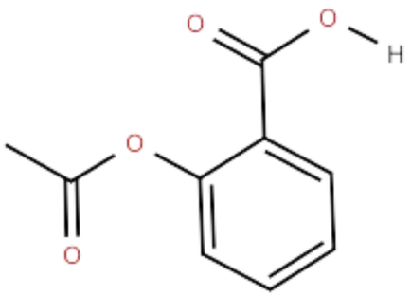
CARD # 09
ASPIRIN (Acetylsalicylic acid)
One molecule represented in four different chemical languages
C9H8O4
MOLECULAR FORMULA
LEWIS STRUCTURE
LEWIS STRUCTURE
CH3COOC6H4COOH
CONDENSED STRUCTURAL FORMULA
BOND-LINE FORMULA
CONDENSED STRUCTURAL FORMULA
BOND-LINE FORMULA
Atom count verified | valence checked | same connectivity across all representations.

Slide 10
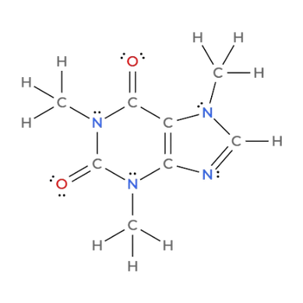
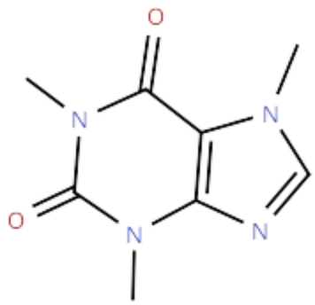
CARD # 10
CAFFEINE
One molecule represented in four different chemical languages
C8H10N4O2
MOLECULAR FORMULA
LEWIS STRUCTURE
LEWIS STRUCTURE
CH₃N(CO)(NCH3)(CO)
CONDENSED STRUCTURAL FORMULA
BOND-LINE FORMULA
BOND-LINE FORMULA
CONDENSED STRUCTURAL FORMULA
Atom count verified | valence checked | same connectivity across all representations.

