Slide 1
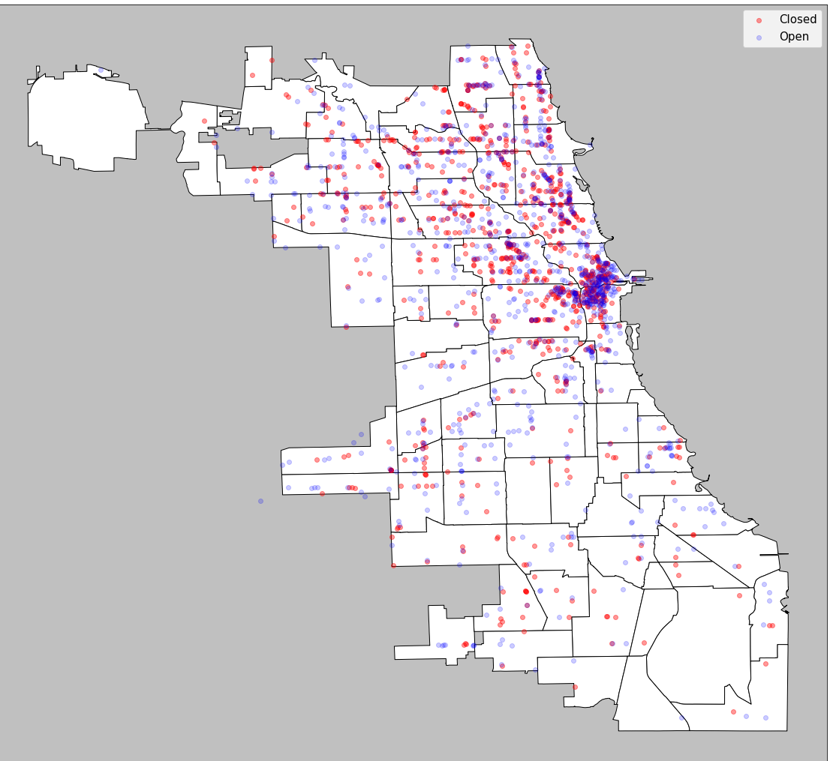
Chicago Businesses
and Covid-19
Sabina Hartnett, Egemen Pamukcu, Max Kramer & Jade Benson
Team name: Localgorithm

Slide 2
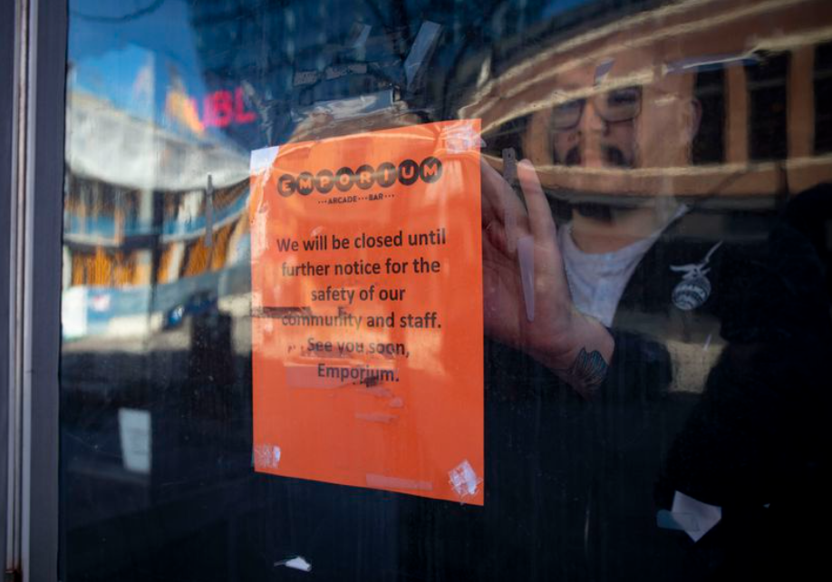
Background & Motivation
March 16th 2020, Gov. J.B. Pritzker orders all bars and restaurants to close across Illinois (only take out and delivery)
June 26th Chicago opens for limited indoor seating, October 27th closes again, Jan 23rd 2021 indoor seating opens again
As of December 2020, 17% of restaurants closed permanently or long-term (more than 110,000) due to the pandemic
Notes:
By now, we are all intimately aware of the toll that the covid-19 pandemic has had on all of our lives and livelihoods.
In efforts to control the spread of the virus, states and cities began to issue policies on restaurant capacity and banned in-person options beginning in March 2020.
Timeline of the Chicago restaurant closures (from the Tribune: https://www.chicagotribune.com/dining/ct-coronavirus-viz-chicago-dining-restaurants-timeline-2020-20201230-shiyie5mtnavfplwoexqkxxnve-list.html) :
March 16th 2020, Gov. J.B. Pritzker orders all bars and restaurants to close across Illinois (only take out and delivery)
May 20th, 2020 Pritzker allows Illinois bars and restaurants to open limited outdoor seating (JUST in suburbs)
June 3 restaurants within chicago are open for limited outdoor dining
June 26 - Chicago allows limited indoor seating in restaurants, bars, breweries (25%)
July 24th bars without food have to close
Oct 27th - clash between state and city policy but Chicago forced to re-close indoor bars and restaurants
Jan 23rd, 2021 restaurants and bars open for 25% capacity indoors again [https://chicago.eater.com/2021/1/23/22245848/chicago-cook-county-indoor-dining-restaurants-bars-dining-room-covid]
Now we’re in phase 4 (up to 50% capacity) https://www.chicago.gov/city/en/sites/covid-19/home/reopening-chicago.html
The decreased accessibility and the economic strain (both consumers can’t afford to eat out as much and restaurants can’t afford their rent/other expenses while closed) has resulted in massive amounts of permanent restaurant closures across the United States.
The National Restaurant Associations’ 2021 report (trying to convince Congress to support more relief efforts) - statistics reported here: https://restaurant.org/news/pressroom/press-releases/restaurant-industry-in-free-fall-10000-close-in
Picture from: https://www.chicagotribune.com/coronavirus/ct-food-covid-19-bar-restaurant-closing-illinois-reaction-20200315-mwgppfqbtvd4djj7jxupxcxhwy-story.html

Slide 3
Research Questions
How many businesses have closed in the city of Chicago during the 2020-21 COVID-19 pandemic?
Where are these businesses located and are there particular neighborhoods experiencing exaggerated rates of closures?
Were COVID-19 metrics associated with these closures?

Slide 4
Methods - Yelp API scraping
Yelp Fusion API limitations: 50 businesses, 5000 queries
Generated the coordinates for the City of Chicago with 150 meter radii
Did a grid search through the city to collect information on Chicago businesses
Collected 11,000+ businesses, addresses, and Yelp ratings
Stored the data in CSVs

Slide 5

Grid Search Through Chicago
300 meters
~25,000 coordinate pairs

Slide 6
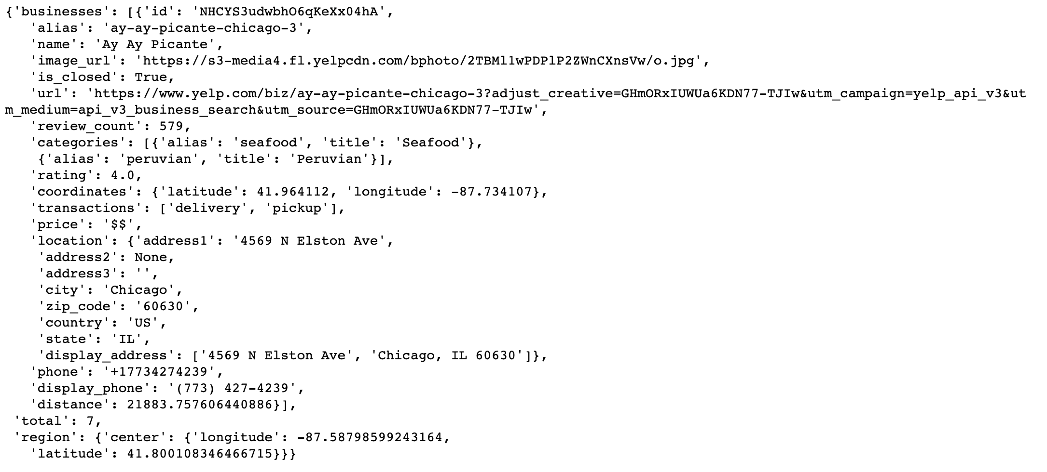
Collected ~11,000 businesses listed on Yelp
Sample
response for one business

Slide 7
Methods - City of Chicago Food Inspection
Use the City of Chicago’s Food Inspection data set to determine restaurant status before and during the pandemic
Identify the closed and “missing” restaurants to query through Yelp
Record linkage
Python: requests package
Business name & address: query Yelp API business match endpoint
Unique Yelp ID: query Yelp API business search endpoint
Link review data, COVID data, business type, and open/closed status
Notes:
City of Chicago data set preparation
Inspections are supposed to happen at least 1x per year so we
Select all restaurant inspections before the pandemic (Jan 1, 2019 - March 1, 2020)
Select all restaurant inspections during pandemic (March 1, 2020 - Feb 2021)
Find the closed restaurants in the during data set and investigate the missing ones from before to during
Query the Yelp API with

Slide 8
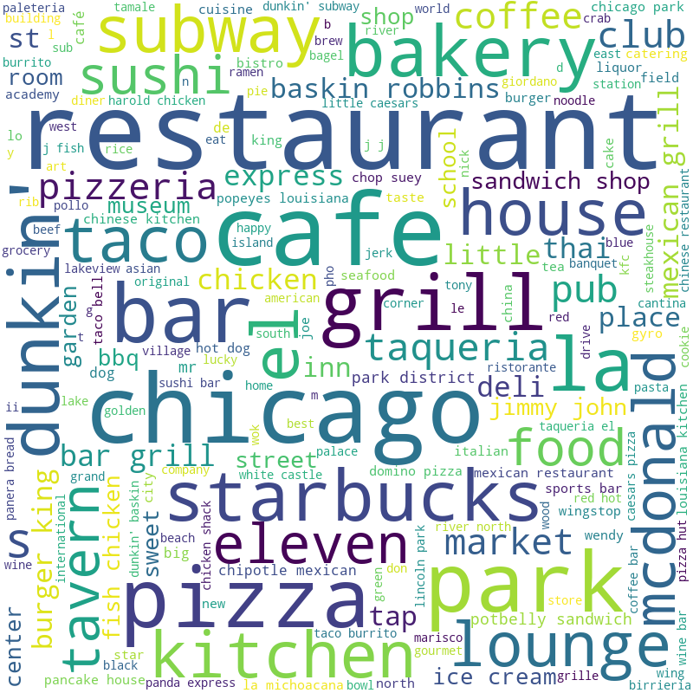
Results
Using names from all businesses
Notes:
All Names World Cloud
Most frequently occurring types of businesses
(sorted by frequency) based on the food
inspection dataset

Slide 9
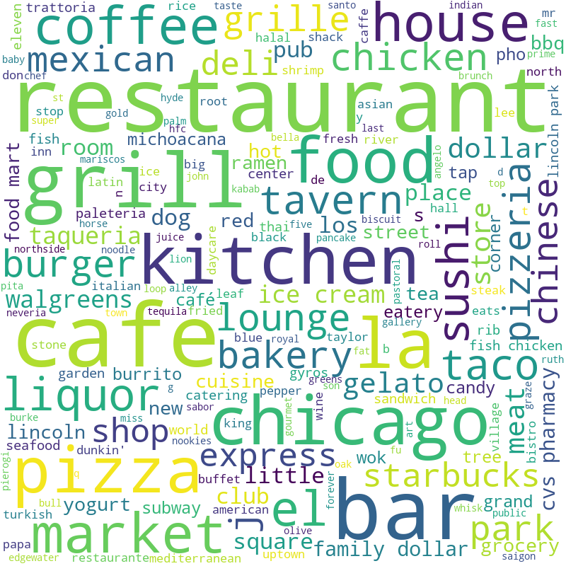
Results
Using names from closed businesses

Slide 10
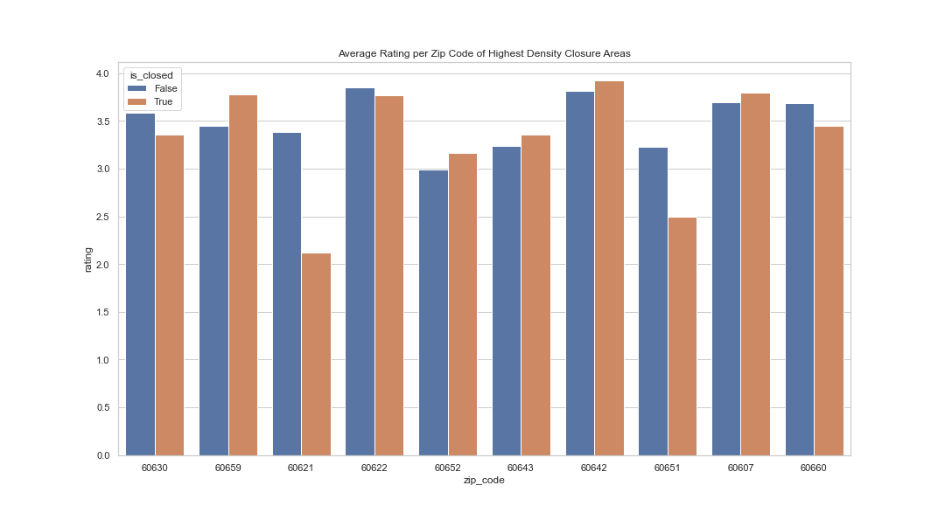
Results
Summary statistics

Slide 11
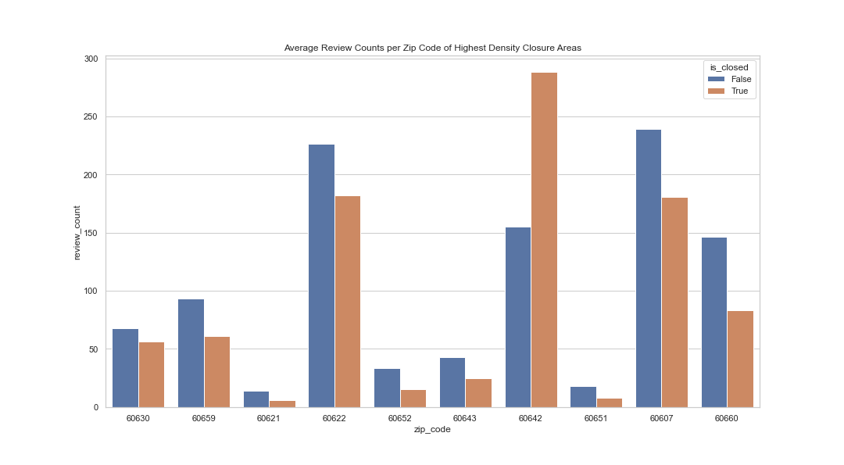
Results
Summary statistics

Slide 12
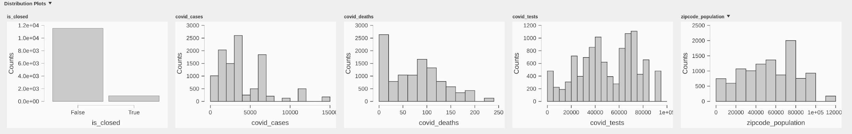
Results - COVID metrics & Covariates

Slide 13
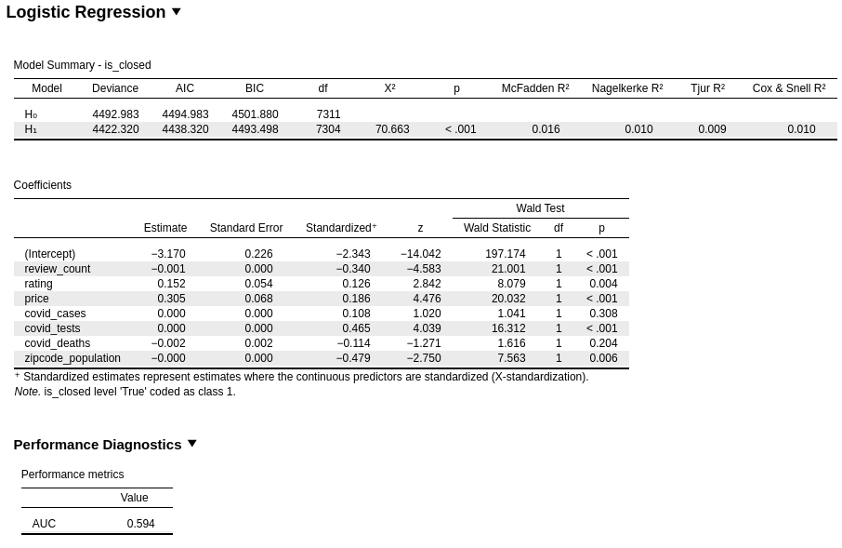

Slide 15
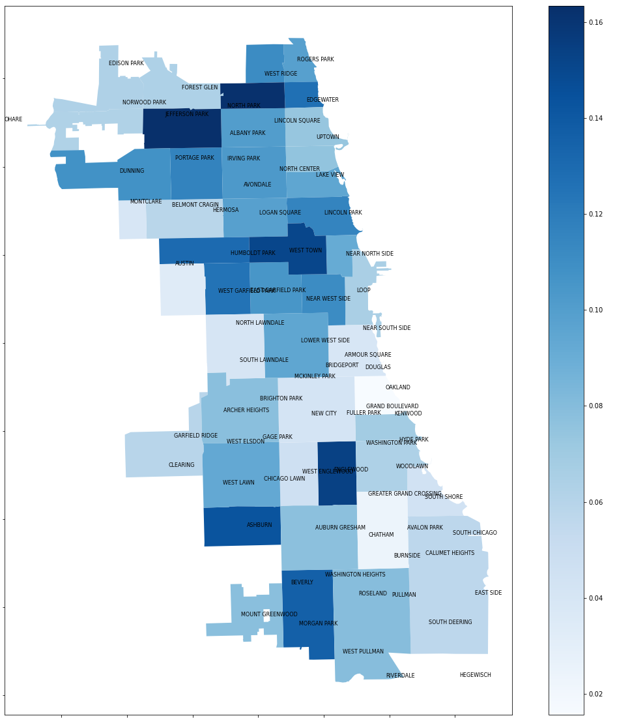
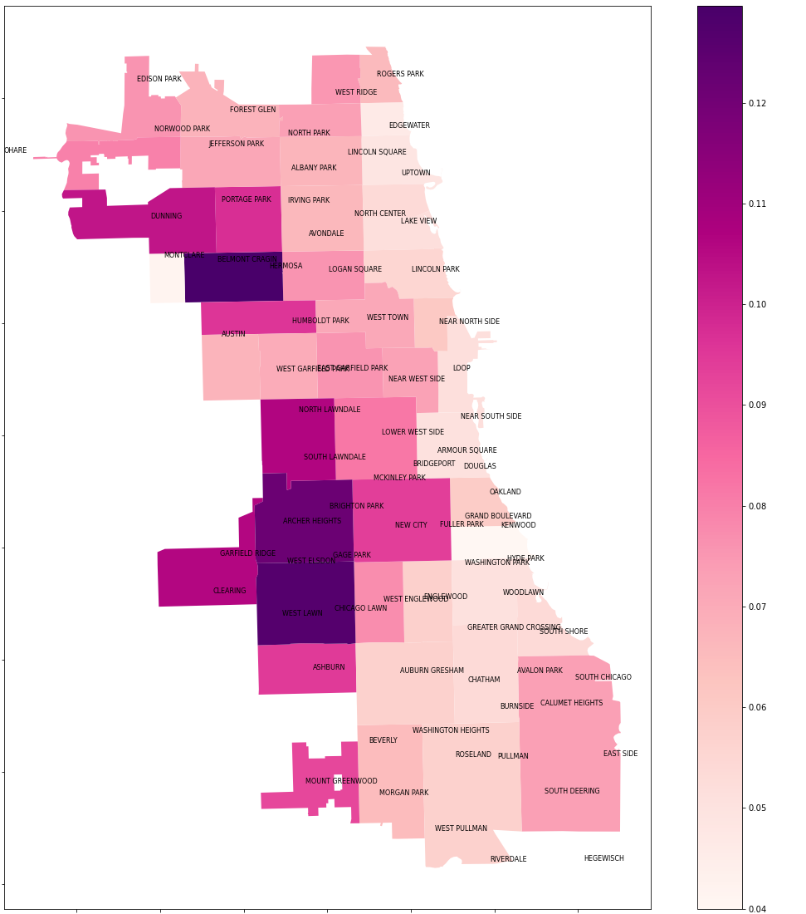
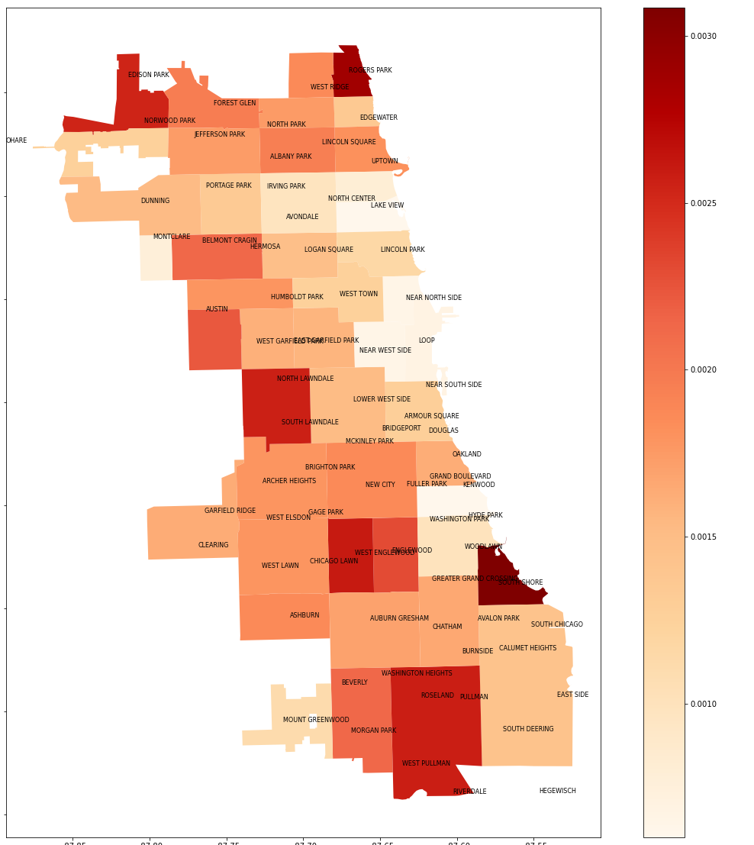
Proportion of Closed Restaurants
COVID-19 Case Rates
COVID-19 Death Rates
Notes:
Density of closures:
Closure rates: as high as 16%!!
Highest values:
12% case rate per zip code
0.3% death rate per zip code
From Chicago’s data portal the overall rates from March 2020 - March 2021 are:
1 in 11 case rate (9%)
1 in 548 death rate (0.18%)
https://www.chicago.gov/city/en/sites/covid-19/home/covid-dashboard.html

Slide 16
Discussion
Strengths
Yelp’s additional features - capture more closed businesses
COVID-19 and businesses information
Geospatial interpretation
Limitations
Yelp’s representativeness
Comparing Chicago Food Inspection and scraped data
Class imbalance
Causality
Confounding factors

Slide 17
Conclusion
Meaningful impact of closed businesses during COVID-19, disproportionate by zip code
Surprising finding - COVID-19 itself was not a driving factor in business closures
Suggests future research directions
Accomplished our initial goals
Web scraping
Merging disparate sources
Compelling visualizations

