Slide 1
Explaining Sankey Diagram Implementation
Yichuan. Zhang
2251668

Slide 2
Outline
1. Introduction
2. Code explanation
3. Algorithm
4. File handling
5. Error handling
6. Display features
7. OOP design

Slide 3
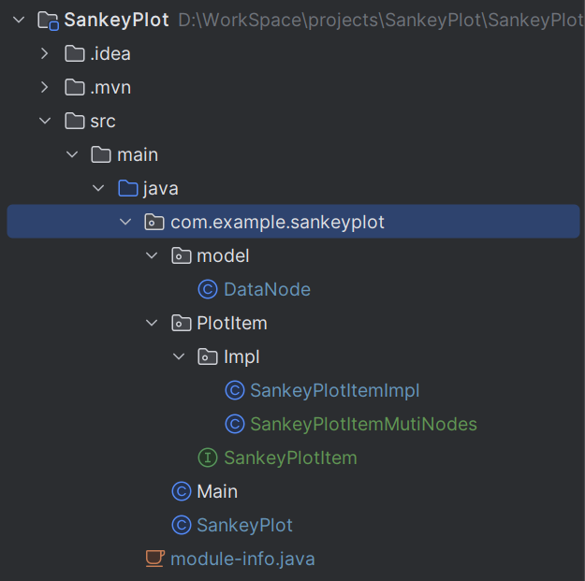
Code explanation
Hierarchy of the program

Slide 4
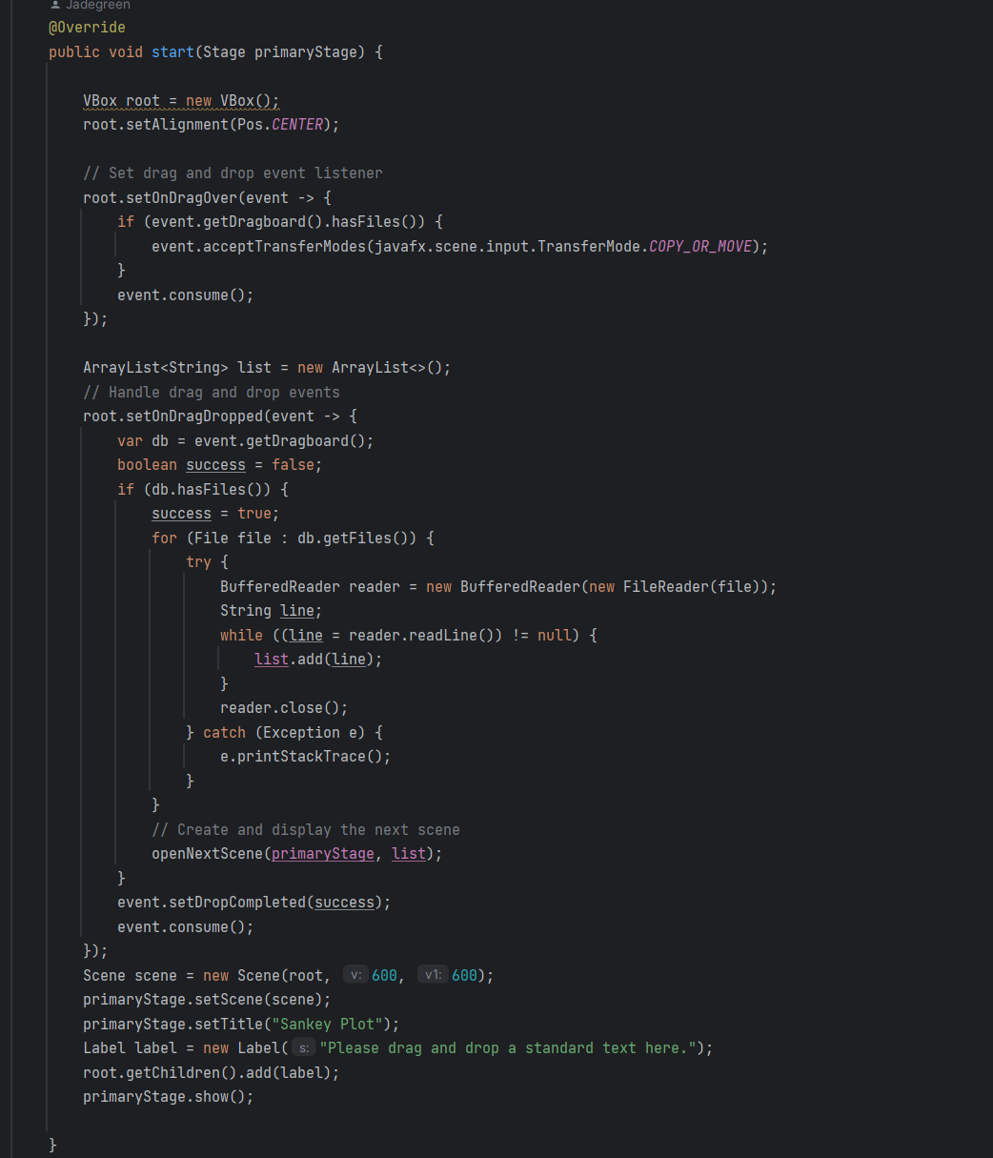
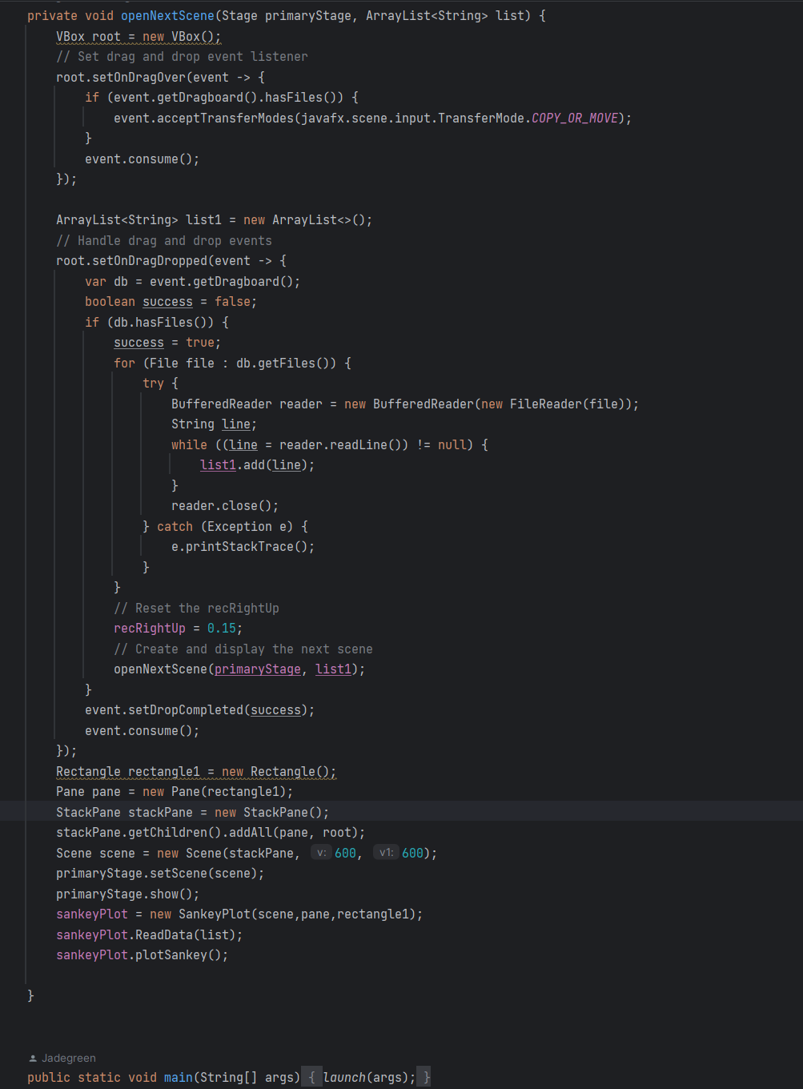
Code explanation
The Main class in the program

Slide 5
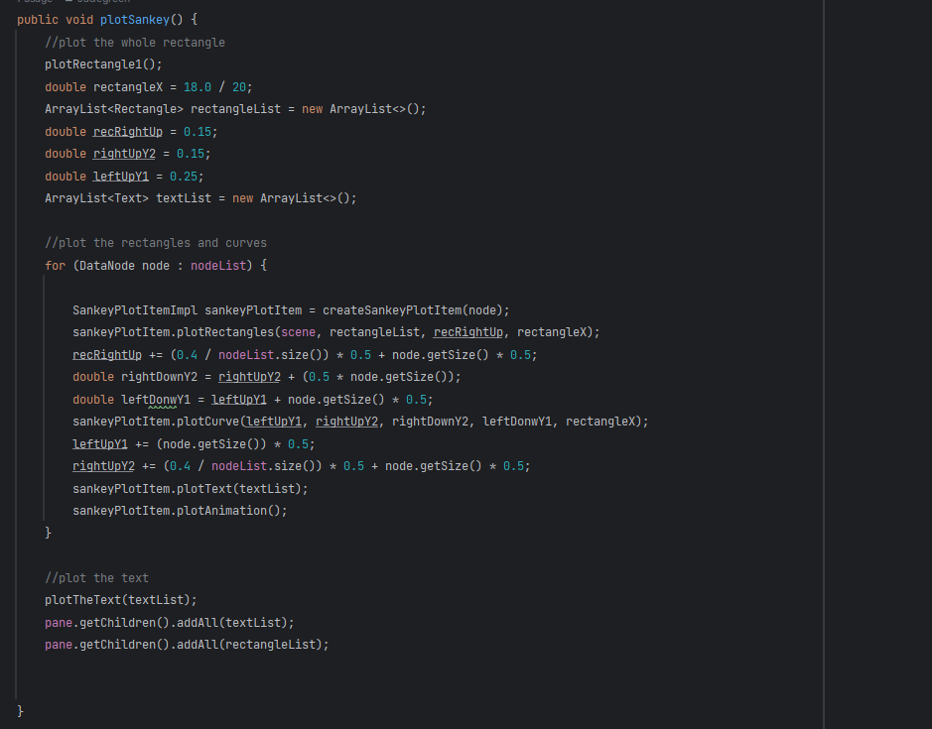
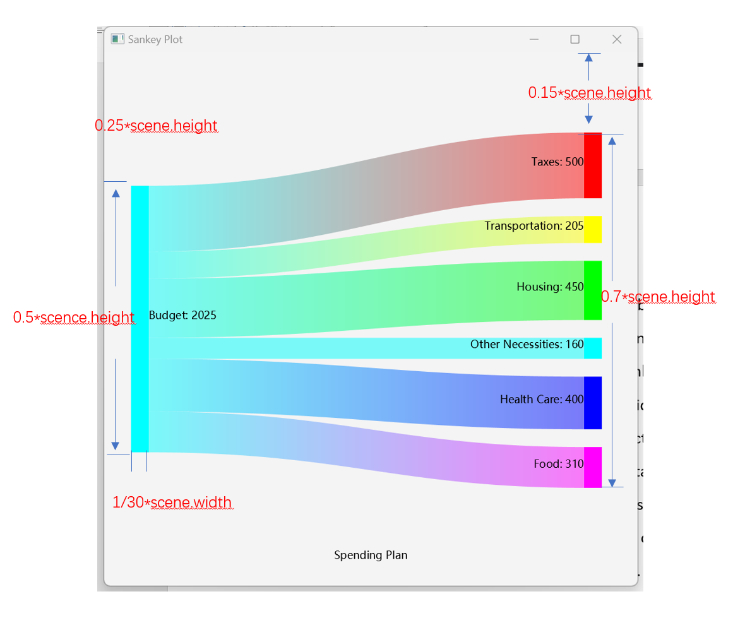
Algorithm
The plotSankey method in SankeyPlot class

Slide 6
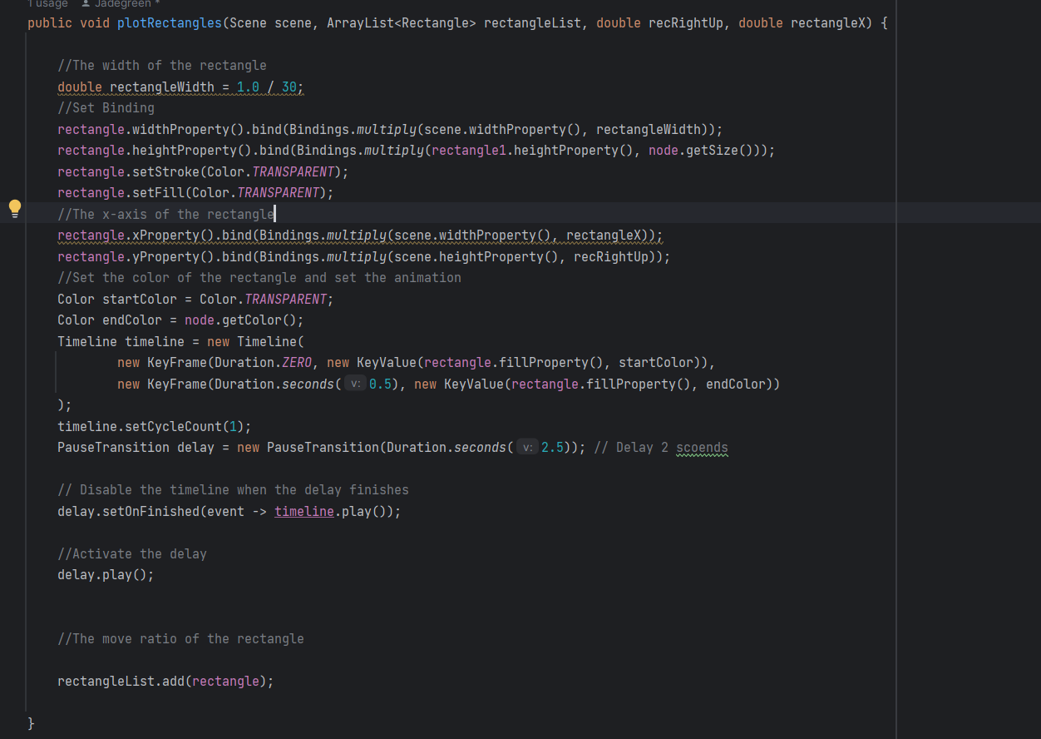
Algorithm
The Graphics drawing logic.
Rectangles

Slide 7
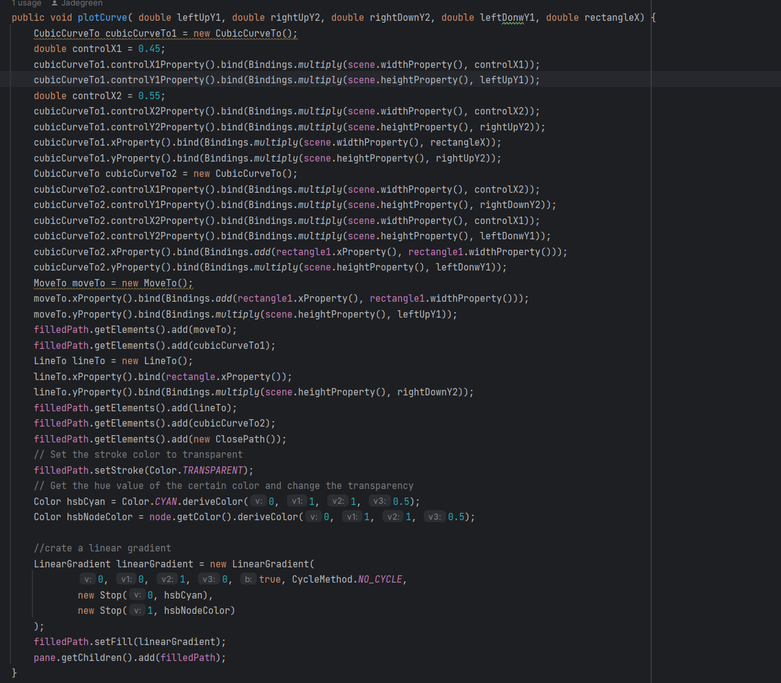
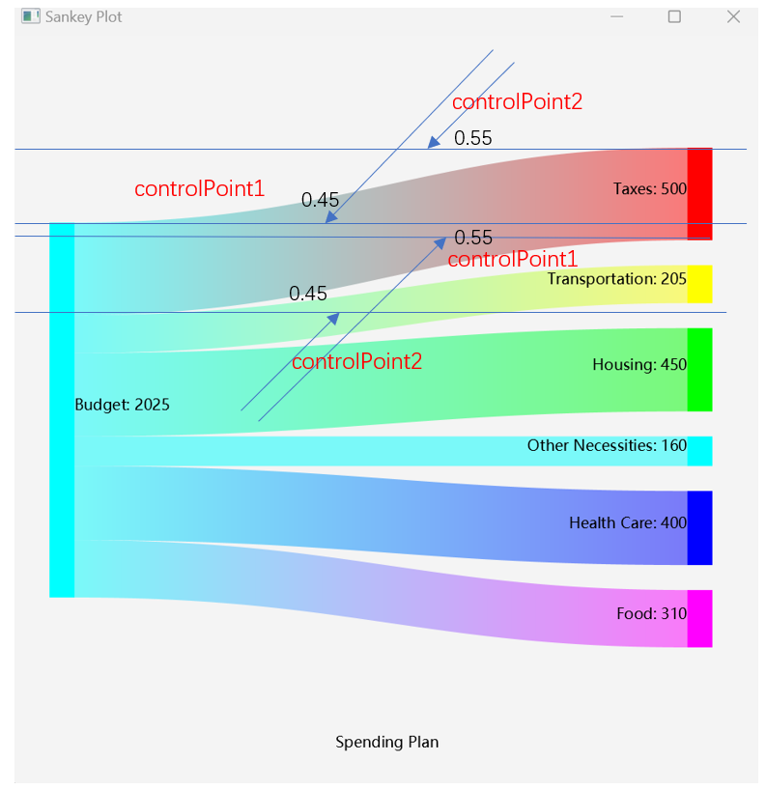
Algorithm
The Graphics drawing logic.
Curves

Slide 8
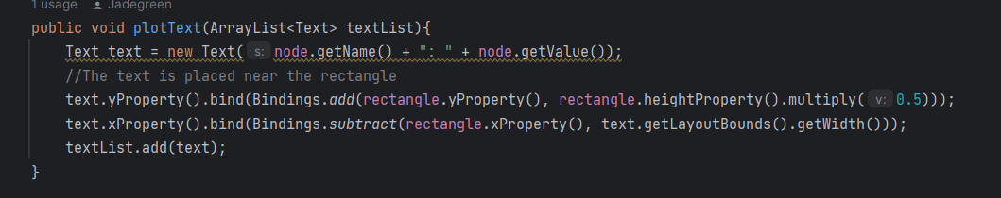
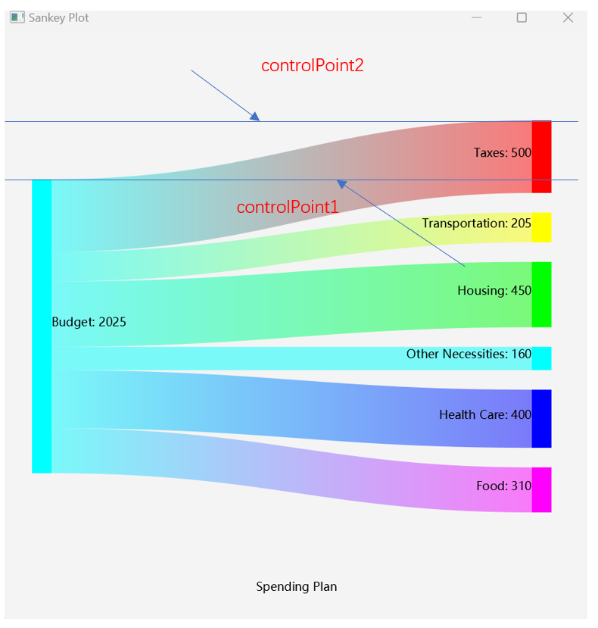
Algorithm
The Graphics drawing logic.
Text

Slide 9
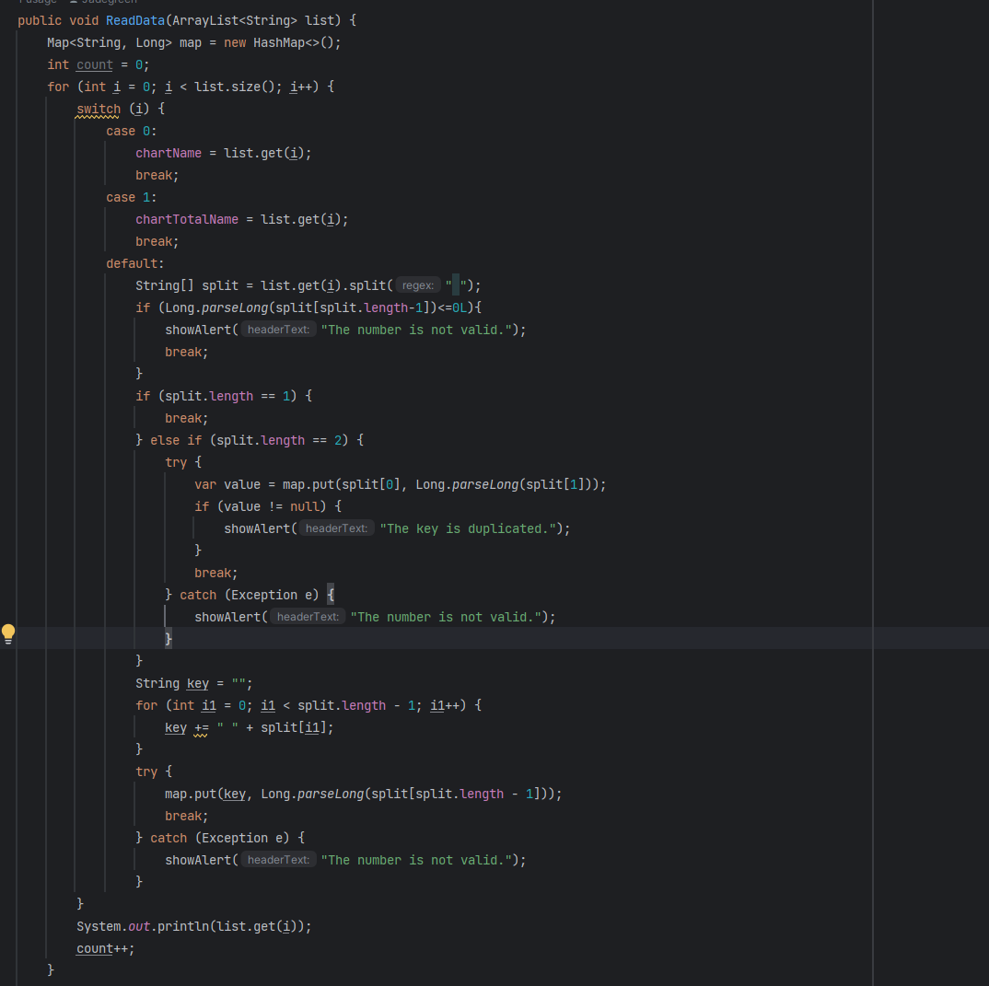
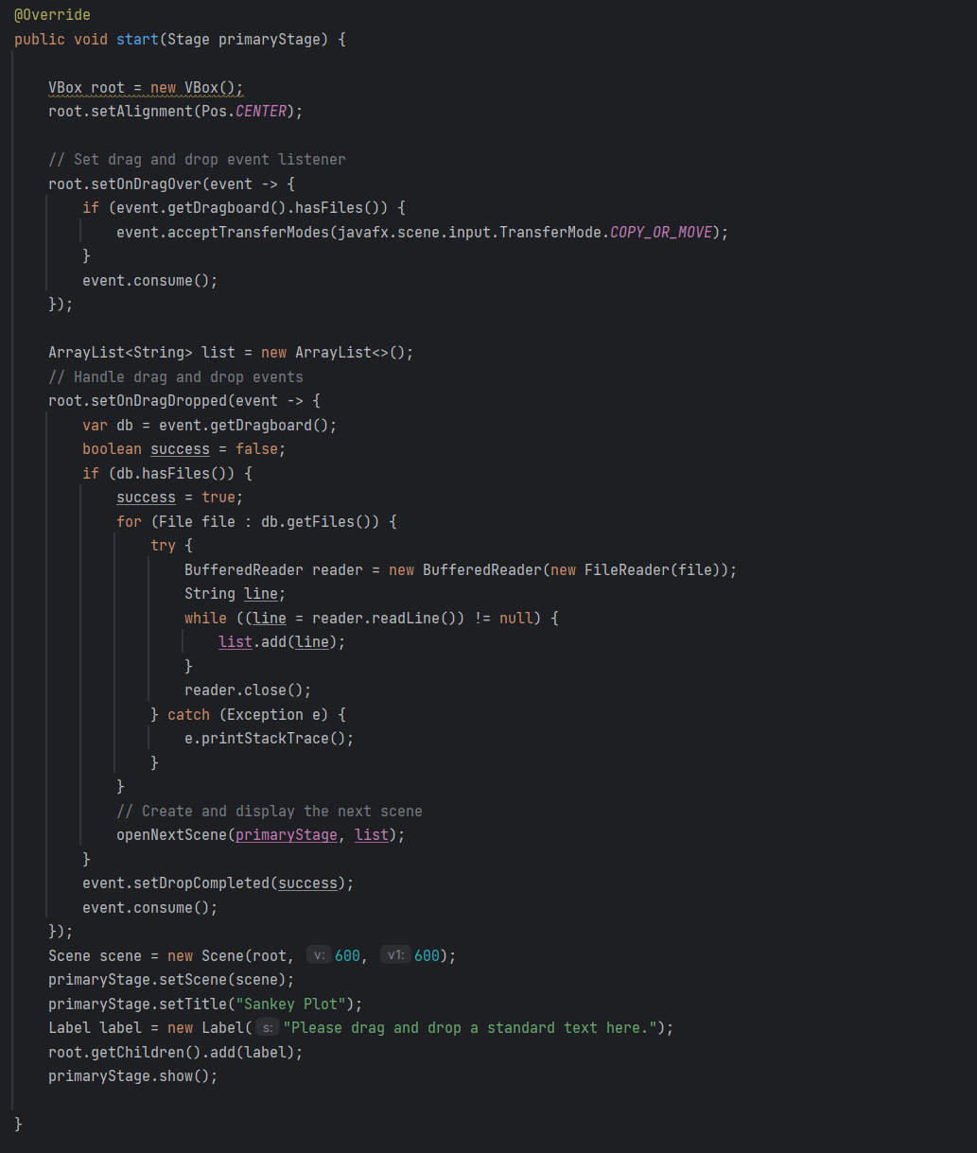
File handling

Slide 10
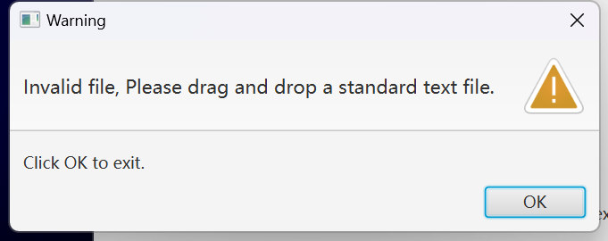
Error handling
The program pop up a alert window and stop the program

Slide 11
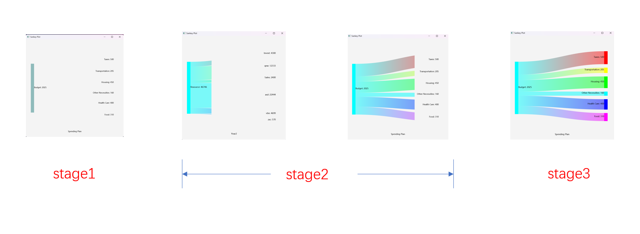
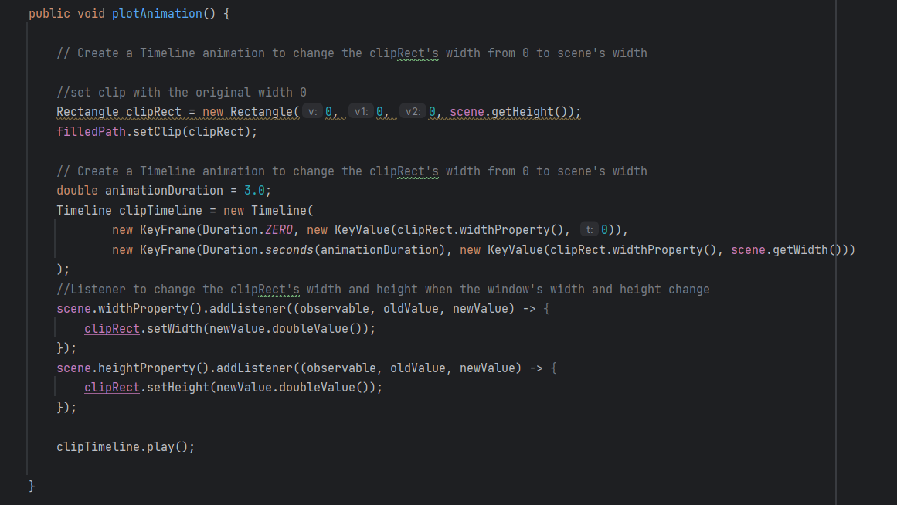
Display feature
Animation

Slide 12
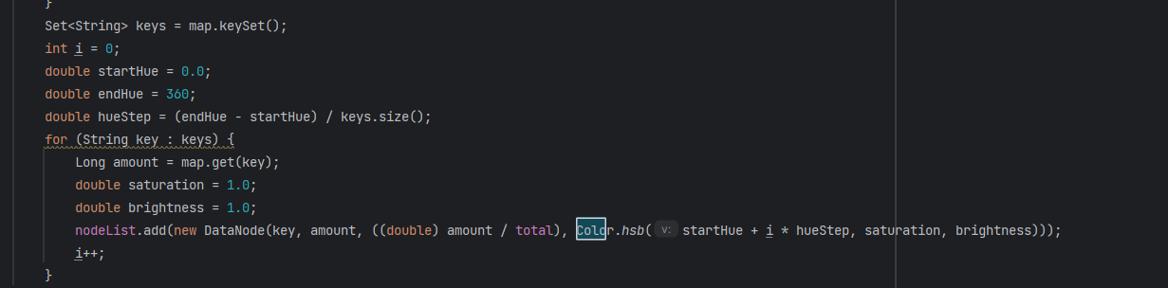
Display feature
Color

Slide 13
OOP Design
Application
Void PlotItem(listMap)
Void
Read(List)
Void
PlotSankey()
.
.
.
SankeyPlot
Main
String name
Long value
Double size
Color color
SankeyPlotItem
DataNode
SankeyPlotItemImpl
………

Slide 14
THANK YOU
14

