Slide 1

汇报类型：组会
Software and Hardware Co-Optimization of GNN
汇报人： | 刘洁琼
单位： | 华南理工大学
联系方式： | jqiongLiu@163.com

Slide 2
1
Background
2
Related Works
目 录
3
Problem Definition
4

Slide 3
1
Background

Slide 4

Background
High computational cost of GNN: 19G FLOPs on Reddit dataset^{[1]}
The success of CNN co-optimization
Motivation
To find both GNN architectures with highest accuracy and hardware design with guaranteed performance (accuracy & efficiency)
Target
Challenges
Large search space
Co-optimization strategy for DNN is not suitable for GNN
eg. FLOP efficiency of GNNs is 35% lower than VGG^{[2]}
[1] Zhang Y , You H , Fu Y , et al. G-CoS: GNN-Accelerator Co-Search Towards Both Better Accuracy and Efficiency[J]. 2021.
[2] Zhihui Zhang, Jingwen Leng, Shuwen Lu, Youshan Miao, Yijia Diao, Minyi Guo, Chao Li, Yuhao Zhu: ZIPPER: Exploiting Tile- and Operator-level Parallelism for General and Scalable Graph Neural Network Acceleration. CoRR abs/2107.08709 (2021)

Slide 5
Related Work Reference
GNN inference accelerators
BoostGCN^{[1]}: designed for certain GNN structure, and based on FPGA
G-NAS (GNN Network Architecture Search)
GraphNAS^{[2]}: based on Reinforcement Learning (only latency considered)
EvlovingGCN^{[3]}: based on Evolutionary Algorithm (only latency considered)
Hardware aware G-NAS
FBNet^{[4]}: high hardware cost
Deepburning-g^{[5]}: GNN network architecture not considered
Hardware-Software Co-Optimization
G-CoS[6]: only considered accuracy as metrics
[1] B. Zhang, R. Kannan and V. Prasanna, "BoostGCN: A Framework for Optimizing GCN Inference on FPGA," 2021 IEEE 29th Annual International Symposium on FCCM, 2021
[2] Y. Gao et al., “Graphnas: Graph neural architecture search with reinforcement learning,” arXiv preprint arXiv:1904.09981, 2019
[3] G. Kyriakides and K. Margaritis, “Evolving graph convolutional networks for neural architecture search,” Neural Computing and Applications, 2021
[4] Bichen Wu et al. 2019. Fbnet: Hardware-aware efficient convnet design via differentiable neural architecture search. In Proceedings of the IEEE/CVF Conference on Computer Vision and Pattern Recognition.
[5] S. Liang et al., “Deepburning-gl: an automated framework for generating graph neural network accelerators,” in ICCAD, 2020.
[6] Y. Zhang, H. You, Y. Fu, T. Geng, A. Li and Y. Lin, "G-CoS: GNN-Accelerator Co-Search Towards Both Better Accuracy and Efficiency," 2021 IEEE/ACM ICCAD, 2021

Slide 6
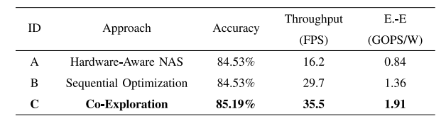

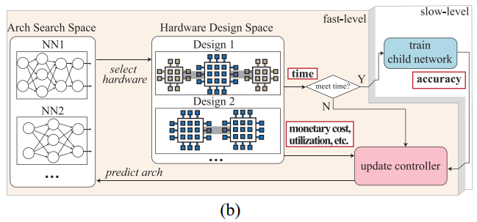
Related Work
GNN inference accelerators
Focus on specific GNN design instead of the design space
G-NAS (GNN Network Architecture Search)
Inefficient search process: 20000 networks-P100 GPUs require 4 days^{[1]}
Time performance & Hardware efficiency not considered
Hardware aware G-NAS
Assume fixed hardware design
Explore architecture search space only
[1] W. Jiang et al., "Hardware/Software Co-Exploration of Neural Architectures," in IEEE Transactions on Computer-Aided Design of Integrated Circuits and Systems, vol. 39, no. 12, pp. 4805-4815, Dec. 2020, doi: 10.1109/TCAD.2020.2986127.

Slide 7
2
Problem Definition

Slide 8
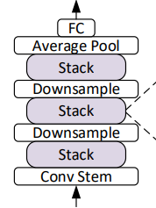

Software Design Space
GNN Network Design Space: $Gnet=\left\{op_{i}, C, Lr, O\right\}, i∈[1,L]$
Intra-layer Design:
Suppose L Layers in GNN，each L have m choices: $i^{th} {layer}^{′}s L_{i}^{m}∈\{B,D,ACT,AGG\}$
Inter-layer Design
2 kind of connection between adjacent layers
Connection Type: C $∈$ {Stack(0), Skip connections(1)}
Configuration Parameters
Learning Rate: LR $∈$ {0.1, 0.01, 0.001};
Optimizer: O $∈$ {Adam, SGD}
Attributes | Type | Value
Batch Norm | Bool | 0/1
Dropout | enum | {0, 0.3, 0.6}
Activation | enum | {ReLU,LReLU}
Aggregation | enum | {Mean, Max, Sum}
Fig. A stack connection

Slide 9
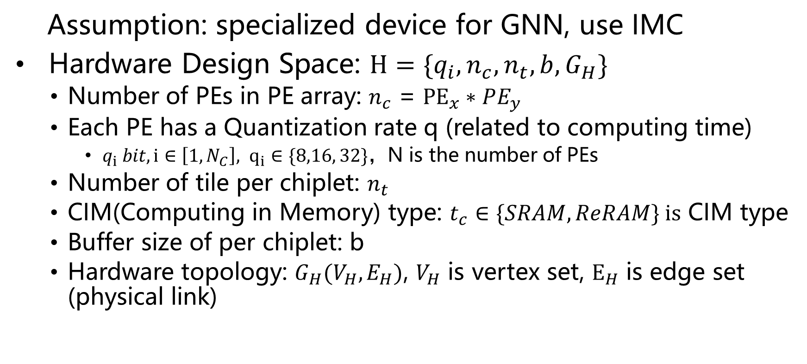
Hardware Design Space
Assumption: specialized device for GNN, use IMC
Hardware Design Space: $H=\{q_{i}, n_{c}, n_{t}, b,G_{H}\}$
Number of PEs in PE array: $n_{c}$ = ${PE}_{x}∗PE_{y}$
Each PE has a Quantization rate q (related to computing time)
$q_{i} bit, {i∈\left[1,N_{C}\right], q}_{i}∈\{8,16, 32\}，$N is the number of PEs
Number of tile per chiplet: $n_{t}$
CIM(Computing in Memory) type: $t_{c}∈\{SRAM, ReRAM\} is$ CIM type
Buffer size of per chiplet: b
Hardware topology: $G_{H}(V_{H},E_{H})$, $V_{H}$ is vertex set, $E_{H}$ is edge set (physical link)

Slide 10
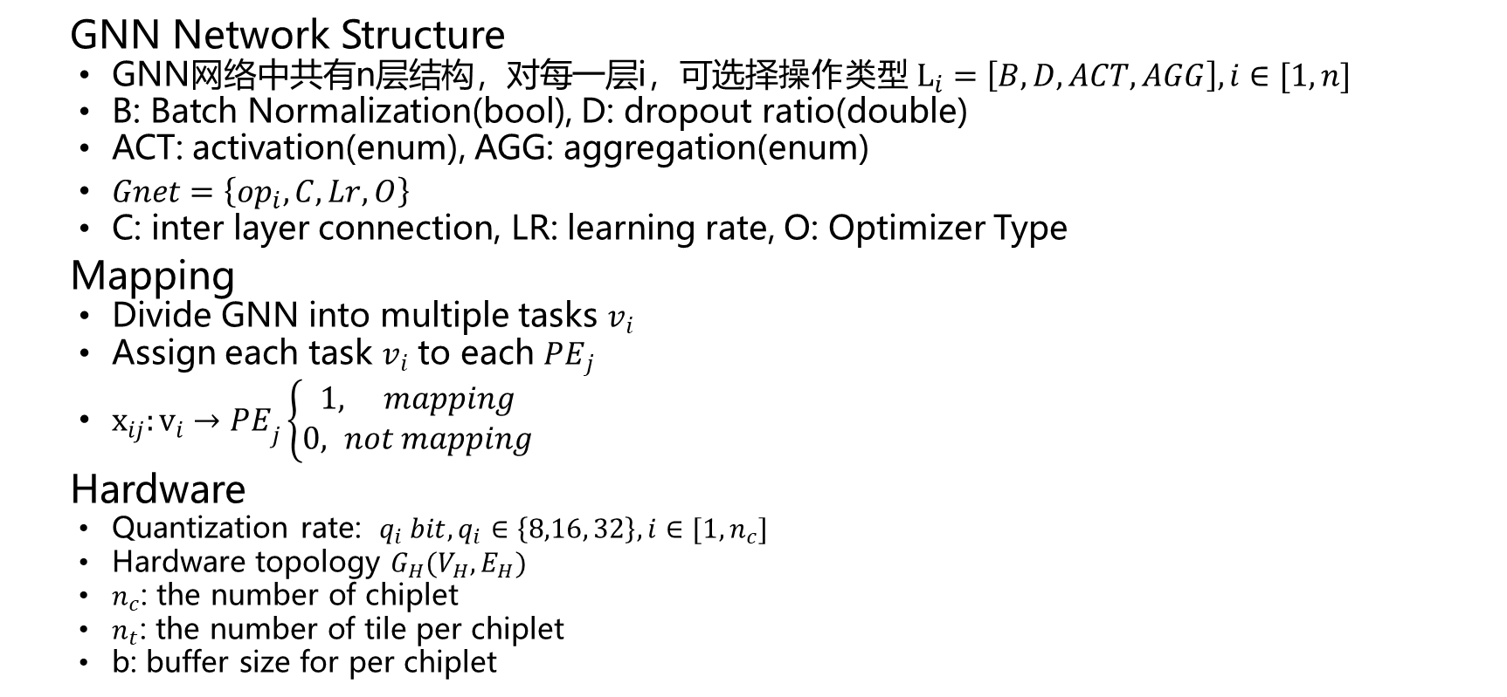
Decision Variables
GNN Network Structure
GNN网络中共有n层结构，对每一层i，可选择$操作类型 L_{i}=\left[B, D, ACT,AGG\right], i∈[1,n]$
B: Batch Normalization(bool), D: dropout ratio(double)
ACT: activation(enum), AGG: aggregation(enum)
$Gnet=\left\{op_{i}, C, Lr, O\right\}$
C: inter layer connection, LR: learning rate, O: Optimizer Type
Mapping
Divide GNN into multiple tasks $v_{i}$
Assign each task $v_{i}$ to each ${PE}_{j}$
$x_{ij}:{v_{i}→PE}_{j}\left\{\begin{aligned}1, mapping \\ 0, not mapping\end{aligned}\right.$
Hardware
Quantization rate: ${q_{i} bit, q_{i}∈\left\{8,16, 32\right\}, i∈[1,n_{c}]}_{}$
Hardware topology $G_{H}(V_{H},E_{H})$
$n_{c}$: the number of chiplet
$n_{t}$: the number of tile per chiplet
b: buffer size for per chiplet
Network
Structure
I1
I2
I3
Task
Division
I
I
I
PE Set
PE
PE
PE
PE
PE
PE
PE
PE
Fig. task division and assignment

Slide 11
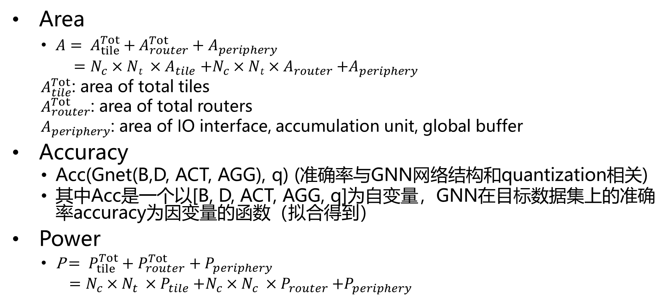
Constraints
Area
$A= A_{tile}^{Tot}+A_{router}^{Tot}+A_{periphery}$
$=N_{c}×Nt ×A_{tile}$ ${+N}_{c}×Nt×A_{router}$ $+A_{periphery}$
$A_{tile}^{Tot}$: area of total tiles
$A_{router}^{Tot}$: area of total routers
$A_{periphery}$: area of IO interface, accumulation unit, global buffer
Accuracy
Acc(Gnet(B,D, ACT, AGG), q) (准确率与GNN网络结构和quantization相关)
其中Acc是一个以[B, D, ACT, AGG, q]为自变量，GNN在目标数据集上的准确率accuracy为因变量的函数（拟合得到）
Power
P$= P_{tile}^{Tot}+P_{router}^{Tot}+P_{periphery}$
$=N_{c}×N_{t} ×P_{tile}$ ${+N}_{c}×N_{c} ×P_{router}$ $+P_{periphery}$

Slide 12
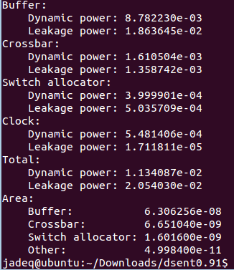
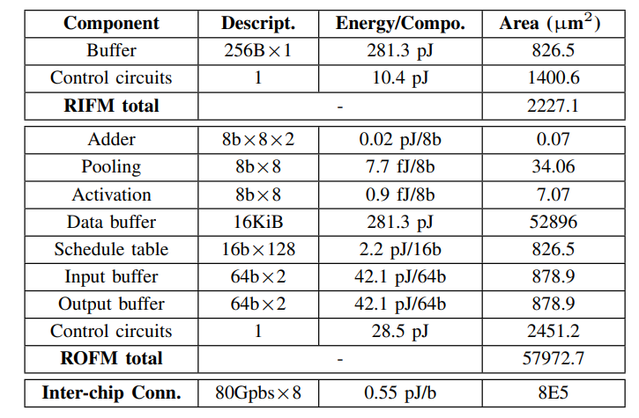
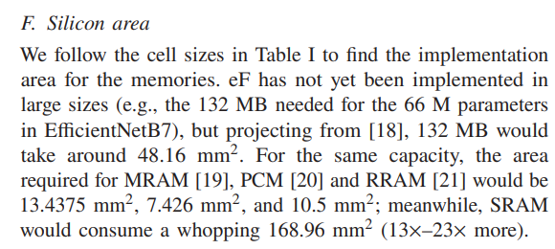
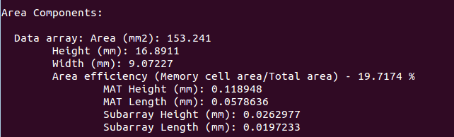

Data for Constant Values
Area
$A_{tile}^{Tot}$
$A_{router}^{Tot}$
$A_{periphery}^{Tot}$
Power
$P_{tile}^{Tot}$
$P_{router}^{Tot}$
$P_{periphery}^{Tot}$
Fig. information from dsent for routers
Fig. configuration information for IMC
Fig. information from cacti for SRAM

Slide 13
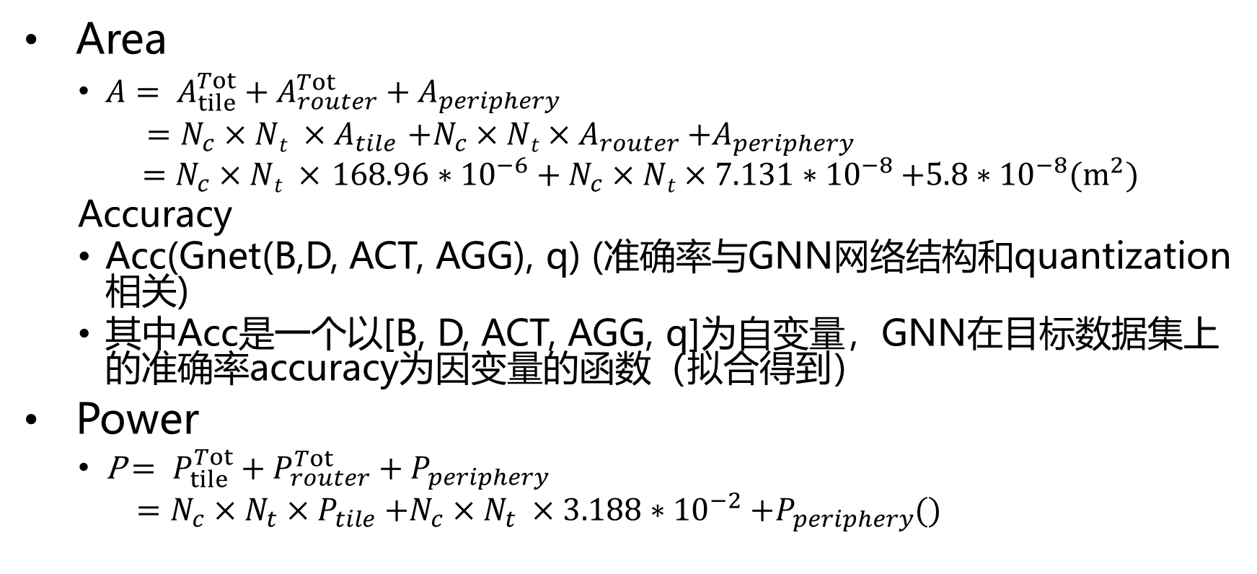
Constraints
Area
$A= A_{tile}^{Tot}+A_{router}^{Tot}+A_{periphery}$
$=N_{c}×Nt ×A_{tile}$ ${+N}_{c}×Nt×A_{router}$ $+A_{periphery}$
$=N_{c}×Nt ×$ ${168.96∗{10}^{−6}+N}_{c}×Nt×7.131∗{10}^{−8}$ $+5.8∗{10}^{−8}(m^{2})$
Accuracy
Acc(Gnet(B,D, ACT, AGG), q) (准确率与GNN网络结构和quantization相关)
其中Acc是一个以[B, D, ACT, AGG, q]为自变量，GNN在目标数据集上的准确率accuracy为因变量的函数（拟合得到）
Power
P$= P_{tile}^{Tot}+P_{router}^{Tot}+P_{periphery}$
$=N_{c}×N_{t}×P_{tile}$ ${+N}_{c}×N_{t} ×3.188∗{10}^{−2}$ $+P_{periphery}$()

Slide 14
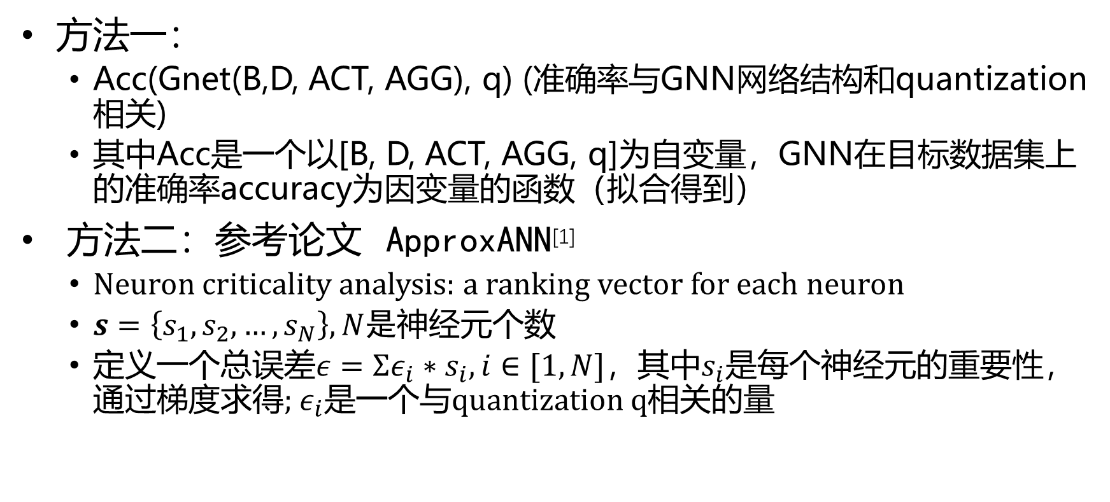
Constraints-Accuracy
方法一：
Acc(Gnet(B,D, ACT, AGG), q) (准确率与GNN网络结构和quantization相关)
其中Acc是一个以[B, D, ACT, AGG, q]为自变量，GNN在目标数据集上的准确率accuracy为因变量的函数（拟合得到）
方法二：参考论文 ApproxANN^{[1]}
Neuron criticality analysis: a ranking vector for each neuron
$s=\left\{s_{1}, s_{2},…, s_{N}\right\}, N是$神经元个数
定义一个总误差$ε=Σε_{i}∗s_{i}, i∈[1,N]$，其中$s_{i}是$每个神经元的重要性，通过梯度求得; $ε_{i}是$一个与quantization q相关的量
[1]ApproxANN: An Approximate Computing Framework for Artificial Neural Network

Slide 15
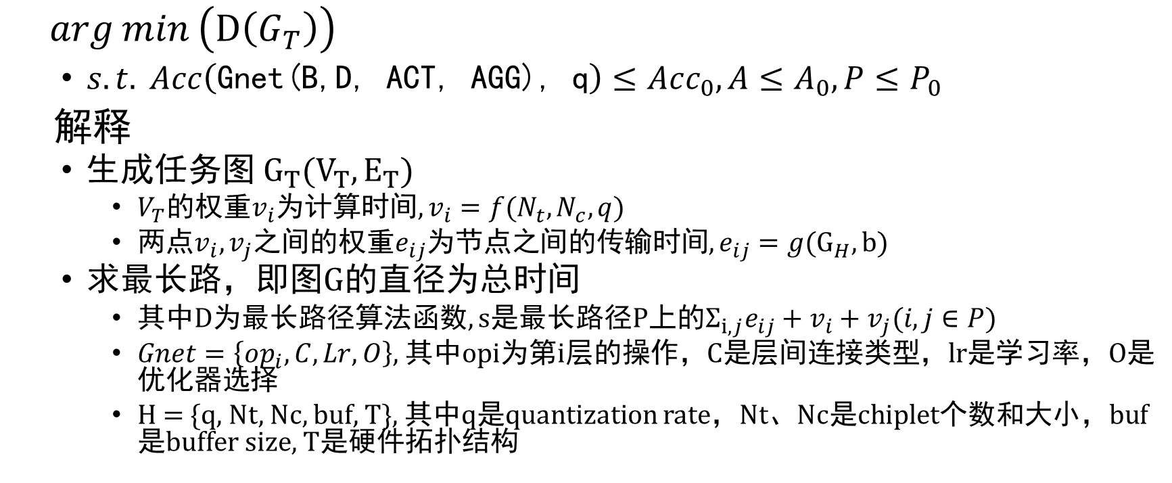
Objective Function
$\arg{min}\left(D\left(G_{T}\right)\right)$
$s.t.{Acc\left(\text{Gnet}\text{(}\text{B}\text{,}\text{D}\text{, }\text{ACT}\text{, }\text{AGG}\text{), }\text{q}\right)≤Acc_{0}, A≤A_{0},P≤P_{0}}$
解释
生成任务图 $G_{T}(V_{T}, E_{T})$
$V_{T}$的权重$v_{i}$为计算时间, $v_{i}=f(N_{t}, N_{c},q)$
两点$v_{i}, v_{j}$之间的权重$e_{ij}$为节点之间的传输时间, $e_{ij}={g(G_{H},b)}_{}$
求最长路，即图G的直径为总时间
其中D为最长路径算法函数, s是最长路径P上的$Σ_{i,j}e_{ij}+v_{i}+v_{j}(i,j∈P)$
$Gnet=\left\{op_{i}, C, Lr, O\right\},$其中opi为第i层的操作，C是层间连接类型，lr是学习率，O是优化器选择
H = {q, Nt, Nc, buf, T}, 其中q是quantization rate，Nt、Nc是chiplet个数和大小，buf是buffer size, T是硬件拓扑结构

Slide 16

Objective Function
$\arg{min}\left(D\left(G_{T}\right)\right)$

Slide 18
谢谢！
敬请批评指正！

