Slide 1

汇报类型：组会
Software and Hardware Co-Optimization of GNN
汇报人： | 刘洁琼
单位： | 华南理工大学
联系方式： | jqiongLiu@163.com

Slide 2
1
Background
2
Related Work
目 录
3
Problem Definition
4

Slide 3
1
Background

Slide 4

Background
High computational cost of GNN: 19G FLOPs on Reddit dataset^{[1]}
The success of CNN co-optimization
Motivation
To find both GNN architectures with highest accuracy and hardware design with guaranteed performance (accuracy & efficiency)
Target
Challenges
Large search space
Co-optimization strategy for DNN is not suitable for GNN
eg. FLOP efficiency of GNNs is 35% lower than VGG^{[2]}
[1] Zhang Y , You H , Fu Y , et al. G-CoS: GNN-Accelerator Co-Search Towards Both Better Accuracy and Efficiency[J]. 2021.
[2] Zhihui Zhang, Jingwen Leng, Shuwen Lu, Youshan Miao, Yijia Diao, Minyi Guo, Chao Li, Yuhao Zhu: ZIPPER: Exploiting Tile- and Operator-level Parallelism for General and Scalable Graph Neural Network Acceleration. CoRR abs/2107.08709 (2021)

Slide 5
2
Related Work

Slide 6
Related Work Reference
GNN inference accelerators
BoostGCN^{[1]}: designed for certain GNN structure, and based on FPGA
G-NAS (GNN Network Architecture Search)
GraphNAS^{[2]}: based on Reinforcement Learning (only latency considered)
EvlovingGCN^{[3]}: based on Evolutionary Algorithm (only latency considered)
Hardware aware G-NAS
FBNet^{[4]}: high hardware cost
Deepburning-g^{[5]}: GNN network architecture not considered
Hardware-Software Co-Optimization
G-CoS[6]: only considered accuracy as metrics
[1] B. Zhang, R. Kannan and V. Prasanna, "BoostGCN: A Framework for Optimizing GCN Inference on FPGA," 2021 IEEE 29th Annual International Symposium on FCCM, 2021
[2] Y. Gao et al., “Graphnas: Graph neural architecture search with reinforcement learning,” arXiv preprint arXiv:1904.09981, 2019
[3] G. Kyriakides and K. Margaritis, “Evolving graph convolutional networks for neural architecture search,” Neural Computing and Applications, 2021
[4] Bichen Wu et al. 2019. Fbnet: Hardware-aware efficient convnet design via differentiable neural architecture search. In Proceedings of the IEEE/CVF Conference on Computer Vision and Pattern Recognition.
[5] S. Liang et al., “Deepburning-gl: an automated framework for generating graph neural network accelerators,” in ICCAD, 2020.
[6] Y. Zhang, H. You, Y. Fu, T. Geng, A. Li and Y. Lin, "G-CoS: GNN-Accelerator Co-Search Towards Both Better Accuracy and Efficiency," 2021 IEEE/ACM ICCAD, 2021

Slide 7
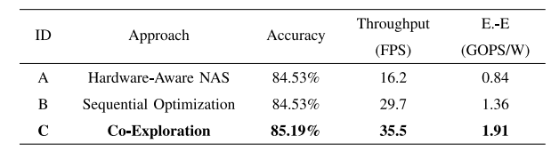

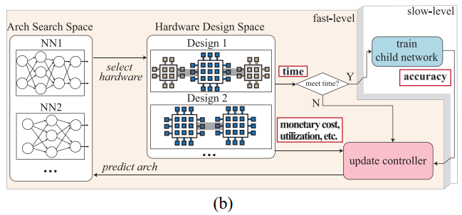
Related Work
GNN inference accelerators
Focus on specific GNN design instead of the design space
G-NAS (GNN Network Architecture Search)
Inefficient search process: 20000 networks-P100 GPUs require 4 days^{[1]}
Time performance & Hardware efficiency not considered
Hardware aware G-NAS
Assume fixed hardware design
Explore architecture search space only
[1] W. Jiang et al., "Hardware/Software Co-Exploration of Neural Architectures," in IEEE Transactions on Computer-Aided Design of Integrated Circuits and Systems, vol. 39, no. 12, pp. 4805-4815, Dec. 2020, doi: 10.1109/TCAD.2020.2986127.

Slide 8
3
Problem Definition

Slide 9
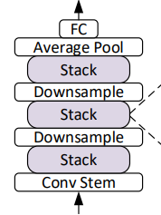

Software Design Space
GNN Network Design Space: $Gnet=\left\{op_{i}, C, Lr, O\right\}, i∈[1,L]$
Intra-layer Design:
Suppose L Layers in GNN，each L have m choices: $i^{th} {layer}^{′}s L_{i}^{m}∈\{B,D,ACT,AGG\}$
Inter-layer Design
2 kind of connection between adjacent layers
Connection Type: C $∈$ {Stack(0), Skip connections(1)}
Configuration Parameters
Learning Rate: LR $∈$ {0.1, 0.01, 0.001};
Optimizer: O $∈$ {Adam, SGD}
Attributes | Type | Value
Batch Norm | Bool | 0/1
Dropout | enum | {0, 0.3, 0.6}
Activation | enum | {ReLU,LReLU}
Aggregation | enum | {Mean, Max, Sum}
Fig. A stack connection

Slide 10
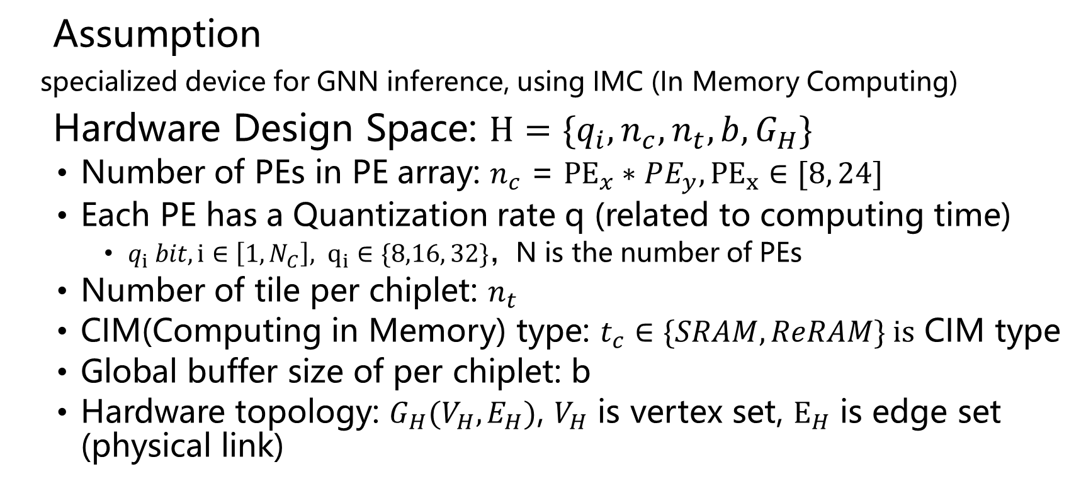
Hardware Design Space
Assumption
specialized device for GNN inference, using IMC (In Memory Computing)
Hardware Design Space: $H=\{q_{i}, n_{c}, n_{t}, b,G_{H}\}$
Number of PEs in PE array: $n_{c}$ = ${PE}_{x}∗PE_{y}, {PE}_{x}∈[8, 24]$
Each PE has a Quantization rate q (related to computing time)
$q_{i} bit, {i∈\left[1,N_{C}\right], q}_{i}∈\{8,16, 32\}，$N is the number of PEs
Number of tile per chiplet: $n_{t}$
CIM(Computing in Memory) type: $t_{c}∈\{SRAM, ReRAM\} is$ CIM type
Global buffer size of per chiplet: b
Hardware topology: $G_{H}(V_{H},E_{H})$, $V_{H}$ is vertex set, $E_{H}$ is edge set (physical link)

Slide 11
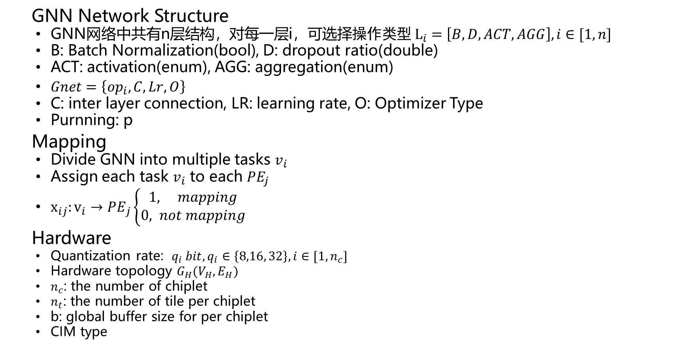
Decision Variables
GNN Network Structure
GNN网络中共有n层结构，对每一层i，可选择$操作类型 L_{i}=\left[B, D, ACT,AGG\right], i∈[1,n]$
B: Batch Normalization(bool), D: dropout ratio(double)
ACT: activation(enum), AGG: aggregation(enum)
$Gnet=\left\{op_{i}, C, Lr, O\right\}$
C: inter layer connection, LR: learning rate, O: Optimizer Type
Purnning: p
Mapping
Divide GNN into multiple tasks $v_{i}$
Assign each task $v_{i}$ to each ${PE}_{j}$
$x_{ij}:{v_{i}→PE}_{j}\left\{\begin{aligned}1, mapping \\ 0, not mapping\end{aligned}\right.$
Hardware
Quantization rate: ${q_{i} bit, q_{i}∈\left\{8,16, 32\right\}, i∈[1,n_{c}]}_{}$
Hardware topology $G_{H}(V_{H},E_{H})$
$n_{c}$: the number of chiplet
$n_{t}$: the number of tile per chiplet
b: global buffer size for per chiplet
CIM type
Network
Structure
I1
I2
I3
Task
Division
I
I
I
PE Set
PE
PE
PE
PE
PE
PE
PE
PE
Fig. task division and assignment

Slide 12
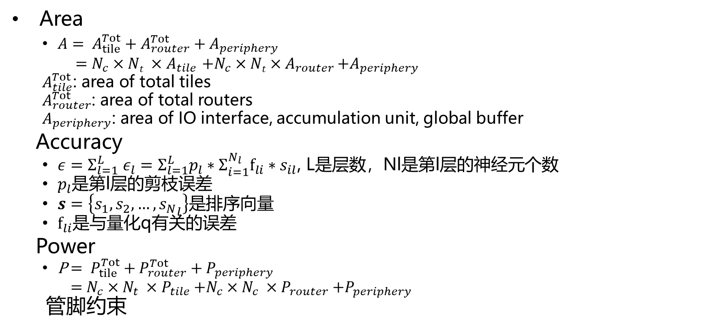
Constraints
Area
$A= A_{tile}^{Tot}+A_{router}^{Tot}+A_{periphery}$
$=N_{c}×Nt ×A_{tile}$ ${+N}_{c}×Nt×A_{router}$ $+A_{periphery}$
$A_{tile}^{Tot}$: area of total tiles
$A_{router}^{Tot}$: area of total routers
$A_{periphery}$: area of IO interface, accumulation unit, global buffer
Accuracy
$ε=Σ_{l=1}^{L} ε_{l}=Σ_{l=1}^{L}p_{l}∗Σ_{i=1}^{N_{l}}f_{li}∗s_{il}$, L是层数，Nl是第l层的神经元个数
$p_{l}$是第l层的剪枝误差
$s=\left\{s_{1}, s_{2},…, {s_{N}}_{l}\right\}$是排序向量
$f_{li}$是与量化q有关的误差
Power
P$= P_{tile}^{Tot}+P_{router}^{Tot}+P_{periphery}$
$=N_{c}×N_{t} ×P_{tile}$ ${+N}_{c}×N_{c} ×P_{router}$ $+P_{periphery}$
管脚约束

Slide 13
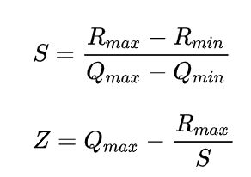
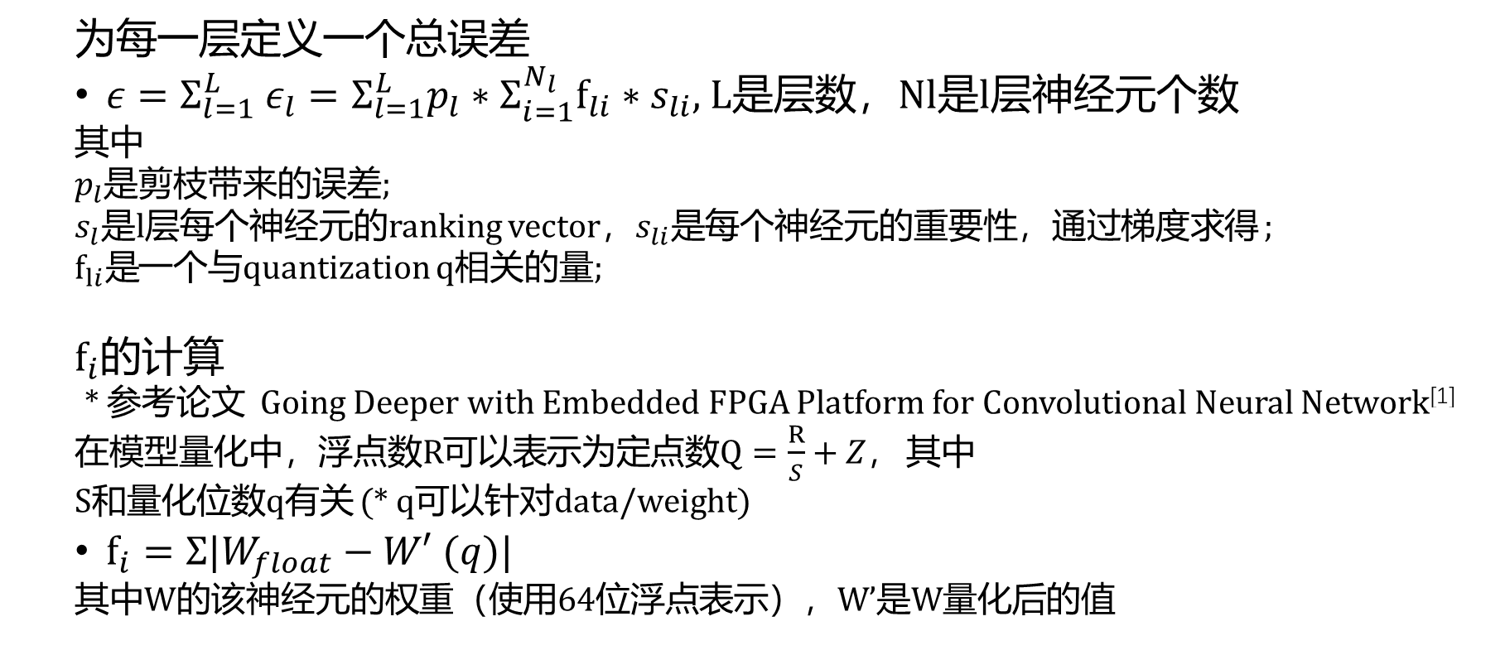
Constraints-Accuracy
为每一层定义一个总误差
$ε=Σ_{l=1}^{L} ε_{l}=Σ_{l=1}^{L}p_{l}∗Σ_{i=1}^{N_{l}}f_{li}∗s_{li}$, L是层数，Nl是l层神经元个数
其中
$p_{l}$是剪枝带来的误差;
$s_{l}$是l层每个神经元的ranking vector，$s_{li}是$每个神经元的重要性，通过梯度求得 ;
$f_{li}是$一个与quantization q相关的量;
$$f_{i}的计算$$
* 参考论文 Going Deeper with Embedded FPGA Platform for Convolutional Neural Network^{[1]}
在模型量化中，浮点数R可以表示为定点数$Q=\frac{R}{S}+Z，$ 其中
S和量化位数q有关 (* q可以针对data/weight)
$f_{i}=Σ|W_{float}−W′ (q)|$
其中W的该神经元的权重（使用64位浮点表示），W’是W量化后的值
[1] Jiantao Qiu, Jie Wang, Song Yao, Kaiyuan Guo, Boxun Li, Erjin Zhou, Jincheng Yu, Tianqi Tang, Ningyi Xu, Sen Song, Yu Wang, and Huazhong Yang. 2016. Going Deeper with Embedded FPGA Platform for Convolutional Neural Network. Association for Computing Machinery, New York, NY, USA, 26–35.

Slide 14
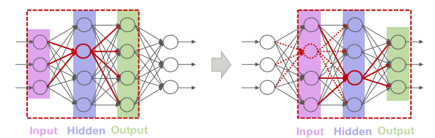
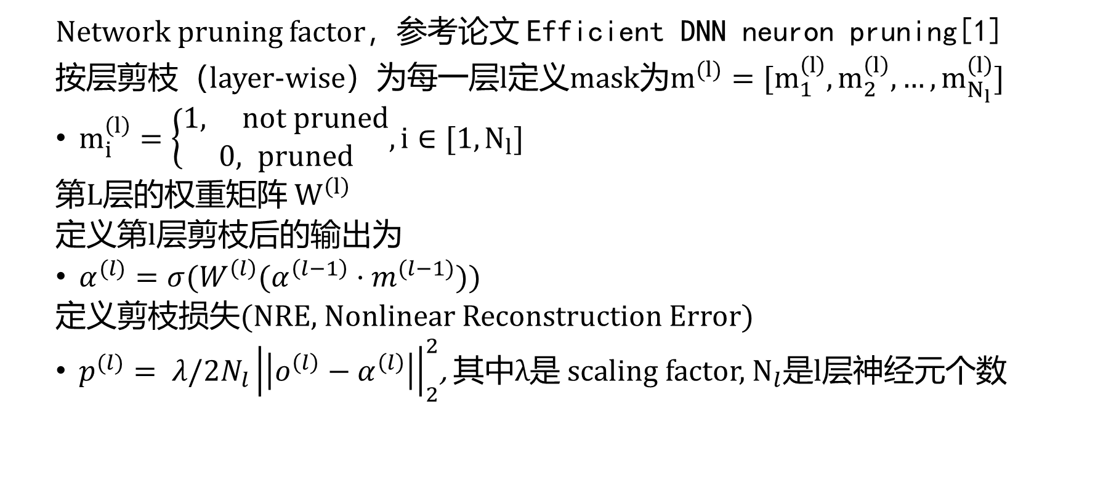
Constraints-Accuracy
Network pruning factor，参考论文 Efficient DNN neuron pruning[1]
按层剪枝（layer-wise）为每一层l定义mask为$m^{(l)}=[m_{1}^{\left(l\right)},m_{2}^{\left(l\right)},…,m_{N_{l}}^{\left(l\right)}]$
$m_{i}^{\left(l\right)}=\left\{\begin{aligned}1, not pruned \\ 0, pruned\end{aligned},i∈[1,N_{l}]\right.$
第L层的权重矩阵${ W}^{\left(l\right)}$
定义第l层剪枝后的输出为
$α^{(l)}=σ(W^{\left(l\right)}(α^{\left(l−1\right)}·m^{(l−1)}))$
定义剪枝损失(NRE, Nonlinear Reconstruction Error)
$p^{(l)}= λ/2N_{l}{\left|\left|o^{\left(l\right)}−α^{\left(l\right)}\right|\right|}_{2}^{2}$, 其中$λ$是 scaling factor, $N_{l}$是l层神经元个数
Fig. layer-wise network pruning
[1] Chunhui Jiang, Guiying Li, Chao Qian, and Ke Tang. 2018. Efficient DNN neuron pruning by minimizing layer-wise nonlinear reconstruction error. In Proceedings of the 27th International Joint Conference on Artificial Intelligence (IJCAI'18). AAAI Press, 2298–2304.

Slide 15
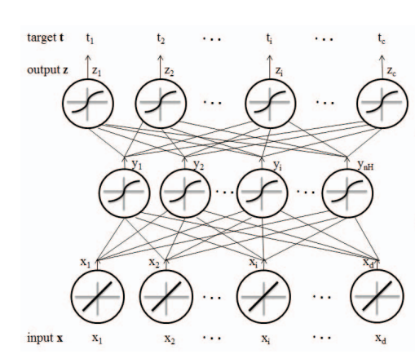
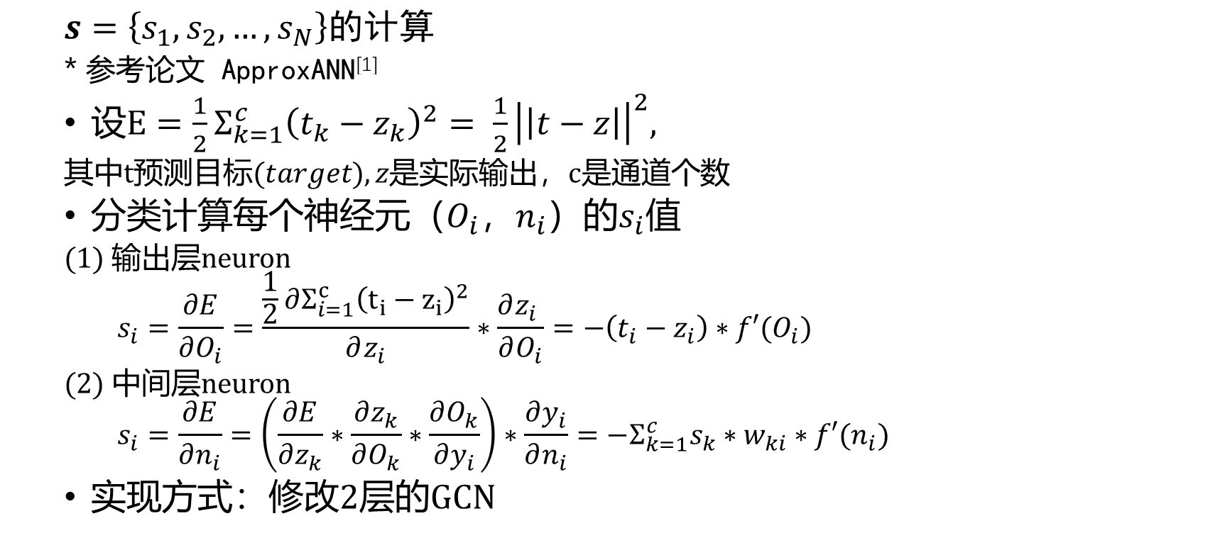
Constraints-Accuracy
$$s=\left\{s_{1}, s_{2},…, s_{N}\right\}的计算$$
* 参考论文 ApproxANN^{[1]}
$设E=\frac{1}{2}Σ_{k=1}^{c}{\left(t_{k}−z_{k}\right)}^{2}= \frac{1}{2}{\left|\left|t−z\right|\right|}^{2},$
其中t预测目标(𝑡𝑎𝑟𝑔𝑒𝑡), 𝑧是实际输出，c是通道个数
分类计算每个神经元（$O_{i}$，$n_{i}$）的$s_{i}值$
(1) 输出层neuron
$$s_{i}=\frac{∂E}{∂O_{i}}=\frac{\frac{1}{2}∂Σ_{i=1}^{c}{\left(t_{i}−z_{i}\right)}^{2}}{∂z_{i}}∗\frac{∂z_{i} }{∂O_{i}}=−\left(t_{i}−z_{i}\right)∗f′(O_{i})$$
(2) 中间层neuron
$$s_{i}=\frac{∂E}{∂n_{i}}=\left(\frac{∂E}{∂z_{k}}∗\frac{∂z_{k}}{∂O_{k}}∗\frac{∂O_{k}}{∂y_{i}}\right)∗\frac{∂y_{i}}{∂n_{i}}={−Σ}_{k=1}^{c}s_{k}∗w_{ki}∗f′(n_{i})$$
实现方式：修改2层的GCN
Fig. 神经元传播关系示意图
[1] Q. Zhang, T. Wang, Y. Tian, F. Yuan and Q. Xu, "ApproxANN: An approximate computing framework for artificial neural network," 2015 Design, Automation & Test in Europe Conference & Exhibition (DATE), 2015, pp. 701-706.

Slide 16
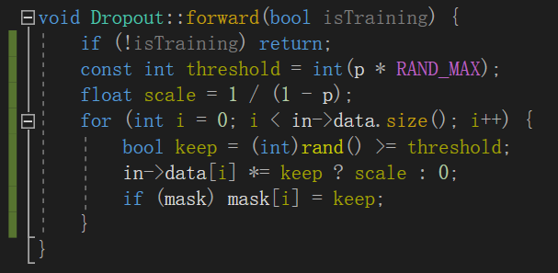
本周工作
内容
找论文中的片间数据（Network Interface：打包/解包时间，传输时间）
整理决策变量和约束，给出可计算的优化目标
看GCN代码，求精度损失
问题
网络剪枝使用阈值控制mask？剪枝和dropout
还缺少的数据？
论文翻译
Fig. dropout 的实现

Slide 17
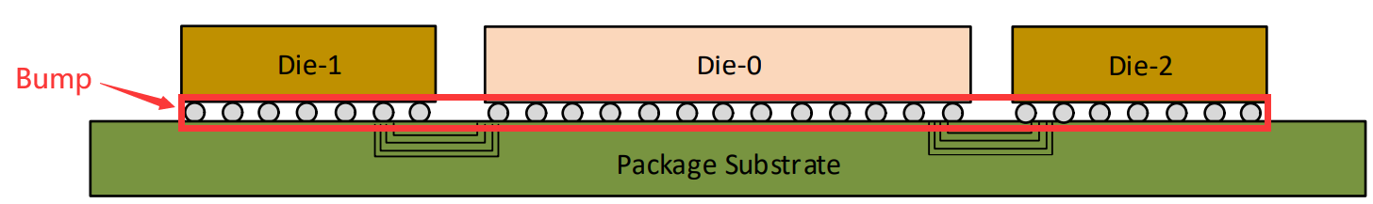
Constraints-管脚约束
* Inter-chip data
2D封装
UCIe on 2D packaging
Bump Pitch | 100 um to 130 um
Channel reach (short reach) | 10 mm
Channel reach (long reach) | 25 mm
图 2D 封装

Slide 18
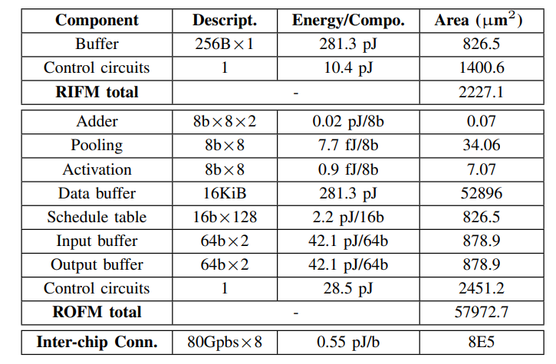
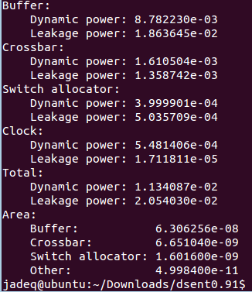
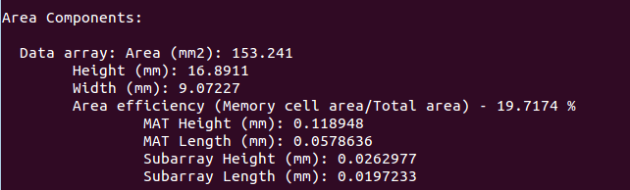
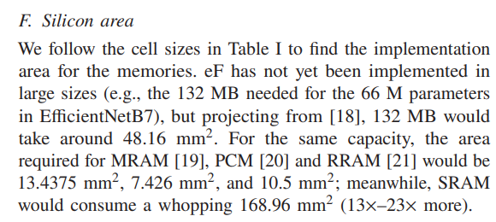

Data for Constant Values
*Intra-chip data
Area
$A_{tile}^{Tot}$
$A_{router}^{Tot}$
$A_{periphery}^{Tot}$
Power
$P_{tile}^{Tot}$
$P_{router}^{Tot}$
$P_{periphery}^{Tot}$
* MAC of different precision
8-bit MAC : 135.1um2, 0.024pJ/op
Fig. information from dsent for routers
Fig. configuration information for IMC^{[1]}
DRAM power: 9.75pJ/bit
Fig. information from cacti for SRAM
Fig. information for RRAM^{[2]}
[1] A Case for Emerging Memories in DNN Accelerators
[2]A Customized NoC Architecture to Enable Highly Localized Computing-On-the-Move DNN Dataflow

Slide 19
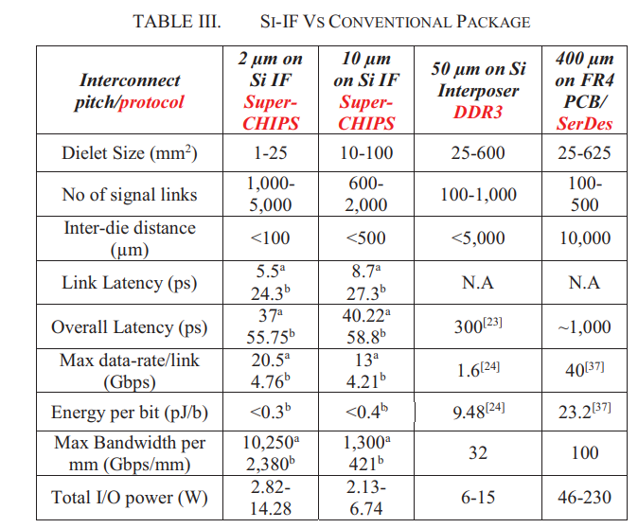
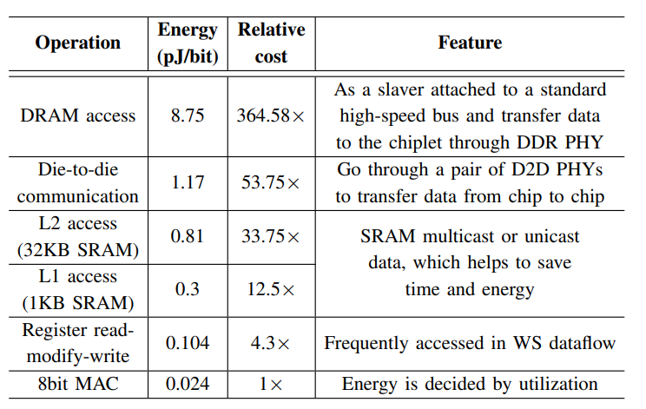
Data for Constant Values
* Inter-chip data
Energy:
L1/L2/DRAM access
Energy per bit: <0.4pJ/bit
Fig. information from NNBaton^{[1]}
Fig. information from SuperCHIPs^{[2]}
[1] NN-Baton: DNN Workload Orchestration and Chiplet Granularity Exploration for Multichip Accelerators
[2] S. Jangam, S. Pal, A. Bajwa, S. Pamarti, P. Gupta and S. S. Iyer, "Latency, Bandwidth and Power Benefits of the SuperCHIPS Integration Scheme," 2017 IEEE 67th Electronic Components and Technology Conference (ECTC), 2017

Slide 20
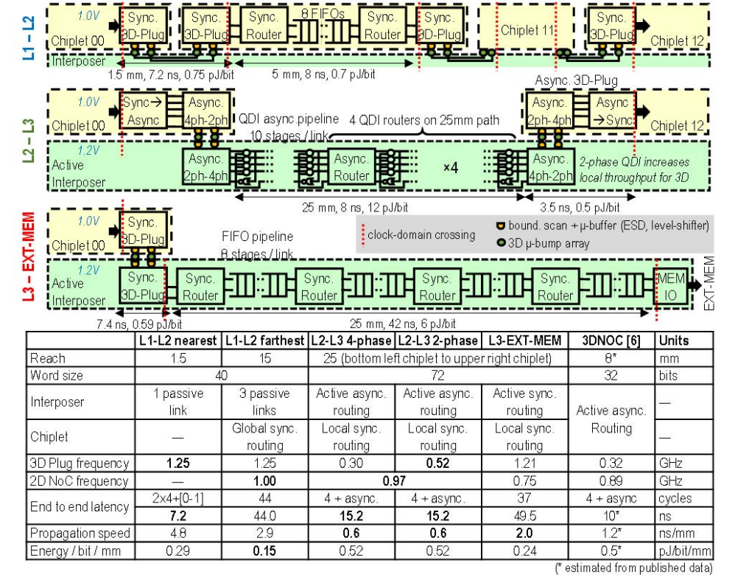

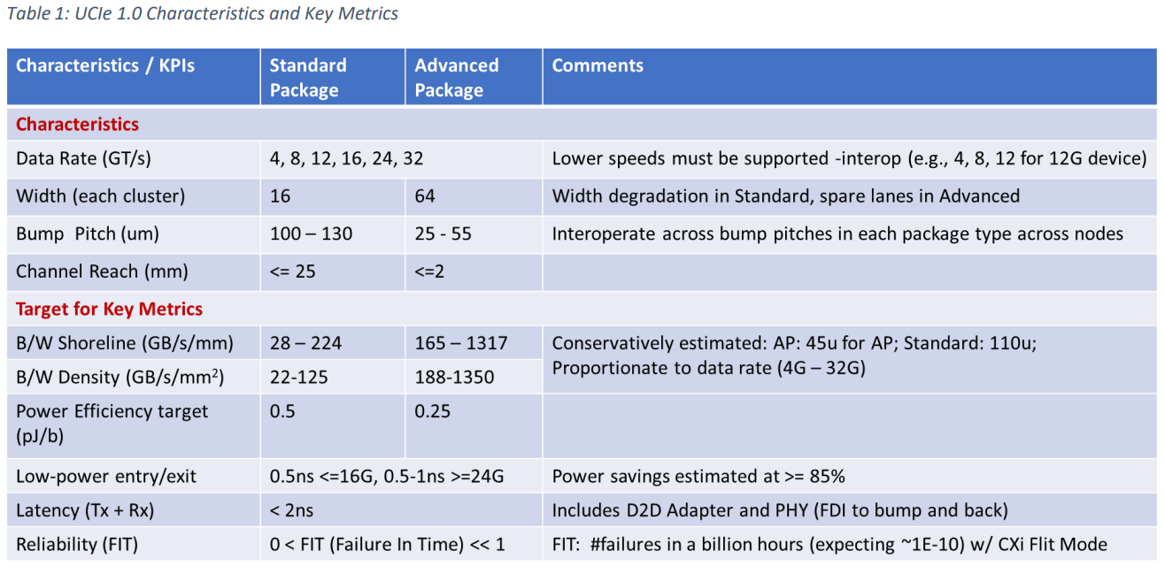
Data for Constant Values
* Inter-chip data
Delay(/cycle)
=打包/解包+传输+收发延迟
收发延迟 from UCIe：Tx+Rx < 2ns
传输：L1-L2 7.2ns(1.25GHz)
L2-L3 traffic 0.6ns/mm
Fig. information from ISSCC paper section 2.3
Fig. information from UCIe

Slide 21
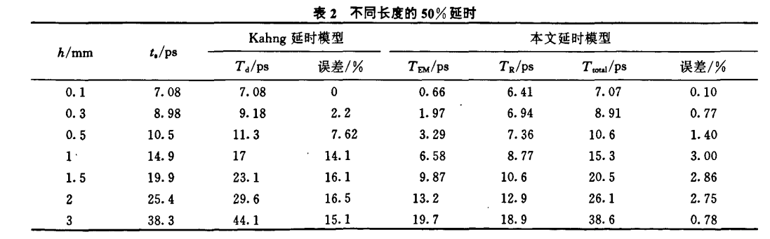

Data for Constant Values
* Inter-chip data
Delay(/cycle)
=打包/解包+传输+收发延迟
T（传输延迟）=$T_{EM}$（电磁波传输延迟）+$T_{R}$（上升沿延迟），
其中$T_{EM}$ = h/v，h是线长，v是电磁波在给定介质中的传播速度；
$T_{R}=kRC=krch^{2}$是一阶矩近似，k是常数，r和c分别是单位长度上的电阻和电容
Fig. 不同线长的延时 来自“改进的RLC互连线延时估算方法”

Slide 22
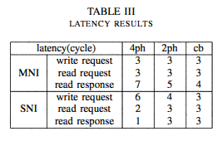
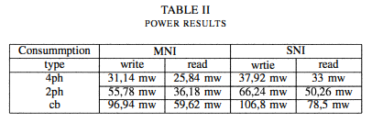
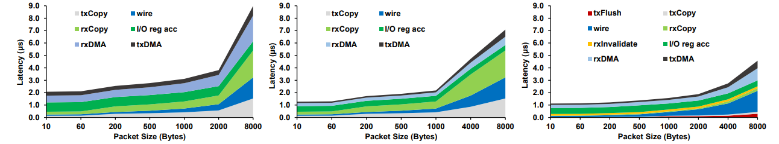
Data for Constant Values
* Inter-chip data
Delay(/cycle)
打包/解包
Latency of network interface
50ns
Fig. power & latency of 2 types of NI
Fig. One-way network latency breakdown for packets of various sizes when using a PCIe NIC (left), an integrated NIC (middle), and NetDIMM (left)
[1] Mohammad Alian and Nam Sung Kim. 2019. NetDIMM: Low-Latency Near-Memory Network Interface Architecture. In Proceedings of the 52nd Annual IEEE/ACM International Symposium on Microarchitecture (MICRO '52). Association for Computing Machinery, New York, NY, USA, 699–711.
[2] B. Attia, W. Chouchene, A. Zitouni, A. Nourdin and R. Tourki, "Design and implementation of low latency network interface for network on chip," 2010 5th International Design and Test Workshop, 2010, pp. 37-42, doi: 10.1109/IDT.2010.5724404.

Slide 23
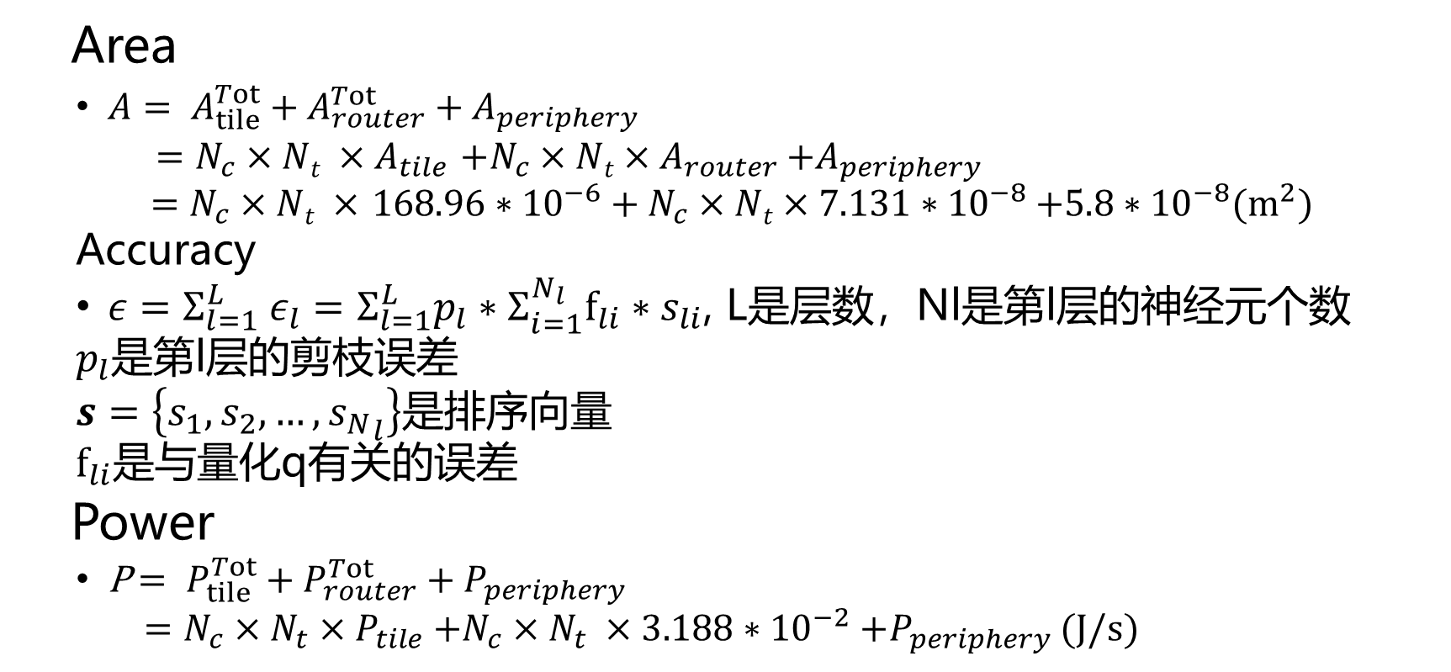
Constraints
Area
$A= A_{tile}^{Tot}+A_{router}^{Tot}+A_{periphery}$
$=N_{c}×Nt ×A_{tile}$ ${+N}_{c}×Nt×A_{router}$ $+A_{periphery}$
$=N_{c}×Nt ×$ ${168.96∗{10}^{−6}+N}_{c}×Nt×7.131∗{10}^{−8}$ $+5.8∗{10}^{−8}(m^{2})$
Accuracy
$ε=Σ_{l=1}^{L} ε_{l}=Σ_{l=1}^{L}p_{l}∗Σ_{i=1}^{N_{l}}f_{li}∗s_{li}$, L是层数，Nl是第l层的神经元个数
$p_{l}$是第l层的剪枝误差
$s=\left\{s_{1}, s_{2},…, {s_{N}}_{l}\right\}$是排序向量
$f_{li}$是与量化q有关的误差
Power
P$= P_{tile}^{Tot}+P_{router}^{Tot}+P_{periphery}$
$=N_{c}×N_{t}×P_{tile}$ ${+N}_{c}×N_{t} ×3.188∗{10}^{−2}$ $+P_{periphery}$ (J/s)

Slide 24
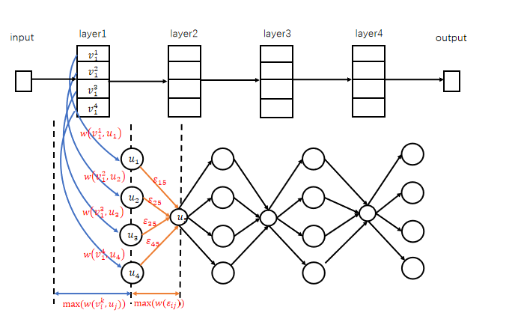
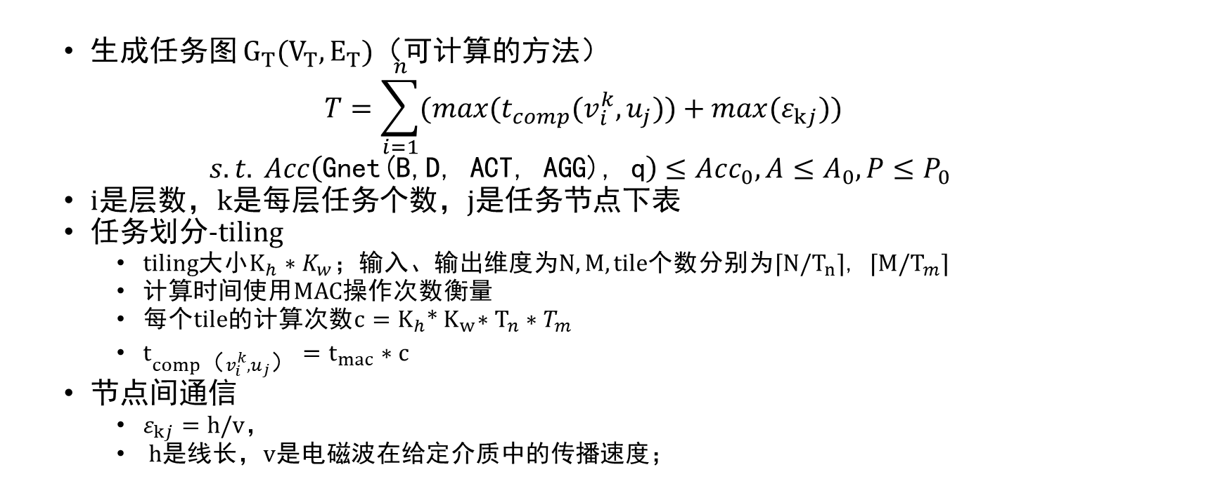
Objective Function
生成任务图 $G_{T}(V_{T}, E_{T})$（可计算的方法）
$$T=\sum_{i=1}^{n}{(max(t_{comp}(v_{i}^{k},u_{j}))+max(ε_{kj}))}$$
$$s.t.{Acc\left(\text{Gnet}\text{(}\text{B}\text{,}\text{D}\text{, }\text{ACT}\text{, }\text{AGG}\text{), }\text{q}\right)≤Acc_{0}, A≤A_{0},P≤P_{0}}$$
i是层数，k是每层任务个数，j是任务节点下表
任务划分-tiling
tiling大小$K_{h}∗K_{w}$；输入、输出维度为$N,M$, tile个数分别为⌈$N/T_{n}$⌉, ⌈$M/T_{m}$⌉
$计算时间$使用MAC操作次数衡量
每个tile的计算次数$c=K_{h}$*${ K}_{w}∗T_{n}∗T_{m}$
$t_{comp（v_{i}^{k},u_{j}）}=t_{mac}∗c$
节点间通信
$ε_{kj}=\text{h}\text{/}\text{v}$，
h是线长，v是电磁波在给定介质中的传播速度；
Fig.示意图

Slide 26
谢谢！
敬请批评指正！

