Slide 1

JoBreaker
Jade Zhang, Data Science Fellow, May 2017
Notes:
Use only useful information as slide titles!

Slide 2

Motivation
Database Administrator?
Data Scientist?
Business Analyst?
Data Engineer?
Product Manager?
Data Architect?
Notes:
The past few years have seen great increase in the demand and diversity for data-related roles in industry. This has provided great opportunities, but also challenges for everybody trying to get into this field. First on the job hunters’ side, either new grads or people switching their career paths, what kind of roles am I best suited for? On the company’s side, what job title should I use for this new data-focused role? And how does it compare with the existing data-related roles in the market? To answer these questions, my project will analyze job postings and try to find if there are common consensus on what each of these roles means, based on the choice of job title for each particular job description, and based on that build an app to map any given job description or personal profile to the job titles analyzed here, ranked by the probability of matching.
Be excited and elaborate about this product!

Slide 3
Product
JoBreaker
Notes:
Don’t use word cloud as open feature. Have a blurb of text explaining

Slide 4
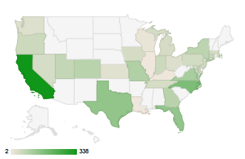
Data
Indeed.com API
Distribution of data across job titles
Distribution of data across states
Notes:
PM, Dadmin and Data scientist and ML, distinguishable and well clustered, while DE, BA more scattered around. Pipeline of my work is: BOW preprocessing, tfidf vectorizer to tranform the words into vectors, then train a RF classifier using the vectors as X variables and the job title as the Y variable.
----- Meeting Notes (6/16/17 14:02) -----
add in title for each graph. add this to backup slide.

Slide 5
Pipeline
pandas
sklearn
regex
nltk
Preprocessing
Clean stopwords, non-letters, URL, etc.
Getting features
TF-IDF
Classification
Accuracy: 0.76
Validation
Random Forest
5-fold cross validation
F1 score: 0.75
Notes:
----- Meeting Notes (6/16/17 14:02) -----
make things bigger
emphasize the baseline accuracy to be 1/7
use darker colors
Make animations, highlight each step
Highlight the result!

Slide 6
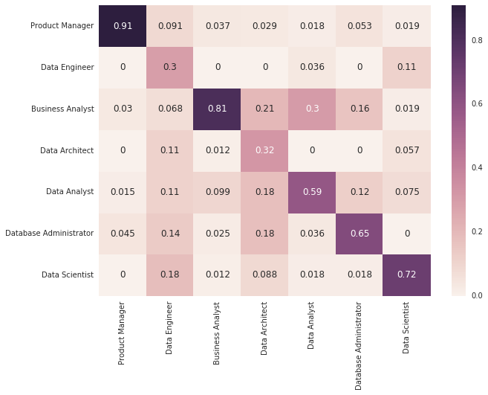
Additional Insights
True
Database Administrator
Data Scientist
Well-defined job titles:
Product Manager
Business Analyst
Data Scientist
Confused job titles:
Data Engineer
Data Architect
Data Analyst
Product Manager
Business Analyst
Data Analyst
Data Engineer
Data Architect
Prediction
Jgipaoweijgpaowejbioapwjeiojpaowiejtopiawjebioja
Notes:
----- Meeting Notes (6/16/17 14:02) -----
swap colors for good and bad job titles (don't use red)
word order doesn't really matter in this case (keyword dominating)
distances among bulletins!

Slide 7
Takehome message
Benefits to companies
insights

Slide 8
About me
Yu (Jade) Zhang
Ph.D in theoretical ecology

Slide 9
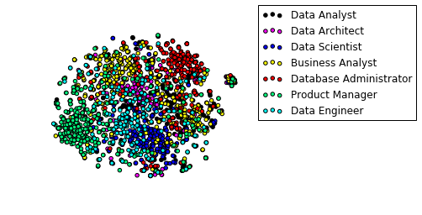

Slide 10
Physics
Computer Science
Model
Ph.D
Clinical
Minimum degree
Optimization
Algorithm
Analysis
Plan
Partner
Network
Design
Performance
Life cycle
Management
Development
Field Experience
Notes:
Dig into this! Maybe just get keywords for each job title
Insights.

