Slide 1
Insight Data Science Project Demo JoBreaker
Jade Zhang

Slide 2

Motivation
New grads/career changers:
What role am I best suited for?
Recruiters/hiring managers:
What job title should I use for this new data position?
How does it compare with the other data roles?
Database Administrator?
Data Scientist?
Business Analyst?
Data Engineer?
Product Manager?
Notes:
The past few years have seen great increase in the demand and diversity for data-related roles in industry. This has provided great opportunities, but also challenges for everybody trying to get into this field. First on the job hunters’ side, either new grads or people switching their career paths, what kind of roles am I best suited for? On the company’s side, what job title should I use for this new data-focused role? And how does it compare with the existing data-related roles in the market? To answer these questions, my project will analyze job postings and try to find if there are common consensus on what each of these roles means, based on the choice of job title for each particular job description, and based on that build an app to map any given job description or personal profile to the job titles analyzed here, ranked by the probability of matching.

Slide 3
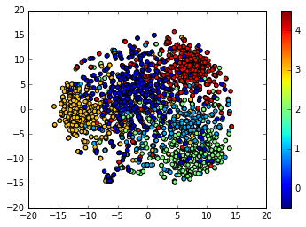
Data and Method
Indeed.com API
2800 job postings from 29 states, 284 cities (Best Performing Cities, 2016)
Pipeline
Bag of words
tf-idf vectorizer
Randomforest
0.76 accuracy in 5-fold CV, 0.75 F1 score
Product Manager
Database Administrator
Data Scientist
Data Engineer
Business Analyst
Notes:
PM, Dadmin and Data scientist and ML, distinguishable and well clustered, while DE, BA more scattered around. Pipeline of my work is: BOW preprocessing, tfidf vectorizer to tranform the words into vectors, then train a RF classifier using the vectors as X variables and the job title as the Y variable.

Slide 4
Product
Demo link:
JoBreaker

Slide 6
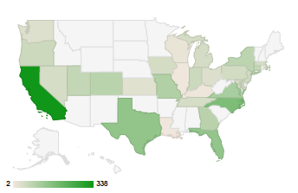

Slide 7
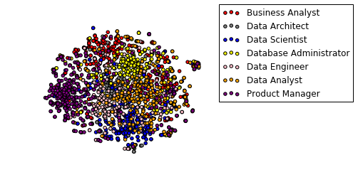

Slide 8
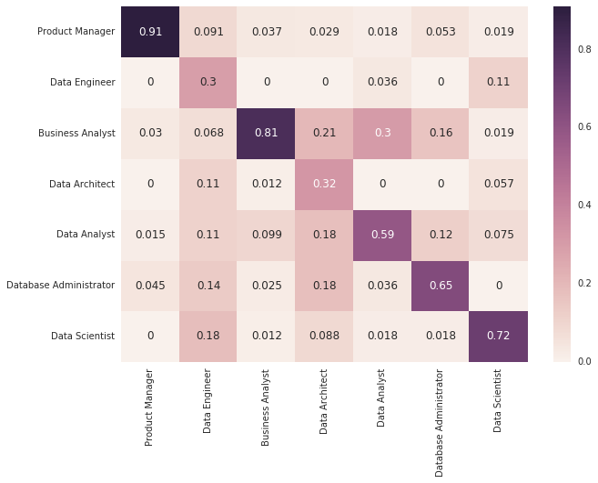

Slide 9
Physics
Model
Ph.D
Clinical
Minimum (degree/experience)
Optimization
Algorithm
Analysis
Plan
Partner
Network
Design
Performance
Life cycle
Management
Development
Software
Experience

Slide 10
Physics
Model
Ph.D
Clinical
Minimum (degree/experience)
Optimization
Algorithm
Analysis
Plan
Partner
Sale
Network
Market
Revenue
Design
Performance
Growth
Story
Customer
Life cycle
Management
Implementation
SQL
Microsoft
system
Oracle
Troubleshooting
Field experience
Security
Enterprise
Enterprise
solution
Health
document
Finance
Bachelor
Office
Creative

