Slide 1
JoBreaker
Yu (Jade) Zhang
Data Science Fellow, May 2017

Slide 2
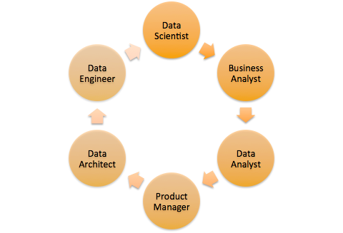
What the heck is a … ?
?

Slide 3
JoBreaker

Slide 4
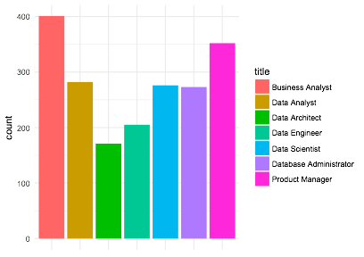
How I built it - data
Indeed.com API
1983 job postings
7 data-related job titles
Business Analyst
Data Analyst
Data Architect
Data Engineer
Data Scientist
Database Administrator
Product Manager
Distribution of data across job titles

Slide 5

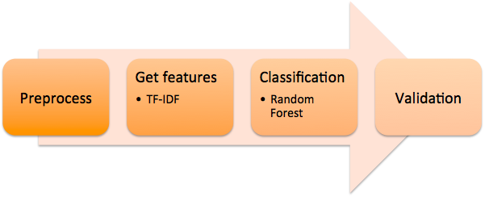
How I build it - pipeline

Slide 6
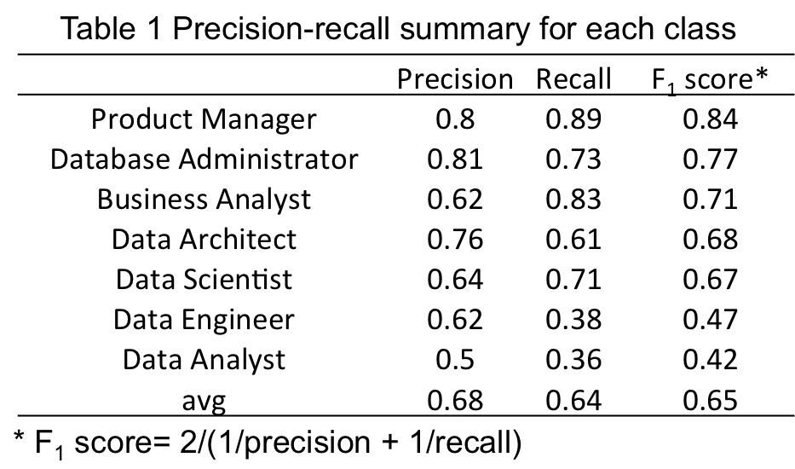
Predictability varies across job titles

Slide 7
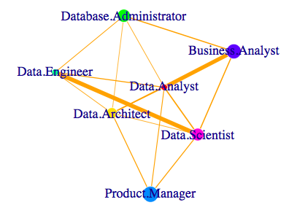
Some are more similar than others
Thicker edges Indicate higher probability to mistake one for another between the two job titles at the ends.
Try to avoid overlapping responsibilities when hiring both BA & DA, or DS & DE.

Slide 8

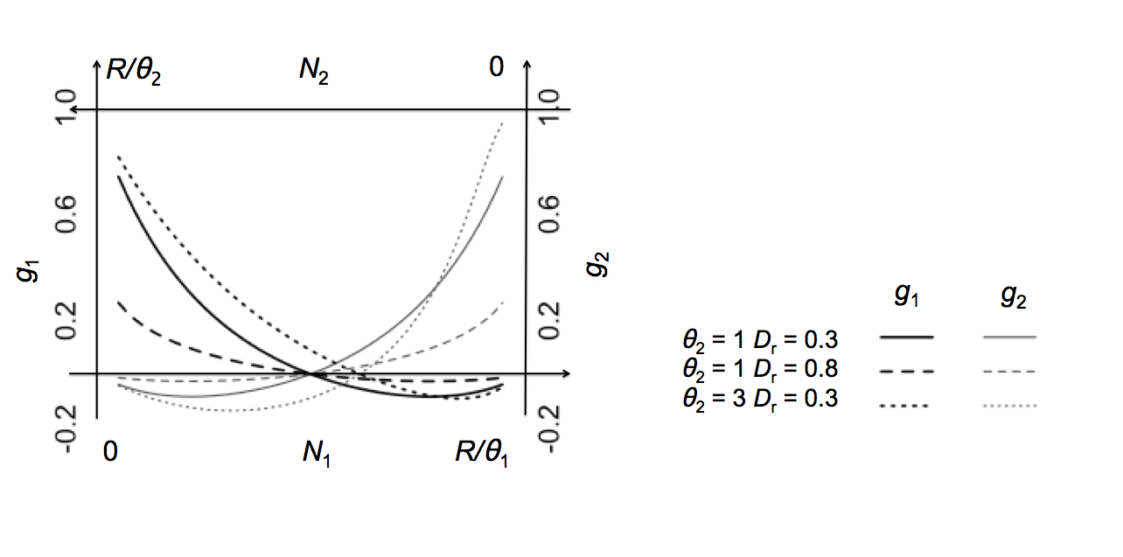
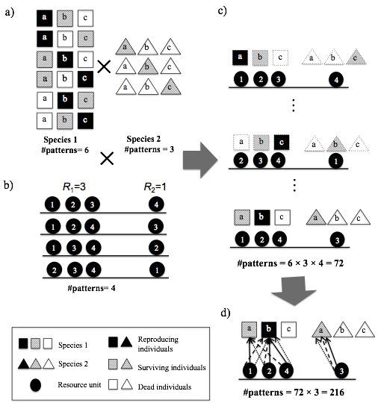
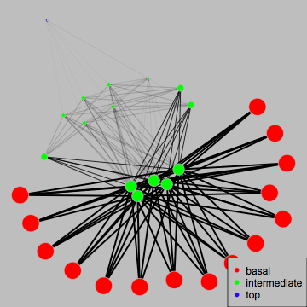
Yu (Jade) Zhang
Ph.D in Theoretical Ecology

Slide 9
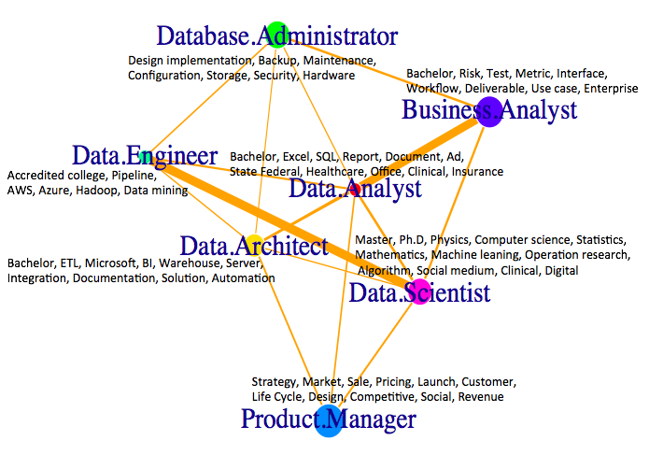

Slide 10
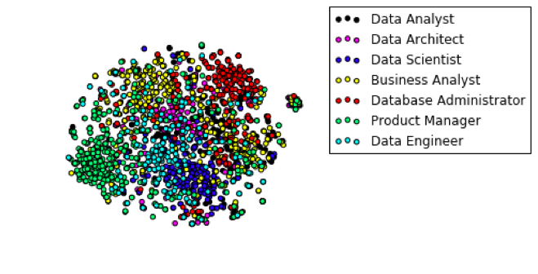

Slide 11
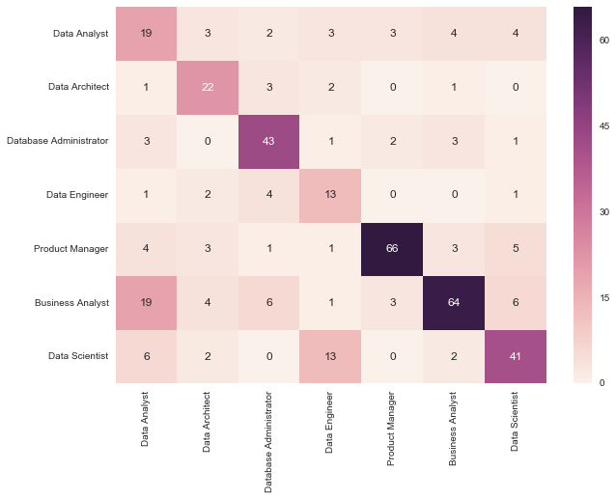

Slide 12
