Slide 1
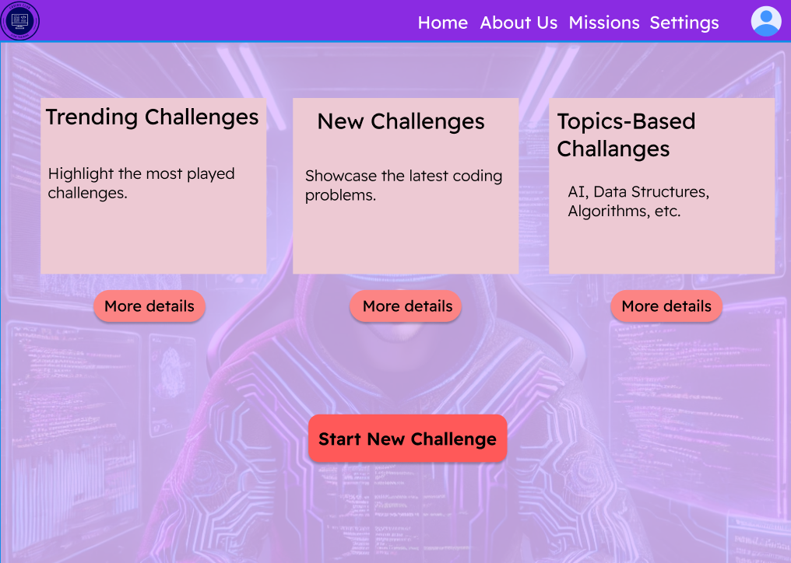

Slide 2


Back
Beginner Challenges
Intermediate Challenges
Advanced Challenges
FizzBuzz Challenge
Two Sum Problem
Maze Solver
Reverse a String
Binary Search Algorithm
AI Tic-Tac-Toe Bot
Palindrome Checker
Anagram Detector
Graph Cycle Detection
Sum of an Array
Merge Two Sorted Arrays
LRU Cache

Slide 3


Back
Beginner Challenges
FizzBuzz Challenge
Participate
Reverse String
Participate
Palindrome Checker
Participate
Sum Of an Array
Participate

Slide 4

Back
FizzBuzz Challenge Description:
Write a program that prints numbers from 1 to 15.
For multiples of 3, print "Fizz" instead of the number.
For multiples of 5, print "Buzz" instead of the number.
For multiples of both 3 and 5, print "FizzBuzz."
Start Coding

Slide 5
Back
Intermediate Challenges
Two Sum Problem
Participate
Binary search
Participate
Anagram Detector
Participate
Merge Sorted Array
Participate

Slide 6
Back
Two Sum Problem Description:
Given an array of integers and a target sum, return the indices of the two numbers that add up to the target.
Assume there is exactly one solution, and you cannot use the same element twice.
Start Coding

Slide 7
Back
Challenges
Maze Solver
Participate
AI TIC TAC TIO BOT
Participate
Graph Cycle
Participate
LRU Chahe
Participate

Slide 8
Back
Maze Solver Challenge Description:
Given a 2D maze represented by a grid of 0s and 1s, where 0 is a passable path and 1 is a wall, find the shortest path from the top-left to the bottom-right corner of the maze. Return the path coordinates.
Start Coding

Slide 9
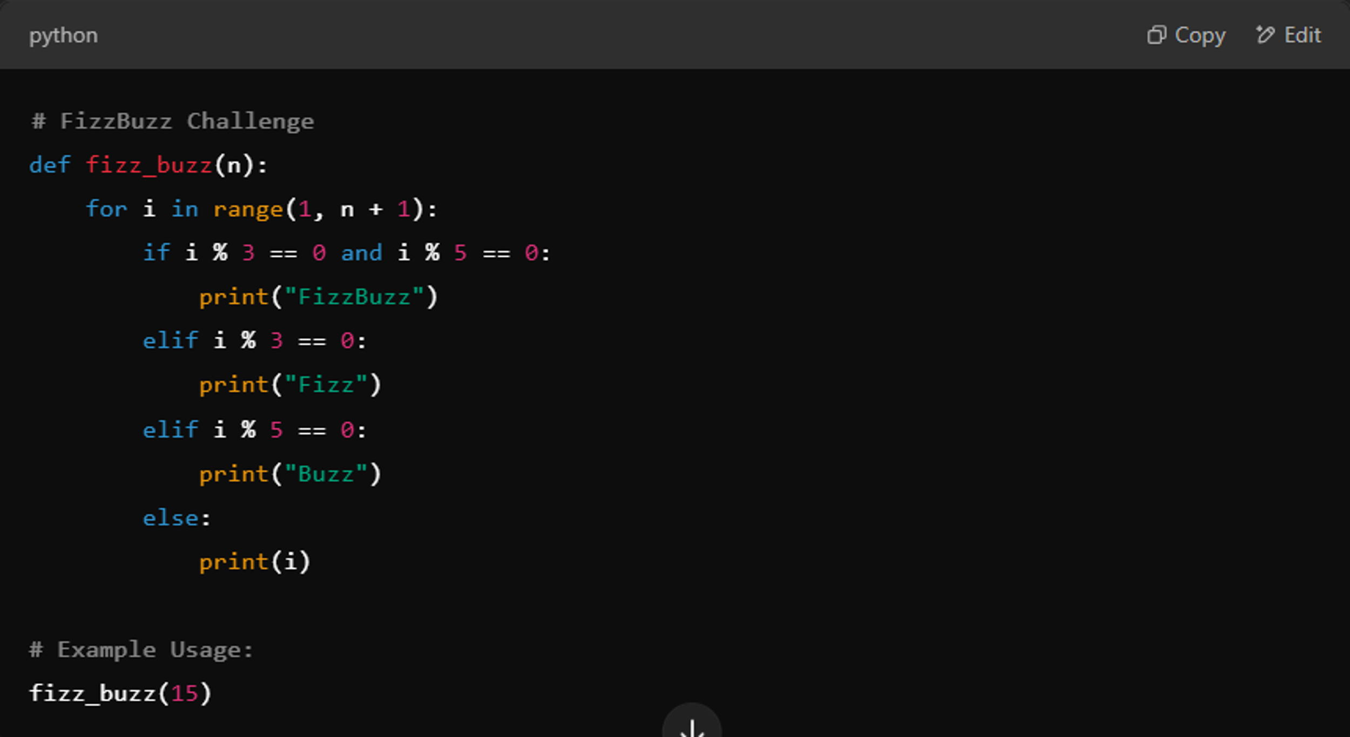

Back
Submit

Slide 10

Back
You Did Great..!
Errors: 0
Code Worked
Play Again

