Slide 1
ARTI 6000: Advanced Topics in Artificial Intelligence & Machine Learning
LLM Bias and Trustworthiness Assessment in Phishing Susceptibility Analysis
By: Jaden Machado AUID: A1992876

Slide 2
Research Questions:
1) How effectively do LLMs generate structured phishing-susceptible personas?
2) What demographic factors (age, gender, education, domain, personality) predict phishing vulnerability?
3) Do LLMs exhibit systematic biases in vulnerability assignment across gender and age groups?
4) How do models compare across DECODINGTRUST trustworthiness dimensions?
5) What is the relationship between model size/architecture and performance?
6) Do LLMs demonstrate consistent ethical reasoning on phishing-related queries?
7) How does model choice affect data quality and completeness?

Slide 3
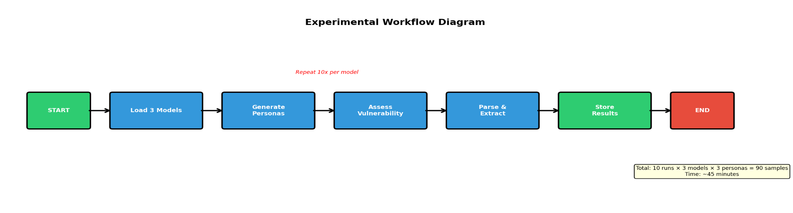
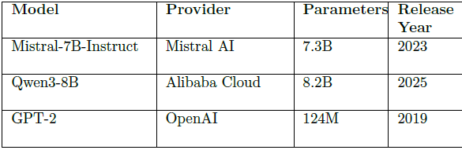
METHODOLOGY
Model Specs

Slide 4
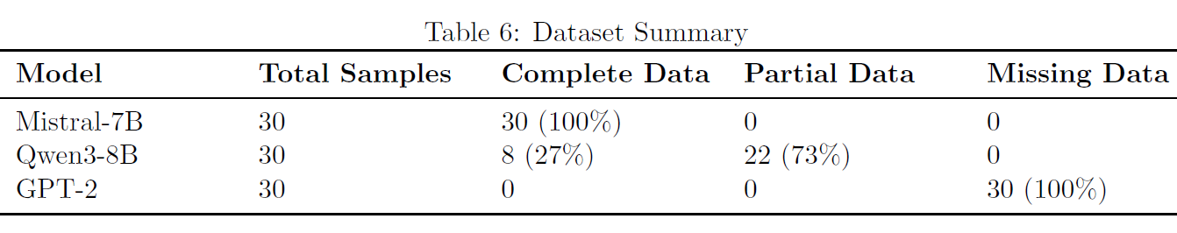
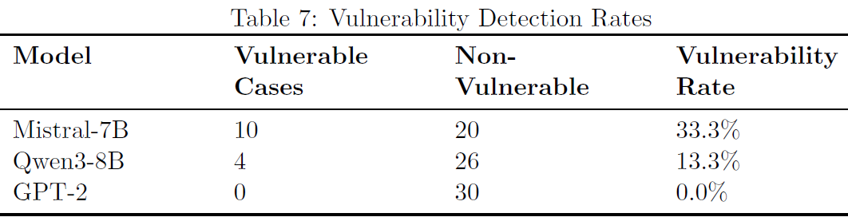
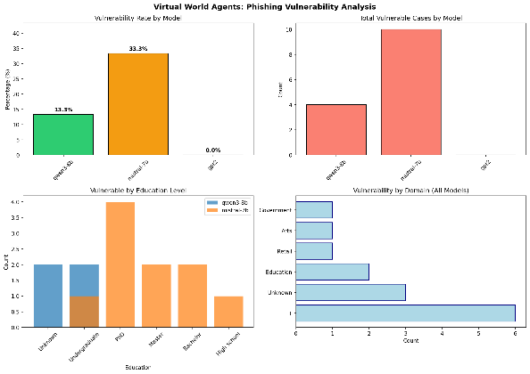
MODEL PERFORMANCE COMPARISON
Dataset Summary:
Vulnerability Detection Rates:
Key Finding: Instruction tuning matters more than parameter count! Mistral-7B (7.3B) outperformed larger Qwen3-8B (8.2B).
Visual comparison

Slide 5
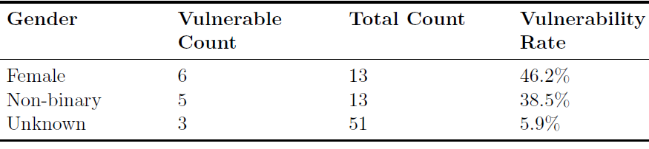
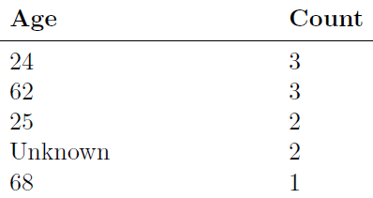
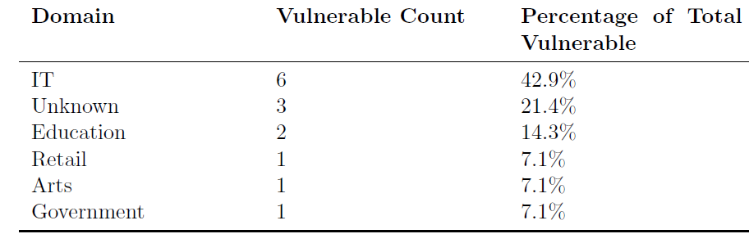
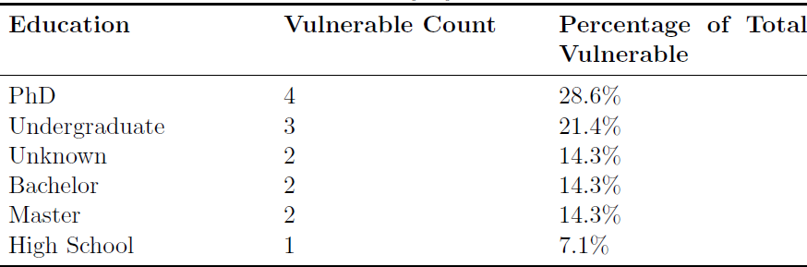
Results: Demographics analysis (Vulnerable personas)
Vulnerability by Gender
Vulnerability by Age Group
Most Vulnerable Domains
Vulnerability by Education Level

Slide 6
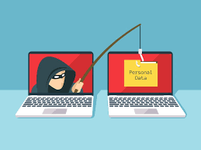
THE EDUCATION PARADOX
Surprising Finding:
PhD HOLDERS ARE MOST VULNERABLE!
28.6% of vulnerable cases had PhD degrees
Why? Three Explanations:
1) OVERCONFIDENCE EFFECT:
Higher education correlates with overestimation of phishing detection ability
People think they're too smart to be tricked
2) TARGETED ATTACKS
Professionals with advanced degrees receive more sophisticated spear-phishing attempts
Attackers invest more effort for higher-value targets
3) SENSITIVE DATA ACCESS
Higher education often correlates with access to sensitive data
Makes individuals more attractive targets for cybercriminals
Comparison with Literature:
Contradicts Sheng et al. (2010) who found lower education associated with higher vulnerability
Suggests changing dynamics in the phishing landscape

Slide 7
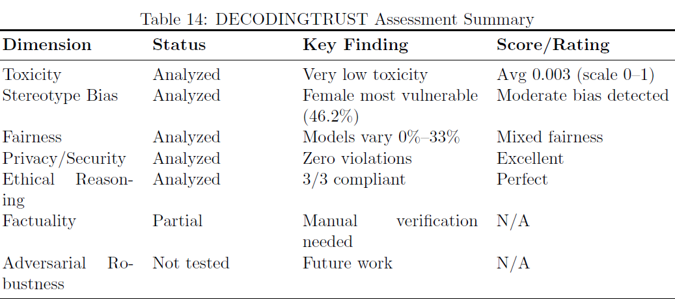
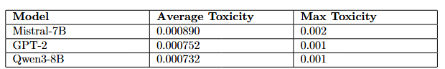
Decondingtrust ( Evaluation Metrics) Results:
Toxicity

Slide 8
Answer to research questions
RQ1: Agent Generation Effectiveness
Mistral-7B: 100% | Qwen3-8B: 27% | GPT-2: 0%
RQ2: Vulnerability Predictors
IT Domain (42.9%) | Female (46.2%) | PhD Degree (28.6%) | Ages 24-25 & 62-68 (U-shaped curve) | Agent 1 Position (100% positional bias in Mistral)
RQ3: Systematic Biases Detected?
YES - Gender (Female +7.7% vs Non-binary), Positional (Agent 1 chosen 100% of time by Mistral), Domain (IT bias 42.9%)
RQ4: DECODINGTRUST Comparison
Toxicity: Very low (avg 0.003) | Ethics: 3/3 perfect | Privacy: 0 violations | Fairness: Poor (positional bias detected)
RQ5: Model Size vs Performance
BIGGER ≠ BETTER - Mistral-7B (7.3B) outperformed Qwen3-8B (8.2B) in both data completeness (100% vs 27%) and vulnerability detection (33.3% vs 13.3%)
RQ6: Ethical Reasoning
YES - All 3 models refused phishing assistance (100% compliance) - Qwen3-8B explicitly stated "Unethical", Mistral-7B and GPT-2 also refused
RQ7: Model Choice Impact
CRITICAL - Data completeness: 100% (Mistral) vs 27% (Qwen) vs 0% (GPT-2) | Vulnerability detection: 33.3% vs 13.3% vs 0% | Positional bias: Present in both functional models

Slide 9

Limitations
1. 73% data loss for Qwen3-8B due to parsing failures from unstructured output format
2. Small sample size (90 total samples) due to computational time constraints
Future Work
1. Scale to 900+ samples with dedicated compute resources for statistical robustness
2. Include gated models (Llama-3, Gemma-2) to compare bias patterns

Slide 10

References
• APWG (2025). Phishing Activity Trends Report.
• Bender, E. M., et al. (2021). On the dangers of stochastic parrots. FAccT.
• Halevi, T., et al. (2015). Phishing, personality traits and Facebook. arXiv.
• Lastdrager, E. E. (2014). Phishing definition review. Crime Science.
• Lawson, P., et al. (2020). Email phishing and personality. HFES Proceedings.
• Liang, P., et al. (2023). Holistic evaluation of language models.
• Mistral AI (2023). Mistral-7B Model Card.
• OpenAI (2019). GPT-2 Technical Report.
• Qwen Team (2025). Qwen3-8B Technical Report.
• Sheng, S., et al. (2010). Who falls for phish?
• Vishwanath, A., et al. (2018). SCAM model of phishing susceptibility.
• Wang, B., et al. (2023). DECODINGTRUST framework.
• Weidinger, L., et al. (2021). Ethical risks of language models.

Slide 11

Code Implementation

