Slide 1
ARTI 6000: Advanced Topics in Artificial Intelligence & Machine Learning
Implementing and Evaluating an RLHF Pipeline for Open-Source LLMs
By: Jaden Machado AUID: A1992876

Slide 2
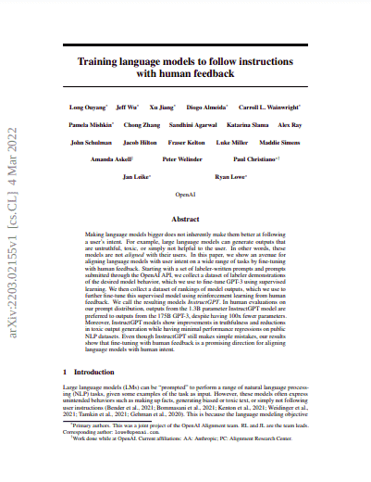
What is RLHF?
RLHF = Reinforcement Learning from Human Feedback
Aligns LLMs with what humans actually want
Fixes: hallucinations, bias, unhelpful outputs
Key insight from InstructGPT Paper:
1.3B model + RLHF > 175B original model
Research Question: Does model capacity significantly impact the effectiveness of Reinforcement Learning from Human Feedback (RLHF) in small, open-source language models?
InstructGPT Paper

Slide 3
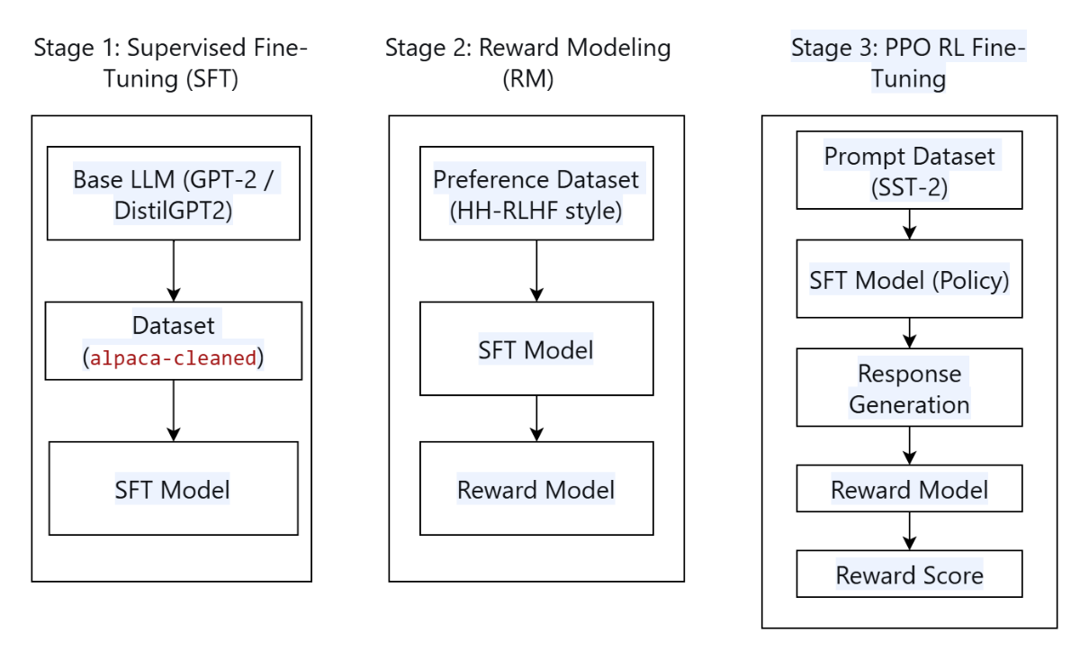
The 3-Stage Pipeline of RLHF
Stage 1: SFT
Train on instruction-response pairs (Alpaca dataset)
Stage 2: Reward Modelling
Train model to score responses (chosen vs rejected)
Stage 3: PPO
RL fine-tuning using reward model as guide

Slide 4
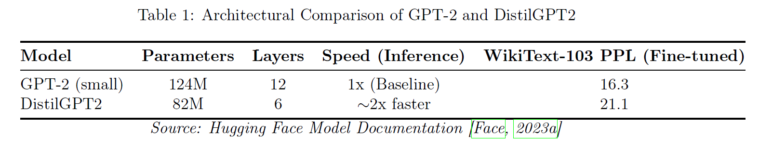
Models:
Datasets
SFT: yahma/alpaca-cleaned (1% subset)
Reward: Custom 2-example dataset (proof of concept)
PPO prompts: SST-2 movie reviews (filtered >8 words)

Slide 5
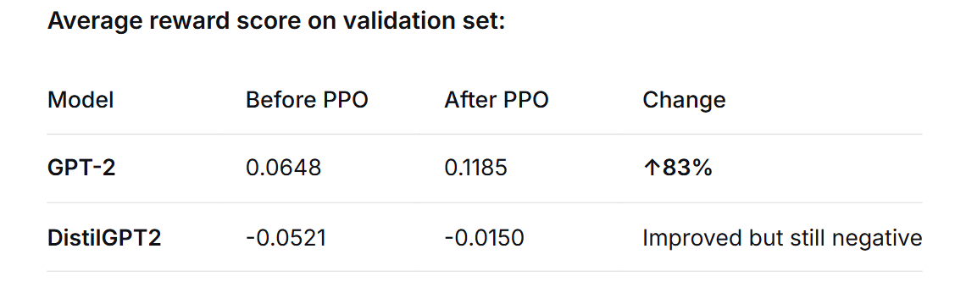
Key Results after applying PPO

Slide 6
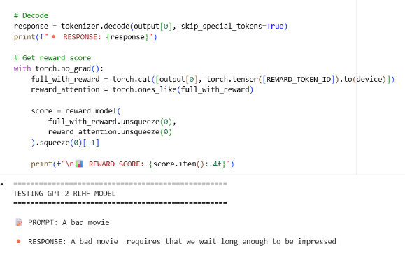
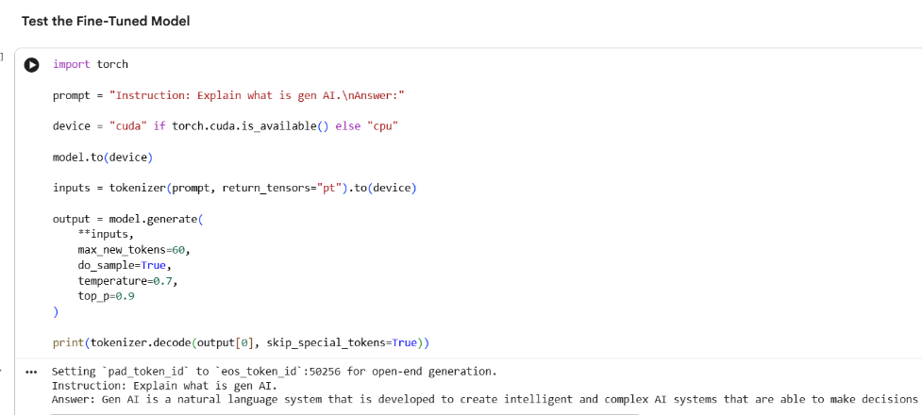
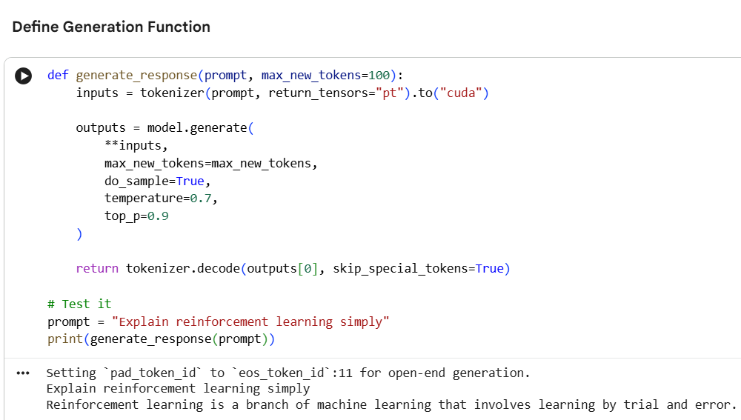
Output Results of different Models
Using gpt2 model with SFT, reward training and PPO
Using distillgpt2 model getting an output that is repetitive
Using Falcon-7b-instruct with 7B parameters without Reward training or PPO and getting amazing results

Slide 7
Research Conclusion
YES - Capacity critically determines RLHF success
Quantitative evidence
GPT-2 (124M): 83% reward increase (0.0648 → 0.1185) after applying PPO.
DistilGPT2 (82M): No improvement, policy collapsed , poor outputs.

Slide 8
Future work
🔹 Scale up to Llama 2 7B / Mistral 7B
🔹 Use real preference data (HH-RLHF, OpenAssistant)
🔹 Try DPO instead of PPO
🔹 Use TRL/OpenRLHF libraries

Slide 9

References
1) Ouyang et al. 2022 (InstructGPT)
2) Bai et al. 2022 (HH-RLHF)
3) Rafailov et al. 2023 (DPO)
4) Code reference: https://github.com/ash80/RLHF_in_notebooks

Slide 10

Code Implementation

