Slide 1
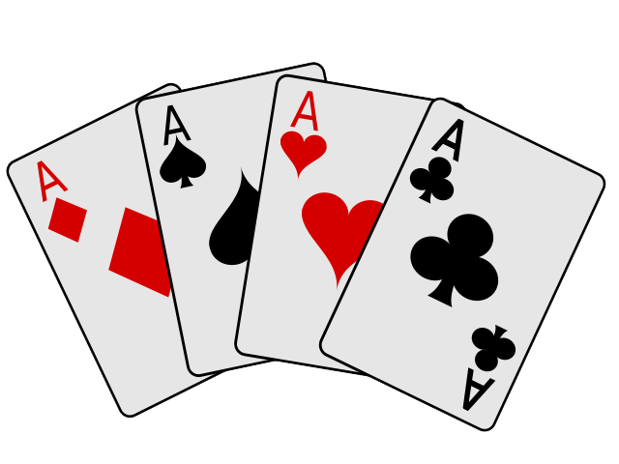
Minimax Poker Evaluation
Jaden Perleoni• 06/26/2024

Slide 2
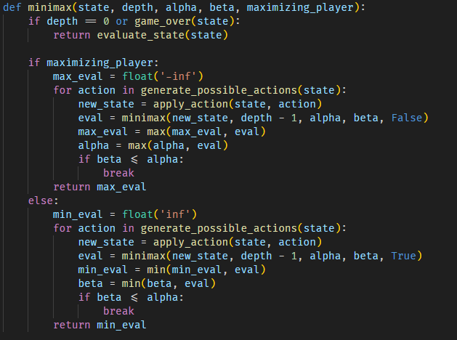
Adapted Algorithm
Minimax:
This project uses the algorithm minimax in order to determine the best possible value a player can get in a hand.
The player trying to find the best action for a hand is called the Max.
The player trying to find the worst action(lowest value) for a hand is called the Min.
In the context of poker, the max represents the player’s hand and the min represents the opponent’s hand.

Slide 3
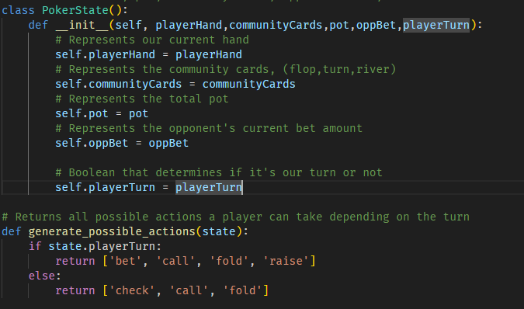
Poker State
A poker state contains:
The player’s hand
Community cards
Pot amount $
The opponent’s bet amount
A boolean to determine if it is current our turn
The function generate_possible_actions is used to return the possible actions a player can take. The actions depend on whether or not it is the player’s turn.

Slide 4
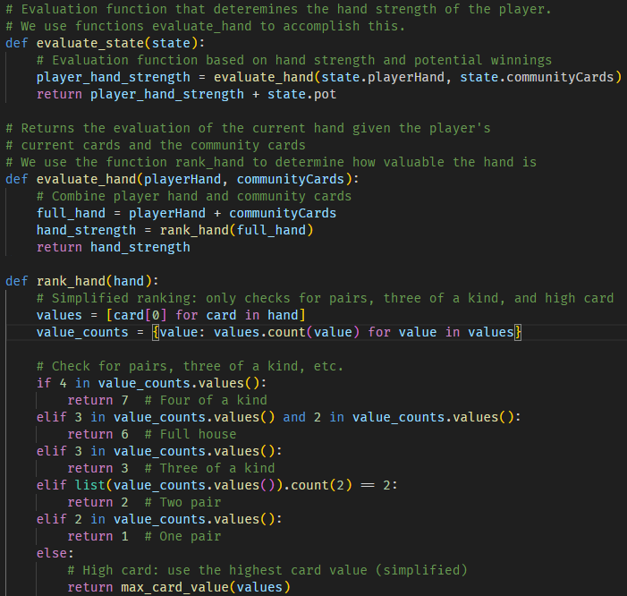
Evaluation function
The evaluation function is used to determine the hand strength of the player. Three functions are used:
evaluate_state
evaluate_hand
rank_hand
Evaluate State: Calls evaluate_hand with the player’s cards and the community cards
Evaluate_hand: Combines the player’s hand with the community cards and calls function rank_hand on them
Rank_hand: Returns the value of the determined hand.
(Only has logic for four of a kind, three of a kind, full house, two pair, and one pair)

Slide 5
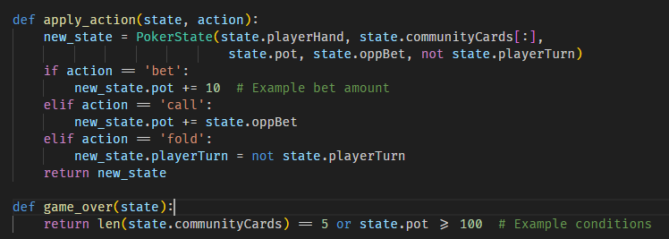
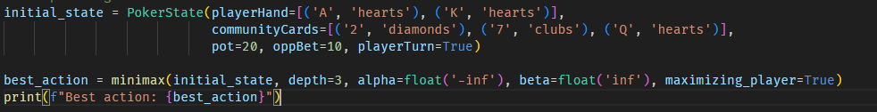
Implementation
Apply_action:
This function takes in a state and an action with the goal of determining the next state after the action has been taken. For example, if the action is bet, the state’s pot increases.
Game_over:
Determines how to terminate a game. In this example, the game ends if all 5 community cards are placed, or if the total pot exceeds $100, to ensure we don’t lose too much money.

