Slide 1
Dynamic Multiclassification Agent Interaction with Environmental Variants
Eric Hong JD Davenport

Slide 2
Overview
Motivation
Problem Description
Proposed Solution
Implementation
Results
Future Work
Q & A

Slide 3
Motivation
Advancements in Video Game Artificial Intelligence
Replacement of finite state machine driven decisions.
Dynamic World Interaction.
“Intelligent” Social capabilities
Advancements in Unmanned Robotic Exploration Vehicles
Real-time decision capability
Geospatial awareness / preparedness
Efficient sample acquisition

Slide 4
Problem Description
How can we implement an intelligent system that can yield accurate results in real-time?
How can the learning domain that makes use of this technique be as sterile as possible in terms of human tampering and/or independence?
How can this system continue to learn dynamically from what it has “observed” to make use of this additional knowledge?

Slide 5
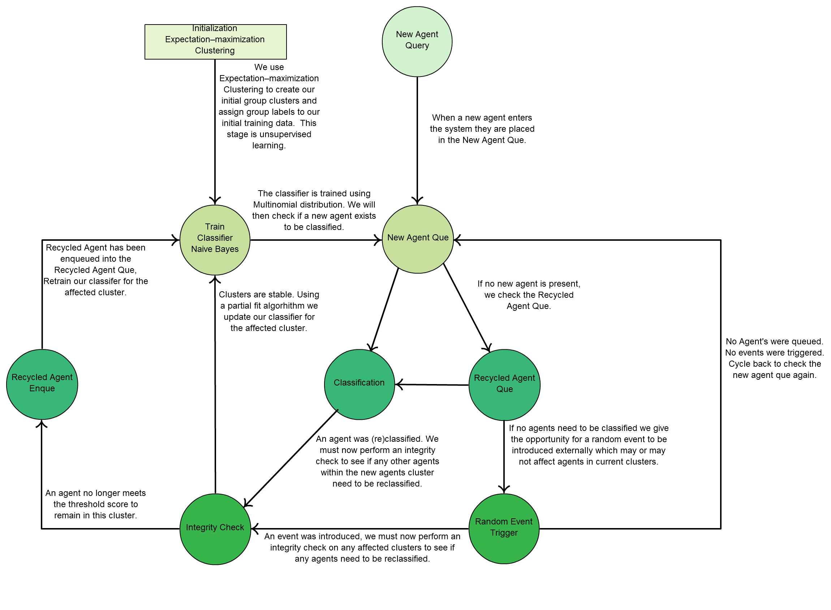
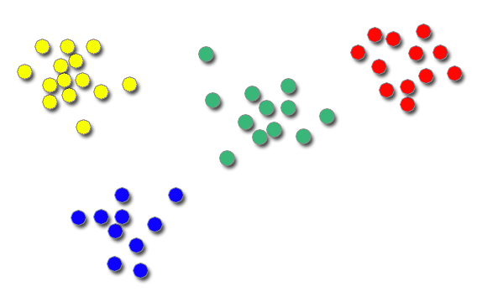
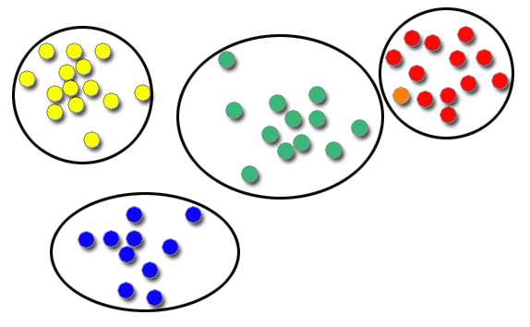
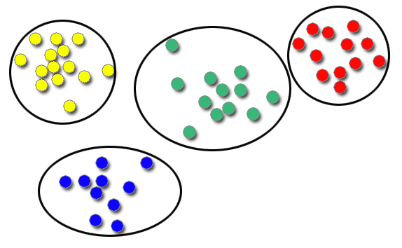
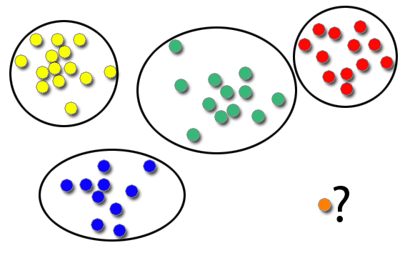
Proposed Solution
To create the sterile environment we will use expectation- maximization as an unsupervised learning step to create our initial clusters.
In order to meet the needs of a very quick classification that is still fairly accurate we will use a Bayes Multinomial classifier.
In order to allow the system to learn in a dynamic method we will update our training data using a partial fit algorithm each time an agent is classified.

Slide 6
Implementation
Introduction of tolerance for compatibility evaluation.
Introduction of threshold for final decision on acceptance.
Tolerance and Threshold give more granular control over accuracy.
Introduction of New Agent and Recycled Agent Queues for handling of agents into the system.
Introduction of Event Handler to allow stochastic events and possibly handle misclassified agents.
Language: Python
Libraries: Numpy & Science Kit Learn
http://www.numpy.org/
http://scikit-learn.org/stable/
Clustering: Expectation Maximization
Classifier: Naïve Bayes with Multinomial Distribution
OS: Mac OSX
CPU: Intel I7 2.3 GHz

Slide 7
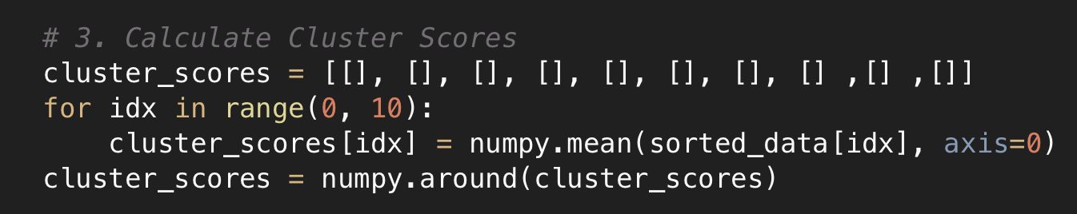

Slide 8
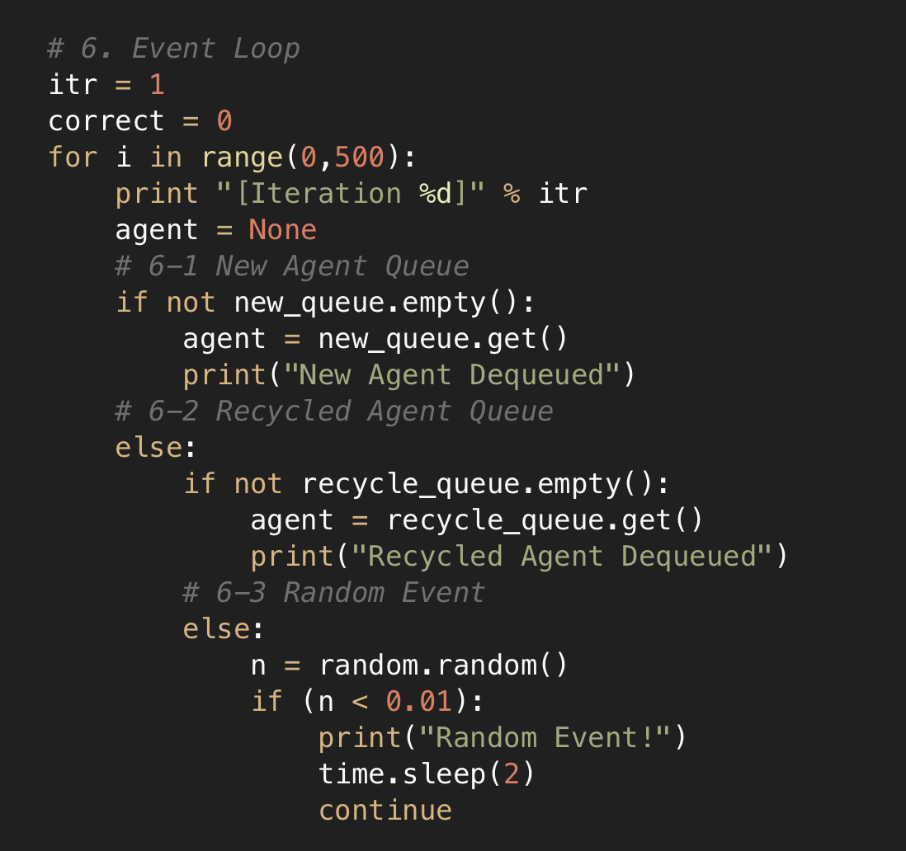

Slide 9
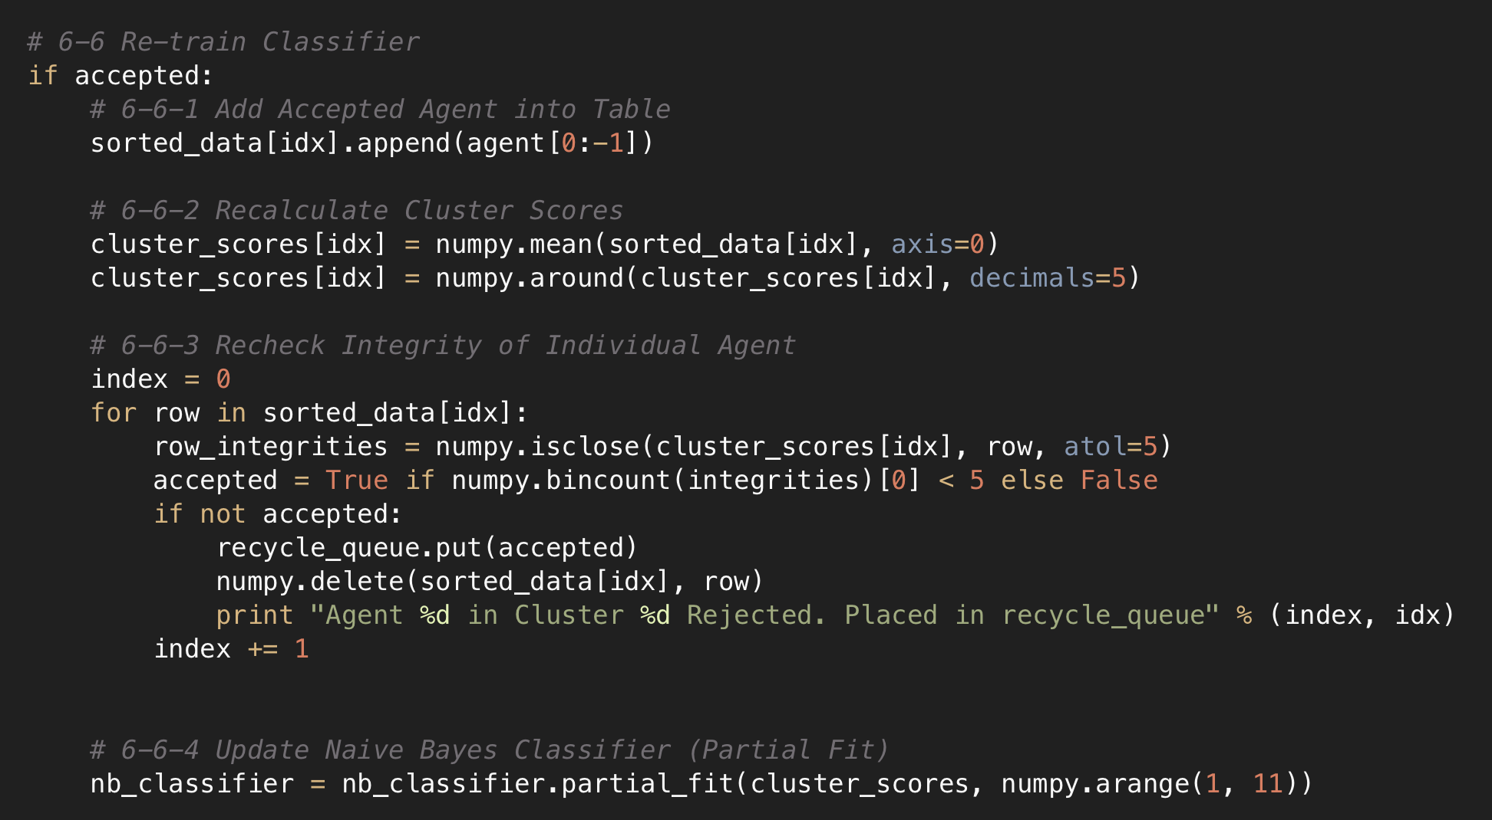

Slide 10
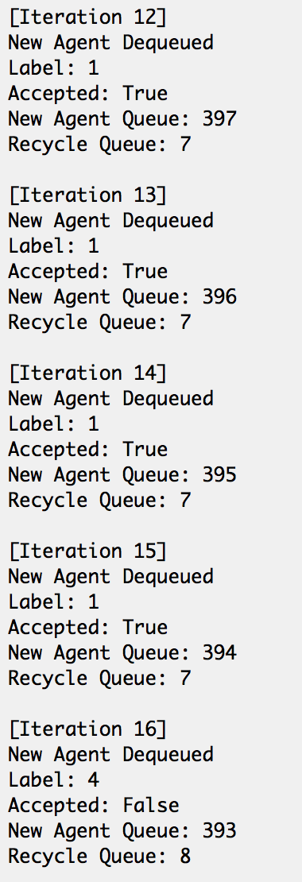

Slide 11
Results
(Vs 1000 agents) | Gaussian | Multinomial
Completion Time | .81 sec | .84 sec
Avg Accuracy | 82% | 83%
(Vs 1000 agents) | K-Means | E-M
Completion Time | 1.5 sec | 1.4 sec
Avg Accuracy | 7.8% | 11.7%
Default Distribution
Multinomial Distribution
K-Means
Expectation-Maximization
Slightly less accurate
Slightly faster
Slightly more accurate
Slightly slower
Slightly Slower
Slightly Less Accurate*
Slightly Faster
Slightly More Accurate*
* Note that measuring this was only attempted to help us decide between the two method as matter of completeness

Slide 12
Results
# Iterations | Accuracy
500 | 83.5 %
1000 | 83.2 %
5000 | 82.7 %

Slide 13
Future Work
We would like to see if we can further increase efficiency via better data sets, cluster destruction/reconstruction, and our own threshold/tolerance system.
We would like to additionally see how our system would operate using a multiclass SVM such as the implementation presented by Josh Archer and Bryant Nelson.
Overall improvements to efficiency in terms of speed while maintaining or improving accuracy would be optimal.

Slide 14
Questions?

