Slide 1
Training-Free Reliability Screening
for Prompted Segmentation
When does a stable mask still fail?
Frozen SAM ViT-B
Controlled natural-image experiments
No model training or learned uncertainty head
Course project | Real observations and image-level bootstrap intervals
1
Notes:
Our project asks when a frozen segmentation model can recognize its own failures. We use the original Segment Anything Model, or SAM, without training or fine-tuning. The aim is to rank unreliable masks for review. We do not alter the mask itself. Our strongest counterargument is simple: a model can produce the same wrong segmentation repeatedly. We test that possibility instead of assuming stability means correctness.
Sources: docs/design.md; results/summary.json; results/bootstrap.json; results/budget_timing.json.

Slide 2
Research context and contribution
Existing foundations
This study
SAM: promptable masks and predicted IoU
PointPrompt: prompting behavior
Prompt uncertainty: already studied
Natural images and an additional Pet corpus
Interior versus boundary clicks
Radius, decode budget and stable errors
The contribution is a controlled analysis; perturbation uncertainty is not claimed as new
2
Notes:
SAM predicts its own mask quality. PointPrompt studies the role of prompts. Prompt perturbation uncertainty also already exists, including a recent medical-image study with largely negative comparisons. We therefore do not claim a new uncertainty principle. Our contribution is a controlled natural-image analysis of click position, perturbation radius, compute budget, and a separate public image corpus.
Sources: docs/design.md; results/summary.json; results/bootstrap.json; results/budget_timing.json.

Slide 3
Image-level experimental protocol
Split | Images | Simulated click cases
Validation | 45 | 90
Main test | 106 | 212
Additional Pet | 74 | 148
Two click regimes: foreground interior and near boundary
Annotations simulate clicks and evaluate masks; reliability scoring never receives them
3
Notes:
We split the main dataset by image: forty-five validation images and one hundred and six test images. We separately download seventy-four Pet images, two per breed. Each image has an interior and a boundary click simulated from annotations. Labels are used only for simulation and evaluation. All scoring code receives the image, click and predictions. Uncertain annotation borders are ignored, and every image's two clicks stay together in statistical resampling.
Sources: docs/design.md; results/summary.json; results/bootstrap.json; results/budget_timing.json.

Slide 4
Reliability scores and inference budget
Score | Additional work
SAM confidence / threshold stability | No additional model call
Mean / minimum prompt consistency | K decodes; reuse image embedding
Fixed fusion: (confidence + consistency) / 2 | K decodes; no learned weights
Horizontal-flip consistency | One image encoding + one decode
Radius: 1%, 3%, 6% of image diagonal | K: 2, 4, 8
Primary configuration selected on validation only: r0.06_k8
4
Notes:
The baselines are SAM confidence, threshold stability and horizontal-flip consistency. Our prompt score averages overlap between the original mask and nearby-click masks. We also test minimum overlap and equal-weight fusion with confidence. We sweep three radii and three budgets. Validation chooses r0.06_k8; that choice is frozen before test evaluation. Nearby clicks may leave the object, so we record that diagnostic instead of secretly fixing prompts with labels.
Sources: docs/design.md; results/summary.json; results/bootstrap.json; results/budget_timing.json.

Slide 5
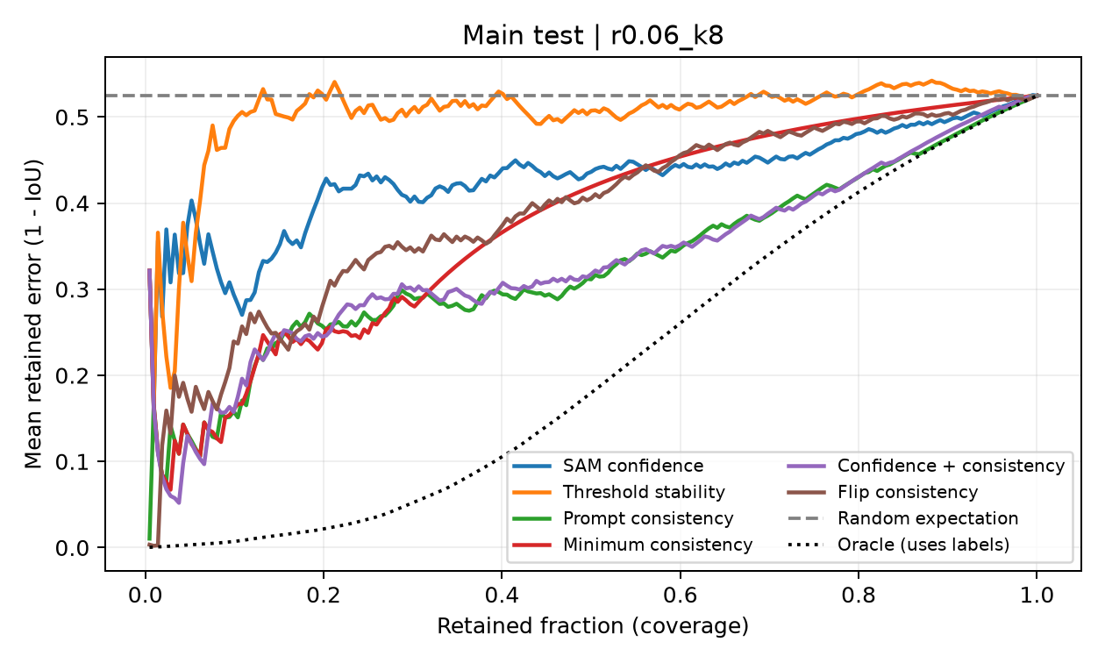
Main held-out selective risk
Lower AURC is better
Confidence: 0.430
Fixed fusion: 0.333
Paired difference: -0.0971
95% CI: -0.1449 to -0.0528
Mean consistency: 0.329
Fusion adds no demonstrated gain over it
The paired interval excludes zero within this protocol
5
Notes:
On the main test set the original masks have mean IoU 0.475. Confidence has AURC 0.430, and fusion has AURC 0.333. Lower is better. The paired difference is -0.0971. The ninety-five percent interval runs from -0.1449 to -0.0528. It excludes zero within this evaluation protocol. The curves show whether refusing low-confidence cases actually lowers retained error.
Sources: docs/design.md; results/summary.json; results/bootstrap.json; results/budget_timing.json.

Slide 6
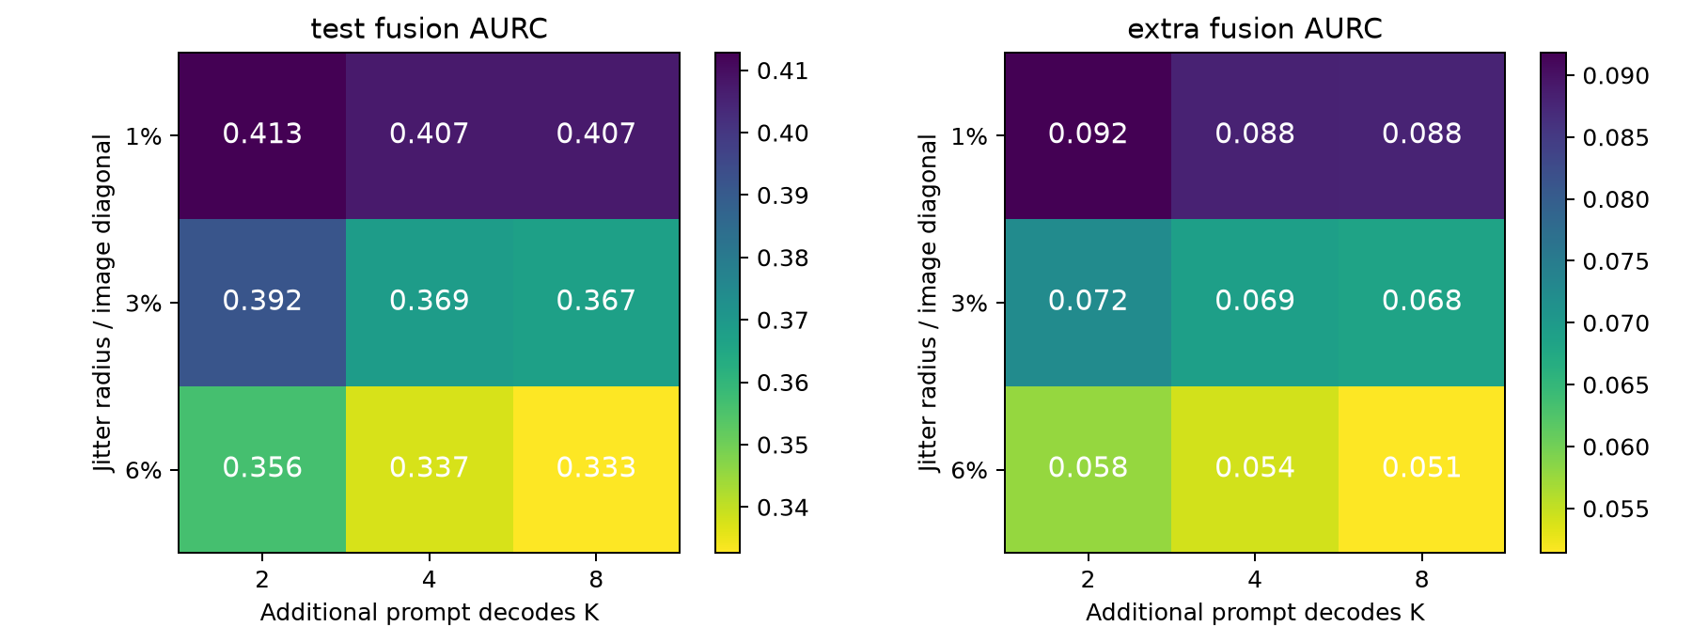
Additional corpus and sensitivity
Pet: 74 images / 148 cases
Confidence AURC 0.103
Fusion AURC 0.051
Same frozen configuration
Sensitivity cells are descriptive; they do not replace validation selection
6
Notes:
We apply exactly the same configuration to the Pet corpus. Mean IoU is 0.812; confidence AURC is 0.103, compared with fusion AURC 0.051. This checks sensitivity to a second set of natural images. It does not establish that those images were absent from SAM pretraining. We separately inspect radius and budget sensitivity, and report subgroup results as exploratory.
Sources: docs/design.md; results/summary.json; results/bootstrap.json; results/budget_timing.json.

Slide 7
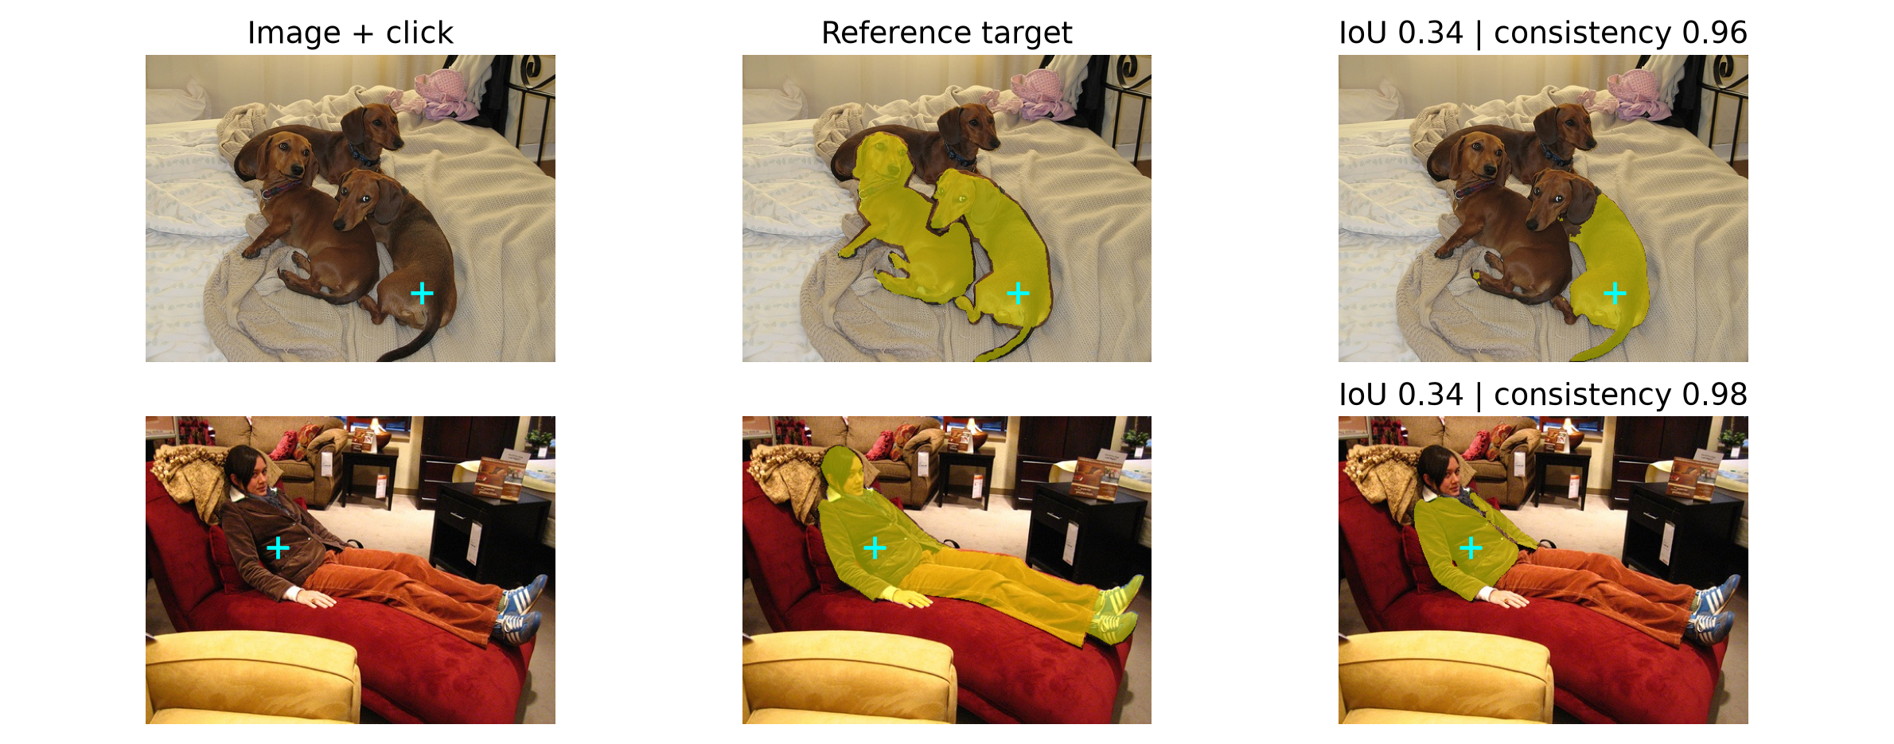
Stable errors in actual predictions
Consistency >= 0.9 and true IoU < 0.5: 2 main cases; 0 Pet cases
7
Notes:
We define a stable failure in advance as prompt consistency at least point nine and true IoU below point five. There are 2 such main-test cases and 0 Pet cases. The examples show the original image, the reference object and the prediction. These cases reveal the fundamental limitation: agreement can describe a repeated mistake. A reliable screening method must be tested against labels, even when it does not use labels at inference.
Sources: docs/design.md; results/summary.json; results/bootstrap.json; results/budget_timing.json.

Slide 8
Measured additional inference cost
Actual batches on five validation images | cuda | synchronized GPU timing
The complete research sweep costs more than deploying one selected score
8
Notes:
Prompt variations reuse one cached image embedding, while horizontal flip needs another encoder pass. We measure actual batches of two, four and eight decodes on five validation images, rather than assuming cost scales linearly. The full experimental sweep costs more than deploying just the chosen method. Quality and cost must be read together: cheap inference is useful only if its ranking is informative.
Sources: docs/design.md; results/summary.json; results/bootstrap.json; results/budget_timing.json.

Slide 9
Findings and limitations
Fusion lowers observed main-test AURC
Agreement measures repeatability, not semantic correctness
Limits: simulated users, one backbone, finite public corpora
All methods leave the original segmentation unchanged
Code, raw observations, masks and paired intervals support every reported result
9
Notes:
The project provides executable code, preserved observations, controlled comparisons and image-level bootstrap intervals, with no training. Its conclusion follows the measured results, including negative findings. Limits include simulated users, one backbone and finite datasets. Future work should test real user clicks and additional models. Each team member should present their assigned section and document their actual contribution.
Sources: docs/design.md; results/summary.json; results/bootstrap.json; results/budget_timing.json.

