Slide 1
Game Development 1B
Chapter 14

Slide 2

Files and the File and Directory Classes
Temporary storage
Usually called computer memory or random access memory (RAM)
Variables use temporary storage
Volatile
Permanent storage
Data is not lost when a computer loses power
Nonvolatile
The program is saved to a disk

Slide 3
Files and the File and Directory Classes
Computer file
A collection of information stored on a nonvolatile device in a computer system
Files exist on permanent storage devices
Text files
Contain information in ASCII or Unicode characters
Can be data files or source code files (e.g., C# source code)

Slide 4
Files and the File and Directory Classes
Binary files - Store software, images, music, etc.
Occupies space on a section of a storage device
Has a name, a size, a type, and a specific time of creation
Write to the file
Store data in a file on a persistent storage device
Read from the file
Copy data from a file on a storage device into RAM
Computer users organize their files into folders or directories

Slide 5
Files and the File and Directory Classes
Root Directory
The main storage location on your computer
Folder or Directory
A location inside the root directory designed to group items or files that are similar in nature
Path
A combination of the disk drive plus the complete hierarchy of directories in which a file resides
C:\Projects\Application1\Application1.sln

Slide 6
Files and the File and Directory Classes
File class
Contains methods to access information about files
Contained in the System.IO namespace
Directory class
Provides information about directories or folders

Slide 7
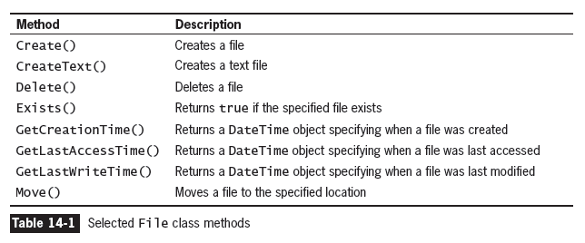
Files and the File and Directory Classes

Slide 8
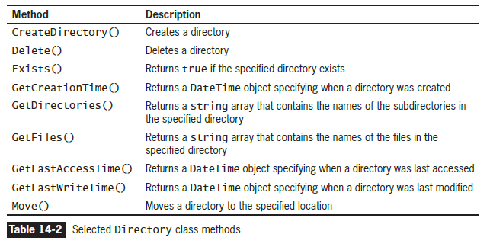
Files and the File and Directory Classes

Slide 9
Understanding file data organisation
Businesses store data in a relationship known as the data hierarchy
Character
Any of the letters, numbers, or other special symbols (such as punctuation marks) that comprise data
Characters are made up of bytes containing eight (8) bits
ASCII characters contain one (1) byte
Unicode characters contain two (2) bytes

Slide 10
Understanding file data organisation
Field
A character or group of characters that has some meaning
Record
A collection of related fields that contain data about an entity
Sequential access file
Each record is read in order based on its relative position
Records can be stored in order based on a value in the record
The field used to uniquely identify each record in a sequential file is the key field
Random access file
Records are not in any sequence and can be accessed in any order

Slide 11
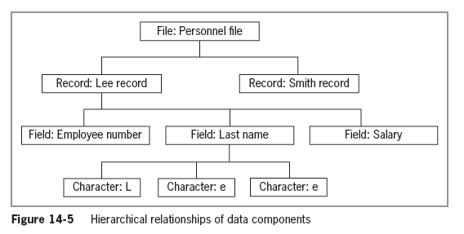
Understanding file data organisation

Slide 12
Understanding file data organisation
A C# application opens a file by creating an object and associating a stream of bytes with that object
1
When you finish using a file, the program should close the file
2
Not closing a file may make it inaccessible
3
Not closing an output file can result in data not being written to the file
4

Slide 13
Example
In this example, we’ll create a directory if one doesn’t already exist
1
On the second run, we’ll create a file if it doesn’t already exist
2
Can combine to create a file when you create the directory
3
Wanted to show you the power of sequential runs as we get into this a lot in read/writing
4

Slide 14
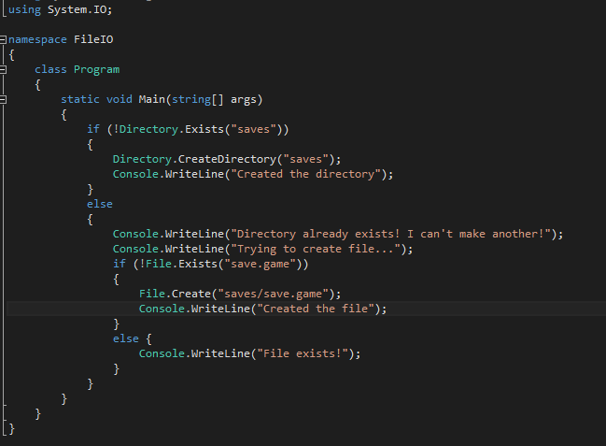
Example
Note: System.IO
Note if File/Directory.Exists
Note paths
Sln – bin/debug

Slide 15
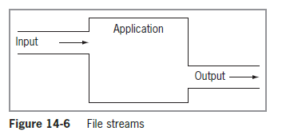
streaming
A stream functions as a pipeline or channel between an input device and an application, and potentially an output device

Slide 16
Default stream objects in C#
Console.In
Standard input stream object - Accepts data from the keyboard
Console.Out
Standard output stream object - Allows a program to produce output on the screen
Console.Error
Standard error stream object - Allows a program to write error messages to the screen

Slide 17
Understanding streams
Most streams flow in only one direction

Slide 18
Understanding streams
StreamReader
StreamReader for text input from a file
StreamWriter
StreamWriter for text output to a file
FileStream
FileStream is used alone for bytes and with either StreamReader and StreamWriter for text), for either input from and output to a file

Slide 19
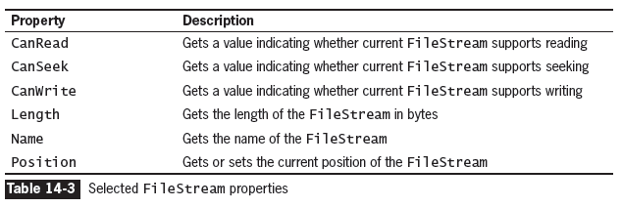
Understanding streams

Slide 20
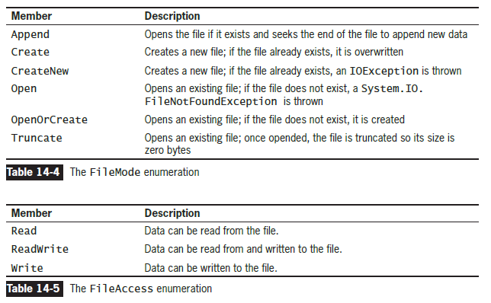
Understanding streams

Slide 21
Writing and Reading a Sequential Access File
C# uses files only as streams of bytes
01
When you write a program to store a data file, you must dictate the form the file will take
02
Whether you are writing data to a file or reading data from one, you create a FileStream object
03

Slide 22
Writing and Reading a Sequential Access File
Reading from a text file is similar to writing to a text file
Classes used:
FileStream
StreamReader

Slide 23
Writing and Reading a Sequential Access File
FileStream inFile = new FileStream(FILENAME,
FileMode.Open, FileAccess.Read);
StreamReader reader = new StreamReader(inFile);

Slide 24
Writing and Reading a Sequential Access File
Token
A block of text within a string that represents an entity or field
Delimiter
A character used to specify the boundary between records and, potentially, fields in text files
When you write data to a text file:
You can separate the fields with a delimiter
Delimiters are needed when fields are not fixed in size and position—field size varies
CSV files (comma-separated value files) are delimited files

Slide 25
example
Writing
Writing to an existing file
Reading
Reading from that file if it exists
Parsing
Parsing read data into an object

Slide 26
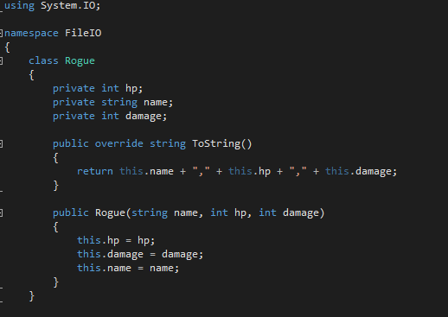
example

Slide 27
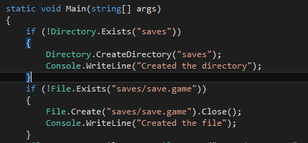
example

Slide 28
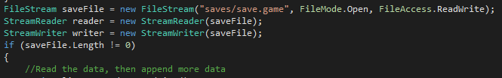
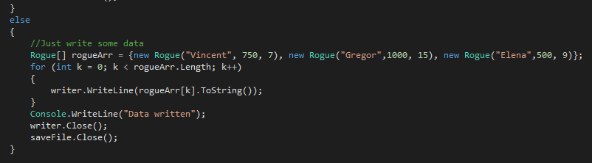
example

Slide 29
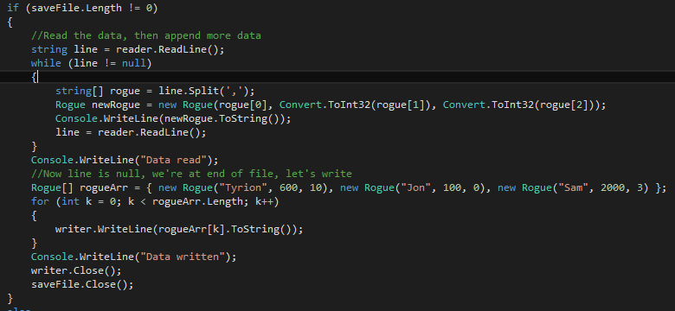
example

Slide 30
Disadvantages to writing to a text file
Data in a text file is easily readable in a text editor such as Notepad, which means it is not secure
It is cumbersome to convert each field to text and combine the fields with delimiters

Slide 31
Serialisation and deserialisation
You can write objects to and read objects from files
Serialization
The process of converting objects into streams of bytes
Deserialization
Converts streams of bytes back into objects

Slide 32
Serialisation and deserialisation
In a class marked with the [Serializable] attribute, every instance variable must also be Serializable
By default, all C# simple data types are serializable, including strings
If your class contains fields that are more complex data types, you must check the declaration of those classes to ensure they are serializable

Slide 33
Serialisation and deserialisation
To create a class that can be serialized:
Mark it with the [Serializable] attribute
Namespaces included in programs that employ serialization:
System.Runtime.Serialization.Formatters.Binary;
System.Runtime.Serialization;

Slide 34
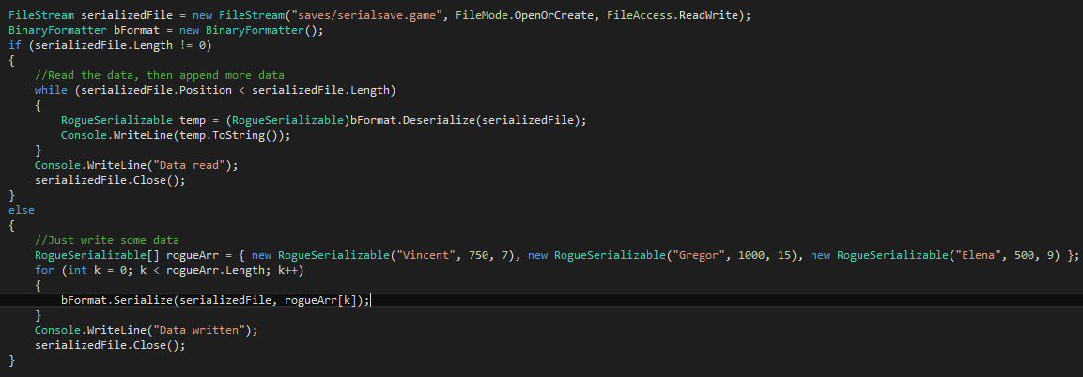
Serialisation and deserialisation

Slide 35
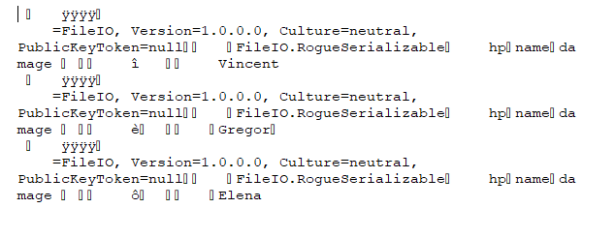
Serialisation and deserialisation

