Slide 1

Diabetes Readmission Prediction
By
J Nandu

Slide 2
Data Set Description VARIABLE NAMES: DESCRIPTION
Encounter ID Unique identifier of an encounter
Patient number Unique identifier of a patient
Race Values: Caucasian, Asian, African American, Hispanic, and other
Gender Values: male, female, and unknown/invalid
Age Grouped in 10-year intervals: 0, 10), 10, 20), …, 90, 100)
Weight Weight in pounds
Admission type Integer identifier corresponding to 9 distinct values, for example, emergency, urgent, elective, newborn, and not available
Discharge disposition Integer identifier corresponding to 29 distinct values, for example, discharged to home, expired, and not available
Admission source Integer identifier corresponding to 21 distinct values, for example, physician referral, emergency room, and transfer from a hospital
Time in hospital Integer number of days between admission and discharge
Payer code Integer identifier corresponding to 23 distinct values, for example, Blue Cross/Blue Shield, Medicare, and self-pay Medical
Medical specialty Integer identifier of a specialty of the admitting physician, corresponding to 84 distinct values, for example, cardiology, internal medicine, family/general practice, and surgeon
Number of lab procedures Number of lab tests performed during the encounter
Number of procedures Numeric Number of procedures
Number of medications Number of distinct generic names administered during the encounter

Slide 3
Number of outpatient visits Number of outpatient visits of the patient in the year preceding the encounter
Number of emergency visits Number of emergency visits of the patient in the year preceding the encounter
Number of inpatient visits Number of inpatient visits of the patient in the year preceding the encounter
Diagnosis 1 The primary diagnosis (coded as first three digits of ICD9); 848 distinct values
Diagnosis 2 Secondary diagnosis (coded as first three digits of ICD9); 923 distinct values
Diagnosis 3 Additional secondary diagnosis (coded as first three digits of ICD9); 954 distinct values
Number of diagnoses Number of diagnoses entered into the system 0%
Glucose serum test result Indicates the range of the result or if the test was not taken. Values: “>200,” “>300,” “normal,” and “none” if not measured
A1c test result Indicates the range of the result or if the test was not taken. Values: “>8” if the result was greater than 8%, “>7” if the result was greater than 7% but less than 8%, “normal” if the result was less than 7%, and “none” if not measured.
Change of medications Indicates if there was a change in diabetic medications (either dosage or generic name). Values: “change” and “no change”
Diabetes medications Indicate if there was any diabetic medication prescribed. Values: “yes” and “no”
Here is the shape of our dataset
101766, 50

Slide 4
Here we have 24 features for medications For the generic names: metformin, repaglinide, nateglinide, chlorpropamide, glimepiride, acetohexamide, glipizide, glyburide, tolbutamide, pioglitazone, rosiglitazone, acarbose, miglitol, troglitazone, tolazamide, examide, sitagliptin, insulin, glyburide-metformin, glipizide-metformin, glimepiride- pioglitazone, metformin-rosiglitazone, and
metformin- pioglitazone, the feature indicates whether the drug was prescribed or there was a change in the dosage. Values: “up” if the dosage was increased during the encounter, “down” if the dosage was decreased, “steady” if the dosage did not change, and “no” if the drug was not prescribed
Readmitted Days to inpatient readmission. Values: “<30” if the patient was readmitted in less than 30 days, “>30” if the patient was readmitted in more than 30 days, and “No” for no record of readmission

Slide 5
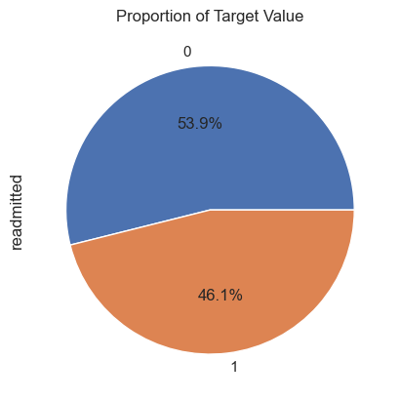
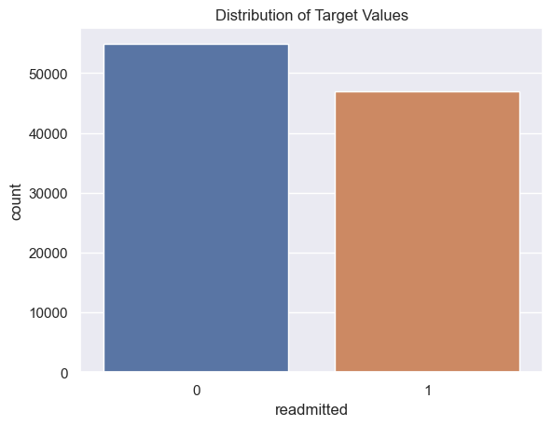
Readmitted
These two diagrams show us that our target variable is almost balanced and distributed.
This column our target feature. It is about "days to inpatient readmission"
If the patient was readmitted in less than 30 days "<30" if the patient was readmitted in more than 30 days ">30" If there is no record "NO" We decided to reduce these values to two and map them according to the following rule;
NO -> 0 <30 and >30 -> 1

Slide 6
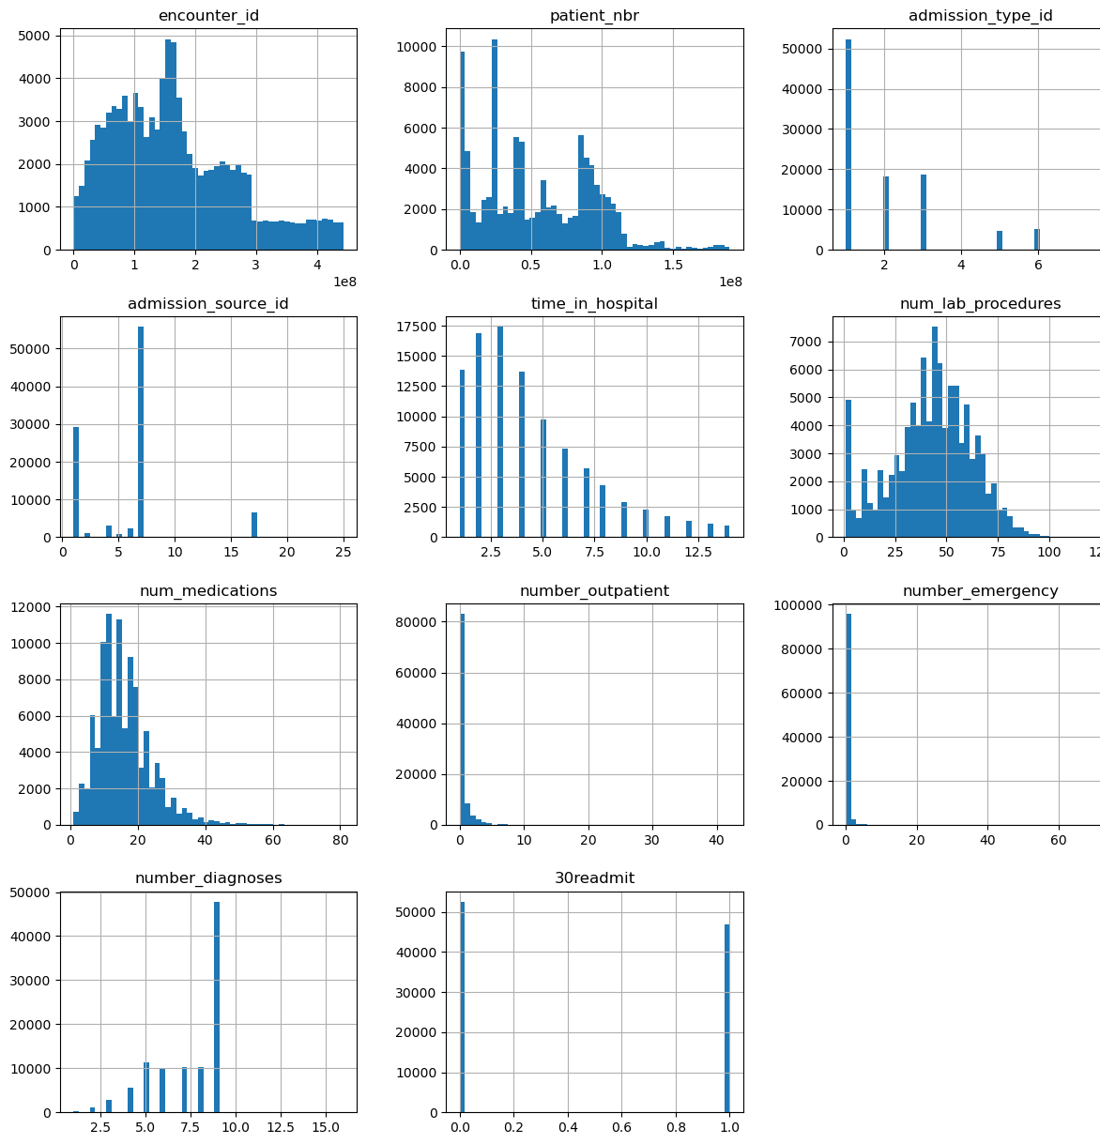
Numerical variables
Where each histogram represents the distribution of values for a specific numerical variable in the dataset. This visualization helps you gain insights into the dataset's central tendency, spread, skewness, and potential outliers for each numerical variable.

Slide 7
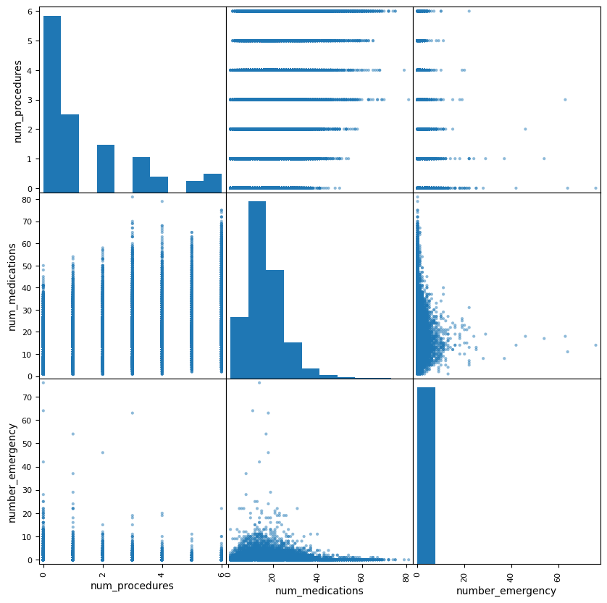
num_procedures', 'num_medications', 'number_emergency
In this case Patients who experience more frequent emergencies might receive more intensive and immediate medical attention. During such emergency care, the focus could be on stabilizing the patient's condition rather than prescribing numerous medications. As a result, the total number of medications might decrease.
From this, we can see that there is no problem with multi-collinearity. We can also see that as the number_emergency increases the num_medication decreases.

Slide 8
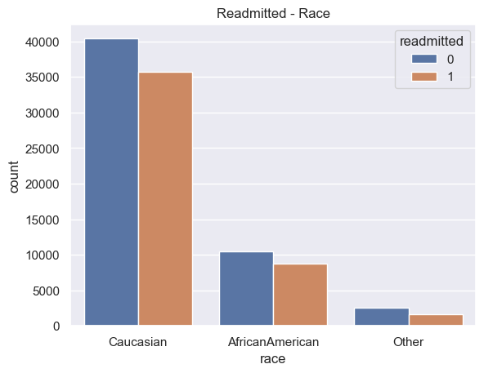
Readmitted - Race
As we see, there are Caucasians in 76 per cent of all our data. And other 24 per cent is divided into African Americans, Hispanics, Asians and Others.
Here we decided to divide into 3 groups Caucasian, African American and Other.
The proportion of Race
Caucasian 76.486788
AfricanAmerican 19.307891
Other 4.205321

Slide 9
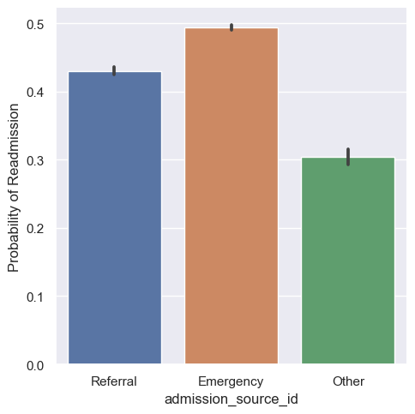
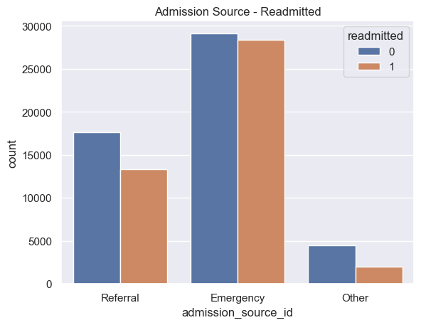
Admission_Source_Id VS Readmitted
We see that Readmitted Probability of Referral is very close to Emergency, although Emergency has more samples than other

Slide 10
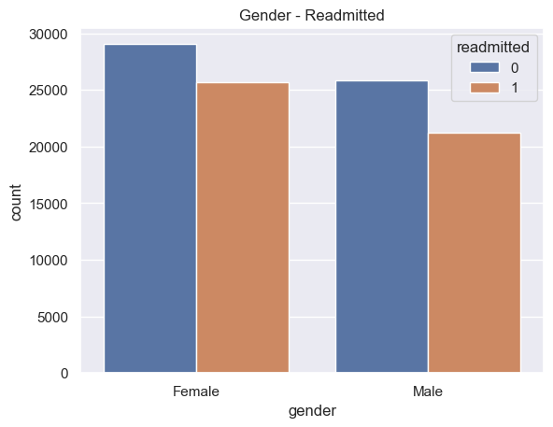
Gender VS Readmitted
Proportions of Race Value
Female 0.537586
Male 0.462384

Slide 11
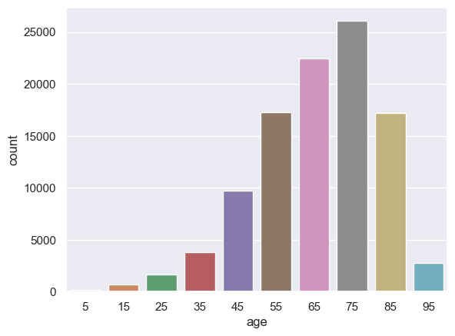
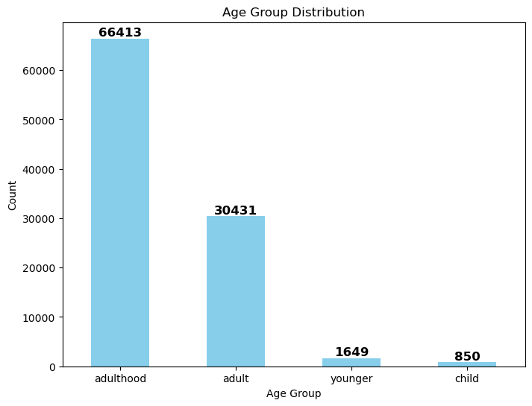
Age Group Distribution

Slide 12
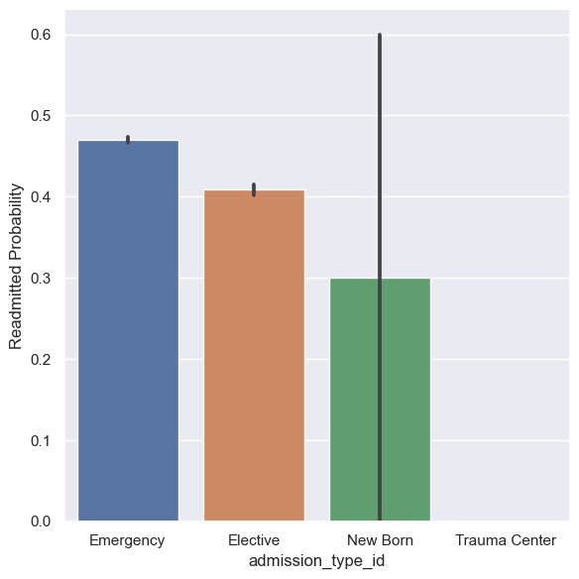
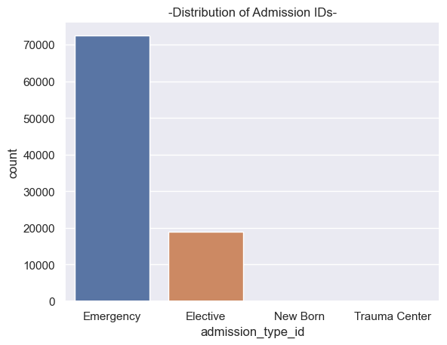
Admission Type ID
Distribution of ID-
Emergency 72468
Elective 18868
Trauma Center 21
Newborn 10

Slide 13
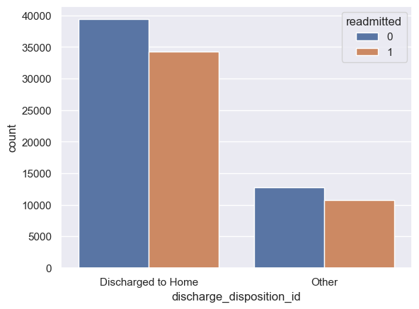
Discharge disposition
Admission Source
Emergency 57492
Referral 30855
Other 6474
Proportions of ID's
Discharged to Home 73649
Other 23434

Slide 14
Admission_Source_Id Vs Readmitted
We see that Readmitted Probability of Referral is very close to Emergency, although Emergency is have more samples than other

Slide 15
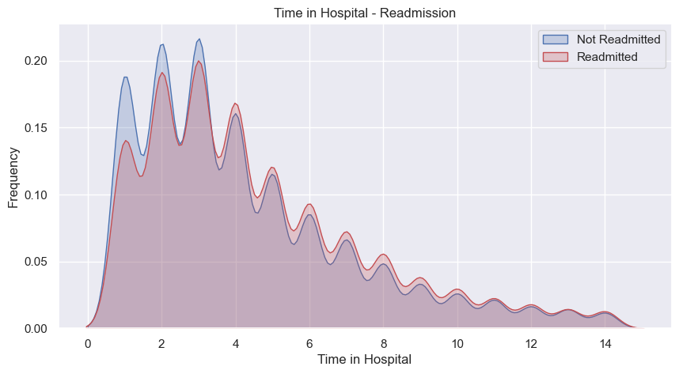
Time In Hospital VS Readmission
Most of people stayed 2 - 3 days in hospital

Slide 16
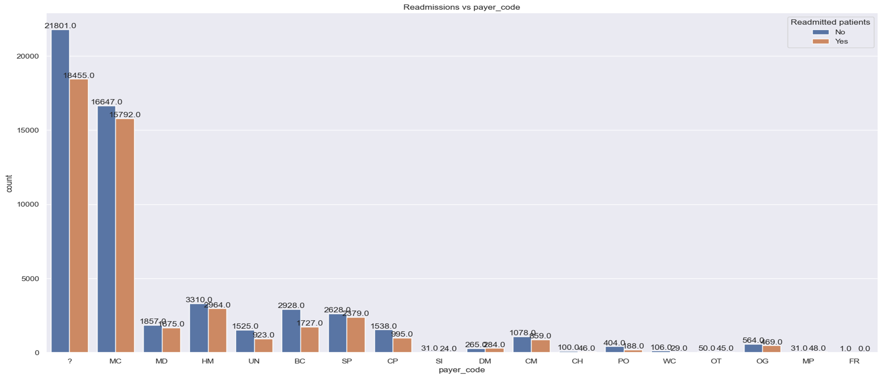
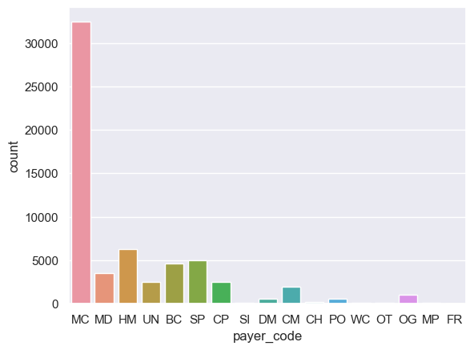
Payer Code Vs Readmitted
MC 32439 HM 6274 SP 5007 BC 4655 MD 3532 CP 2531
UN 2448 CM 1937 OG 1033 PO 592 DM 549 CH 146 WC 135 OT 95
MP 79 SI 55 FR 1
Blue Cross\Blue Shield, Medicare, and self-pay

Slide 17
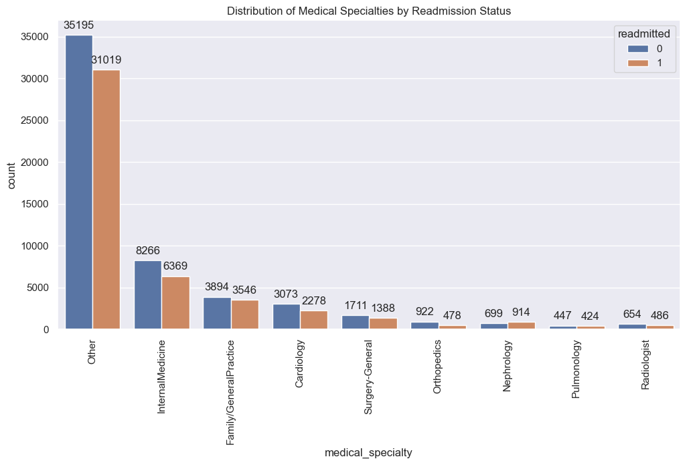
Medical Specialty Vs Readmitted

Slide 18
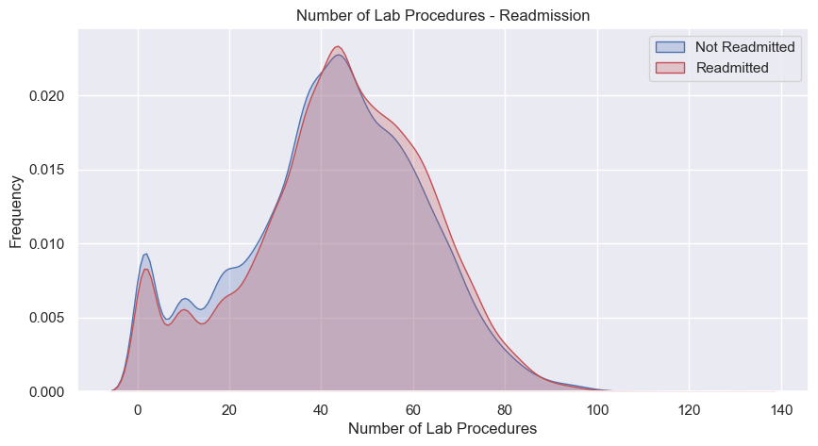
Number of Lab Procedures - Readmission

Slide 19
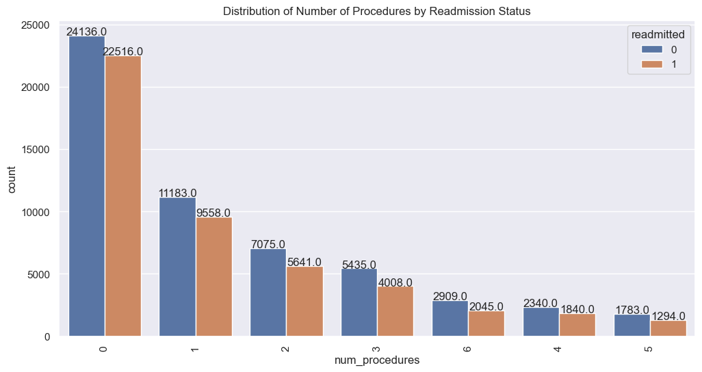
Number_Procedures VS Readmitted
Proportions of Values
0 45.843774
1 20.381671
2 12.495701
3 9.279404
6 4.868174
4 4.107583
5 3.023692

Slide 20
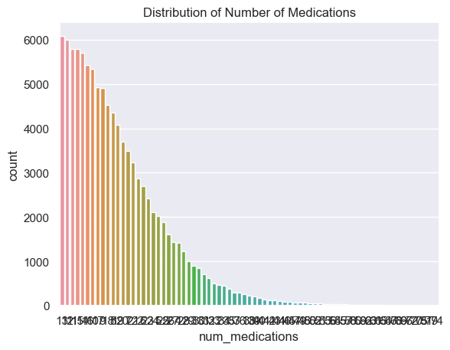
Number Of Medications
13 6086
12 6004
11 5795
15 5792
14 5707
...
70 2
75 2
81 1
79 1
74 1

Slide 21
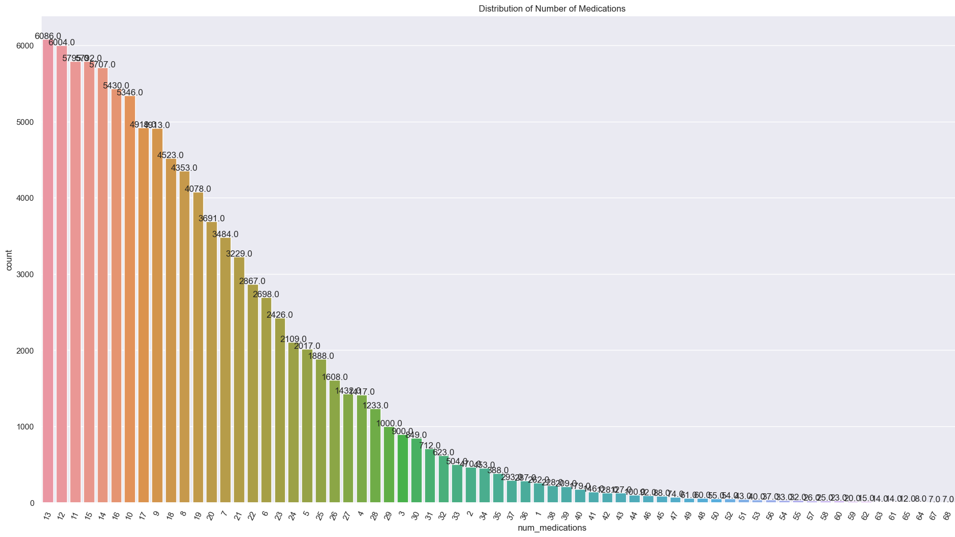

Slide 22
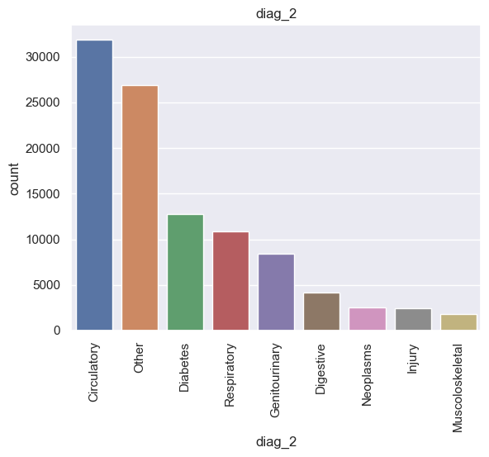
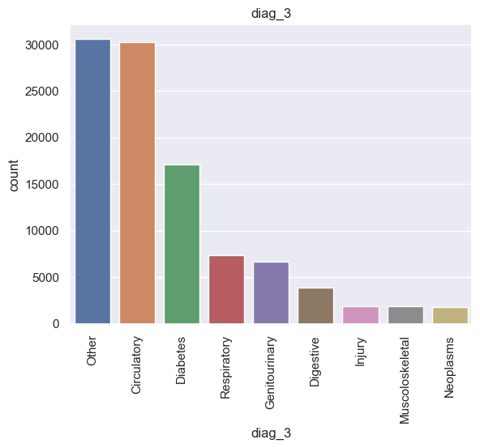
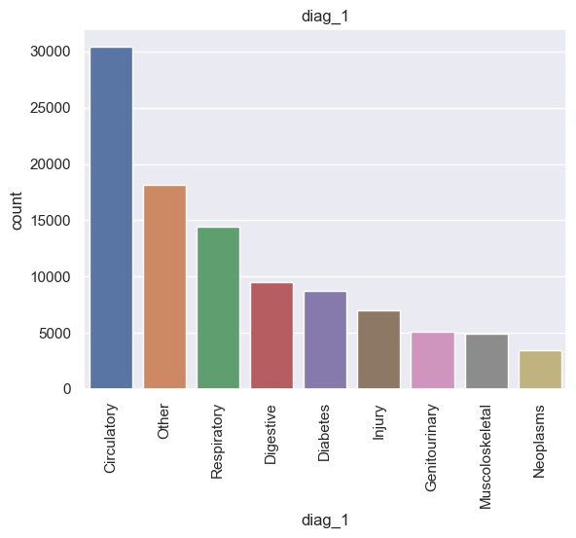
diag_1,diag_2,diag_3

Slide 23
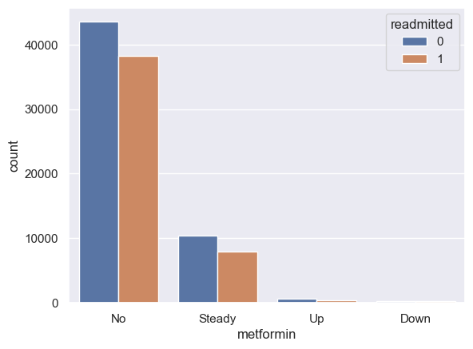
Metformin VS Readmitted
METFORMIN
No 81776
Steady 18345
Up 1067
Down 575

Slide 24
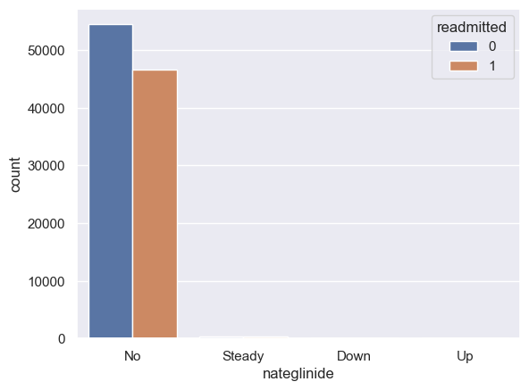
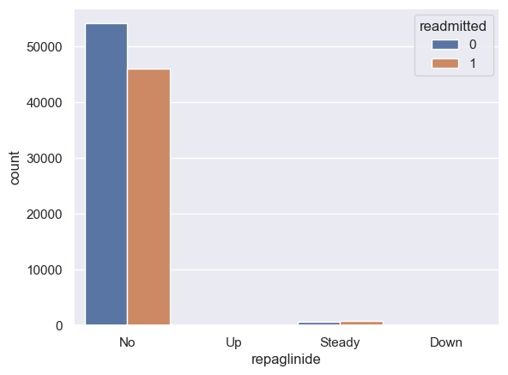
Repaglinide VS Readmitted
REPAGLINIDE
No 100224
Steady 1384
Up 110
Down 45
NATEGLINIDE
No 101060
Steady 668
Up 24
Down 11
Nateglinide VS Readmitted

Slide 25
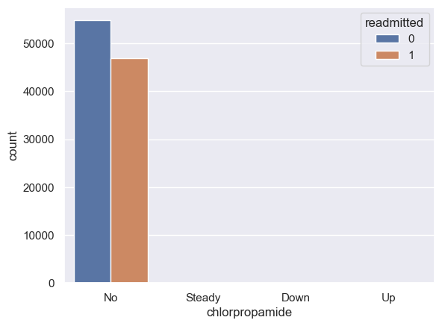
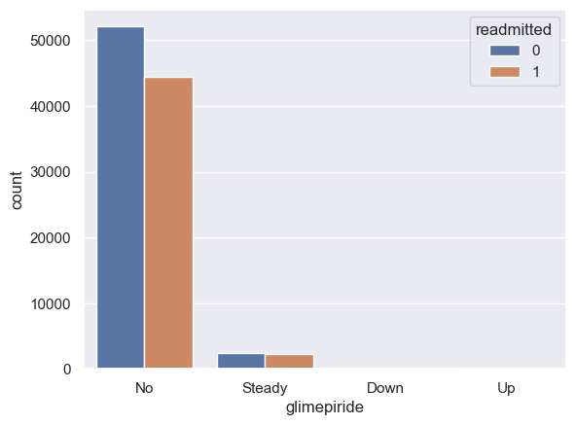
chlorpropamide VS Readmitted
CHLORPROPAMIDE
No 101677
Steady 79
Up 6
Down 1
GLIMEPIRIDE
No 96572
Steady 4670
Up 327
Down 194
GLIMEPIRIDE VS Readmitted

Slide 26
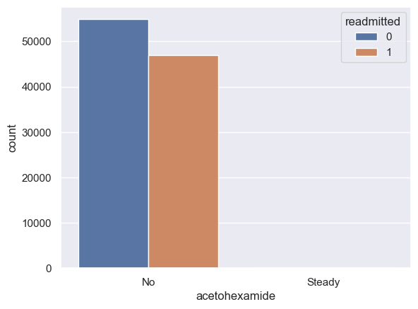
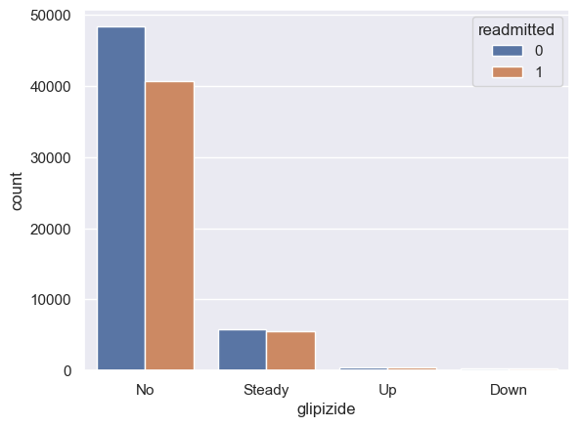
Acetohexamide VS Readmitted
ACETOHEXAMIDE
No 101762
Steady 1
GLIPIZIDE
No 89078
Steady 11355
Up 770
Down 560
Glipizide VS Readmitted

Slide 27

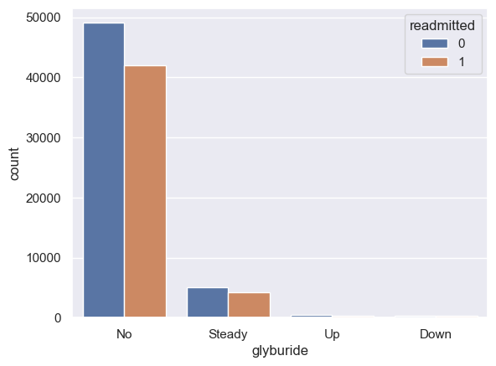
Glyburide VS Readmitted
GLYBURIDE
No 91113
Steady 9274
Up 812
Down 564
TOLBUTAMIDE
No 101740
Steady 23
Tolbutamide VS Readmitted

Slide 28

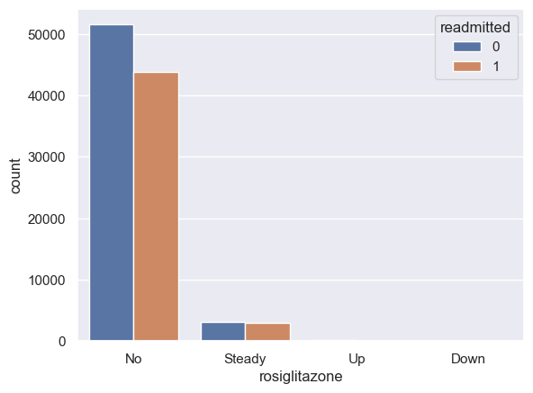
Pioglitazone VS Readmitted
PIOGLITAZONE
No 94436
Steady 6975
Up 234
Down 118
ROSIGLITAZONE
No 95399
Steady 6099
Up 178
Down 87
Rosiglitazone VS Readmitted

Slide 29


Acarbose Vs Readmission
ACARBOSE
No 101455
Steady 295
Up 10
Down 3
MIGLITOL
No 101725
Steady 31
Down 5
Up 2
Miglitol Vs Readmission

Slide 30
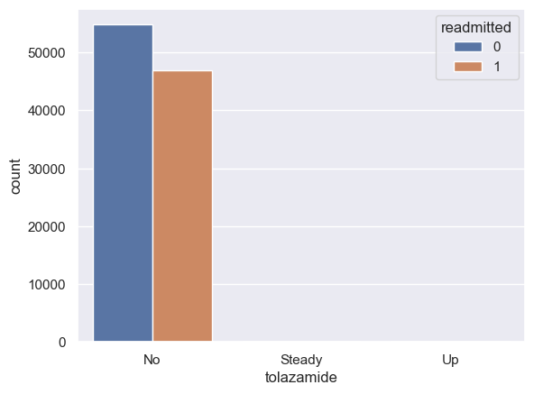
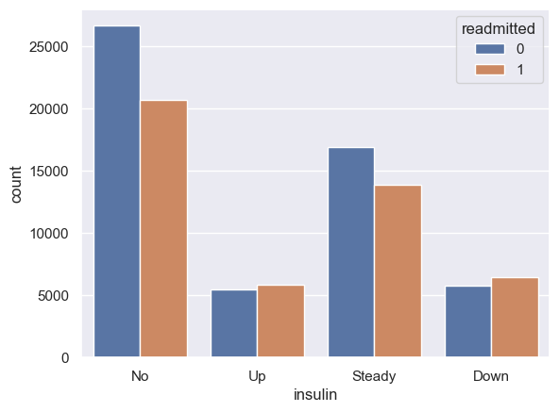
Tolazamide VS Readmitted
TOLAZAMIDE
No 101724
Steady 38
Up 1
INSULIN
No 47380
Steady 30849
Down 12218
Up 11316
Insulin vs Admitted

Slide 31
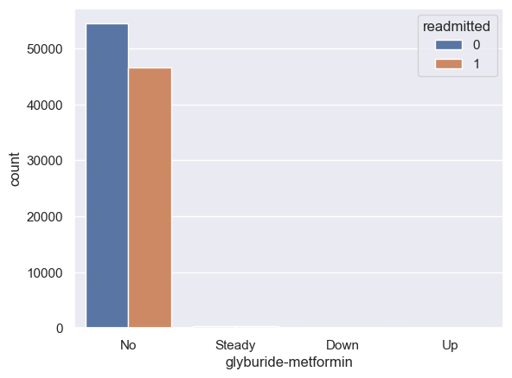

Glyburide-metformin VS Readmitted
GLYBURIDE-METFORMIN
No 101057
Steady 692
Up 8
Down 6
GLIPIZIDE-METFORMIN
No 101750
Steady 13
Glipizide-metformin VS Readmitted

Slide 32


Metformin-Rosiglitazone VS Readmitted
METFORMIN-ROSIGLITAZONE
No 101761
Steady 2
METFORMIN-PIOGLITAZONE
No 101762
Steady 1
Metformin-Rosiglitazone VS Readmitted

Slide 33
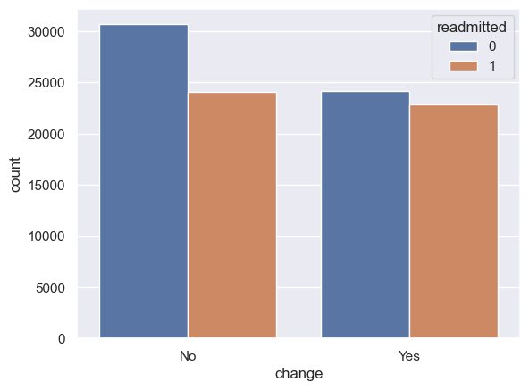
Change VS Readmitted
No 54754
Ch 47009

Slide 34

Glucose Serum Vs Readmitted
Indicates the range of the result or if the test was not taken. Values:
0 96417
2 2749
1 2597

Slide 35
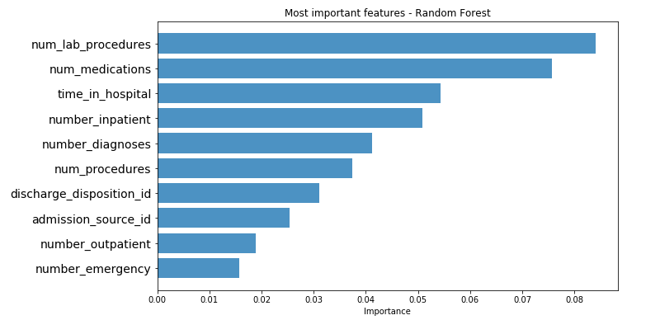
Most Important Feature

Slide 36

Findings
High preceding year visits.
The patient is discharged to another medical facility or discharged to a home with health services.
The patient is given diabetes medicines.
Metformin and/or insulin are not being given or the dosage is low.
A secondary diagnosis was coming to be Diabetes.
An A1C test was not performed.

Slide 37
High Preceding Year Visits: This suggests that the patient has a history of frequent visits to healthcare facilities, possibly due to complications or uncontrolled diabetes.
High healthcare utilization in the preceding year can be a red flag for healthcare providers, indicating that the patient's condition may require more attention and targeted interventions.
Discharge to Another Medical Facility or Home with Health Services: Patients with complex medical needs or uncontrolled diabetes may be discharged to another
medical facilities, such as a skilled nursing facility or rehabilitation Centre, or their home with additional health services. This may be done to ensure ongoing medical
monitoring and support to prevent readmissions.
Patient Given Diabetes Medicines: This indicates that the patient has been prescribed medications specifically for diabetes management. Proper medication
management is essential to control blood sugar levels and prevent complications associated with diabetes.

Slide 38
Metformin and/or Insulin Not Given or Low Dosage: Metformin and insulin are common medications used to manage diabetes.
If these medications are not given or prescribed at a low dosage, it may indicate inadequate diabetes management, which can increase the risk of hospital readmission.
Secondary Diagnosis of Diabetes: A secondary diagnosis of diabetes means that diabetes is not the primary reason for hospitalization, but it is
a significant health condition present in the patient. In such cases, it is essential for healthcare providers to address diabetes management to prevent complications
during the hospital stay and after discharge.
A1C Test Not Performed: The A1C test is a crucial tool for assessing a patient's average blood sugar levels over the past few months. If this test is not performed,
healthcare providers may lack essential information about the patient's diabetes control, making it challenging to tailor the treatment plan effectively.

Slide 39
One of the Reasons For Readmission
Number_diagnoses: The total number of diagnoses recorded for each patient during their hospital encounter. A higher number of diagnoses may indicate more complex health conditions and potential reasons for readmission.
Number_emergency: The number of emergency department visits a patient had in the year before the current hospital encounter. Frequent emergency visits.
Number_outpatient: The number of outpatient visits a patient had in the year before the current hospital encounter. Frequent outpatient visits may indicate ongoing medical needs.

Slide 40
Medication Errors: Patients may experience medication-related issues, such as incorrect dosages, drug interactions, or failure to adhere to prescribed medications, which can result in readmissions.
Postoperative Complications: Surgical patients may face complications after discharge, such as infections, wound problems, or other surgical site issues.
Unplanned Discharges: Patients discharged too early, before they are medically stable, may experience complications requiring readmission.

Slide 41

MC - Medicare: Medicare is a federal health insurance program in the United States that primarily covers individuals who are 65 and older, as well as certain younger individuals with disabilities.
HM - Health Maintenance Organization (HMO): HMO is a type of managed care health insurance plan that requires members to choose a primary care physician and get referrals for specialized care.
SP - Self-Pay: This code might indicate that the patient is responsible for paying their medical expenses out-of-pocket without insurance coverage.
BC - Blue Cross: Blue Cross is a group of independent health insurance companies that provide health insurance plans across the United States.
MD - Medicaid: Medicaid is a state and federally-funded program that provides health coverage to low-income individuals and families.
CP - Commercial Payer: This code may represent a commercial insurance company or private health insurance plan.
UN - Unknown: This code might be used when the payer information is unknown or not yet determined.
CM - Champus (Civilian Health and Medical Program of the Uniformed Services): CM refers to a health insurance program for military dependents and retirees.
OG - Other Government Programs: This code may include other government-sponsored health insurance programs or plans.

Slide 42
PO - Point of Service (POS): POS is a type of managed care plan that allows members to receive care both within a network of providers and outside the network at a higher cost.
DM - Disease Management: DM could indicate a disease management program or specialized care for chronic conditions.
CH - Children's Health Insurance Program (CHIP): CHIP provides health insurance coverage for low-income children and sometimes pregnant women in the United States.
WC - Workers' Compensation: WC is a type of insurance that provides medical benefits and wage replacement to employees who suffer work-related injuries or illnesses.
OT - Other: This code may be used to represent other payer types not specifically listed.
MP - Medical Practice: This code might be used when the patient pays directly to a medical practice for services rendered.
SI - Supplemental Insurance: SI could indicate additional insurance coverage to supplement primary health insurance.
FR - Federal Employee Program: FR might refer to a health insurance program for federal employees and their families

Slide 43

Thank you So Much

