Slide 1

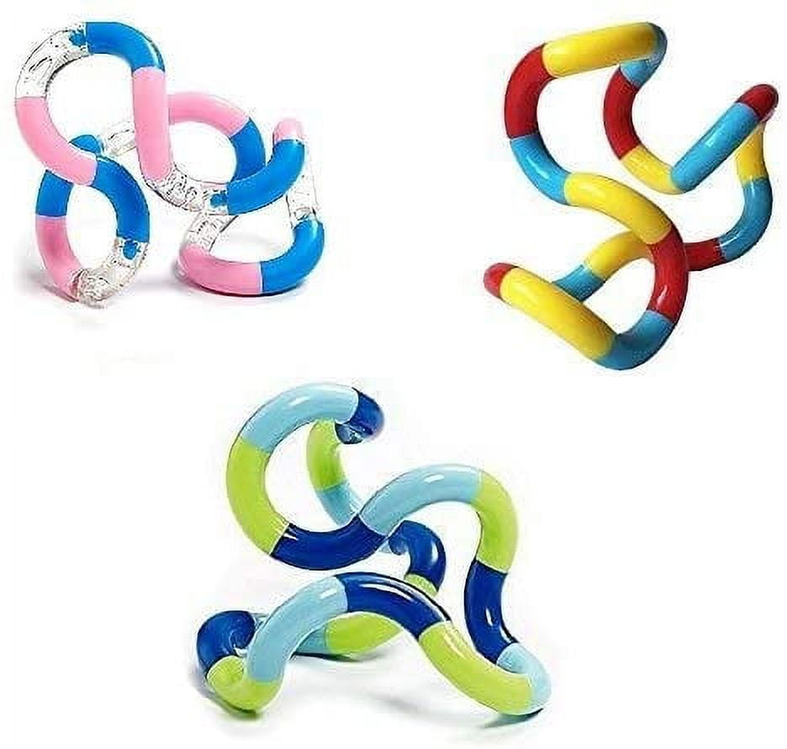
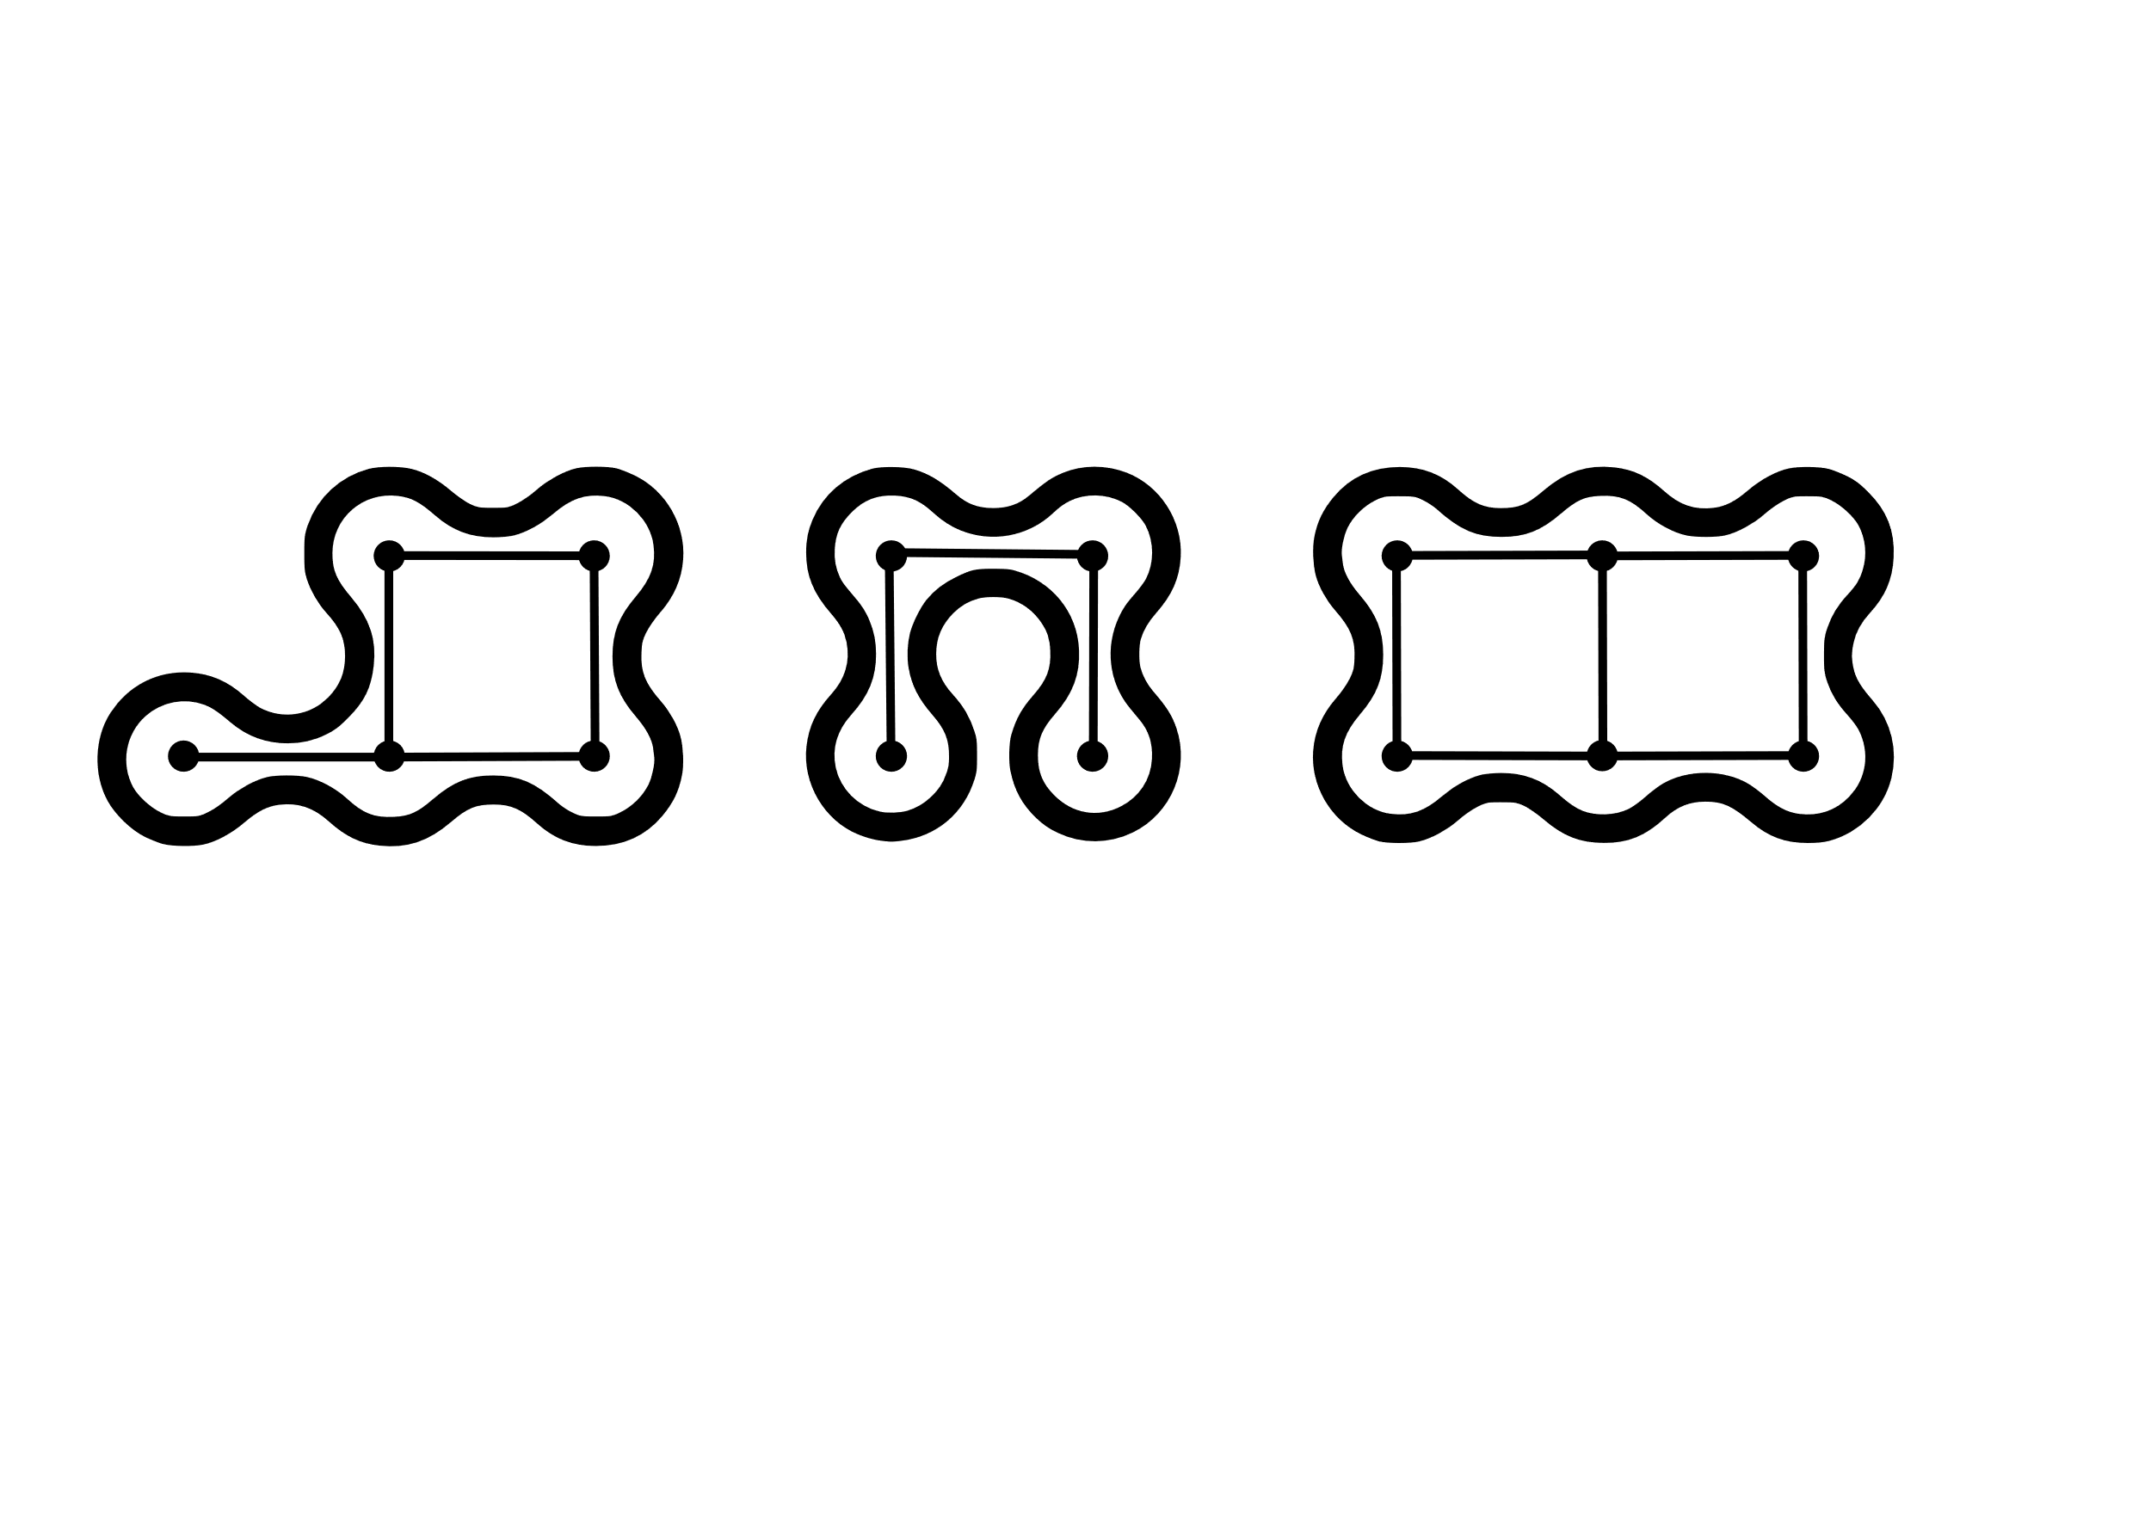
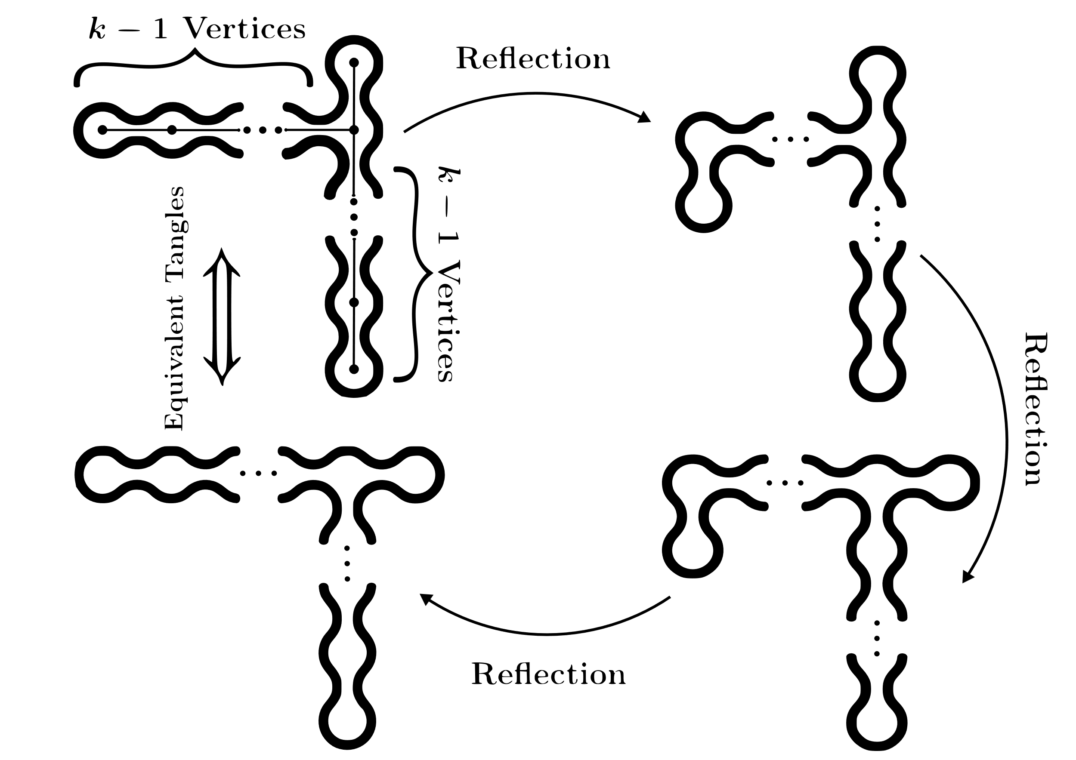
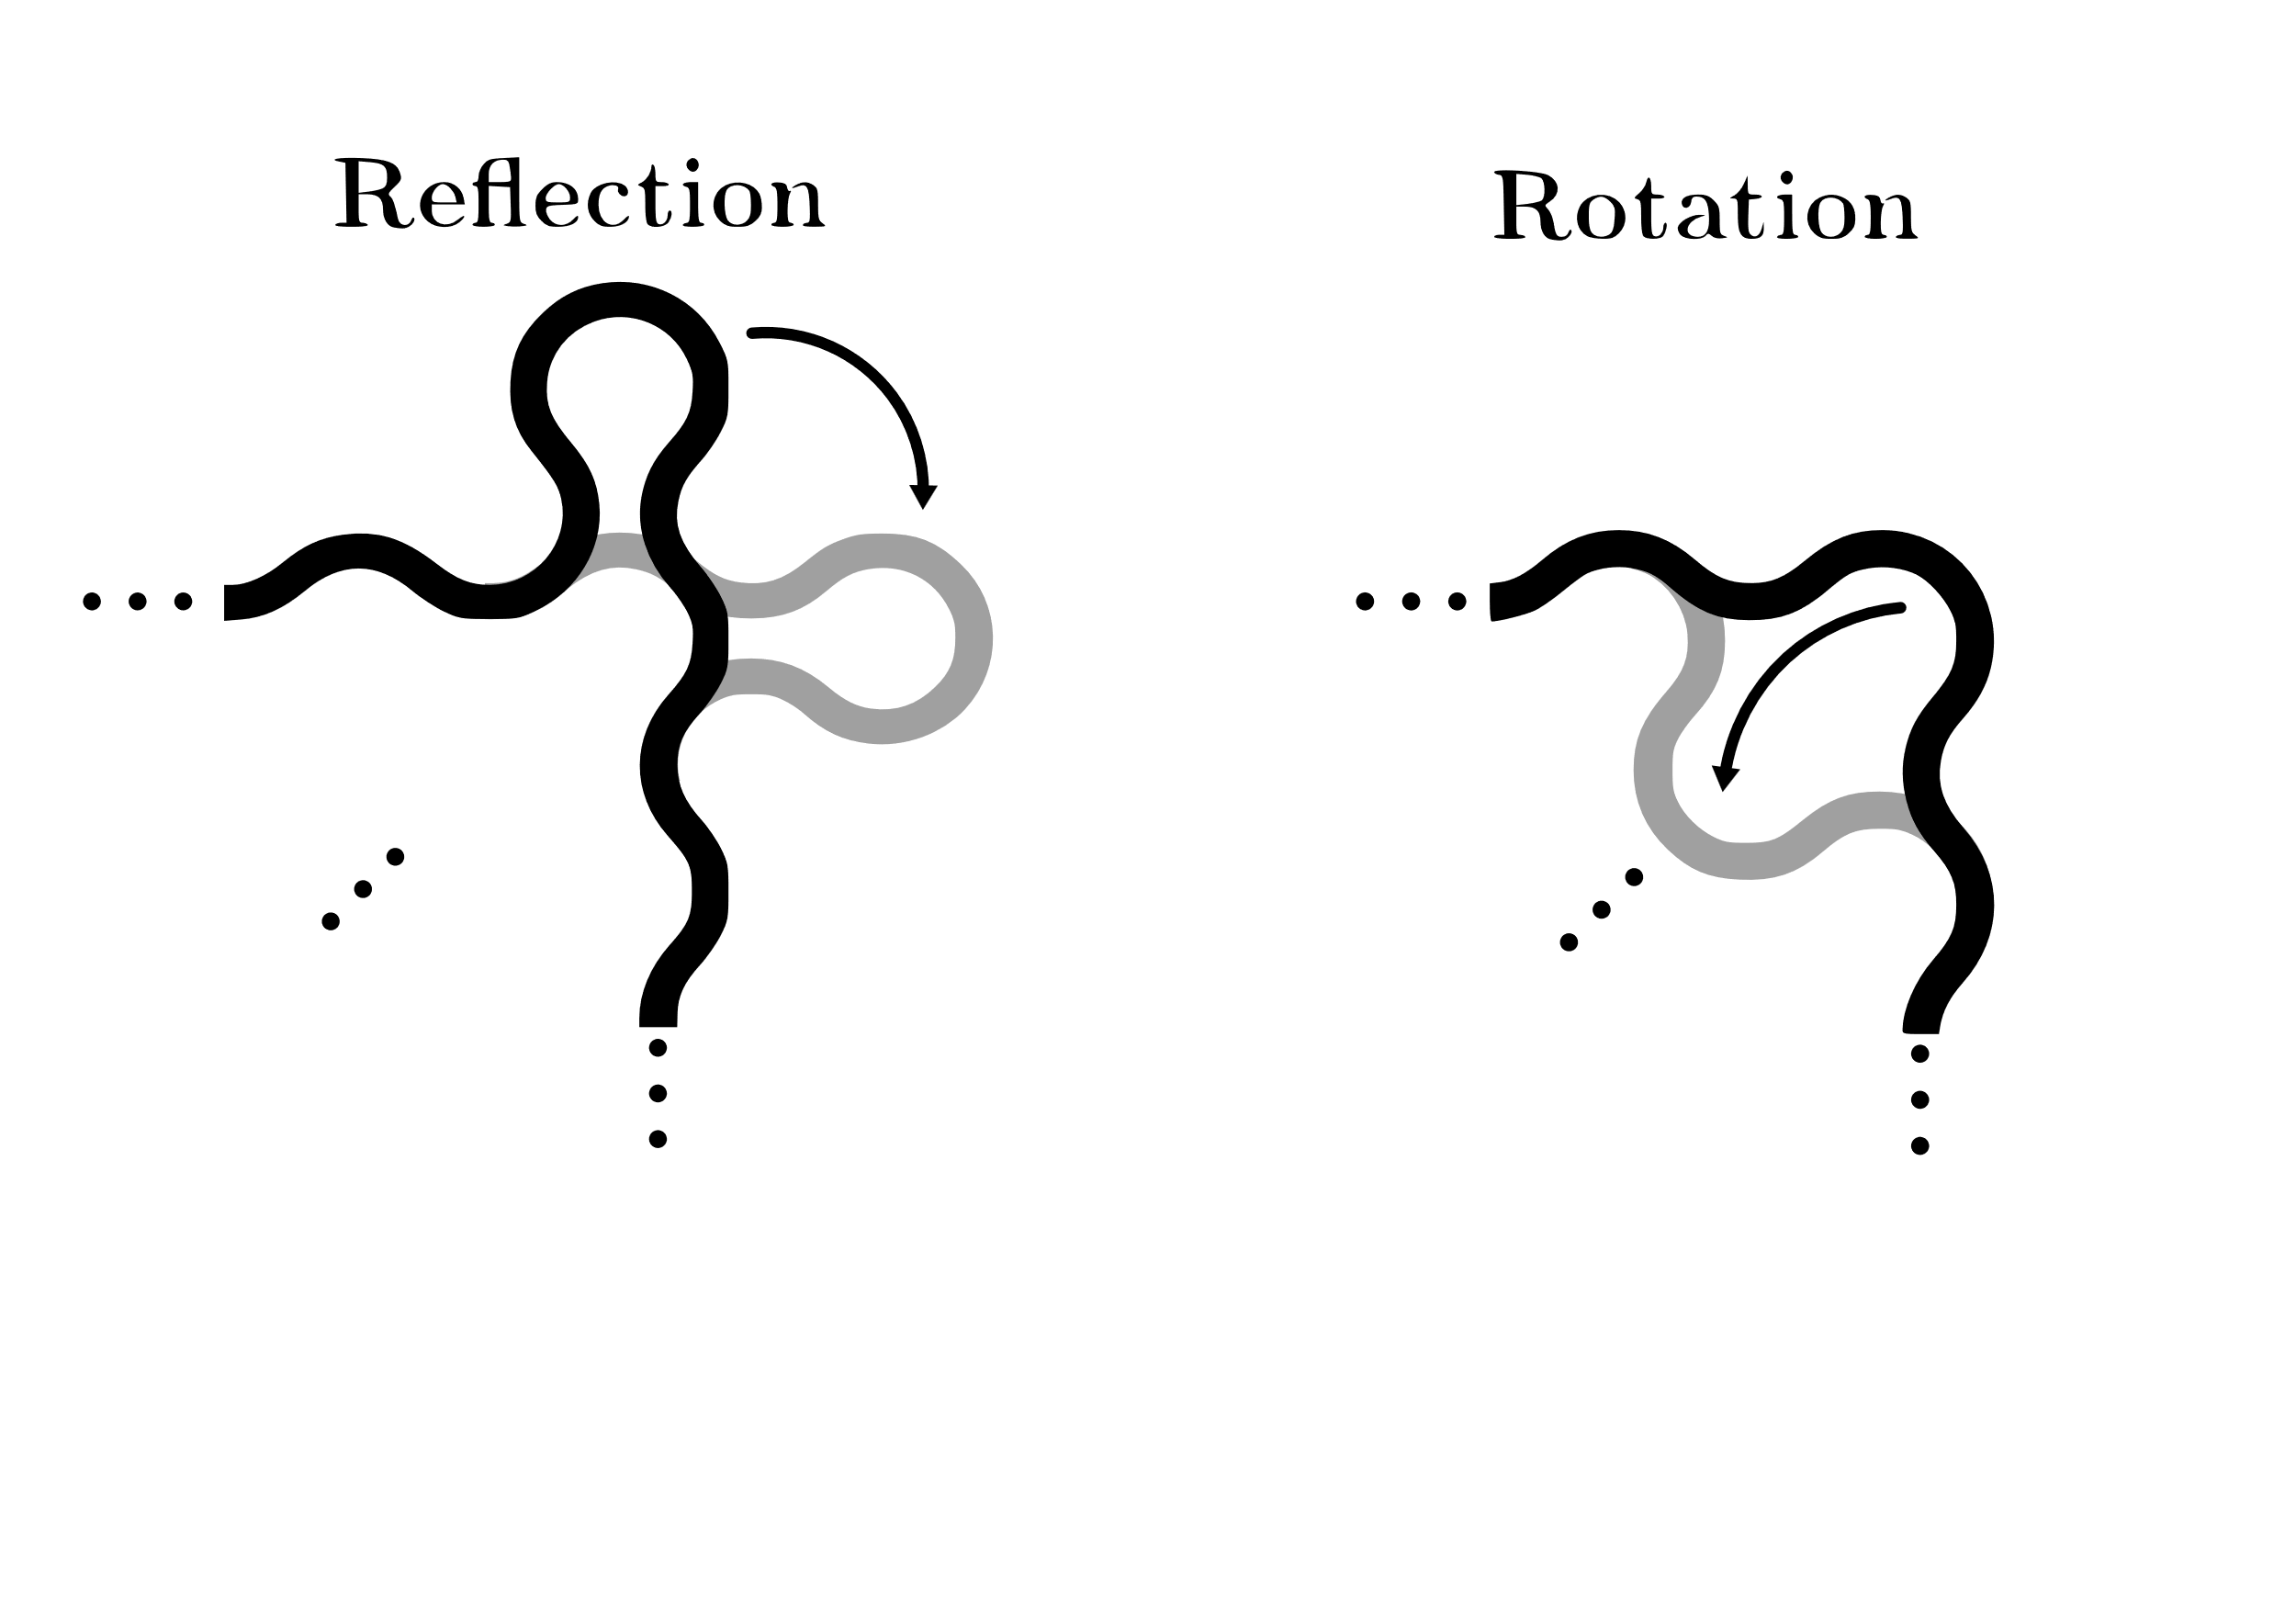
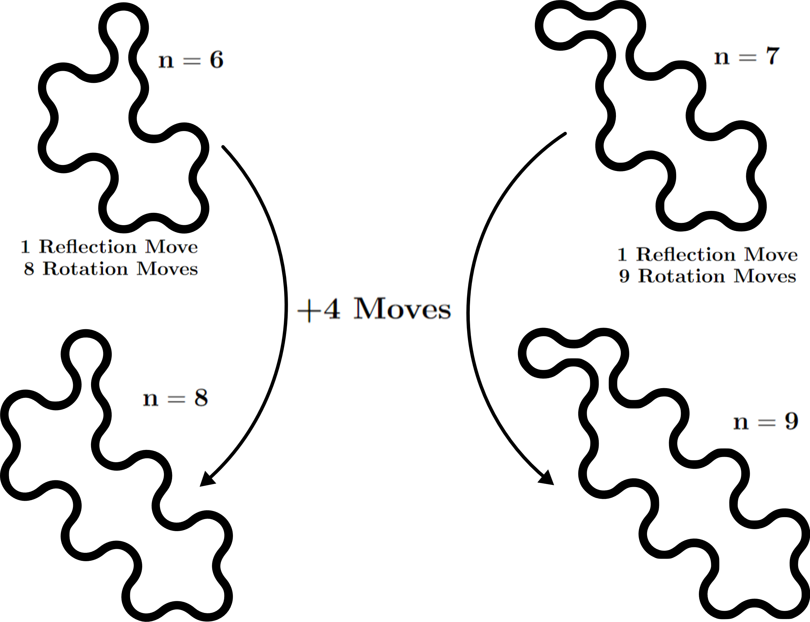
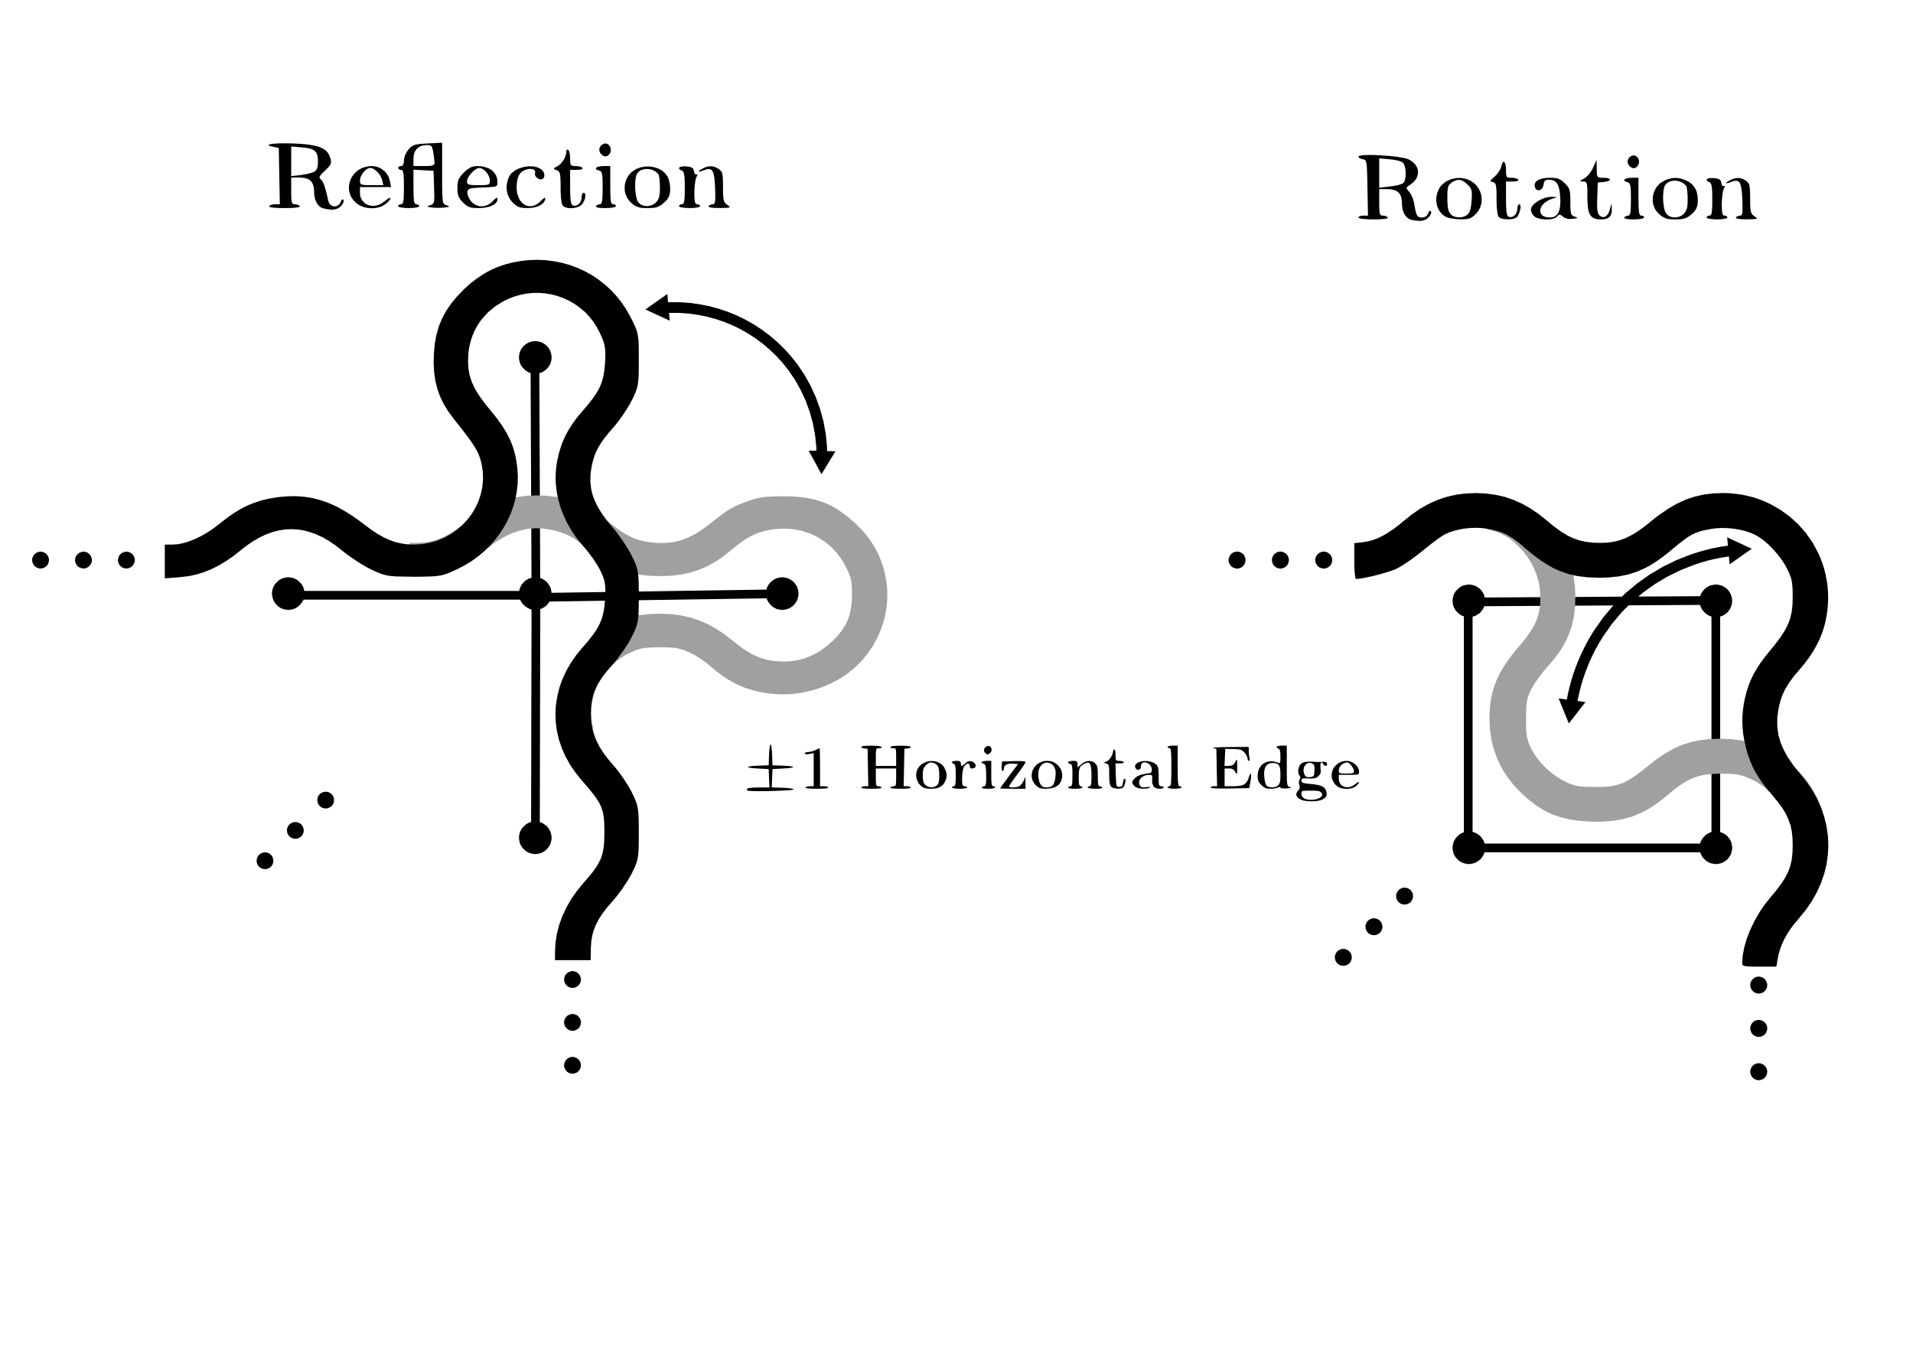
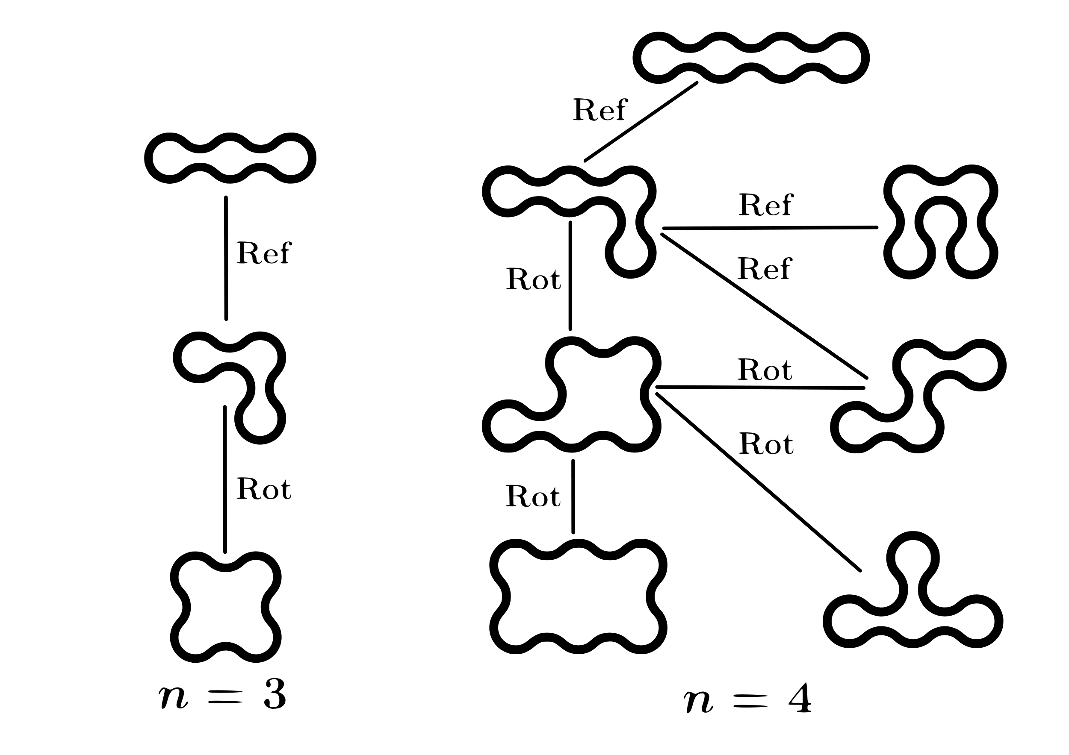


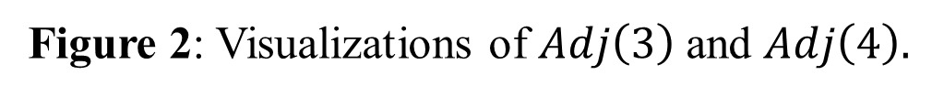
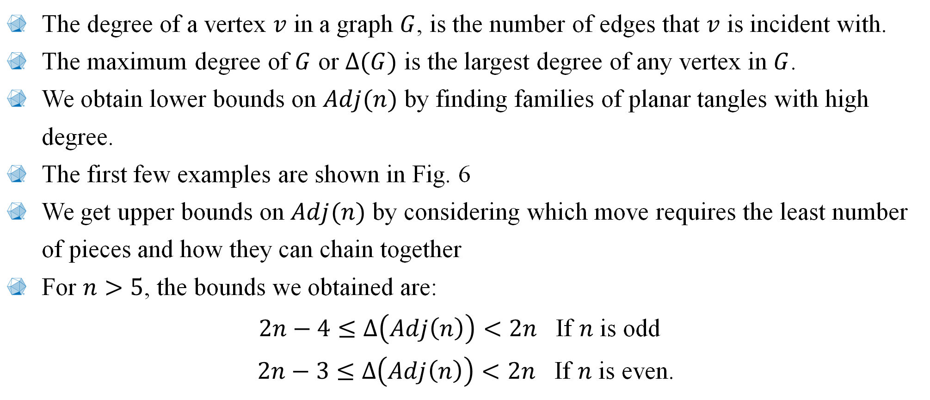


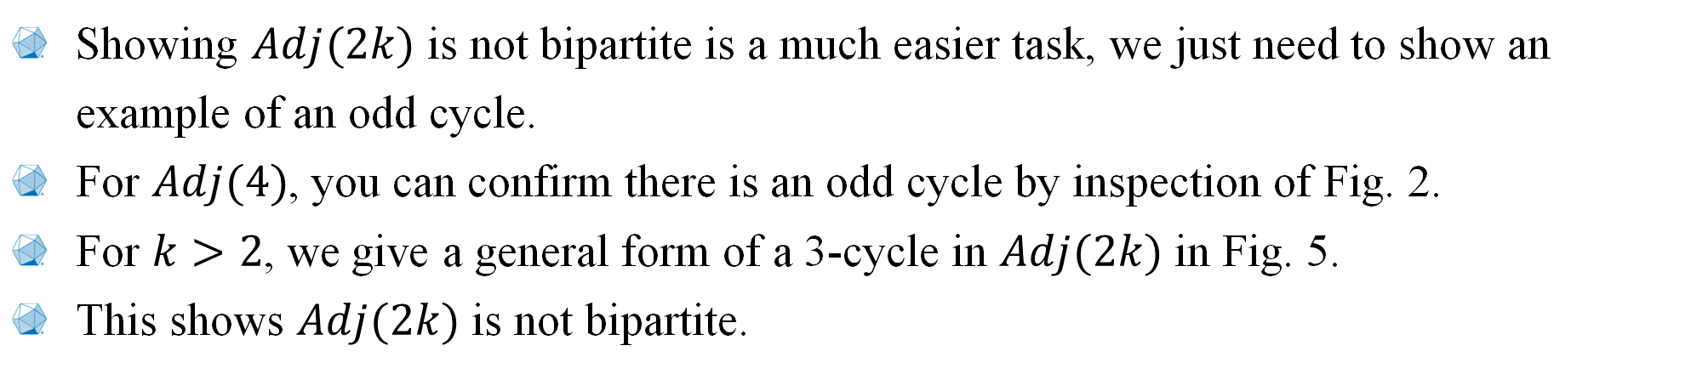
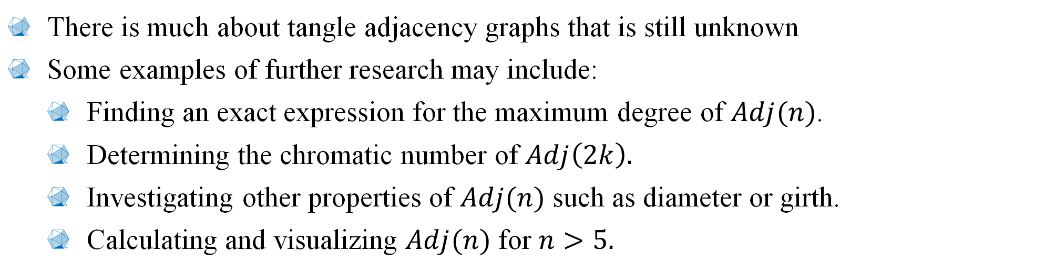
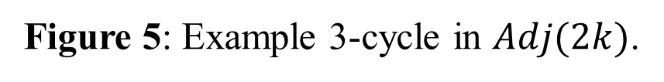
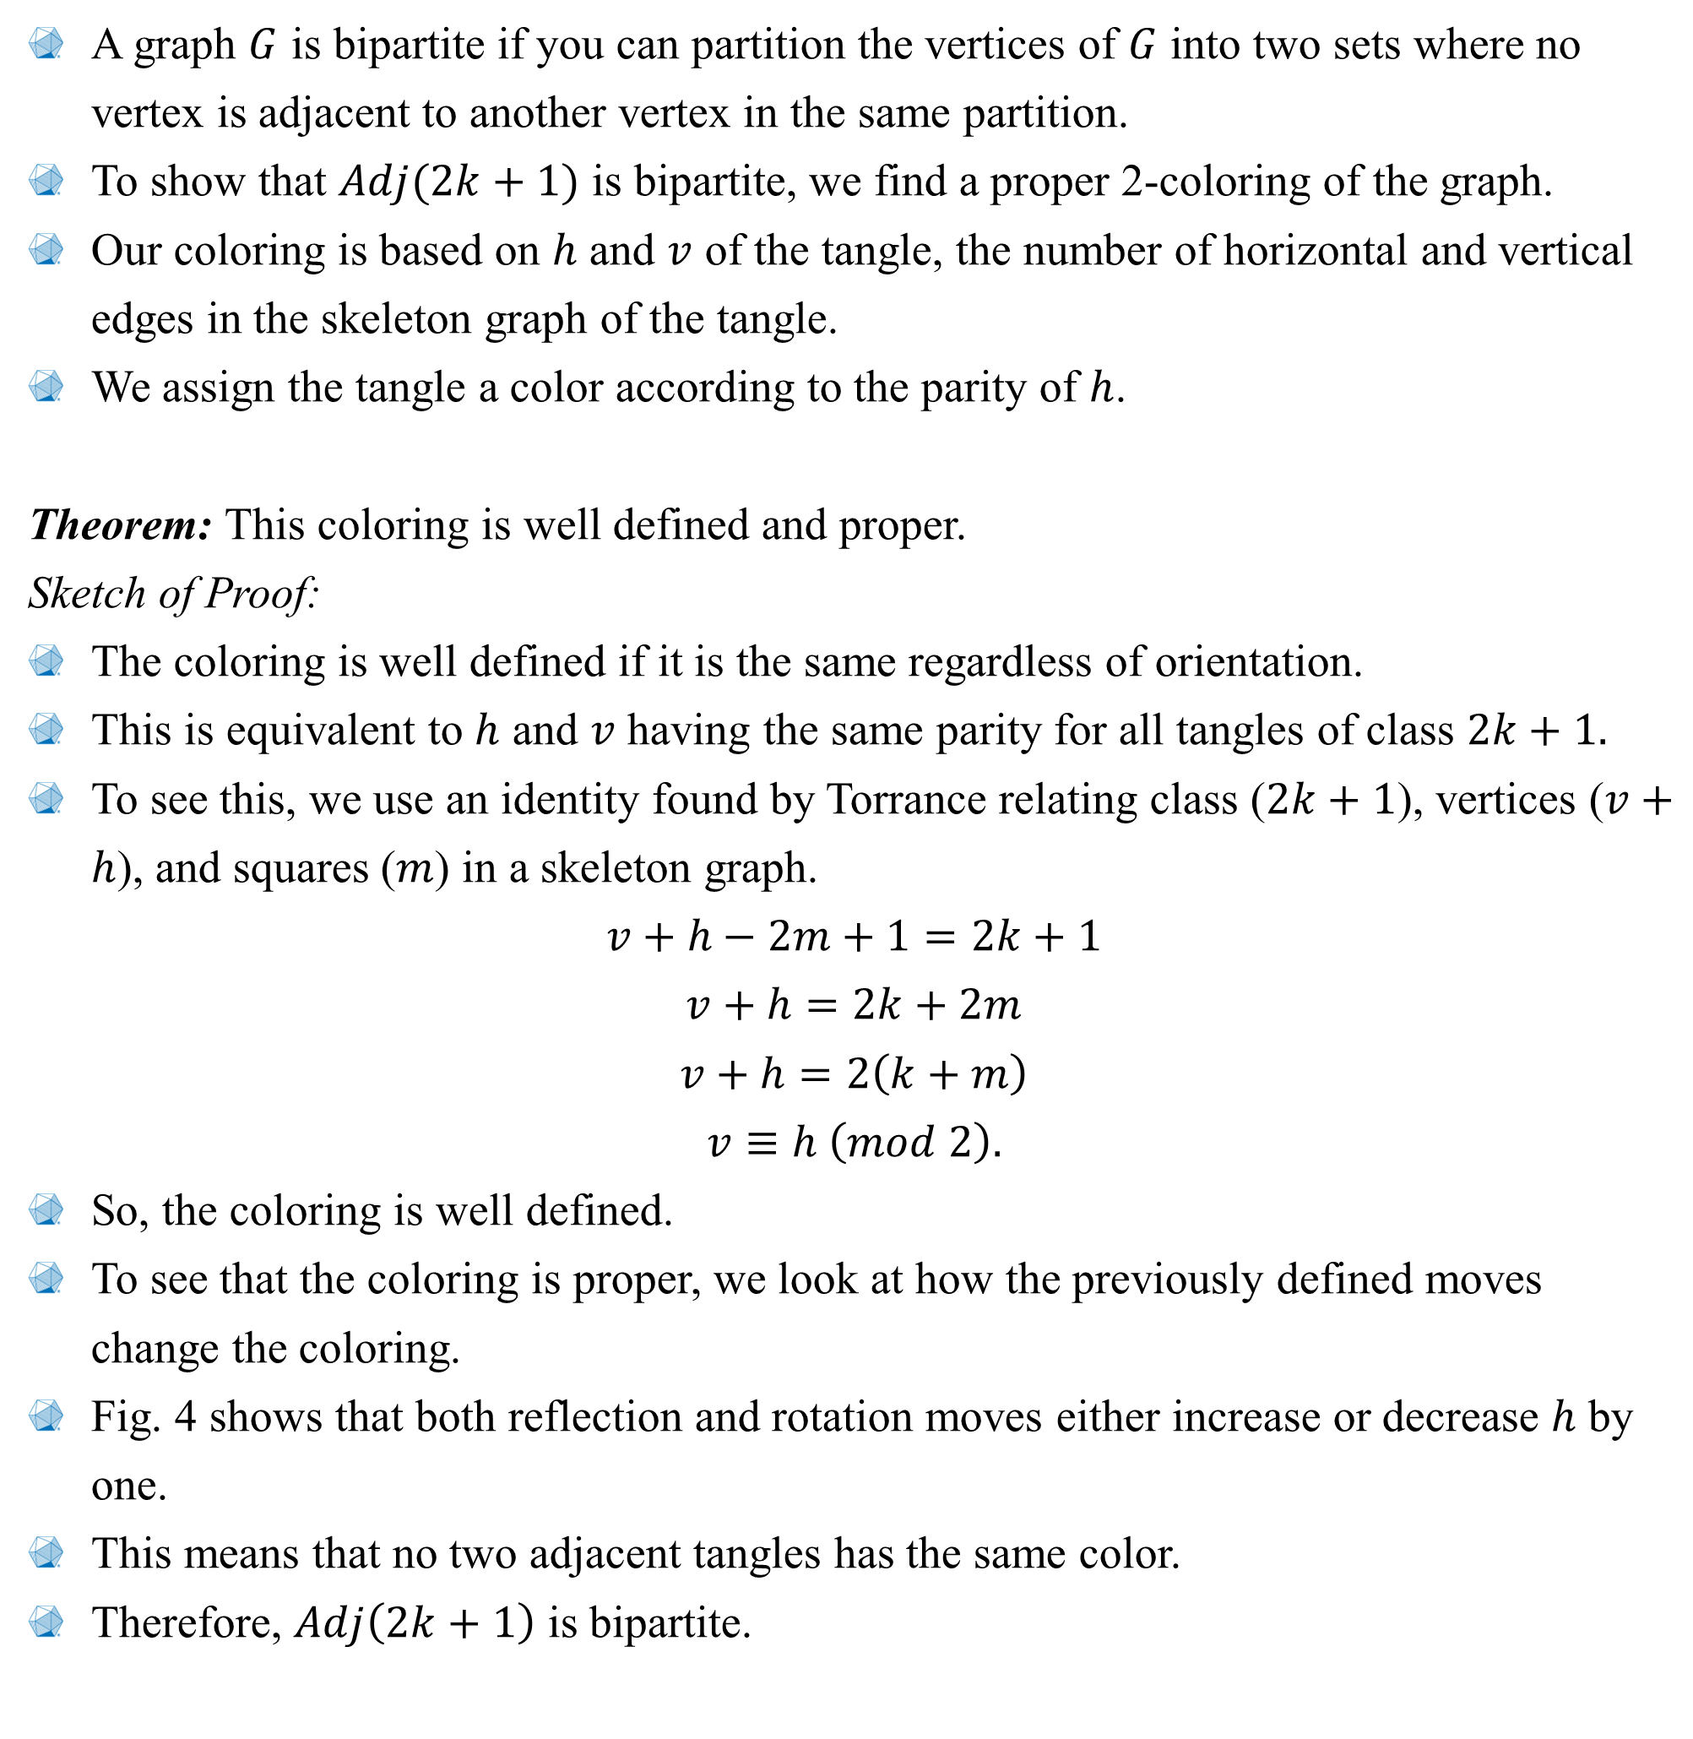

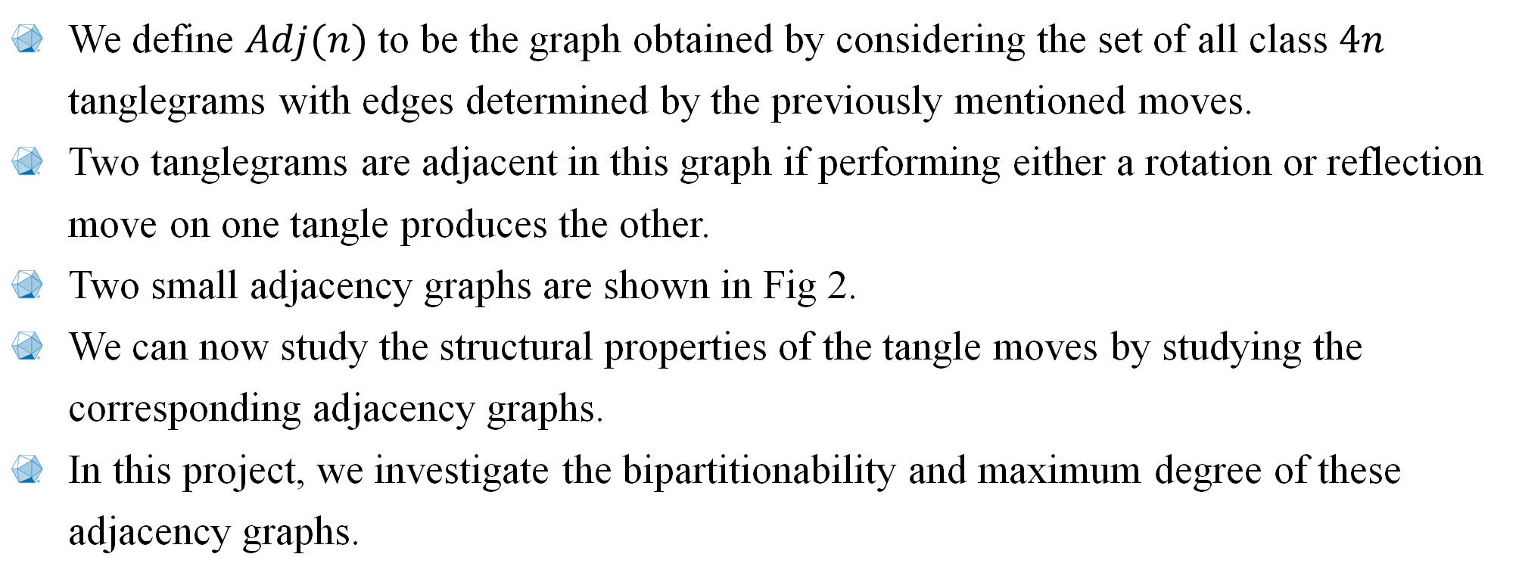
2024 MAA SE Section Meeting : Adjacency Graphs of Equivalence Classes of Planar Tanglegrams
What are Tangles?
Skeleton Graphs
A Tangle is a fidget toy.
The skeleton graph is a way of encoding the geometric structure of single planar tangle into a graph.
This is done by forming a graph that fills the inside the tangle.
A few examples of tanglegrams and their corresponding skeleton graphs are shown in Fig.3
Tangle Q&A
Figure 3: Examples of a skeleton graphs of tanglegrams
When can you make a tangle lie flat?
When the number of pieces in the tangle is a multiple of 4 (this multiple is called the class).
How many planar tangles are there for a given number of pieces?
This is an unsolved problem in general, but all that matters for now is that the number grows extremely fast with the class.
Are there ways to “travel” between planar tangles of a given class?
There are several ways to define moves on planar tangles, but in this project, we consider the two moves given in Fig. 1.
What kind of structure do you get when you look at how tangles connect through these move?
That’s what this project aims to figure out!
$Adj(2k+1)$is Bipartite
A graph $G$ is bipartite if you can partition the vertices of $G$ into two sets where no vertex is adjacent to another vertex in the same partition.
To show that $Adj(2k+1)$ is bipartite, we find a proper 2-coloring of the graph.
Our coloring is based on $h$ and $v$ of the tangle, the number of horizontal and vertical edges in the skeleton graph of the tangle.
We assign the tangle a color according to the parity of $h$.
Theorem: This coloring is well defined and proper.
Sketch of Proof:
The coloring is well defined if it is the same regardless of orientation.
This is equivalent to $h$ and $v$ having the same parity for all tangles of class $2k+1.$
To see this, we use an identity found by Torrance relating class ($2k+1$), vertices ($v+h$), and squares ($m$) in a skeleton graph.
$$v+h−2m+1=2k+1$$
$$v+h=2k+2m$$
$$v+h=2\left(k+m\right)$$
$$v≡h \left(mod 2\right).$$
So, the coloring is well defined.
To see that the coloring is proper, we look at how the previously defined moves change the coloring.
Fig. 4 shows that both reflection and rotation moves either increase or decrease $h$ by one.
This means that no two adjacent tangles has the same color.
Therefore, $Adj\left(2k+1\right)$ is bipartite.
Figure 5: Example 3-cycle in $Adj(2k)$.
Bounds on The Maximum degree of Adj(n)
The degree of a vertex $v$ in a graph $G$, is the number of edges that $v$ is incident with.
The maximum degree of $G$ or $∆(G)$ is the largest degree of any vertex in $G$.
We obtain lower bounds on $Adj(n)$ by finding families of planar tangles with high degree.
The first few examples are shown in Fig. 6
We get upper bounds on $Adj(n)$ by considering which move requires the least number of pieces and how they can chain together
For $n>5$, the bounds we obtained are:
$2n−4≤$ $∆\left(Adj\left(n\right)\right)<2n$ If $n$ is odd
$2n−3≤$ $∆\left(Adj\left(n\right)\right)<2n$ If $n$ is even.
Figure 1: Depiction of the local reflection and rotation moves
Tangle Adjacency Graphs
We define $Adj(n)$ to be the graph obtained by considering the set of all class $4n$ tanglegrams with edges determined by the previously mentioned moves.
Two tanglegrams are adjacent in this graph if performing either a rotation or reflection move on one tangle produces the other.
Two small adjacency graphs are shown in Fig 2.
We can now study the structural properties of the tangle moves by studying the corresponding adjacency graphs.
In this project, we investigate the bipartitionability and maximum degree of these adjacency graphs.
Figure 6: Example high degree tangles
Opportunities for Further Research
There is much about tangle adjacency graphs that is still unknown
Some examples of further research may include:
Finding an exact expression for the maximum degree of $Adj(n)$.
Determining the chromatic number of $Adj\left(2k\right).$
Investigating other properties of $Adj(n)$ such as diameter or girth.
Calculating and visualizing $Adj(n)$ for $n>5.$
Figure 4: Demonstration that the coloring is proper
$Adj(2k)$is not Bipartite
Showing $Adj(2k)$ is not bipartite is a much easier task, we just need to show an example of an odd cycle.
For $Adj(4)$, you can confirm there is an odd cycle by inspection of Fig. 2.
For $k>2$, we give a general form of a 3-cycle in $Adj(2k)$ in Fig. 5.
This shows $Adj(2k)$ is not bipartite.
Jadon Jones & Benji Roush
Berry College
Advisor: Ron Taylor
Figure 2: Visualizations of $Adj\left(3\right)$and $Adj\left(4\right).$

