Slide 1
ShelfLend
A library lending system, shipped the DevSecOps way
Parth Agarwal · Roll No. 10293 · Session 21 Final Capstone
github.com/Jadooonum1/devsecops-python
Notes:
Introduce ShelfLend: a library lending system built end to end with CI/CD, security scanning, Terraform, Kubernetes, GitOps and monitoring.

Slide 2
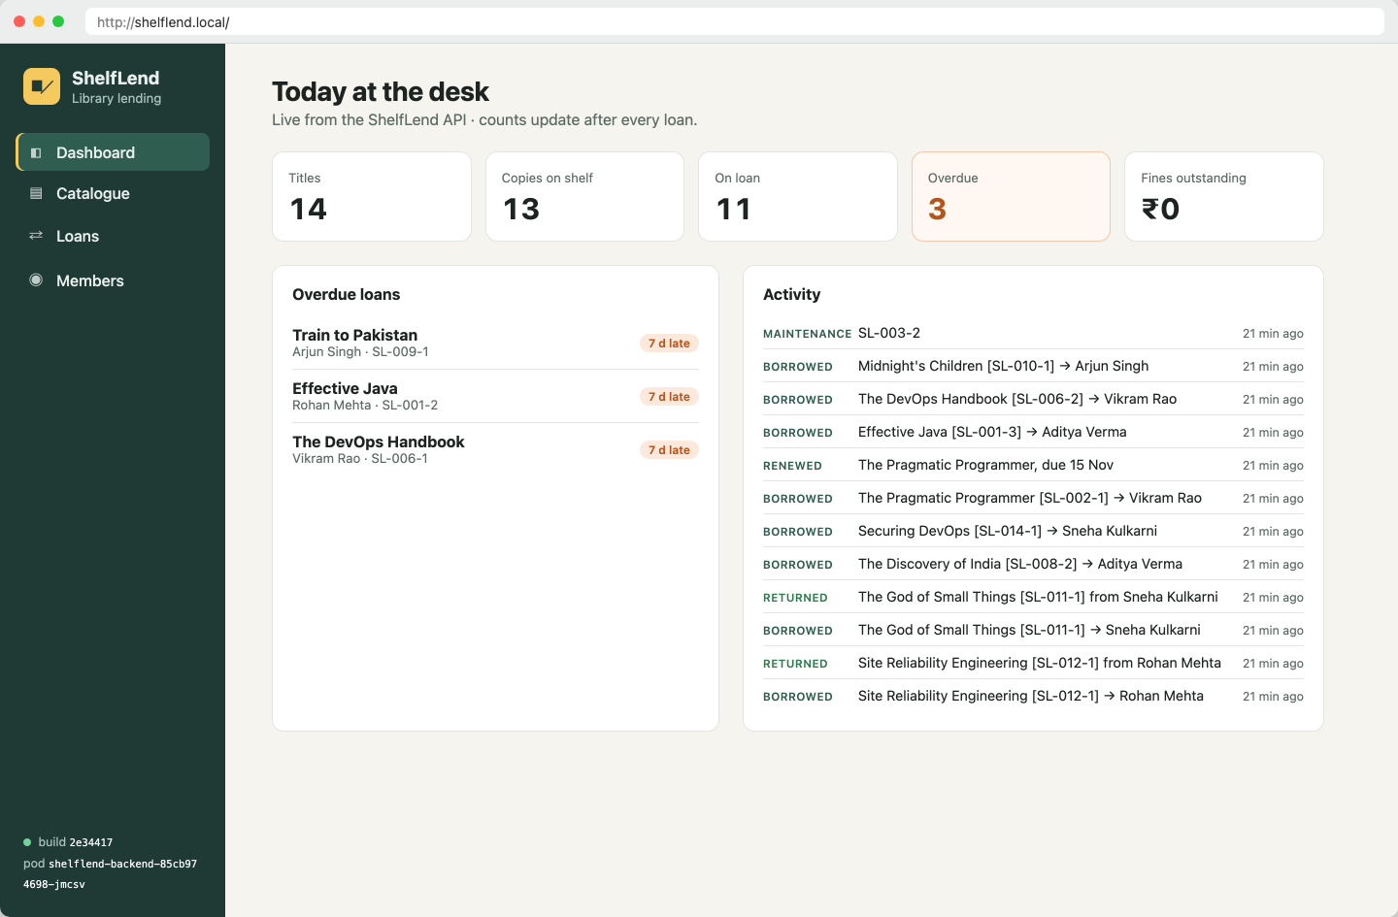
Lending rules a real library desk needs
1
A copy can't be lent twice
Row locks plus a partial unique index on active loans; the second request gets 409.
2
Members have loan limits
Each member has max_loans (default 3); over the limit returns 409 with the count.
3
Overdue loans earn fines
₹10 per late day on return; ₹100 unpaid blocks new loans until settled.
4
Renewals are capped
Up to 2 renewals of 14 days, never on an overdue loan.
Dashboard served through the Kubernetes Ingress
5
Every change is audited
audit_events feeds the dashboard's activity stream.
Notes:
Business rules give the API real conflicts to handle. They are enforced in the API, by row locks, and by Postgres constraints.

Slide 3
Tech stack
Application
Quality
Containers
FastAPI 0.142 · SQLAlchemy 2.0 · Alembic 1.20
React 18 + Vite 6 · PostgreSQL 17
pytest 9 (32 tests, 92% coverage)
SQLite test DB built by real migrations
python:3.12-slim multi-stage (UID 10001)
node:22 → nginx-unprivileged (UID 101)
CI/CD + Security
Platform
Infra + Observability
GitHub Actions · GHCR (SHA tags, amd64+arm64)
Trivy 0.75 · Gitleaks 8.30 · Bandit 1.9
kind 0.33 · Helm 4 · ingress-nginx 1.15
Argo CD 3.5 (GitOps) · HPA + PDB
Terraform 1.16, AWS provider 6.x
kube-prometheus-stack 92.8 · Grafana
Notes:
Versions are the ones actually pinned in the repo.

Slide 4
Architecture
kind cluster · namespace shelflend (PSS restricted)
GitHub Actions
test · scan · push · promote
frontend ×2
nginx :8080
/
GHCR
Browser
Ingress
images tagged by commit SHA
shelflend.local
ingress-nginx
Argo CD
/api
backend 2–6
postgres
syncs helm/ + gitops/ values
FastAPI :8000 · HPA
StatefulSet + PVC
Prometheus → Grafana
ServiceMonitor · PrometheusRule · dashboard
scrapes /metrics every 15 s; alerts
Notes:
Traffic: browser to ingress-nginx; / to the frontend, /api to the backend. Delivery: Actions pushes SHA-tagged images to GHCR and commits the SHA to gitops/; Argo CD applies the Helm chart.

Slide 5
One rule, three layers of defence
“A copy can never be on two active loans”
1
API check
2
Row locks
3
Database
copy.status must be available, else 409 "copy SL-001-1 is on loan"; the loan limit and fine block are checked the same way.
SELECT … FOR UPDATE on member and copy, so two backend replicas handling simultaneous requests are serialised.
Partial unique index uq_loans_one_active_per_copy plus CHECK constraints on statuses, dates and fines. A test proves a raw INSERT is refused.
Migrations take a Postgres advisory lock: in a 3-pod race exactly one pod applied 0001/0002.

Slide 6
CI/CD: every push to main, 11 jobs
Quality gates
Build + scan
Publish
Verify
GitOps
pytest (32)
buildx amd64+arm64
OCI archive
skopeo push
ghcr.io/…:<sha>
kind + helm install
smoke: version, 201, 409
commit SHA to
gitops/values
Alembic up/down/up
+ 3-way race
Trivy per platform
HIGH/CRITICAL = fail
Frontend build
+ npm audit
Gitleaks + Bandit
Helm lint ×4
Scan what you ship: the archive Trivy approved is the exact one pushed. No :latest tag, and a 'tag required' guard in the Helm chart. Least-privilege permissions per job; the promote commit is path-ignored so it can't loop.

Slide 7
DevSecOps: Trivy blocked the first build
7
0
CVE-2025-62727 · Starlette 0.48.0
What: a crafted Range header with many overlapping ranges made Starlette's merging step use excessive CPU, a denial-of-service. Fixed in 0.49.1.
Also found: two more Starlette advisories, setuptools (CVE-2025-47273), and urllib3 + msgpack vendored inside pip (CVE-2026-97687/97689, GHSA-6v7p-g79w-8964).
Fix: upgrade FastAPI/Starlette, and make the backend multi-stage so the runtime image has no pip or setuptools at all (that removes the vendored urllib3 and msgpack too). Trivy exit code 1 → 0.
HIGH findings in the first backend image
after the fix, on amd64 and arm64, backend and frontend
Gate: severity HIGH,CRITICAL · exit-code 1 · ignore-unfixed (under vulnerability:) · Gitleaks over full history · Bandit -ll
Also removed unused nginx modules from the frontend image (libtiff / libxslt / geoip) before the first scan.

Slide 8
Terraform: VPC + EKS in ap-south-1
VPC 10.40.0.0/16 (DNS hostnames on)
22
plain aws_* resources, no modules
ap-south-1a
ap-south-1b
public 10.40.0.0/24
role/elb · public IPs · NAT GW
public 10.40.1.0/24
role/elb · public IPs
4
subnets over 2 AZs (2 public)
private 10.40.10.0/24
EKS node (t3.medium)
private 10.40.11.0/24
EKS node (t3.medium)
2
managed nodes (min 1, max 3)
Run against the moto AWS emulator (no AWS account): init → plan (22 to add) → apply → destroy (22 destroyed). Same .tf files; only a git-ignored provider override differs.
IGW → public route table · NAT → private route table · EKS 1.34 control plane across all 4 subnets

Slide 9
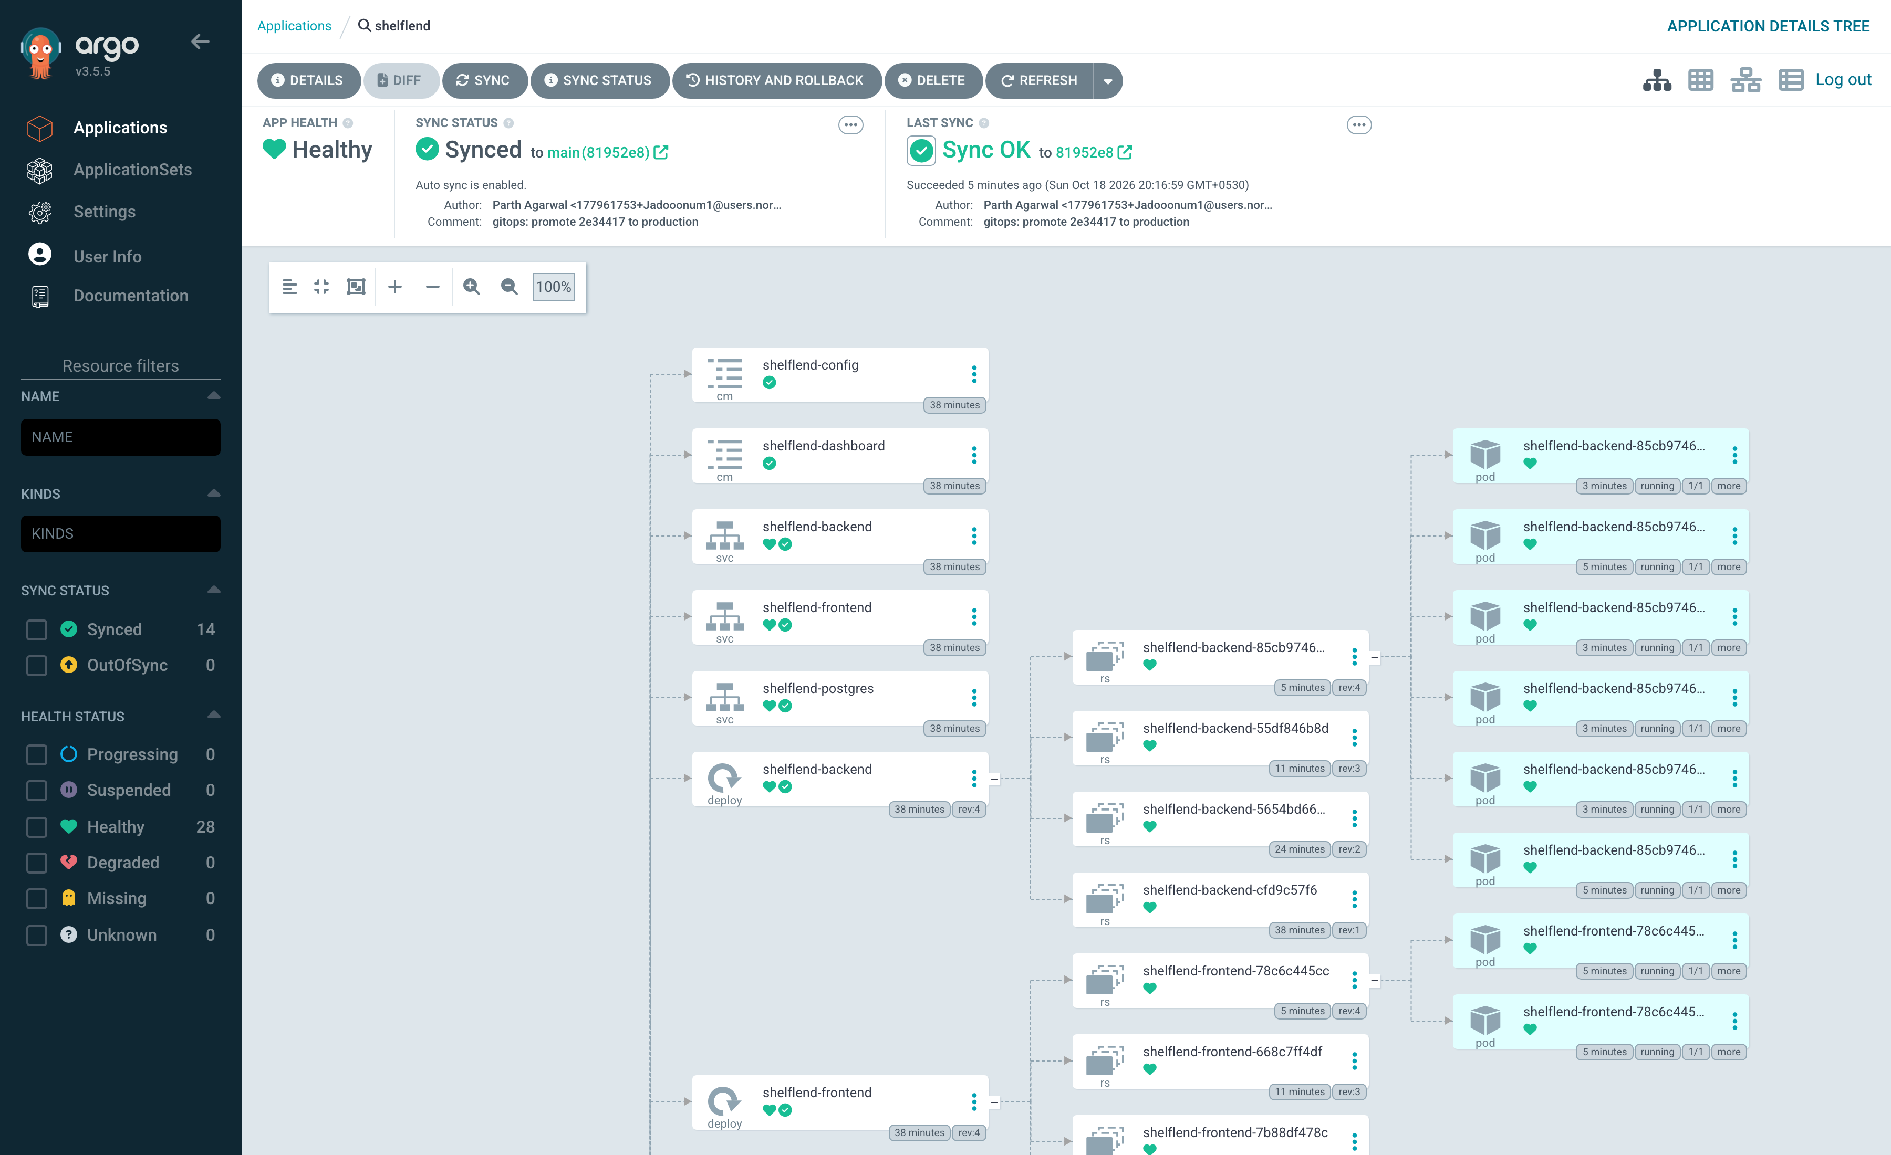
Kubernetes + GitOps loop
git push
pipeline green
promote commit
(SHA → gitops/)
Argo CD sync
(≤ 60 s poll)
rolling update
maxUnavailable 0
Chart: required SHA tag · non-root, read-only root FS, seccomp, drop ALL · HPA 2–6 @60% CPU · PDB minAvailable 1 · Ingress / → frontend, /api → backend

Slide 10
Load test: the HPA scales 2 → 6 and back
6
replicas at peak (max 6)
396%
peak avg CPU vs 60% target
16
curl workers × 4 min via Ingress
scaleDown stabilisation window 60 s; Prometheus showed 6/6 targets UP during the run.

Slide 11
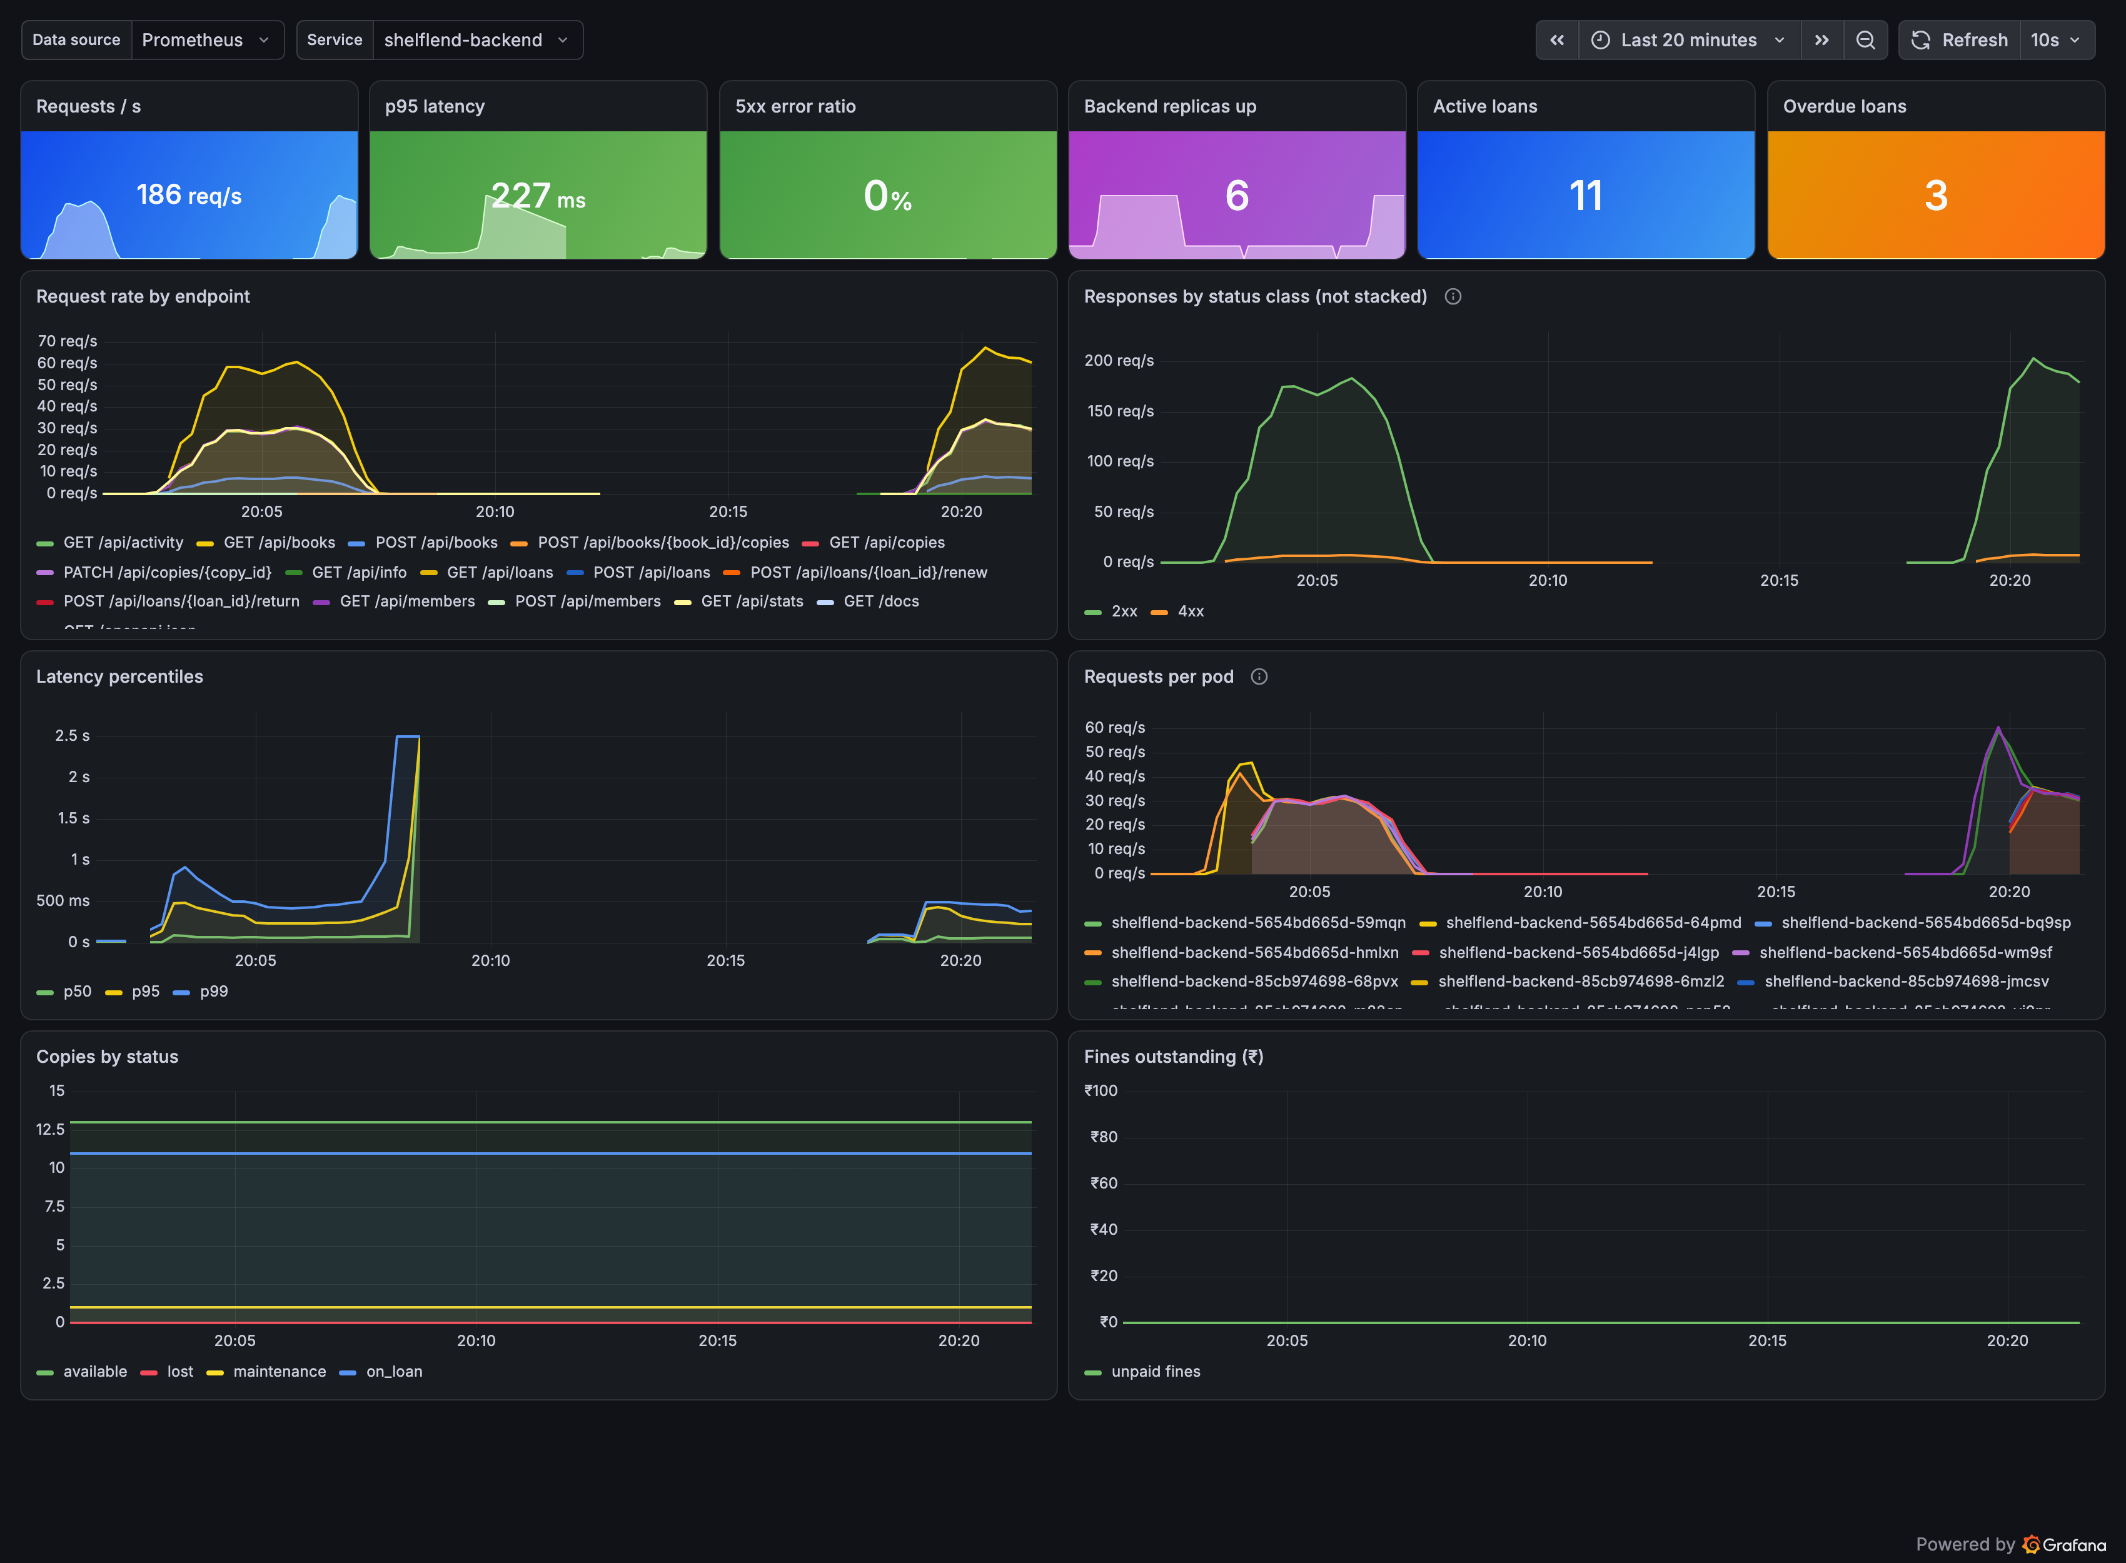
Observability: HTTP and business metrics
/metrics
prometheus-fastapi-instrumentator, latency buckets from 5 ms
Business gauges
loans active/overdue, copies by status, fines, read from Postgres at scrape time
ServiceMonitor
Prometheus scrapes every backend pod every 15 s
4 alert rules
BackendDown, 5xx > 5%, p95 > 500 ms, Overdue loans > 5
Grafana
12-panel dashboard shipped in the Helm chart (sidecar label)

Slide 12
Key learnings
1
Architecture is part of the artifact
2
Scanners find real things
The first GitOps sync crash-looped with 'exec format error': CI built amd64, the Mac runs arm64. Multi-arch images fixed it.
Trivy's first run failed on 7 HIGH findings; dropping pip from the runtime image removed a whole class of them.
3
Defaults hide data
4
Argo CD isn't Helm
Prometheus ignored the ServiceMonitor until the *SelectorNilUsesHelmValues flags were false; Grafana's 5xx stat read 'No data' instead of 0.
No lookup(), no Helm release: the DB secret is created at bootstrap and staging is Helm-installed for helm list.

Slide 13
Known limitations
!
Terraform ran on an emulator
No personal AWS account; plan/apply/destroy ran against moto. The rubric's AWS Console screenshots are replaced by AWS CLI output from the emulator.
!
Single Postgres replica
A StatefulSet with one PVC, no backups or HA; production would use RDS.
!
No authentication
The desk UI is open; a real deployment needs staff login and role checks.
!
Local cluster only
Kubernetes ran on kind; the chart is EKS-ready (Ingress, resources, PDB) but not deployed there.

Slide 14
Thank you
Parth Agarwal · Roll No. 10293
Repo: github.com/Jadooonum1/devsecops-python
Images: ghcr.io/jadooonum1/shelflend-backend · shelflend-frontend
Demo video + slides: demo/

