Slide 1
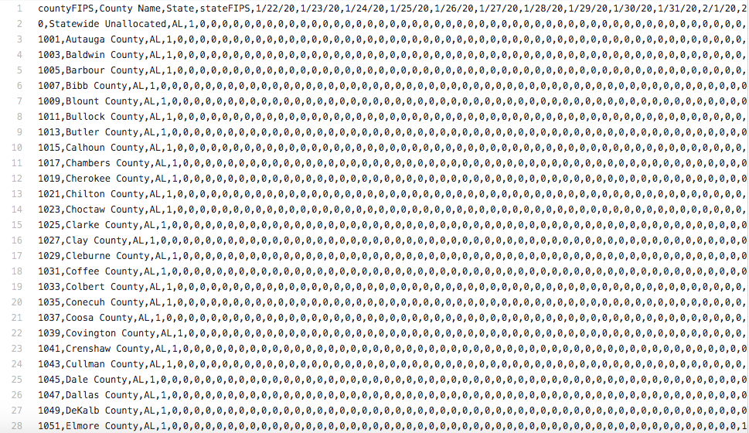
Statistical Learning Spring 2020 Final Project
using the Covid - 19 U.S. Confirmed Cases Dataset
n=3194
p=117
Author - Jadyn (Manqing) Wu

Slide 2
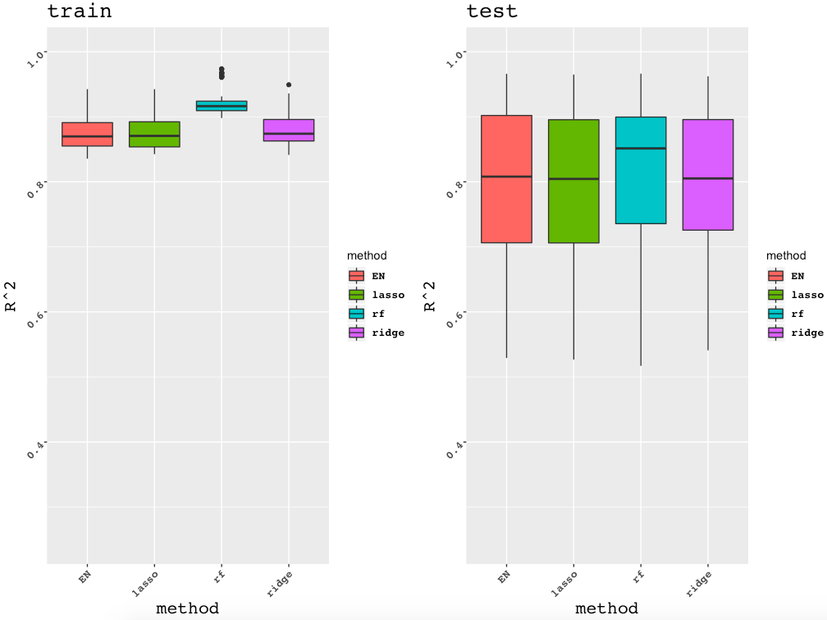
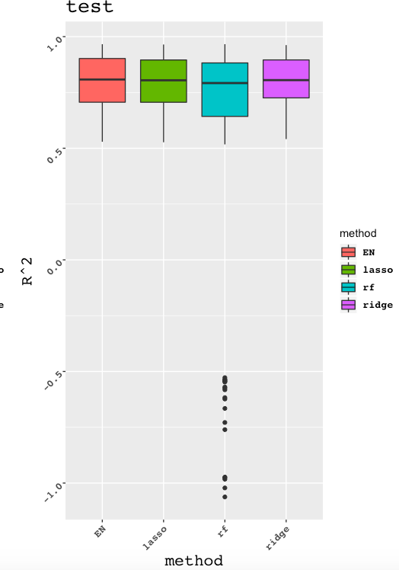
R^2

Slide 3
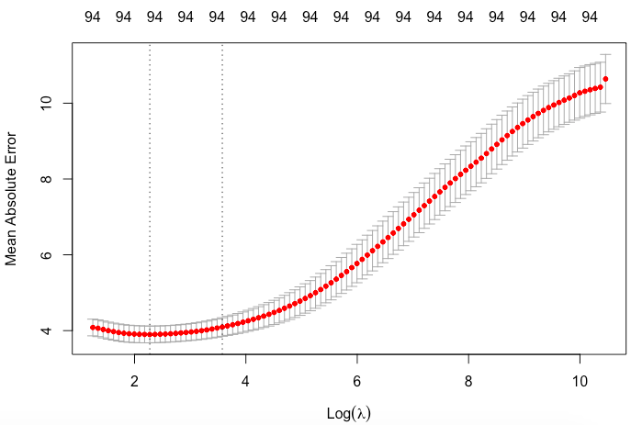
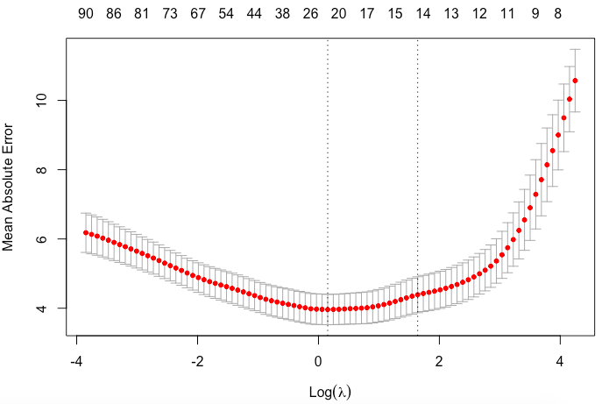
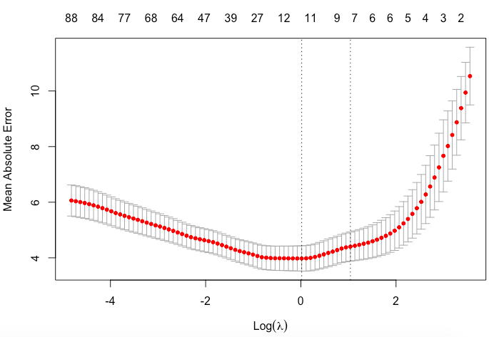
10 Fold CV Curves

Slide 4
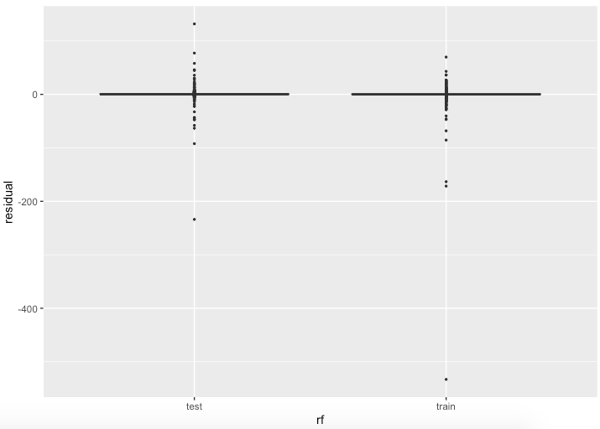
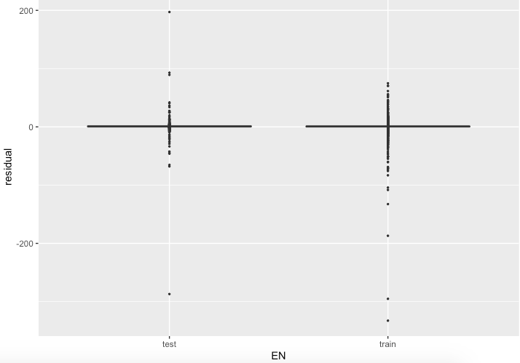
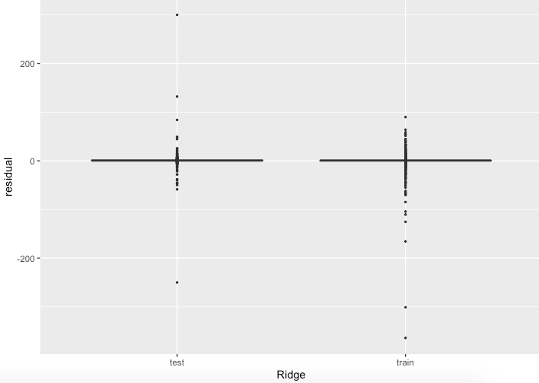
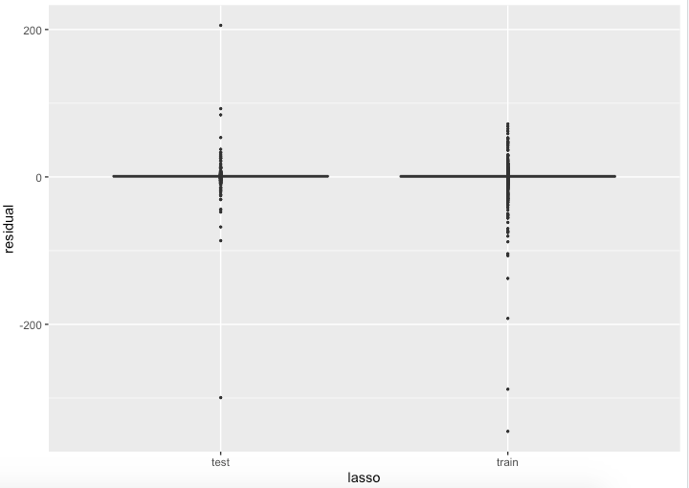
Residuals

Slide 5
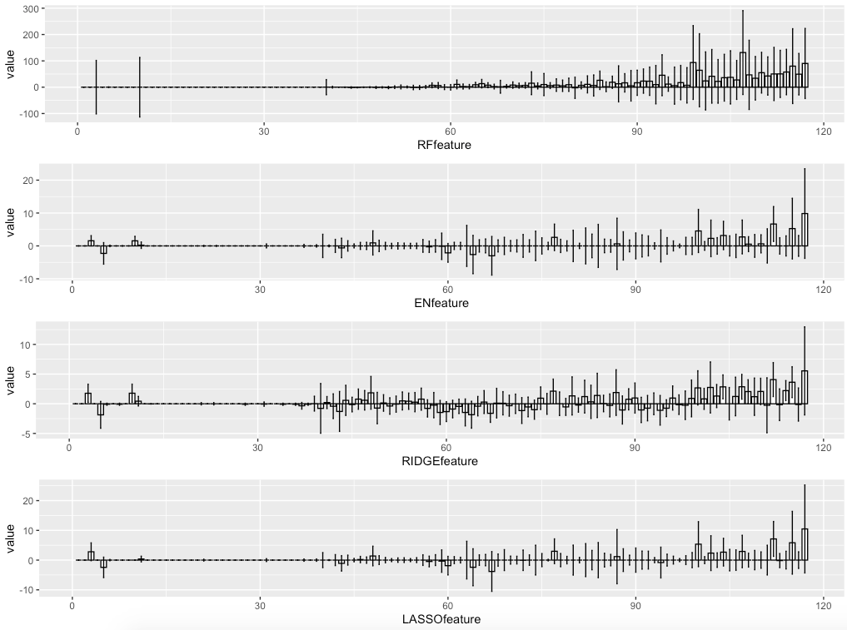
Feature Importance

Slide 6
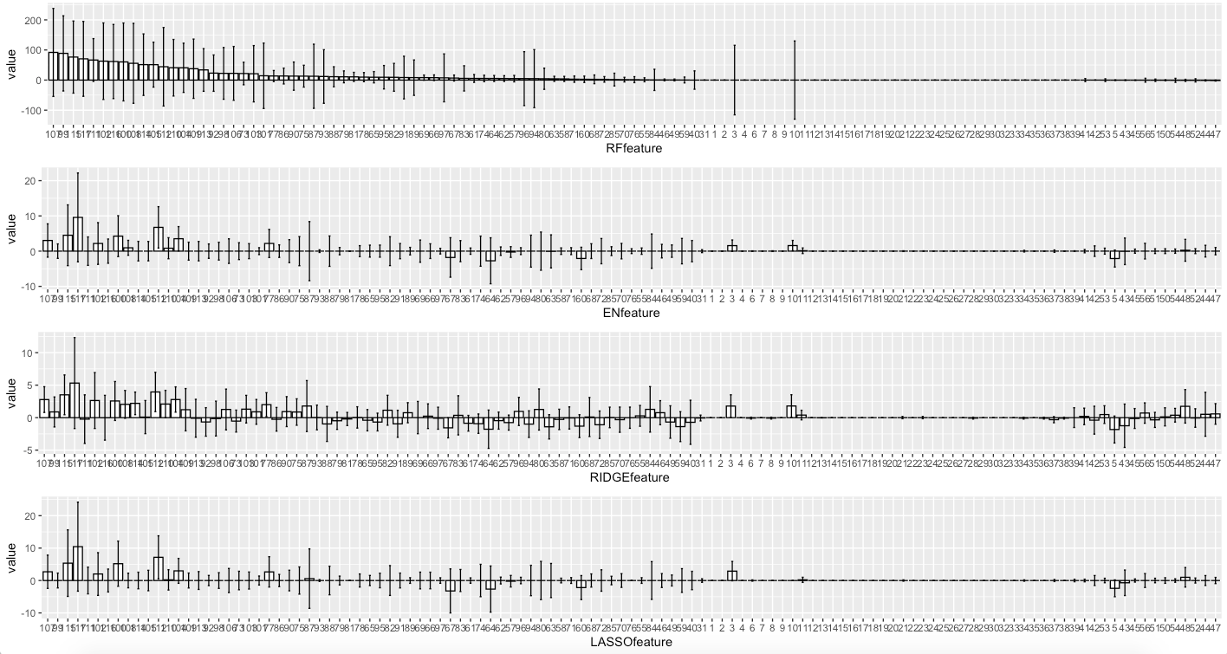
Feature Importance - RF
Method | Top 10
RF | 107 99 115 117 111 102 116 100 108 114
EN | 117 112 115 100 104 107 77 102 10 3
Ridge | 117 112 115 104 107 102 100 114 110 108
LASSO | 117 112 115 100 104 3 107 77 102 48

Slide 7
Summary
Method | Performance | Time per Fit
Random Forest | strange test R^2 Overall ok | ~ 2 min
Elastic-Net | - Picked earlier data points | < 1 min
Ridge | - Overall ok | < 1 min
LASSO | - Picked earlier data points | < 1 min

