Slide 1
Brief #13, power for a city the grid can't protect: Maiduguri, Borno State, Nigeria
The generator works.
The fuel doesn't come.
Who, specifically
User: works engineer & duty manager of a 250-bed referral hospital in a conflict-affected city
Beneficiaries: ICU, theatre, maternity, cold-chain & emergency patients — 91,250 bed-days a year
Payer: hospital management (federal/state budget) — or an energy-service company repaid from diesel no longer bought
In a city whose transmission line is repeatedly cut, critical care ends when the diesel ends — not when kW run short. Nobody decides, in advance and with numbers, which loads the last litres should keep alive.
Gombe–Damaturu–Maiduguri 330 kV line down after tower 372 was vandalised, 22 Sep → 31 Oct 2024 (TCN). Same corridor cut for ~2 months in 2021.
Root cause
39 days
Backup is sized in kW and run on fixed rules. A line outage quadruples diesel need (3,360 L/week normal year, simulated) while deliveries, budgets and convoys stay flat. Status quo at 6,000 L/week (1.8× normal): tank empty 489 h, Tier-1 life-critical circuits dark 487 h of 937.
Days dark
Dec 2022: two Maiduguri hospitals without power for days — generators functional, tanks empty (ICIR, 3 Dec 2022).
50%
of hospitals in sub-Saharan Africa report reliable electricity (WHO / World Bank / IRENA / SEforALL, Energizing Health, 2023).
MEDGRID SENTINEL · Brief #13 · Track 2 Digital Solutions & AI · Setting B Non-residential · Global Energy Hackathon 2026
1 / 5

Slide 2
The solution: MedGrid Sentinel
A fuel-aware brain for hospital microgrids
Digital twin + predictive controller that turns every litre the sun saves into hours of critical care — on the solar, battery and generator a hospital can actually buy.
1 · Fuel-runway governor
2 · Clinical ride-through reserve
3 · Efficient generator cycling
Every hour: diesel + battery + forecast solar vs the energy each care tier needs until the next expected delivery. Defers laundry/HVAC/admin first; Tier-1 never. Every decision logged with its arithmetic.
The battery always holds 2 h of Tier-1 while the generator is off. A failed start or a tripped set never darkens the ICU; the battery forms the island with no transfer break.
When it runs, the set runs hard (load + charging) and stops when the battery is full — fewer low-load hours, less wet-stacking, less exposure to running failures.
Replay: empty-tank hours 489 → 0
Replay: Tier-1 breaks 12 → 0; year: 259 → 0
Year: generator hours 2,667 → 1,381 (−48%)
What makes it new
Same hardware, different brain
Treats diesel logistics as the binding constraint — sizing tools (HOMER, REopt) and hybrid inverters don't schedule care tiers against the next convoy
Isolates the software's value: four controllers on identical hardware, weather, fuel and failures
Works where hospitals are: offline web app (static, no server) + SMS / USSD alerts on any feature phone
+179 h
critical-service hours vs a fixed-rule hybrid inverter on the same 600 kWp + 600 kWh, same 6,000 L/week
MEDGRID SENTINEL · Brief #13 · Track 2 Digital Solutions & AI · Setting B Non-residential · Global Energy Hackathon 2026
2 / 5

Slide 3
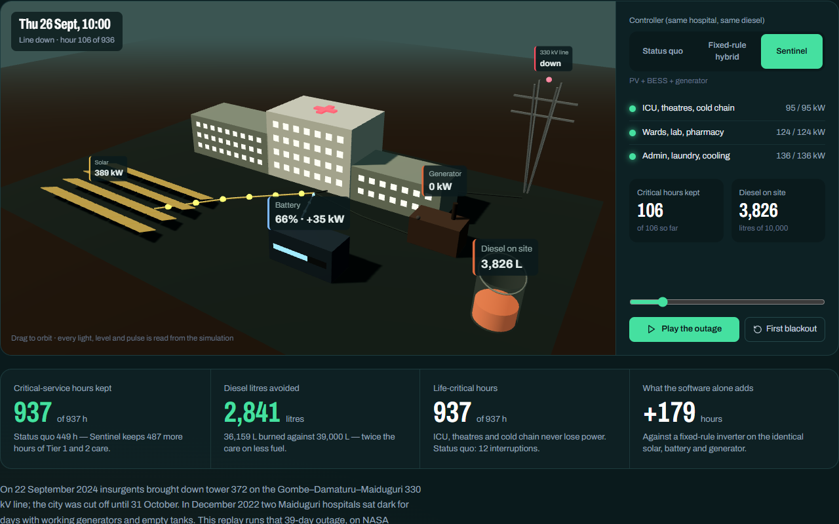
Proof of concept, built this weekend: the real 39-day outage on measured weather
Brief metric: “hours of critical service maintained during a line outage, and diesel litres avoided”
Same outage · same fuel | Critical h | Tier-1 h | Diesel L | Tier-1 breaks
Status quo (diesel only) | 449 | 451 | 39,000 | 12
Diesel + manual rationing | 638 | 639 | 39,000 | 11
Solar + battery, fixed rules | 757 | 798 | 39,000 | 21
Solar + battery + Sentinel | 937 | 937 | 36,159 | 0
937 islanded hours · 6,000 L/week diesel (1.8× normal use) · 10,000 L tank
449 → 937 h
2,841 L
critical-service hours (Metric 1)
diesel avoided in the outage (Metric 2) · 91,654 L/yr
The next outage: 14-day Monte Carlo, 300 trials
P(Tier-1 kept powered for 14 days), average-reliability generator (NREL data), late/missed deliveries: status quo 0% · fixed-rule hybrid 3% · Sentinel 78%. Well-maintained set: Sentinel 91%.
Illustrative 250-bed reference hospital (16 tiered circuits) — simulation, not field-measured performance. Real data: NASA POWER hourly irradiance & temperature (Maiduguri 2022–24), NREL/TP-5C00-76553 generator reliability, NERC tariff, Oct-2026 diesel prices.
89 automated tests · power & diesel mass balance every step · NREL '80 % at 2 weeks' reproduced · solar forecast scored on held-out 2024
MEDGRID SENTINEL · Brief #13 · Track 2 Digital Solutions & AI · Setting B Non-residential · Global Energy Hackathon 2026
3 / 5

Slide 4
Cost, who pays, and the 6–18 month path
Pays back in 3.3 years — or nothing upfront under EaaS
$704k
3.3 yr
₦311.2M/yr
₦20.7M/mo
CapEx (₦940.4M): 600 kWp PV, 600 kWh LFP, 510 kW PCS, Sentinel edge
payback · IRR 30% · NPV ₦553.2M (20 y @ 18%)
energy-cost savings on a full measured year (diesel −40%)
EaaS fee: hospital keeps 20% of savings from month 1; provider IRR 24%
Who owns, pays and maintains
6–18 months: what gets built, and by whom
Energy-service company owns, insures and maintains PV + storage + Sentinel; local O&M technicians; Sentinel subscription $4,800/site-yr is inside the model
Hospital pays a fixed monthly fee below what it saves — energy cost per bed-day ₦8,940 → ₦8,258; nothing passed to patients
No grant assumed. Concessional capital widens the margin (NPV at 10%: ₦1.40B)
Sensitivity: diesel −30% → payback 4 yr; CapEx +30% → 4.3 yr; no line outage → 3.6 yr
M1–3: metering + circuit audit at one Maiduguri-class hospital; Sentinel runs in shadow mode on real data
M4–6: engineering design (IEC 62446 / 62619 / 62109 equipment, NEMSA inspection), EaaS term sheet with a licensed installer
M7–12: install; Sentinel dispatches; SMS alerts live; measured vs predicted published monthly
M13–18: sites 2–3 from the fleet screen (Kano, Abuja)
Biggest risk: real loads differ from the model → shadow-mode gate: proceed only if daily-energy error ≤ ±15%
MEDGRID SENTINEL · Brief #13 · Track 2 Digital Solutions & AI · Setting B Non-residential · Global Energy Hackathon 2026
4 / 5

Slide 5
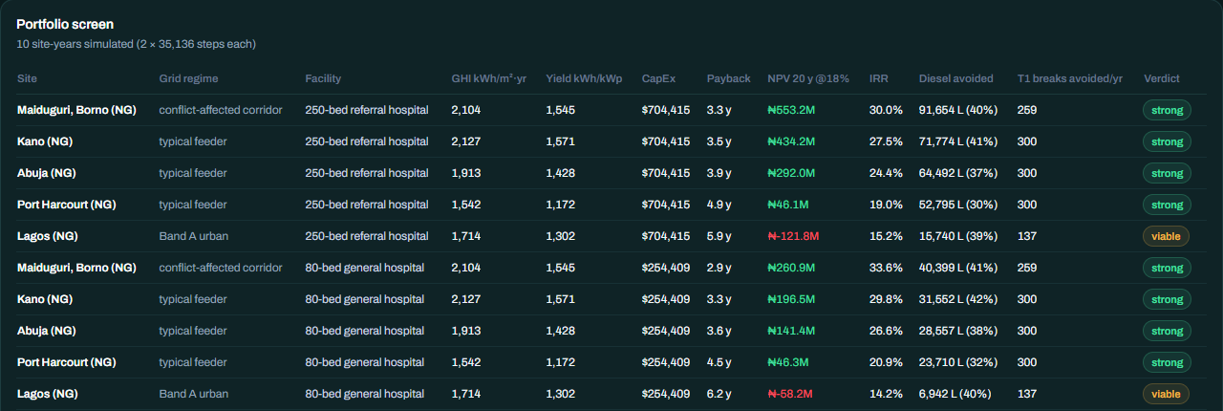
Impact, scale and what we need next
One hospital, every year — then the fleet
91,654 L
246 t
259 → 0
−1,286 h
diesel avoided per year (−40%)
CO₂ avoided per year (2.68 kg/L)
life-critical transfer breaks per year
generator run-hours per year (−48%)
How it travels
Same engine, new configuration. 10 site-years on measured weather: payback Maiduguri 3.3 y · Kano 3.5 y · Abuja 3.9 y · Port Harcourt 4.9 y · Lagos 5.9 y. 4 of 5 sites strong; Lagos only viable (better grid) — the tool says where it pays. Next: Ghana, Kenya, U.S. (NFPA 99/110) configurations.
Team and ask
Fleet screen: 10 full-year simulations on each site's own NASA POWER weather. Same national prices; differences come from sunshine and grid reliability.
Jackson Sixtus Abetianbe — solo entry (product, engineering, finance). We need: one pilot hospital in NE Nigeria, a licensed solar EPC / ESCO partner, 3 months of circuit-level metering, and power-systems + health-facility coaching.
MEDGRID SENTINEL · Brief #13 · Track 2 Digital Solutions & AI · Setting B Non-residential · Global Energy Hackathon 2026
5 / 5

