Slide 1
The clinical adoption meta-model
Jae Duk Seo – March/3/2017

Slide 2
Introduction - index
1. Abstract and Background
2. Clinical Adoption Meta Model - CAMM
3. CAMM adoption Archetypes
4. Discussion and Conclusion

Slide 3
Abstract and Background
Health Information System promise a positive transformation in the Health Care industry but adopting a system/application to a existing organization is a challenge.
There are already multiples of adoption models that measure how well a new tool/application impact and adopts to an organization but they miss out three points a) Adoption models are not Generic to Health Care b) But also sufficiently contextualized as to be accessible to key stakeholder audiences such as clinicians and administrators c) ties together HIS adoption and clinical benefit over time to guide expectations of adoption over time

Slide 4
Clinical Adoption Meta Model
Have 4 dimensions which are 1. Availability 2. System use 3. clinical/health behavior 4. clinical/health outcome
1. Availability – [User Access – login], [System availability – Server running], [Content availability – Is the content available to the user]
2. System Use – [Use of the system – is the system being used by the clinicians], [User experience – Is the system too complicated for a user to use the system]
3. clinical/health behavior-[Adoption to the system – is the system becoming a ritual to the clinical ]
4. clinical/health outcome-[Impacted attribute of the HIS thanks to the adoption of the system – thanks to the system becoming integrated with the organization an expected/intended outcome have been reached]

Slide 5
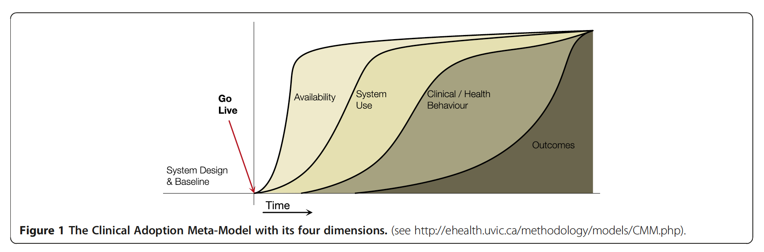
Clinical Adoption Meta Model

Slide 6
CAMM adoption Archetypes
Following the CAMM there are multiple possible outcome, here we take a look at seven of those out come which are
1. No Deployment.
2. Low Adoption.
3. Adoption without Benefit (behavior and outcome).
4. Behavior Change without Outcome Benefit.
5. Adoption with Outcome Benefits.
6. Adoption with Harm.
7. Benefit without Use.

Slide 7
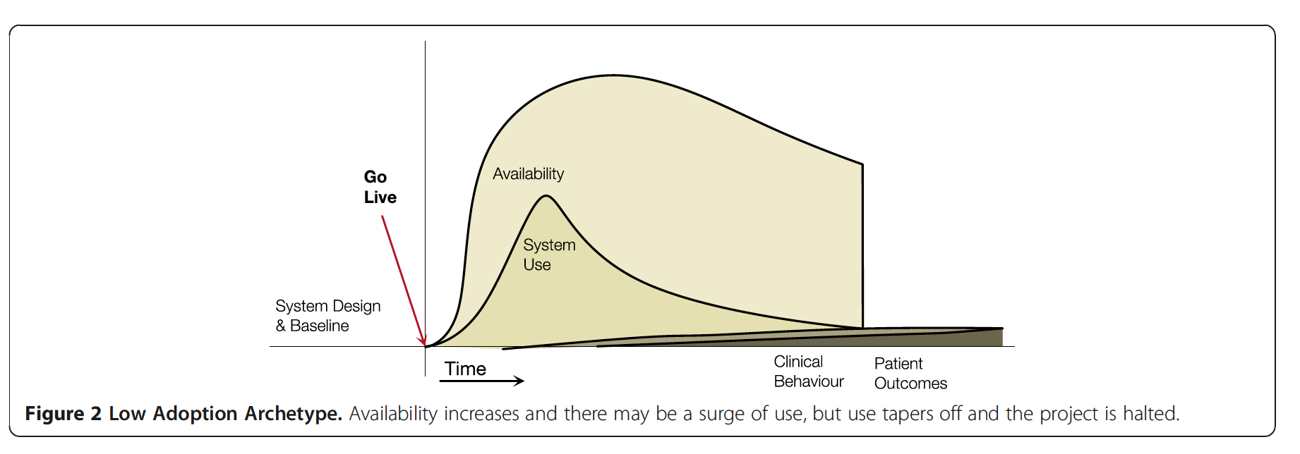
1. No Deployment - 2. Low Adoption.
1. No Deployment – a system have been built but never deployed to the organization.
2. Low Adoption – a system have been deployed but never used often.

Slide 8
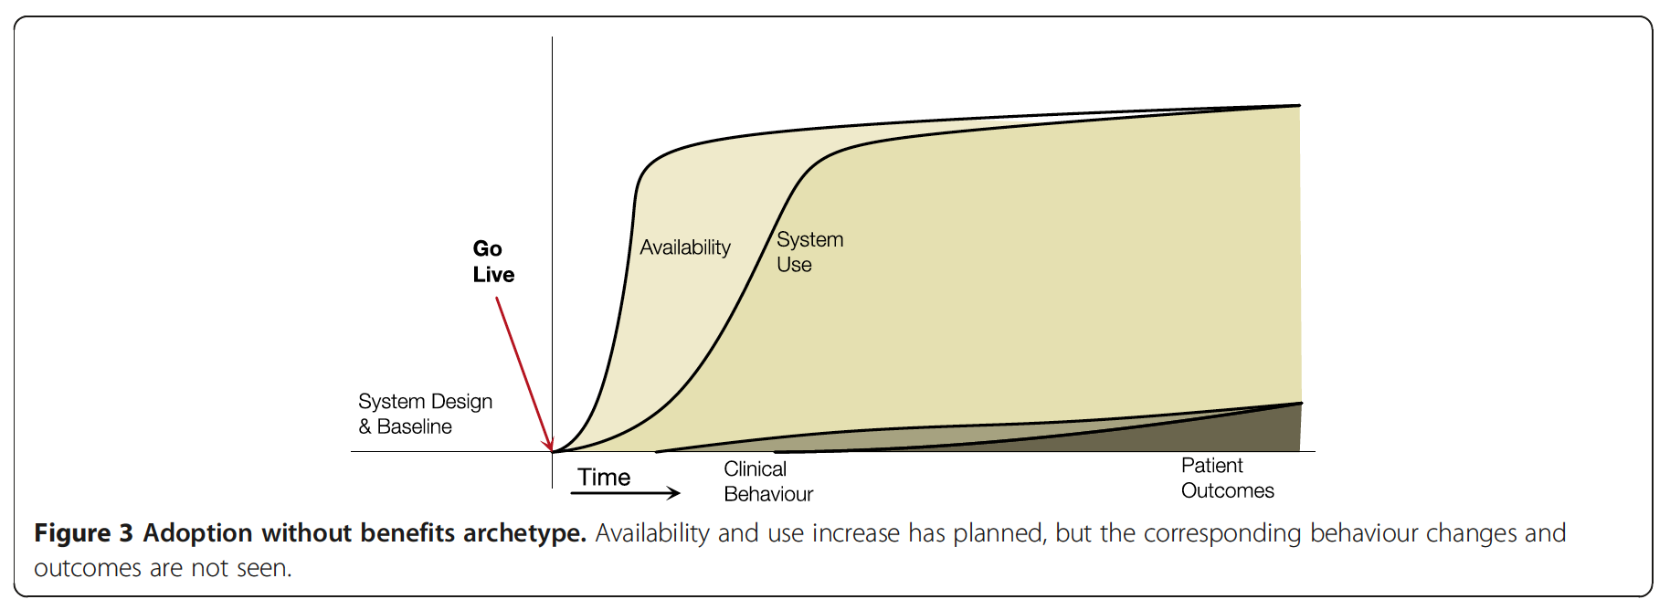
3. Adoption without Benefit
A system is deployed an being used by the clinicians but there are no expected outcome and behavior

Slide 9
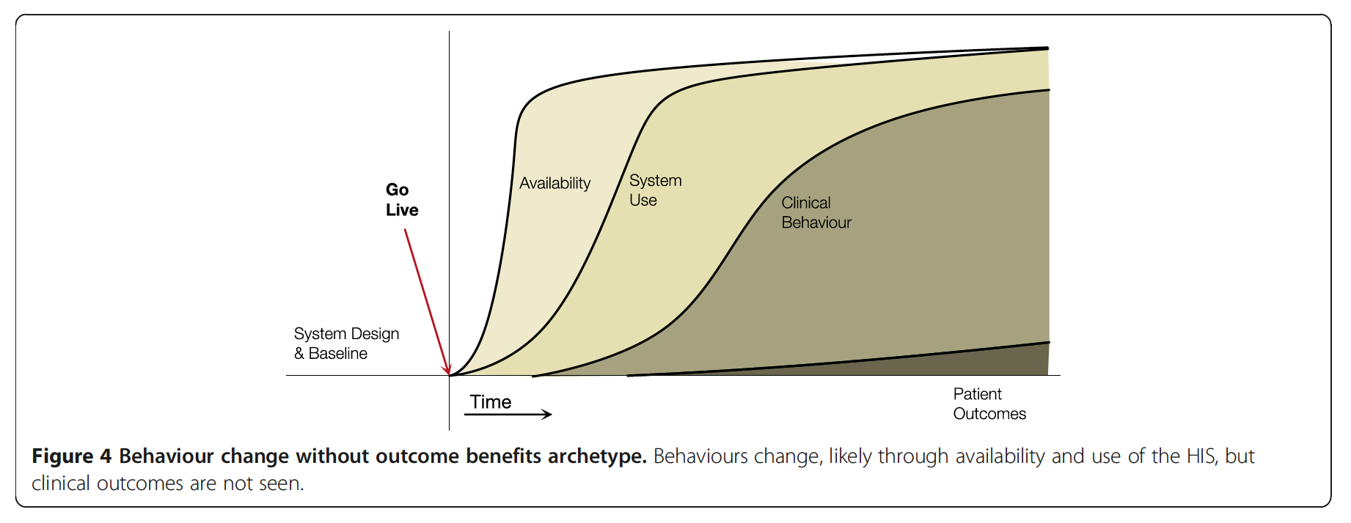
4. Behavior Change without Outcome Benefit
A system is being deployed and being used by the clinicians are using it but there is no outcome that is wanted and expected.

Slide 10
5. Adoption with Outcome Benefits
The most desirable model to achieve, with expected outcomes and expected behavior.

Slide 11
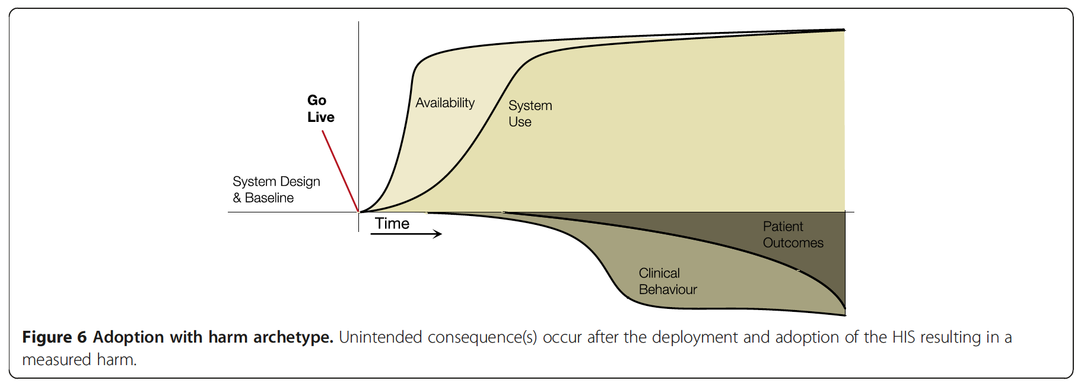
6. Adoption with Harm
A system was deployed and is in use but it harms the organization.

Slide 12
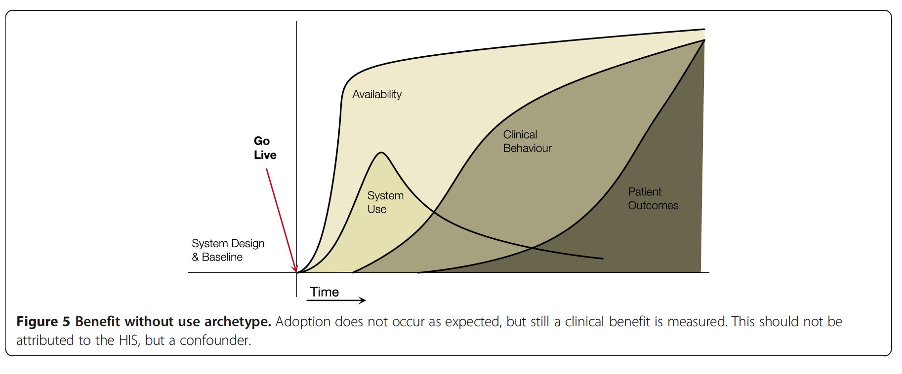
7. Benefit without Use
A rare case where the system is used once or twice but benefits the organization.

Slide 13
Discussion and conclusion
One limitation of the CAMM is there are no specific timeline in the X axis – it would be good to have those indicators.
Developer – Benefits them, since they can know where they went wrong, in each step. Can trace back to the point where the CAMM is not showing a desired outcome. Evaluators – Use the model to measure performance of the application as well as the impact that it has on the organization. Learner/Researcher – Via CAMM they can research or learn the design studies on adoption.

