Slide 1
RAIK 283: Data Structures & Algorithms
Asymptotic Notations*
Dr. Ying Lu
ylu@cse.unl.edu
August 30, 2012
http://www.cse.unl.edu/~ylu/raik283
*slides refrred to
http://www.aw-bc.com/info/levitin
Design and Analysis of Algorithms Chapter 2.2

Slide 2
Review: algorithm efficiency indicator
order of growth
of
an algorithm’s basic operation count
the algorithm’s time efficiency
Design and Analysis of Algorithms Chapter 2.2

Slide 3
Asymptotic growth rate
A way of comparing functions that ignores constant factors and small input sizes
O(g(n)): class of functions t(n) that grow no faster than g(n)
Θ (g(n)): class of functions t(n) that grow at same rate as g(n)
Ω(g(n)): class of functions t(n) that grow at least as fast as g(n)
Design and Analysis of Algorithms Chapter 2.2

Slide 4
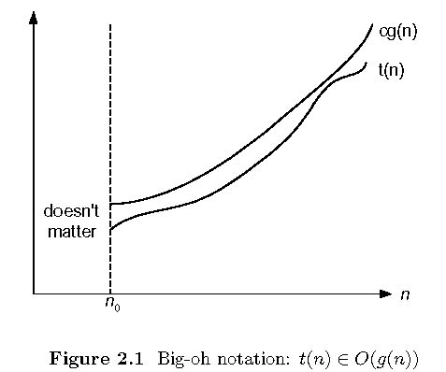
Big-oh
t(n) ∈ O(g(n))
∃c > 0, ∃n₀ ≥ 0 , ∀n ≥ n₀, t(n) ≤ cg(n)
Design and Analysis of Algorithms Chapter 2.2
Notes:
N0: pronounced as n_nought

Slide 5
Small-oh
t(n) ∈ o(g(n))
∃c > 0, ∃n₀ ≥ 0 , ∀n ≥ n₀, t(n) < cg(n)
Design and Analysis of Algorithms Chapter 2.2

Slide 6
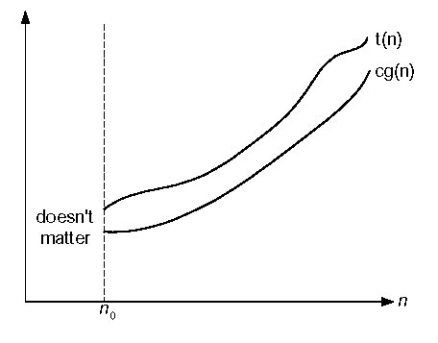
Big-omega
t(n) ∈ Ω(g(n))
Design and Analysis of Algorithms Chapter 2.2

Slide 7
Big-omega
t(n) ∈ Ω(g(n))
∃c > 0, ∃n₀ ≥ 0 , ∀n ≥ n₀, t(n) ≥ cg(n)
Design and Analysis of Algorithms Chapter 2.2

Slide 8
Small-omega
t(n) ∈ ω(g(n))
∃c > 0, ∃n₀ ≥ 0 , ∀n ≥ n₀, t(n) > cg(n)
Design and Analysis of Algorithms Chapter 2.2

Slide 9
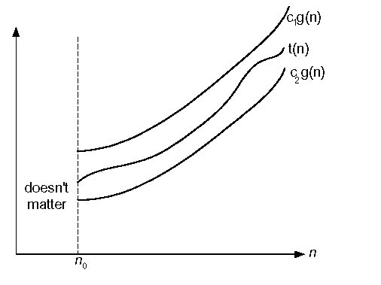
Big-theta
t(n) ∈ Θ(g(n))
∃c₁>c₂>0, ∃n₀≥0, ∀n ≥ n₀, c₂g(n) ≤ t(n) ≤ c₁g(n)
Design and Analysis of Algorithms Chapter 2.2

Slide 10
Big theta
t(n) ∉ Θ(g(n))
The reverse statement of
∃c₁>c₂>0, ∃n₀≥0, ∀n ≥ n₀, c₂g(n) ≤ t(n) ≤ c₁g(n)
Design and Analysis of Algorithms Chapter 2.2

Slide 11
Big theta
t(n) ∉ Θ(g(n))
∀c₁>c₂>0, ∀n₀≥0, ∃n ≥ n₀, t(n) < c₂g(n) or t(n) > c₁g(n)
Design and Analysis of Algorithms Chapter 2.2

Slide 12
Establishing rate of growth: Method 1 – using definition
t(n) is O(g(n)) if order of growth of t(n) ≤ order of growth of g(n) (within constant multiple)
There exist positive constant c and non-negative integer n₀ such that
t(n) ≤ c g(n) for every n ≥ n₀
Examples:
10n ∈ O(2n²)
5n+20 ∈ O(10n)
Design and Analysis of Algorithms Chapter 2.2
Notes:
Examples:
10n is O(2n²)
since 10n ≤ 5 ( 2n²) for n ≥ 1
c n0
5n+20 is O(10n)
since 5n+20 ≤ 10 n for n ≥ 4
c n0

Slide 13
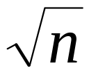
Establishing rate of growth: Method 1 – using definition
 | A | B | O | Ω | Θ
1 | ln²n | n ^{ε} | Yes | No | No
2 | n^{k} | c^{n} | Yes | No | No
3 |  | n^{sinn} | No | No | No
4 | 2^{n} | 2^{n/2} | No | Yes | No
5 | n^{lgc} | c^{lgn} | Yes | Yes | Yes
6 | lg(n!) | lg(n^{n}) | Yes | Yes | Yes
Examples:
2^{n} ∈ Ω(2^{n/2}) 2^{n} ∉ Θ(2^{n/2})
Design and Analysis of Algorithms Chapter 2.2

Slide 14
Establishing rate of growth: Method 1 – using definition
 | A | B | O | Ω | Θ
1 | ln²n | n ^{ε} | Yes | No | No
2 | n^{k} | c^{n} | Yes | No | No
3 |  | n^{sinn} | No | No | No
4 | 2^{n} | 2^{n/2} | No | Yes | No
5 | n^{lgc} | c^{lgn} | Yes | Yes | Yes
6 | lg(n!) | lg(n^{n}) | Yes | Yes | Yes
Examples:
∉ O(n^{sinn}) ∉ Ω(n^{sinn})
Design and Analysis of Algorithms Chapter 2.2

Slide 15
Establishing rate of growth: Method 2 – using limits
lim_{n→∞} t(n)/g(n)
0 order of growth of t(n) < order of growth of g(n)
t(n) ∈ o(g(n)), t(n) ∈ O(g(n))
=
c>0 order of growth of t(n) = order of growth of g(n)
t(n) ∈ Θ(g(n)), t(n) ∈ O(g(n)), t(n) ∈ Ω(g(n))
∞ order of growth of t(n) > order of growth of g(n)
t(n) ∈ ω(g(n)), t(n) ∈ Ω(g(n))
Design and Analysis of Algorithms Chapter 2.2
Notes:
Instert <, =, > in the ____ spaces respectively as you discuss the intuition behind it.

Slide 16
Establishing rate of growth: Method 2 – using limits
Examples:
log_{b} n vs. log_{c} n
log_{b}n = log_{b}c log_{c}n
lim_{n→∞}( log_{b}n / log_{c}n) = lim_{n→∞} (log_{b}c) = log_{b}c
log_{b}n ∈Θ(log_{c}n)
Design and Analysis of Algorithms Chapter 2.2

Slide 17
Exercises: establishing rate of growth – using limits
ln²n vs. lnn²
2^{n} vs. 2^{n/2}
2^{n-1} vs. 2^{n}
log₂n vs. n
Design and Analysis of Algorithms Chapter 2.2

Slide 18
L’Hôpital’s rule
If
lim_{n→∞} t(n) = lim_{n→∞} g(n) = ∞
The derivatives f´, g´ exist,
Then
t(n)
g(n)
t ´(n)
g ´(n)
lim
n→∞
=
lim
n→∞
Example: log₂n vs. n
Design and Analysis of Algorithms Chapter 2.2
Notes:
[lopiˈtal]

Slide 19
Establishing rate of growth
 | A | B | O | Ω | Θ
1 | ln²n | n ^{ε} | Yes | No | No
2 | n^{k} | c^{n} | Yes | No | No
3 |  | n^{sinn} | No | No | No
4 | 2^{n} | 2^{n/2} | No | Yes | No
5 | n^{lgc} | c^{lgn} | Yes | Yes | Yes
6 | lg(n!) | lg(n^{n}) | Yes | Yes | Yes
Examples:
Design and Analysis of Algorithms Chapter 2.2

Slide 20
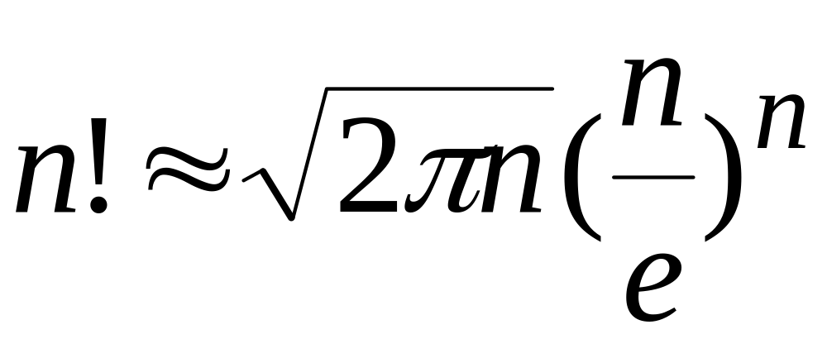
Stirling’s formula
Design and Analysis of Algorithms Chapter 2.2

Slide 21
n! v.s. n^{n} lg(n!) v.s. lg(n^{n})
Examples using stirling’s formula
Ω Θ O
Design and Analysis of Algorithms Chapter 2.2

Slide 22
n! ∈ o(n^{n}) lg(n!) v.s. lg(n^{n})
??? lg(n!) ∈ o(lg(n^{n}))
Examples using stirling’s formula
Ω Θ O
Design and Analysis of Algorithms Chapter 2.2

Slide 23
n! ∈ o(n^{n}) lg(n!) v.s. lg(n^{n}) lg(n!) ∈ Θ(lg(n^{n}))
Examples using stirling’s formula
Ω Θ O
Design and Analysis of Algorithms Chapter 2.2

Slide 24
Special attention
n! ∈ o(n^{n})
  However,
  lg(n!) ∉ o(lg(n^{n})) lg(n!) ∈ Θ(lg(n^{n}))
sinn ∈ Θ (1/2) sinn ∈ O(1/2) sinn ∈ Ω(1/2)
  However,
  n^{1/2} ∉ Θ(n^{sinn}) n^{1/2} ∉ O(n^{sinn}) n^{1/2} ∉ Ω(n^{sinn})
Design and Analysis of Algorithms Chapter 2.2

Slide 25
Asymptotic notation properties
Transitivity:
  f(n) = Θ(g(n)) && g(n) = Θ(h(n)) ⇒ f(n) = Θ(h(n))
  f(n) = O(g(n)) && g(n) = O(h(n)) ⇒ f(n) = O(h(n))
  f(n) = Ω(g(n)) && g(n) = Ω(h(n)) ⇒ f(n) = Ω(h(n))
If t₁(n) ∈ O(g₁(n)) and t₂(n) ∈ O(g₂(n)), then
t₁(n) + t₂(n) ∈
Design and Analysis of Algorithms Chapter 2.2

Slide 26
Asymptotic notation properties
Transitivity:
  f(n) = Θ(g(n)) && g(n) = Θ(h(n)) ⇒ f(n) = Θ(h(n))
  f(n) = O(g(n)) && g(n) = O(h(n)) ⇒ f(n) = O(h(n))
  f(n) = Ω(g(n)) && g(n) = Ω(h(n)) ⇒ f(n) = Ω(h(n))
If t₁(n) ∈ O(g₁(n)) and t₂(n) ∈ O(g₂(n)), then
t₁(n) + t₂(n) ∈ O(max{g₁(n), g₂(n)})
Design and Analysis of Algorithms Chapter 2.2

Slide 27
In-Class Exercises
Exercises 2.2: Problem 1, 2, 3 & 12
Problem 1: Use the most appropriate notation among O, Θ, and Ω to indicate the time efficiency class of sequential search:
  a. in the worst case
  b. in the best case
  c. in the average case ( Hint: C(n) = p*(n+1)/2 + (1-p)*n )
Problem 2: Use the informal definitions of O, Θ, and Ω to determine whether the following assertions are true or false.
  a. n(n+1)/2 ∈ O(n³) b. n(n+1)/2 ∈ O(n²)
  c. n(n+1)/2 ∈ Θ(n³) d. n(n+1)/2 ∈ Ω(n)
Design and Analysis of Algorithms Chapter 2.2

Slide 28
Announcement
40-minute quiz next Tuesday
  problems based on materials covered in Chapter 2.2 (Asymptotic Notations and Basic Efficiency Classes)
Design and Analysis of Algorithms Chapter 2.2

Slide 29
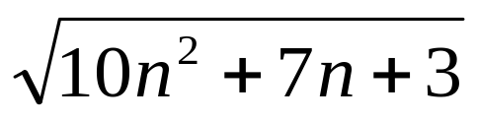
In-Class Exercises
Establish the asymptotic rate of growth (O, Θ, and Ω) of the following pair of functions. Prove your assertions.
  a. 2^{n} vs. 3^{n} b. ln(n+1) vs. ln(n)
Problem 3: For each of the following functions, indicate the class Θ(g(n)) the function belongs to. (Use the simplest g(n) possible in your answers.) Prove your assertions.
  a. (n² + 1)¹⁰ b.
  c. 2nlg(n+2)² + (n+2)²lg(n/2)
  d. 2^{n+1} + 3^{n-1} e. ⎣log₂n⎦
Design and Analysis of Algorithms Chapter 2.2

