Slide 1
ROS 'tf' Package and
ROS Parameters
Usage
By:-
Jayesh Patel
EECE5698
Northeastern University

Slide 2
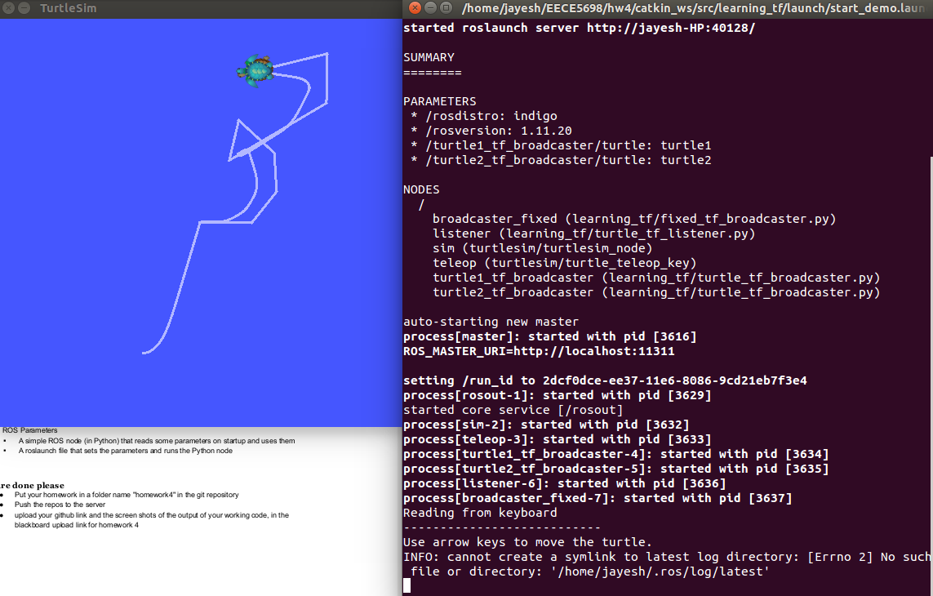
Turtle Follower
Here, turtle2 follows the turtle1 where the position of their co-ordinate frames with respect to world frame is used to calculate the distance between them.

Slide 3
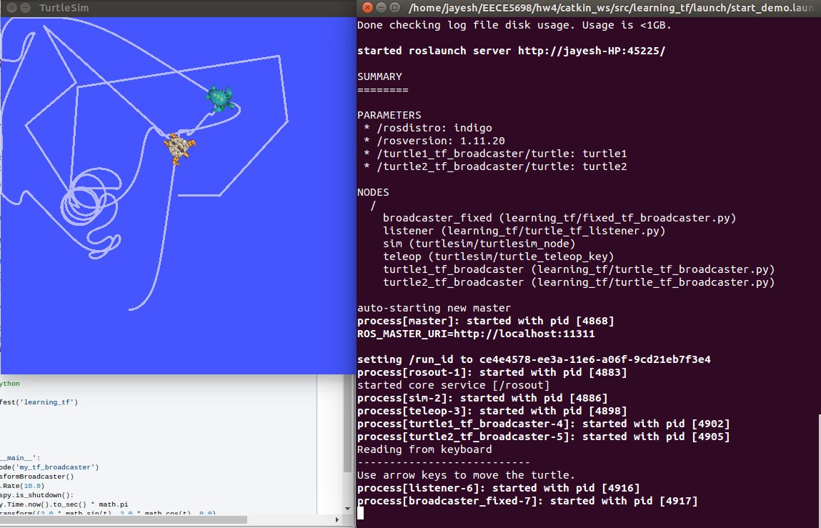
Turtle Follower(fixed frame)
Here, turtle2 is in a fixed frame(/carrot1) that is 2 units left of /turtle2 frame from previous slide. Hence, turtle 2 tries to stay on the left 2 units away from turtle 1.

Slide 4
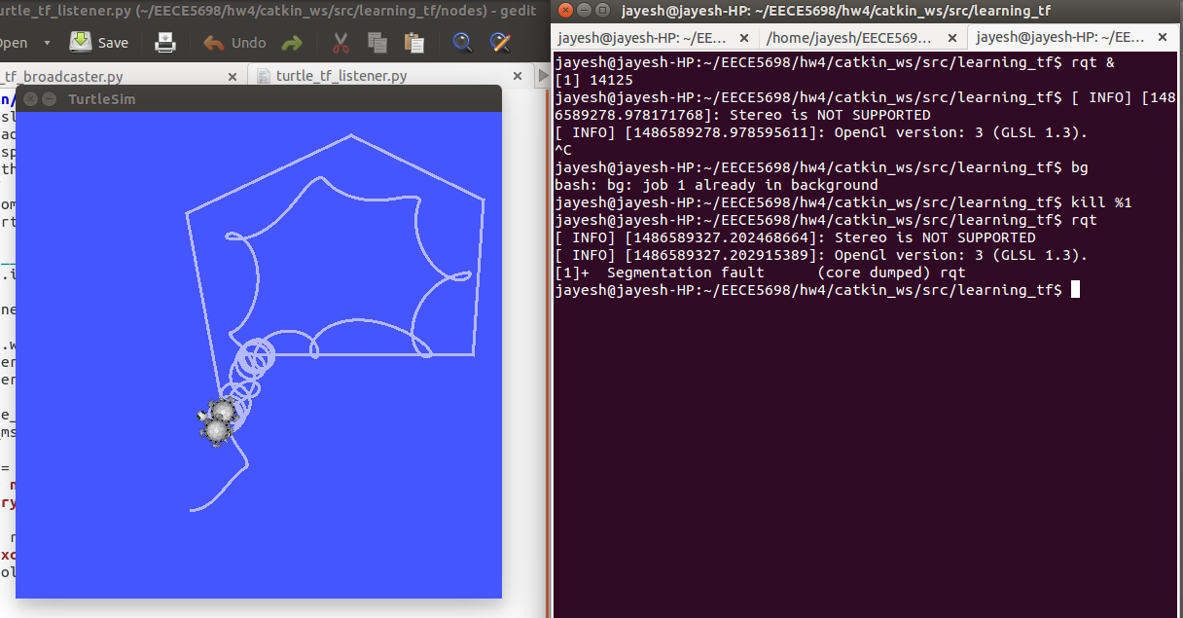
Turtle Follower(Moving frame)
Here, a moving frame is used to drive turtle 2.

Slide 5
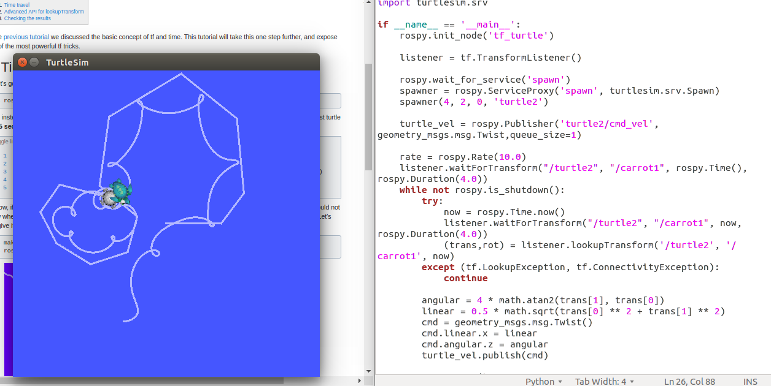
Turtle Follower(tf an time)
This will obtain info about when a particular transform was taken and then use it to move turtle2.
Difference is too small compared to moving frame example to notice(in milliseconds).

Slide 6
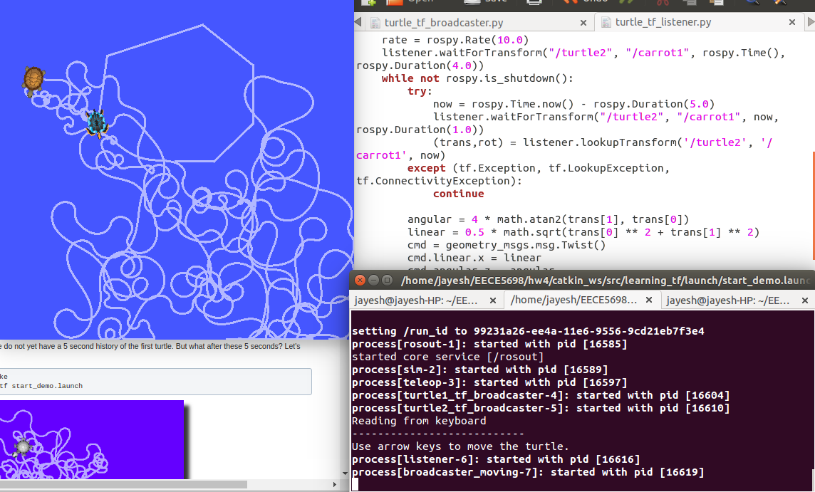
Turtle follower(Time travel)
This is motion of the follower we get with using 5 second old transform to calculate for turtle 2.
This looks uncontrolled because the 5 second old motions/pose of both the turtles are used to control the current turtle2 pose/motion.

Slide 7
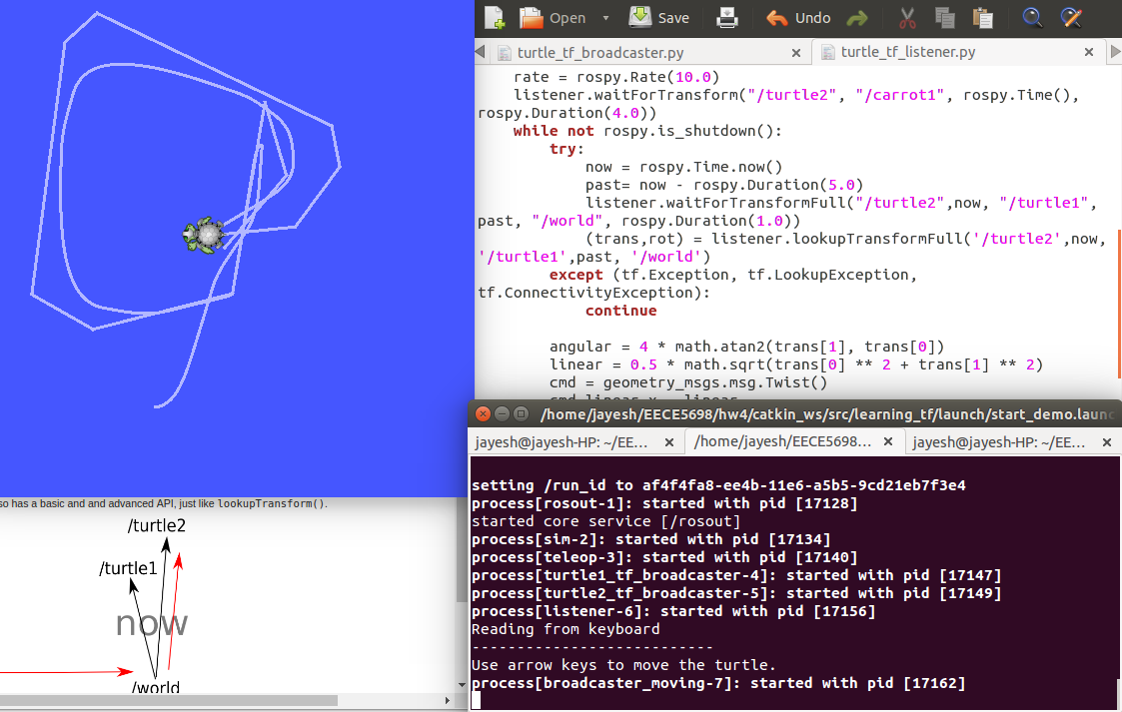
Turtle follower(Time travel adjusted)
In this, current motion/pose of turtle 2 is calculated from 5 second old transform of turtle 1.
Hence, the motion is smooth and as expected.

Slide 8
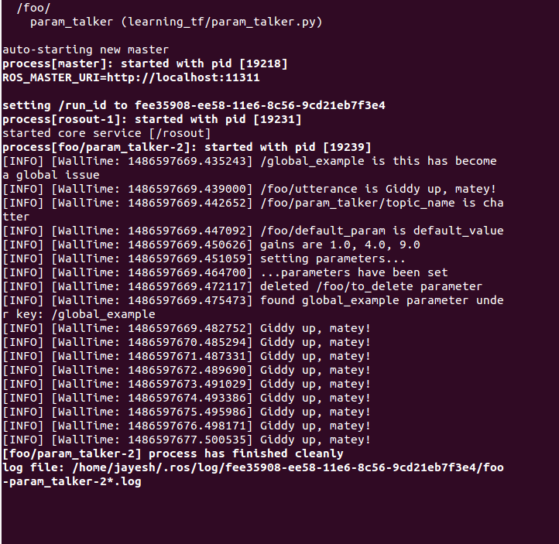
ROS Parameters
Here Ros launch file is used to initialize some parameters in different namespaces and the a node is created to get and set/use those parameters.

