Slide 1
Policing Drones
By:-
Jayeshkumar Patel
EECE5698
Northeastern University

Slide 2
Power Bus
Voltage regulators/Power Distribution Board(BEC or UBEC): To provide regulated voltages to FPV and other sensors and devices (Also providing isolation between motors and other sensors and devices.)
Electronic Speed Control: To generate three phase signals to operate brushless dc motors and its speed control based on PWM input signal.(may have an in-built voltage regulator)
LiPo Battery: Mostly used because of its high power to weight ratio. Extra care needed to charge and maintaining its charge levels to avoid degradation.(Capacity to be determined)

Slide 3
Sensors
FPV camera: To look at the scene in front of the drone. (An OSD module may be included to obtain additional information such as battery level,etc.)
Ultrasonic sensors: For possible collision avoidance/detection from the rest of the sides.

Slide 4
Navigation
GPS: To determine position of the drone. (Activated only when needed in situations such as low battery power and auto-homing to charging station, or when its current location needs to be determined,etc.)
IMU: Needed to stabilize the drone by receiving feedback on its orientation.

Slide 5
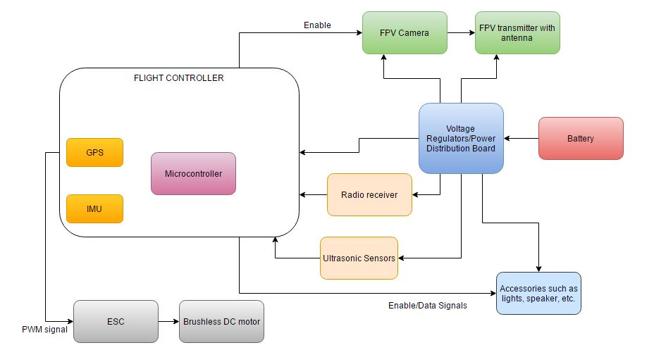
System architecture

