Slide 1
GPS Device Analysis
By:-
Jayesh Patel
EECE5698
Northeastern University

Slide 2
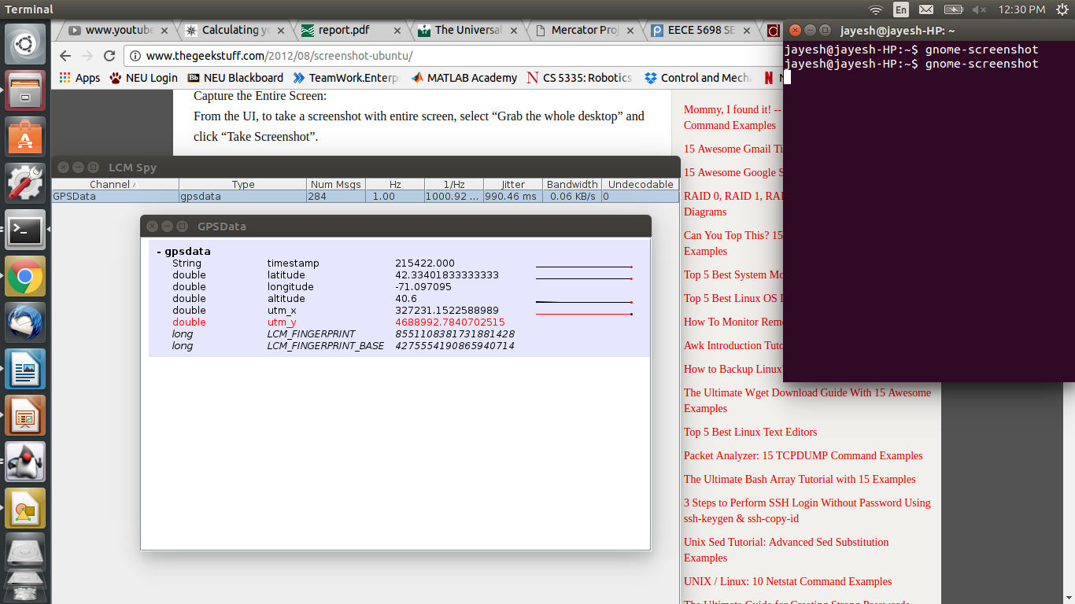
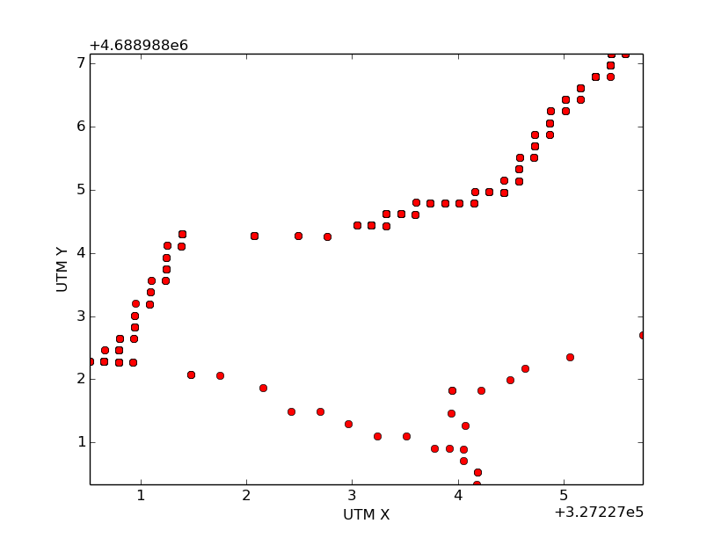
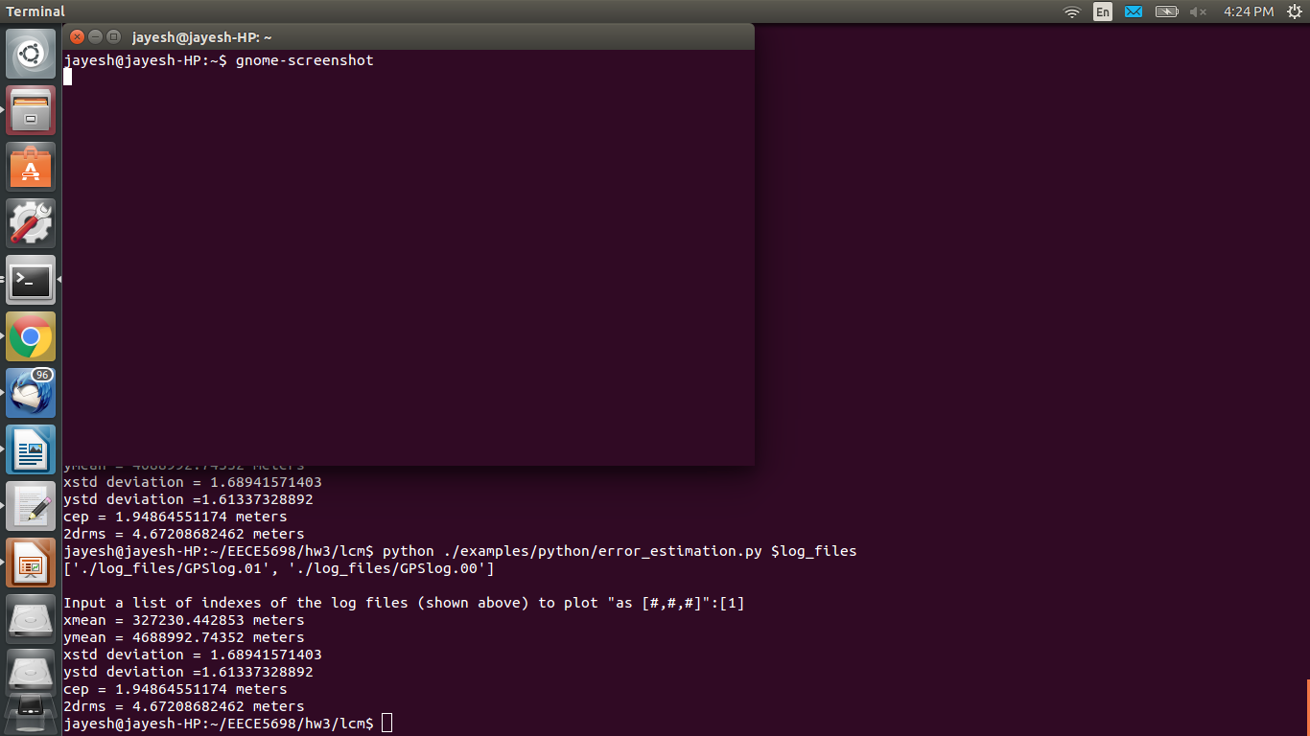
Stationary Readings and Analysis

Slide 3
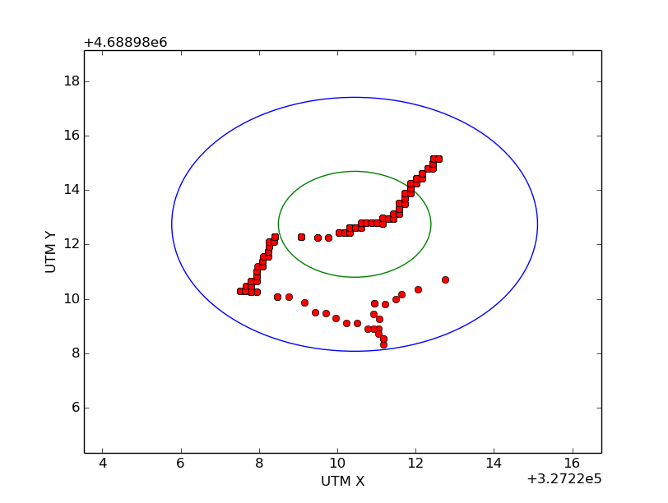
Error Analysis
It can be seen from the stationary readings and their accuracy mesurements in the previous slide that error distribution is non-uniform.
As the true values of utm co-ordinates are unknown, their average values are used for calculation of standard deviation. These std_deviation values are used to calculate GPS accuracy measures such as CEP (circular error probable) and 2DRMS values. (shown in previous slide)
GPS location for a stationary object is affected by several factors and hence the probable area for its position is quite large compared to that for a moving object.
Blue circle --> 2DRMS
Green circle --> CEP

Slide 4
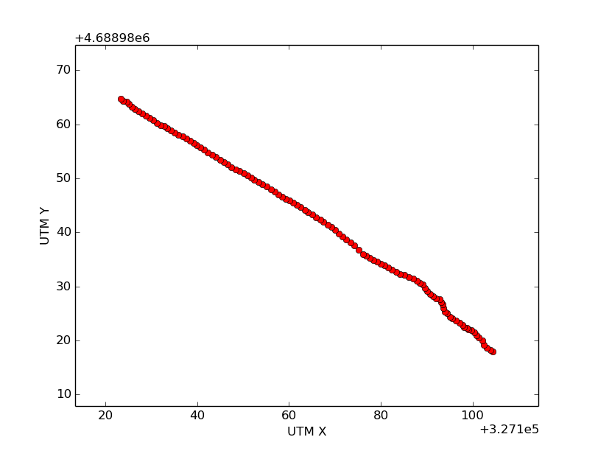
Straight Path Readings
It is evident that GPS accuracy improves for a moving object.
The position errors for a moving object are reduced quite a lot compared to that of a stationary object.
This is due to the reduction of intersection area of the locating spheres while moving.

