Slide 1
IMU data analysis
By:-
Jayesh Patel
EECE5698
Northeastern University

Slide 2
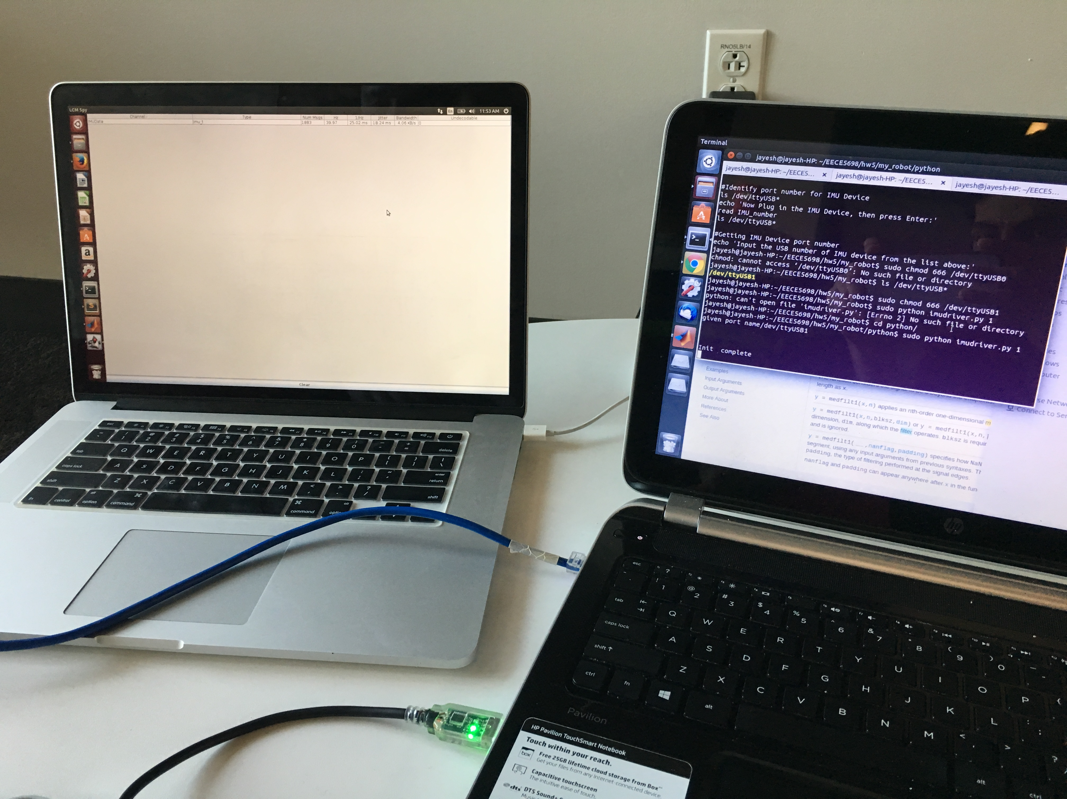
Networking with lcm
Using network switch, we were able to read messages on different devices broadcasted by one of them.

Slide 3
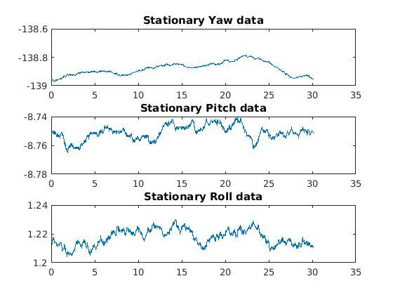
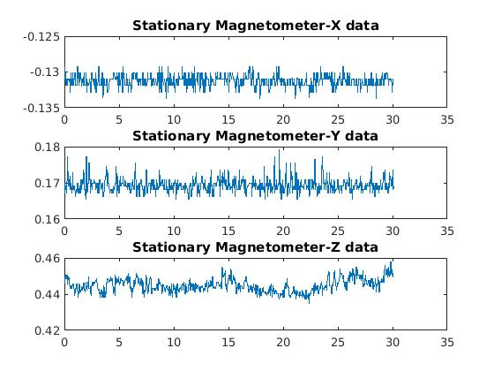
Stationary IMU data analysis
The attitude data(Yaw, pitch and roll), the magnetometer data, gyro data(next slide) and accelerometer data(next slide) from imu device has small amounts of random error(noise). This is expected as imu device has internal filters to filter most of the noise out.

Slide 4
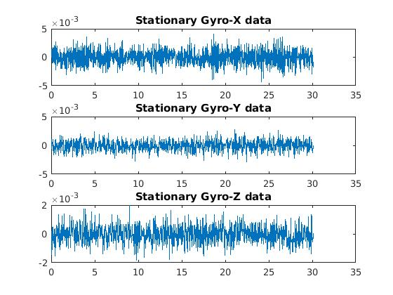
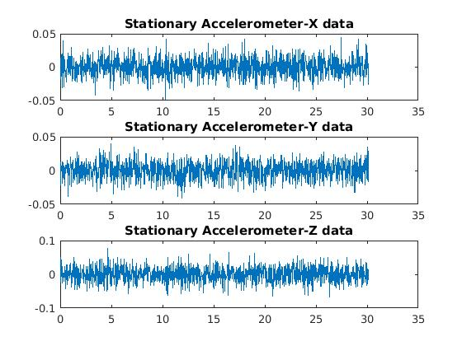
Stationary IMU data analysis

Slide 5
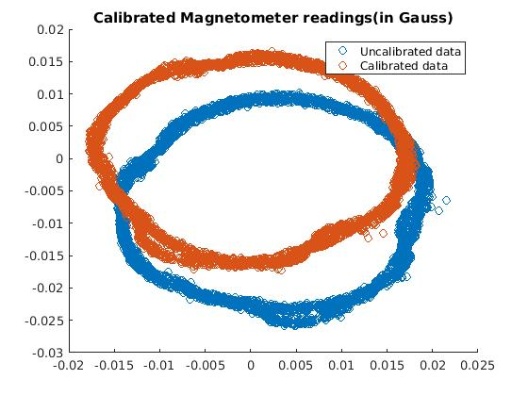
Car-trip data analysis
The graph describes the calibration process before and after plots. Fit_ellipse.m file is used to get ellipse parameters which are then used to figure out the calibration matrices.

Slide 6
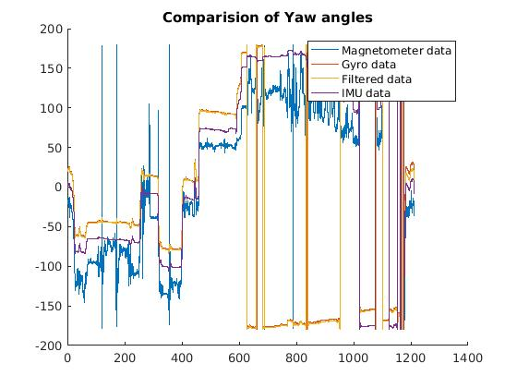
Car-trip data analysis
The graph shows comparision plots of yaw angle data obtained through various process on imu data. It includes angles calculated from magnetometer and gyro data, results of complementary filter and yaw data from imu

Slide 7
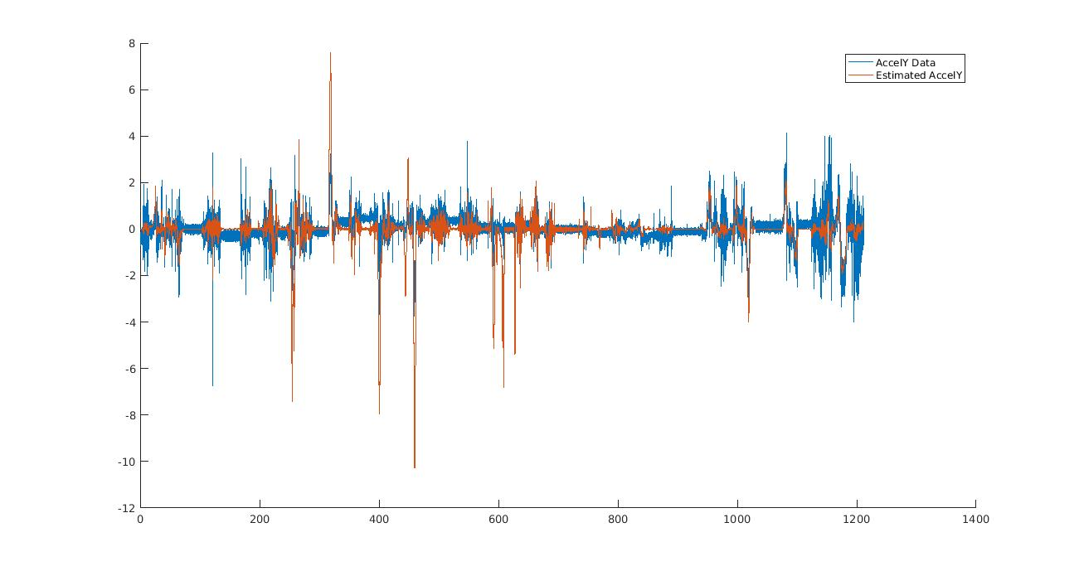
Car-trip data analysis
The graph shows comparision of accelerometer y data and estimated accel-y data from yaw rate and x-velocity.
They match up pretty good except there is a lot of noise seen in accel-y data from imu and there is nosie in the estimated accel-y data due to integrated errors reflected by x-velocity and some errors from yaw-rate.
As overall both data are centered around zero, the xc (distance between imu center and car CG) can be estimated to be very close to zero.

Slide 8
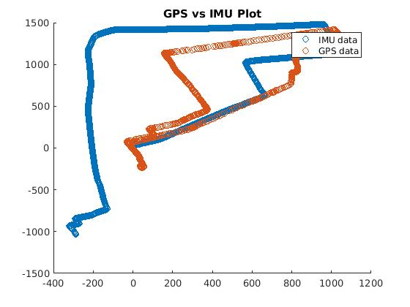
Car-trip data analysis
The graph shows gps and imu data plotted on top of each other. (IMU data is scaled to get a good fit)
The scaling/shape errors are due to the fact that any errors in acclerometer data are integrated twice to obtain the distance.
Some kind of compensation needs to be used to filter out noise at each step of integration to get a better fit.

