Slide 1
Camera Calibration and
Image stitching
By:-
Jayesh Patel
EECE5698
Northeastern University

Slide 2
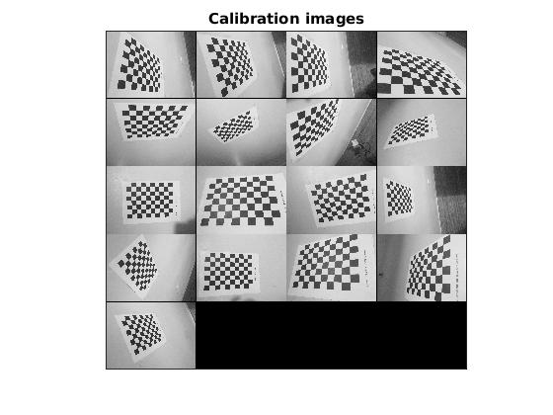
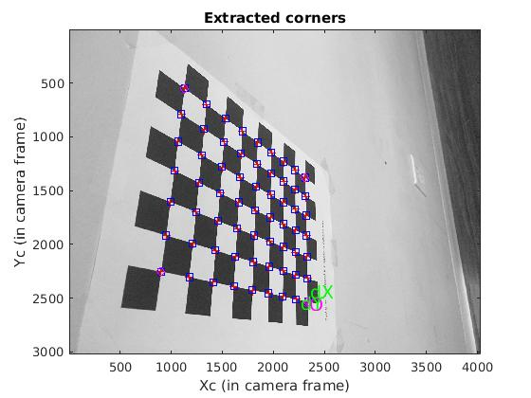
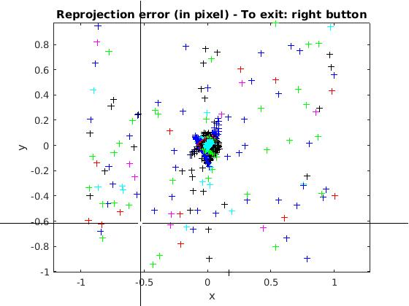
Camera Calibration
The figures show calibration process where the checkerboard images(shown in montage above) are loaded and corner points are manually extracted for all images and initial calibration is carried out, then repeating the process of recomputing corners and calibration such that reprojection error is reduced to sub-pixel range(shown in the upper rightmost figure). Then the final results are stored into file for future use.

Slide 3
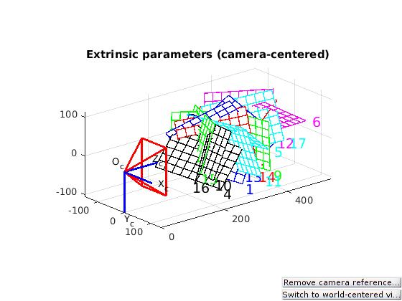
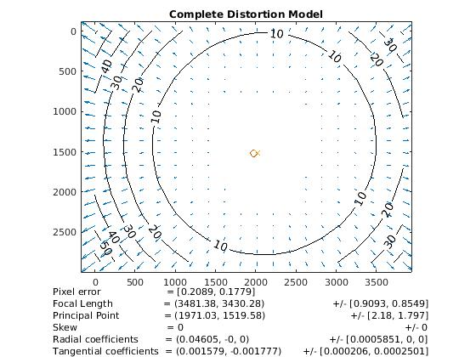
Distortion Model and
Camera Extrinsics
The figure above shows the extrinsic parameters in a camera centered view.
It shows the orientation of the input images relative to a fixed camera frame.
The figure to the right shows complete distortion model made using the saved calibration parameters.

Slide 4
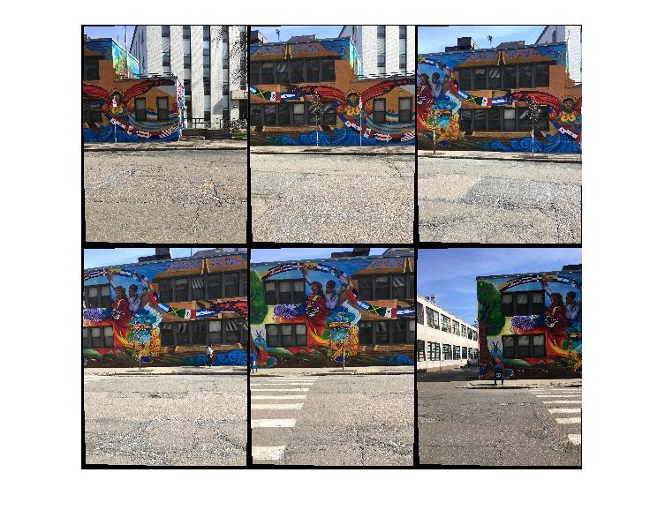
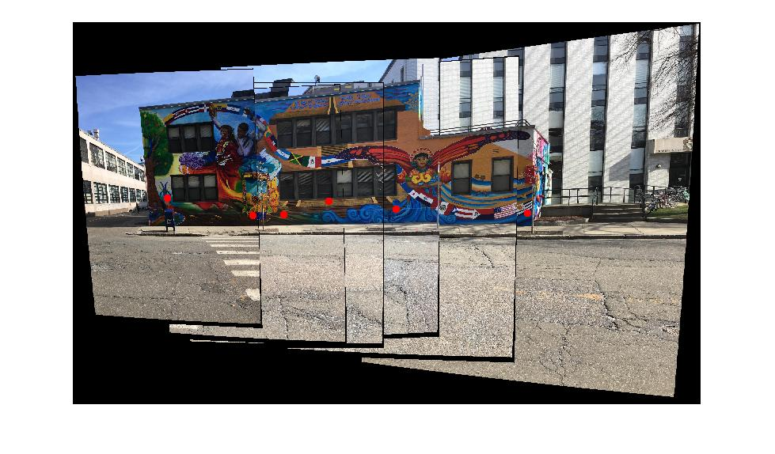
Mosaicing
Camera parameters from the calibration exercise are used to undistort images.
Tile of [38 38] was used as extra input to harris detector for evenly distributing the corner points.
An extra piece of code was added to remove some of the badly matched Feature points.
NOTE: this piece of code will fail to produce good results if it produces more than three badly matchedPoints for image pairs that are just greatly rotated in place in addition to, if any, little translation which is not the case with this homework assignment.
Xlim and Ylim data obtained from OutpuLimits operation is used to estimate the camera positions (shown as red dots)

Slide 5
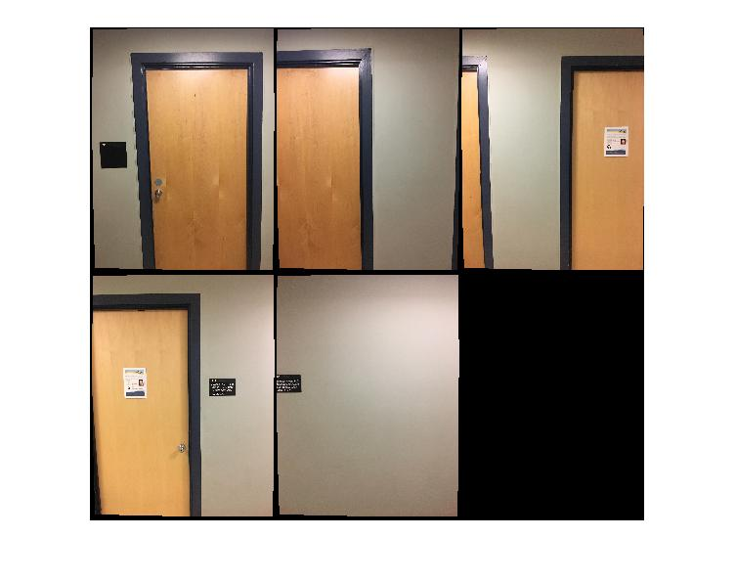
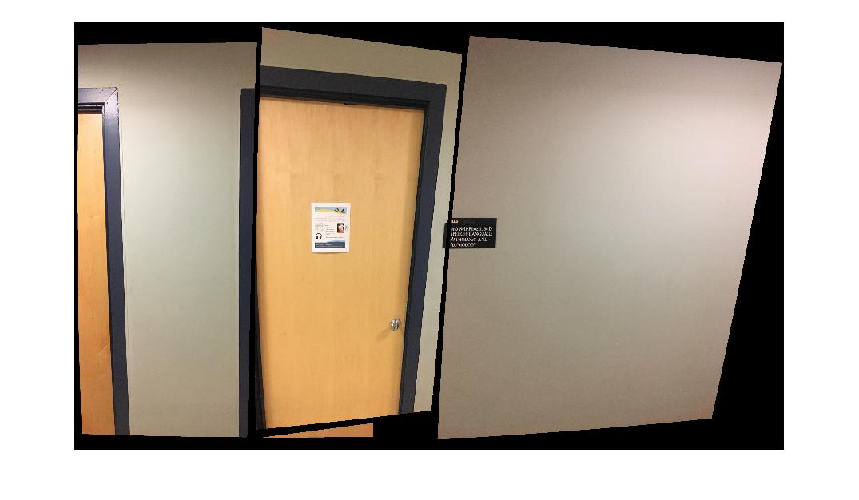
Mosaicing(less features)
Due less availability of matched Features between the first and second images, the first image is not properly stitched and not shown in the results.
For this exercise, the tile was reduced to [2 2] and number of corner points extracted were increased to 4000 so that the corner points would be more concentrated on those areas where the features are concentrated.

Slide 6
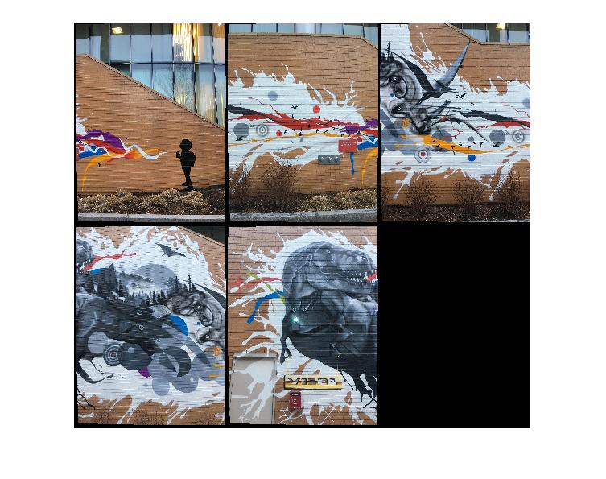
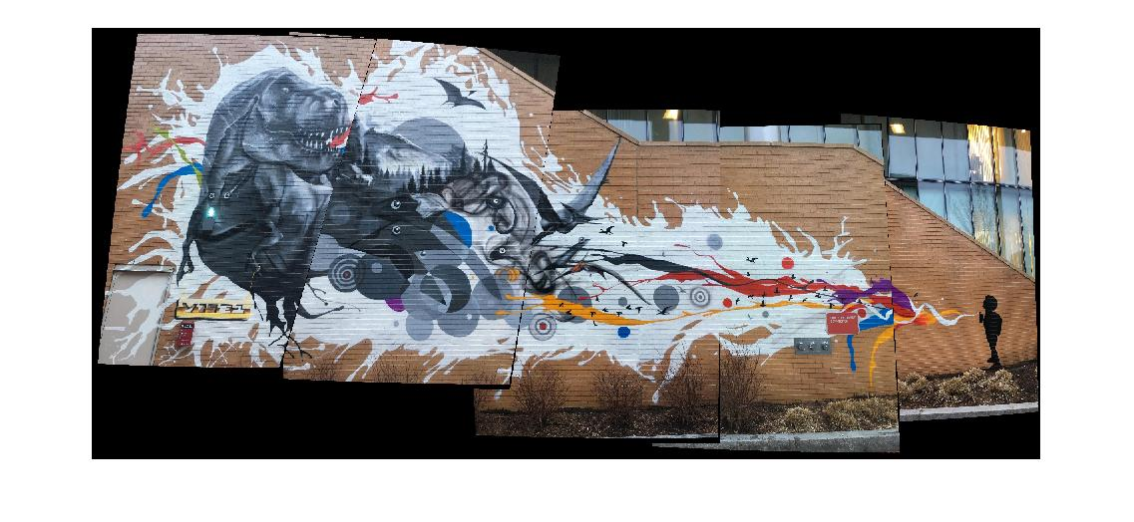
Mosaic(Less overlap)
It was increasingly difficult to create mosaic with less overlap.
To make this work, the tile was increased to [50 50] number of corners extracted were increased to 5000 and some of the conditions in the piece of code that removes badly matched features were relaxed and lastly, the number of trials and maxdistance for the estimateGeometricTransform function were increased.
Despite these efforts the lesser overlap between last two pictures did a poor job to calculate transform and hence stitched image was a little bit off.

