Slide 1
Deep learning Seminar
In Sierra BASE
1Stage_Detection
(Yolo-v1, SSD, EfficientDet(with Effinet), +FPN
2021. 07. 14 정재형

Slide 2
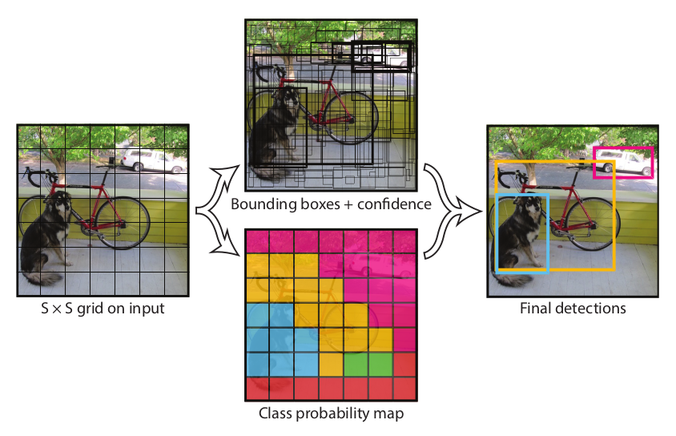
FLOPs : 연산능력
에스파
1/6
1Stage_Detection : YOLO_V1
Final Tensor = S(W)*S(H)*C(2(BB)*5(params)+C(cls_prob))
Divide Input image into S * S grid
2) Each grid cell predicts 2 bounding boxes, confidence scores
3) Each BB predicts 5parameters
4) Each grid cell predicts (Class_Probabilities) per cell
Pr(object)∗IOU(pred,truth)
Pr(class)∗IoU(pred,truth)

Slide 3
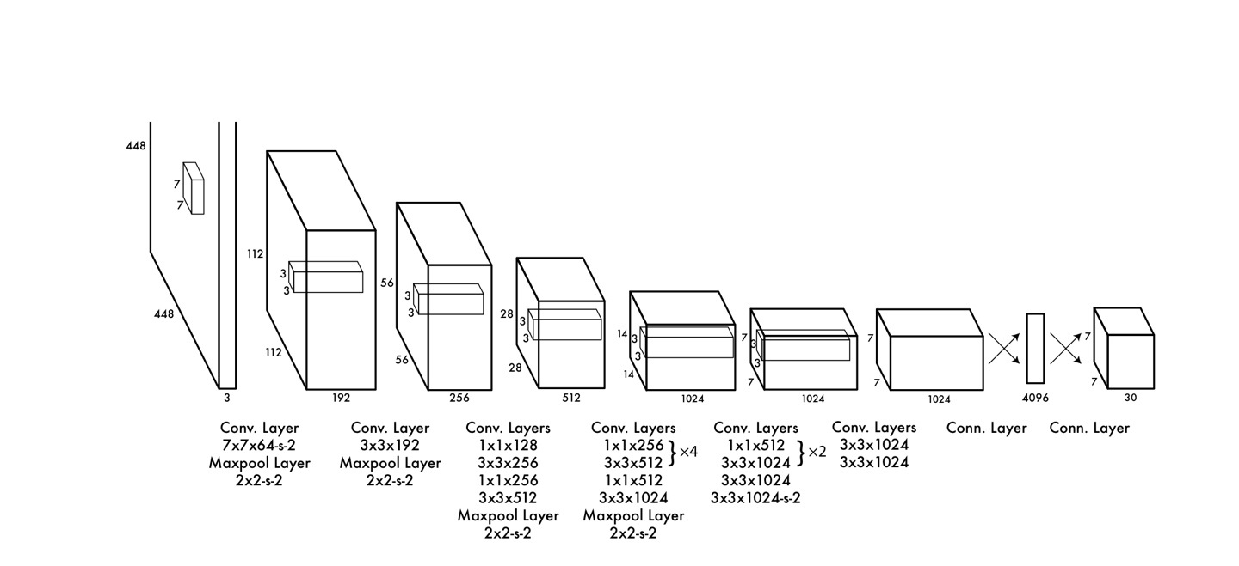
20개의 conv (pretrained)를 쓰고
이 conv는 마치 Inception modul을 concat하지않고 이어붙인 구조이다.
1x1을 쓰는이유는 채널변경도 있지만 1x1을 거치면서 parameter수를 줄여 연산량을 낮추기위함
1/6
YOLO_V1 : Network Structure
First 20 Convolution_Layer : Pretrained with using of ImageNet Data
Add 4 Convolution Layer after the Pretrained Layer
Add 2 Fully-Connected Layer after the 4 CL
Final Tensor = S(W)*S(H)*C(2(BB)*5(params)+C(cls_prob))

Slide 4
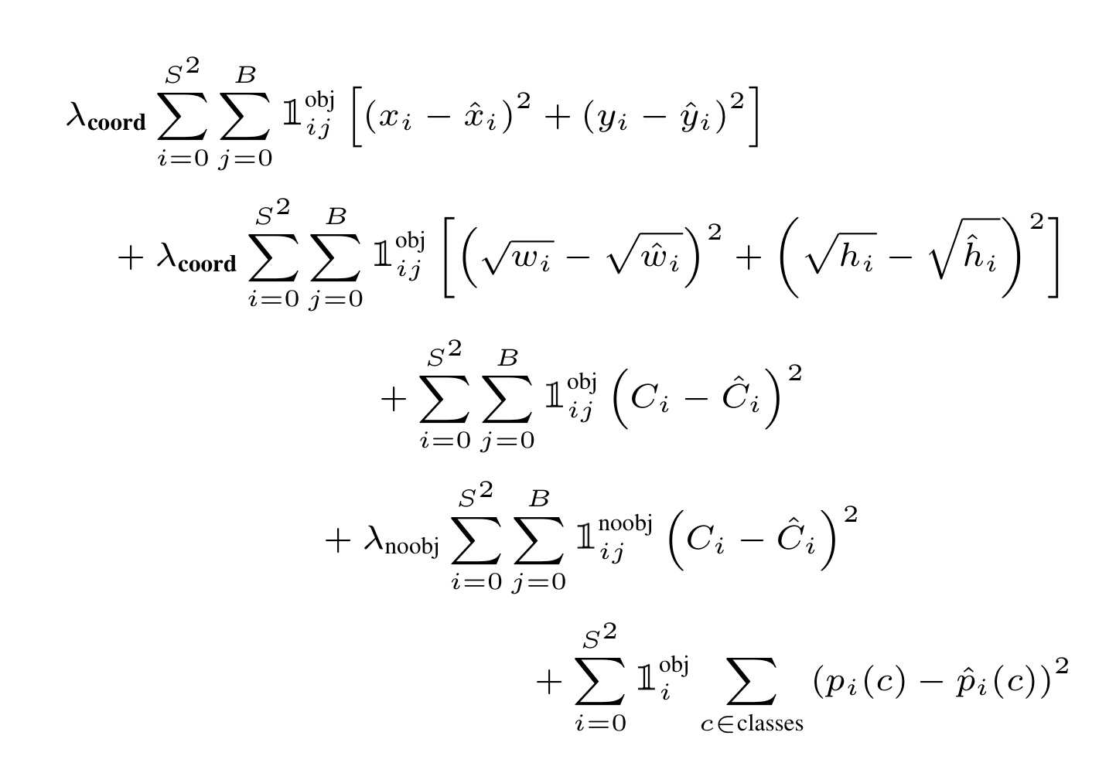

1st term (x, y): The bounding box x and y coordinates is parametrized to be offsets of a particular grid cell location so they are also bounded between 0 and 1. And the sum of square error (SSE) is estimated only when there is object.
2nd term (w, h): The bounding box width and height are normalized by the image width and height so that they fall between 0 and 1. SSE is estimated only when there is object. Since small deviations in large boxes matter less than in small boxes. square root of the bounding box width w and height h instead of the width and height directly to partially address this problem.
3rd term and 4th term (The confidence) (i.e. the IOU between the predicted box and any ground truth box): In every image many grid cells do not contain any object. This pushes the “confidence” scores of those cells towards zero, often overpowering the gradient from cells that do contain objects, and makes the model unstable. Thus, the loss from confidence predictions for boxes that don’t contain objects, is decreased, i.e. λnoobj=0.5.
5th term (Class Probabilities): SSE of class probabilities when there is objects.
λcoord: Due to the same reason mentioned in 3rd and 4th terms, λcoord = 5 to increase the loss from bounding box coordinate predictions.
1/6
YOLO_V1 : Training(Losses)
1 when there is object, 0 when there is no object
Center Loss
BB Location(w,y) when there is object
Width,Height Loss
BB size(w,h)
When there is object
Confidence Loss
Confidence when there is object
0 when there is object, 1 when there is no object
10:1
Confidence when there isn’t object
Class Probability Loss
=
Pr(object)∗IOU(pred,truth)
Class probabilitiese when there is object

Slide 5
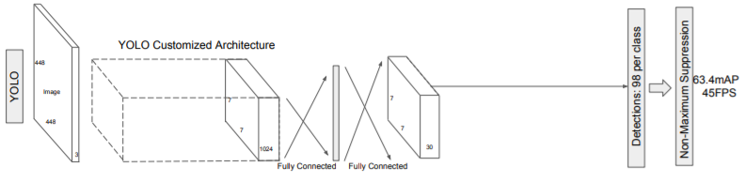
1/6
YOLO_V1 : Inference, Limitations
S(W_grid)*S(H_grid)*2(BB)
Extract (W*H*2) BoundingBoxes for each grid cell
NMS for each BB based on class specific confidence score
Limitations
1. Get 2 predicted bounding boxes from each grid cell, and you can only have one class, so it doesn't detect close small objects very well.
2. Sometimes the localization is not accurate because the small error of the small box is more affected than the small error of the large box.

Slide 6

FLOPs : 연산능력
해상도가 큰 FM은 상대적으로 작은크기의 물체를 잘잡고
해상도가 큰 FM은 큰 크기의 물체를 잘잡는다
1/6
1Stage_Detection : SSD(Single Shot multibox Detector)
SSD doesn’t use Object_Proposal procedure.
Both speed and accuracy of these are superior to YOLO & FasterRCNN
BB Regression
Confidence Score
(300*300)Input Image Size
Default Box
Image with GT boxes
8 * 8 feature map
4 * 4 feature map
SSD uses multi Feature maps with different size.
It also uses many default boxes with the same function as the anchor box
While the training procedure, it only needs (input image, ground truth)

Slide 7
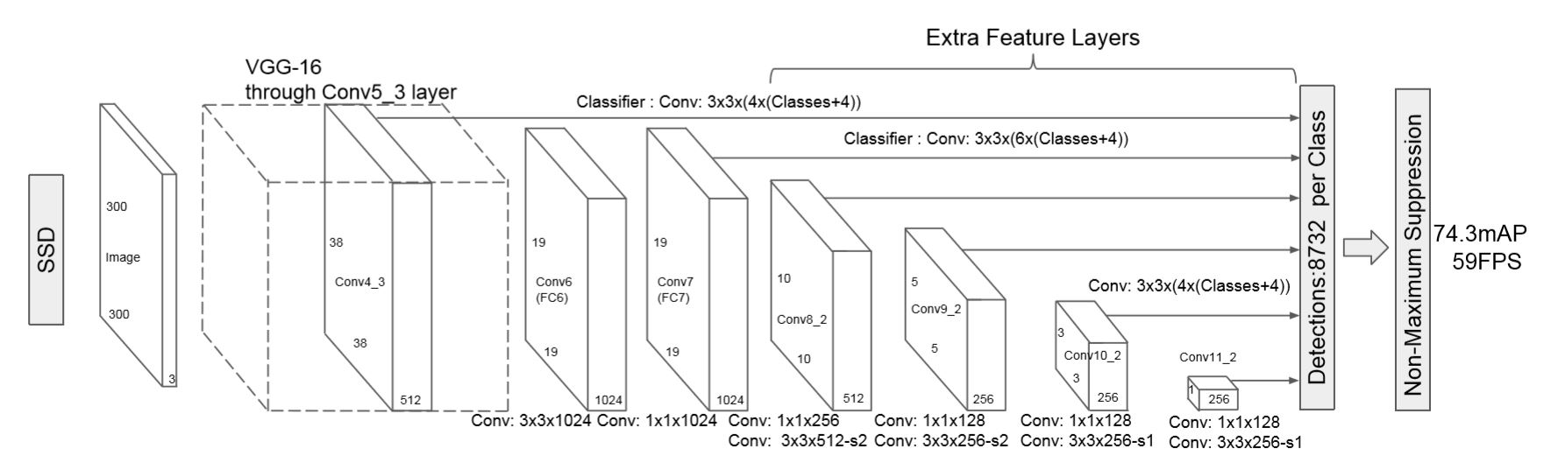
FLOPs : 연산능력
1/6
SSD : Network Structure
BaseNetwork : VGG16
Feed-Forward Convolution Network

Slide 8
FLOPs : 연산능력
1/6
1Stage_Detection : SSDNet – Network Structure
SSDNet doesn’t use Object_Proposal procedure.
Both speed and accuracy of these are superior to YOLO & FasterRCNN

Slide 9
FLOPs : 연산능력
1/6
FPN : Feature Extractor with multiple Feature Map

Slide 10
FLOPs : 연산능력
1/6
FPN : Feature Extractor

Slide 11
FLOPs : 연산능력
1/6
EfficientNet

Slide 12
FLOPs : 연산능력
1/6
EfficientDet : FPN + EfficientNet

Slide 13
6/6
Work Schedule
 | 1주차(~7.7) | 2주차(~7.9) | 3주차(~7.14) | 4주차(~7.16)
내용 | 완료못함 | 레스넷 50 백본 바꿔서 (바꾸는 과정도 코드 어디바꿨는지) 로스 코드비교해서 설명 스무스하게 로스 주는거 보여줘 | 1 스테이지 이론 리뷰 (YOLO – V(n), EfficientDet) | 실습한 결과 백본 바꿔가면서 결과내기 (backbone 대조 결과비교) Loss 스무스하게 수렴 (step별로, (train,val)따로

