Slide 1
Deep learning Seminar
In Sierra BASE
RPN(loss),
BACKbone: resnet50,
Loss 수렴하게
fasterRCNN 내용추가
Feedback of 1Stage_Detector
(Difference between Fully(Connceted, Convolution) Net, IoU, BoundingBox in SSD,
, Logic of FeatureMap in code(FPN & Bi-FPN))
2021. 07. 19 정재형

Slide 2

1/9
Fully-Convolution-Network to replace Fully-Connected-Network
Why we have used Fully-Connected-Net?, And why use Fully-Convolution-Net?
One-hot encodded
aespa_Giselle
aespa_Karina
aespa_Winter
aespa_NingNing
Softmax
0
1
0
0
Limitations of Fully-Connected-Layer
It only can accept the fixed size of Tensor
After input goes through FCN, the Spatial feature disappears.
If use FCN, you have to fix the size with Pooling
So, we use Fully-Convolusion-Net

Slide 3
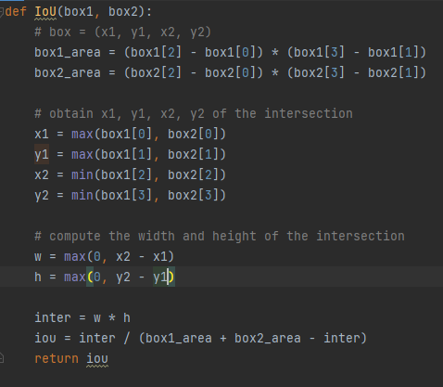


2/9
IoU Calculating
Intersection of Union
Area of Intersection
IoU =
Area of Union
Ex)
Box1 = (0, 0, 10, 10)
Box2 = (-5, -5, 3, 3)

Slide 4

3/9
IoU Calculating
y
Box1 = (0, 0, 10, 10)
10
= 10 * 10 = 100
= 8 * 8 = 64
= box1[0] = 0
= box1[1] = 0
5
= box2[2] = 3
Box2 = (-5, -5, 3, 3)
= box2[3] = 3
3
-5
= max(0,3) = 3
x
0
3
5
10
= max(0,3) = 3
= 9
= 9 / (100 + 64 – 9) = 0.058
-5

Slide 5

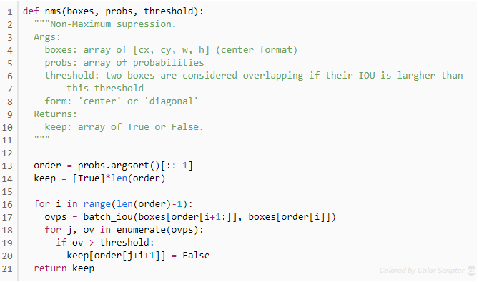
4/9
NMS using IoU as threshold
IoU Threshold= 0.7
KARINA(0.98)
WINTER(0.96)
KARINA(0.98)
KARINA(0.86)
WINTER(0.96)
WINTER(0.67)
WINTER(0.48)
KARINA(0.57)
KARINA(0.24)
WINTER(0.18)
KARINA(0.09)
WINTER(0.06)
Sort by high-low confidence order for each class
In class (KARINA)
(0, 0.98)
(1, 0.86)
(2, 0.57)
(3, 0.24)
(4, 0.09)

Slide 6

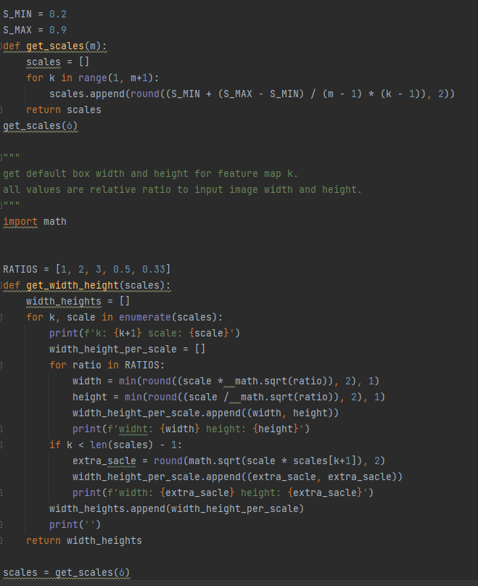

DefaultBox creating in SSD
Loss graph, Inferenced Image, +Precision,score 뽑는방식(score)
사용모델 : fasterRCNN / backbone : Resnet / pre
Loss
L1 : 정답 label과 예측한 값의 절대값 차이를 모두 더해 loss로 정의
L2 : 정답 label과 예측한 값의 차이를 제곱한 값을 모두 더해 loss로 정의
Smooth_L1 : X의 절대값이 1이하이면 곡선, 그외에 영역에서 직선이다.
수정한 것들 : SGD -> Adam
결과 : Inference Image 3장, trainin과 test셋의 loss, mAP
5/9
In SSD, it uses DefaultBox which has
same function as AnchorBox.
For each featureMap,
There are K(normally 6)
Boxes.
8 * 8 feature map
4 * 4 feature map

Slide 7

DefaultBox creating in SSD
Loss graph, Inferenced Image, +Precision,score 뽑는방식(score)
사용모델 : fasterRCNN / backbone : Resnet / pre
Loss
L1 : 정답 label과 예측한 값의 절대값 차이를 모두 더해 loss로 정의
L2 : 정답 label과 예측한 값의 차이를 제곱한 값을 모두 더해 loss로 정의
Smooth_L1 : X의 절대값이 1이하이면 곡선, 그외에 영역에서 직선이다.
수정한 것들 : SGD -> Adam
결과 : Inference Image 3장, trainin과 test셋의 loss, mAP
6/9
Get scale levels for each feature map (K)
Values are relative ratio to width & height
Number of Scales
[0.2, 0.34, 0.48, 0.62, 0.76, 0.9]
Number of FeatureMaps
k: 1 scale: 0.2
widht: 0.2 height: 0.2
widht: 0.28 height: 0.14
widht: 0.35 height: 0.12
widht: 0.14 height: 0.28
widht: 0.11 height: 0.35
width: 0.26 height: 0.26
k: 2 scale: 0.34
widht: 0.34 height: 0.34
widht: 0.48 height: 0.24
widht: 0.59 height: 0.2
widht: 0.24 height: 0.48
widht: 0.2 height: 0.59
width: 0.4 height: 0.4
k: 3 scale: 0.48
widht: 0.48 height: 0.48
widht: 0.68 height: 0.34
widht: 0.83 height: 0.28
widht: 0.34 height: 0.68
widht: 0.28 height: 0.84
width: 0.55 height: 0.55
k: 4 scale: 0.62
widht: 0.62 height: 0.62
widht: 0.88 height: 0.44
widht: 1 height: 0.36
widht: 0.44 height: 0.88
widht: 0.36 height: 1
width: 0.69 height: 0.69
k: 5 scale: 0.76
widht: 0.76 height: 0.76
widht: 1 height: 0.54
widht: 1 height: 0.44
widht: 0.54 height: 1
widht: 0.44 height: 1
width: 0.83 height: 0.83
k: 6 scale: 0.9
widht: 0.9 height: 0.9
widht: 1 height: 0.64
widht: 1 height: 0.52
widht: 0.64 height: 1
widht: 0.52 height: 1
width: 0.96 height : 0.96
0
50
100
150
200
250
300

Slide 8
Difference between FPN & Bi-FPN
7/9
BiFPN :
Bottom_up pathway,
Top_down pathway,
Cross scale Connections,
Delete Node(only 1input)
FPN :
With using Different level features,
It can use various features of different resolution.
Limitations :
Add various featuremap simply without any weights.
Those resolutions are different, so it should be different.
Original FPN :
Top_down pathway,
Lateral Connections
Various trials :
NAS-FPN,
Fully-Connected-FPN,
Panet
BiFPN :
Weighted bi-directional method
Delete node which has only 1 input
because it’s contribution is low.
Cross Scale Connections,
Edging at same class(Bottom_up pathway in last layer) can make features to be more efficient fusion
FPN
Bi-FPN

Slide 9
References
8/9
IoU Calculating Codes:
https://minimin2.tistory.com/144
Default_Box creating in SSD: https://github.com/yeomko22/ssd_defaultbox_generator/blob/master/ssd_defaultbox_generator.ipynb
NMS Codes:
https://dyndy.tistory.com/275
FPN Logic :
https://blog.naver.com/PostView.nhn?blogId=jinyuri303&logNo=221865008339&parentCategoryNo=36&categoryNo=38&viewDate=&isShowPopularPosts=false&from=postView
BiFPN Logic :
https://github.com/zylo117/Yet-Another-EfficientDetPytorch/blob/c533bc2de65135a6fe1d25ca437765c630943afb/efficientdet/model.py#L55

Slide 10
9/9
Work Schedule
 | 2주차(~7.15) | 3주차(~7.19) | 3주차(~7.DD)
 | 1Stage Detector 이론, 개념정리 (YOLO-V1, SSD, FPN, EfficientDet(+Net)) | 1Stage Detector 발표 Feedback 코드 분석 개념이해 - IoU 계산 코드 분석 - SSD에서 BB그려주는 코드분석 - 각 층에서 FeatureMap을 어떻게 서로 섞고 사용하는지 코드분석(Bi-FPN, FPN비교) - Fully Connected, Convolution Network 차이 | Augmentation Loss(focal, CE비교(자세히), YOLO & SSD) Ensemble (multi-scale inference)

