Slide 1
Share & Inspire Lab - Inspiration 2 PREP
Session 1 - Basic concepts

Slide 2

Programming?
Input
Program
Compute
Output

Slide 3

Programming?
Product
Total
Cashier
Scan a production.
Add the price to the total amount
If there are more products to scan, repeat step 1 and 2
If not, print the total amount
It is the programmer's role to make the sequence of operations logical so that computers can perform tasks according to the rules.

Slide 4



Computer
CPU
Subject of calculation.
Do compute based on rules
Stove
RAM
Main memory
Where resources of executed programs are sitting
Cooking Board
Storage
HDD, SSD
Where programs are sitting
Refrigerator
Computer
Kitchen

Slide 5
Programming Language
High Level Language
translate
Low Level Language
CPU
C/C++, Java, Javascript …
Low Level Language
CPU
Low Level Language
CPU
Machine Language or Assembly Language
Machine languages are different depending on CPU manufacturer.
Thanks to translaters, as a developer, we don’t need to know all the other low level languages.
Instead, we can concentrate on only programming using human readable high level languages

Slide 6
Programming Language
Programming
Language
Execute, translate
Compiler
Interpreter
Programming paradigm
Procedural programming
Object-oriented programming

Slide 7
Programming Language
High Level Language
Ex. Java, Python, C/C++
Translate
Low Level Language

Slide 8

Programming Language
Compiler C/C++, Java, C#, …
Translated
Audience
English
English
French
French
Japanese
Japanese
Korean
Chinese
Chinese

Slide 9

Programming Language
Interpreter Python, JavaScript, Ruby, …
Audience
Interpreter
English
French
Japanese
Korean
Chinese

Slide 10
JavaScript
JavaScript is a language designed to dynamically and programmatically control web pages. Therefore, it is the only programming language that can be used in web browsers, which can be said to be the most important platform today.
But it is not limited to the Web platform. After JavaScript runtime platform being developed, with JavaScript, you can also develop Backend Server, Mobile application and so on

Slide 11

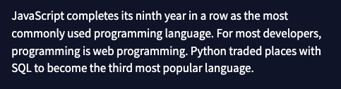
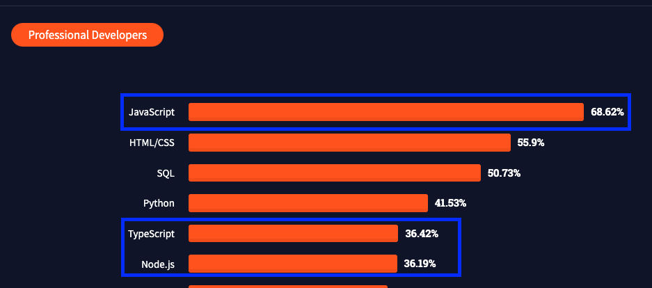
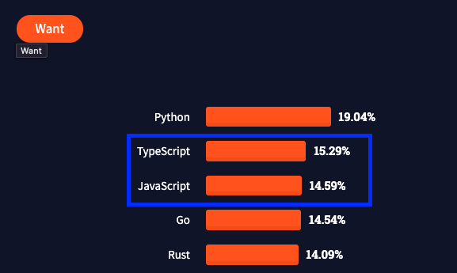
JavaScript

Slide 12

Nose.js
Node. js is a JavaScript runtime built on Chrome's V8 JavaScript engine. Node. js uses an event-driven, non-blocking I/O model that makes it lightweight and efficient.
Javascript

