Slide 1
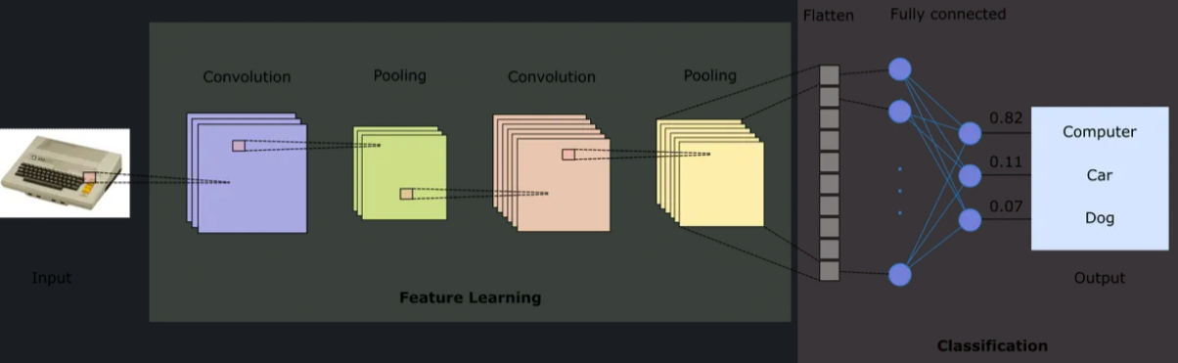
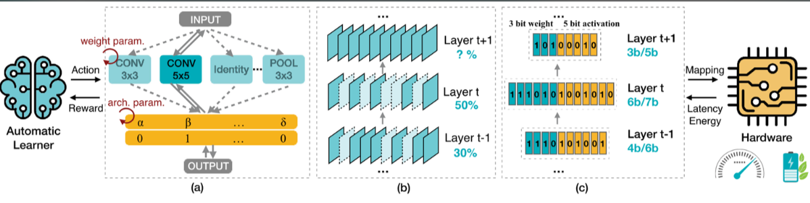

Slide 2
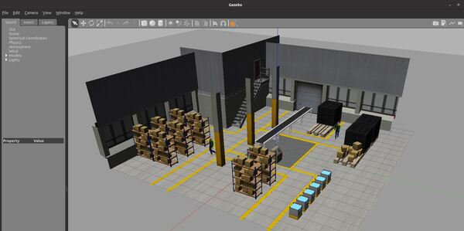
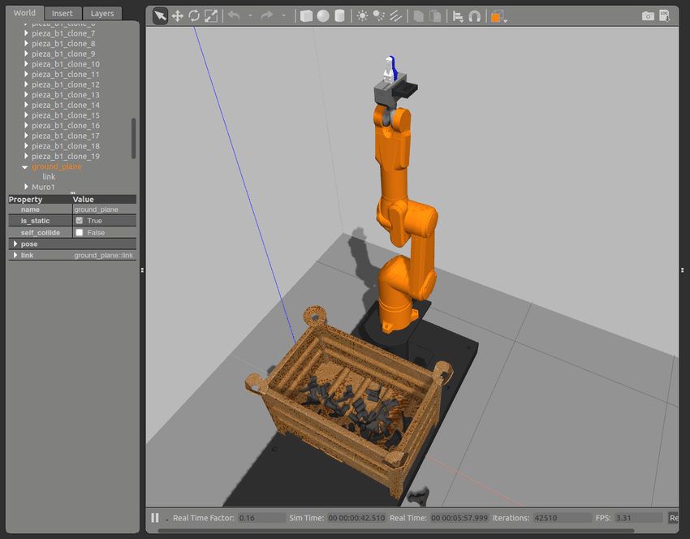
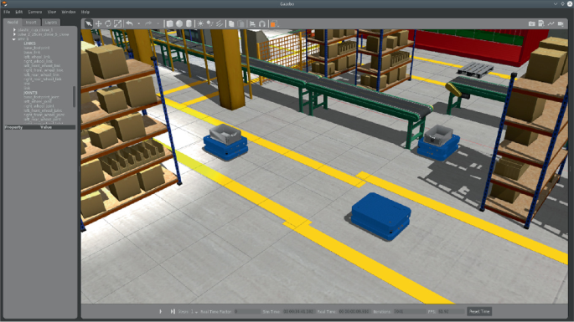

Slide 6
conv
conv
conv

Slide 7
conv
conv
conv

Slide 8
conv
conv
conv

Slide 9
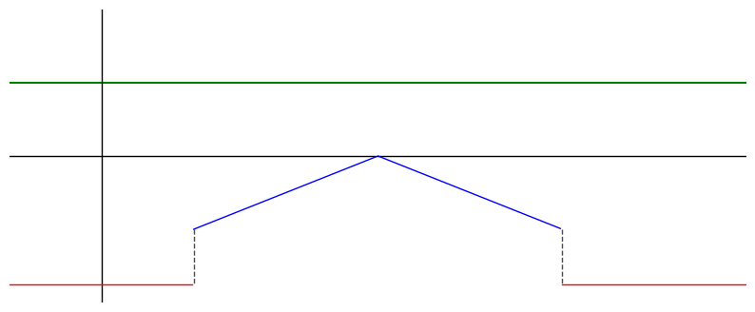







$$y$$
$$C_{S}$$
$$Lower$$
$$bound$$
$$D_{safe}$$
$$Upper$$
$$bound$$
$$x$$
$${−C}_{b}$$

Slide 10
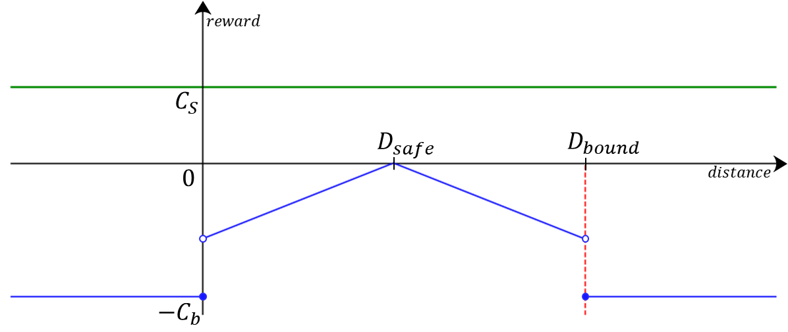

Slide 11
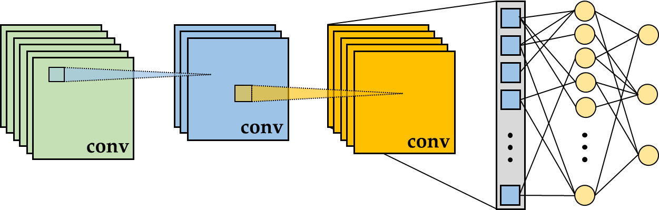


Slide 12
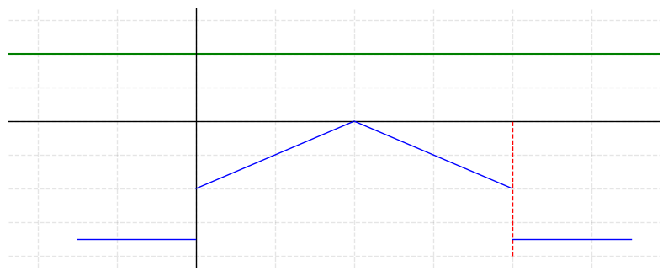




$$C_{S}$$
$$D_{bound}$$
$$0$$
$$C_{b}$$

Slide 13
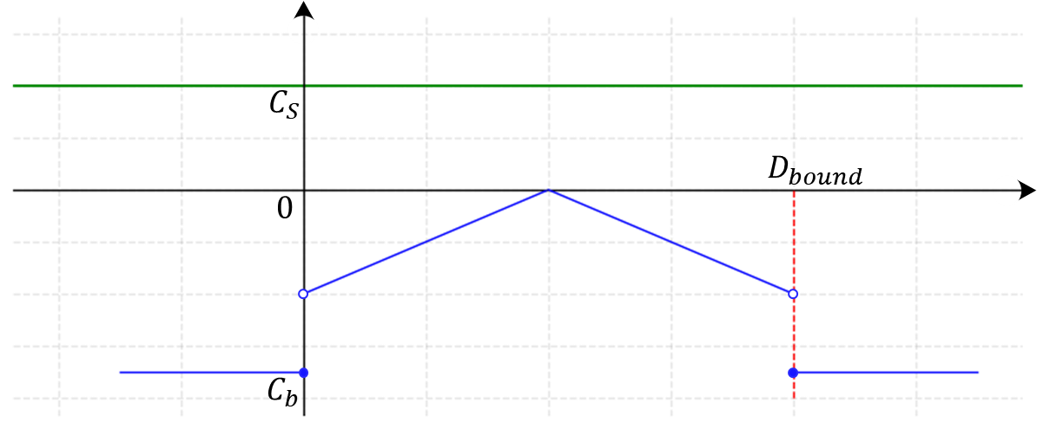
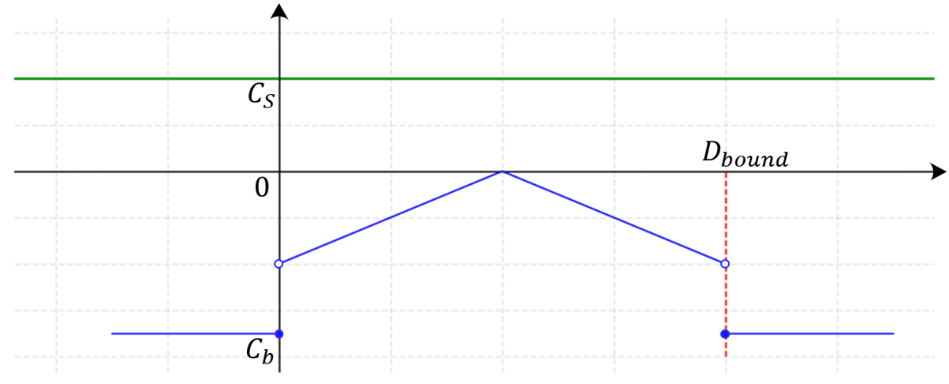

Slide 14
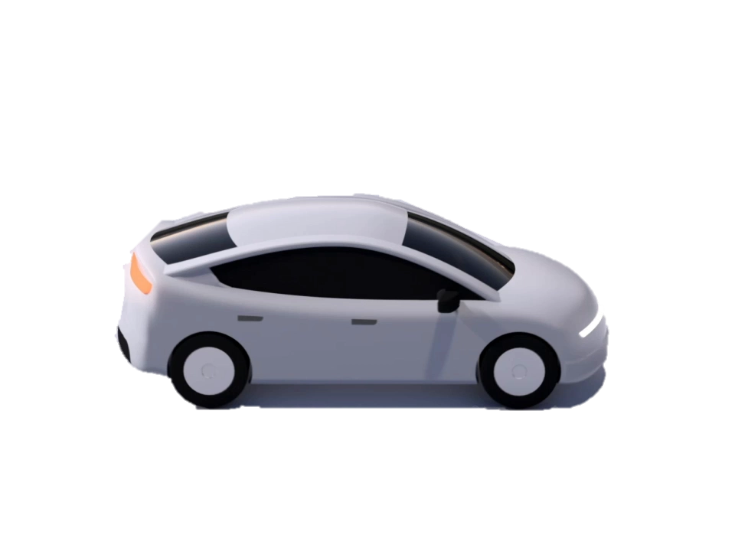

Collision
Sudden lane change

Slide 15
Collision
Sudden lane change

Slide 16
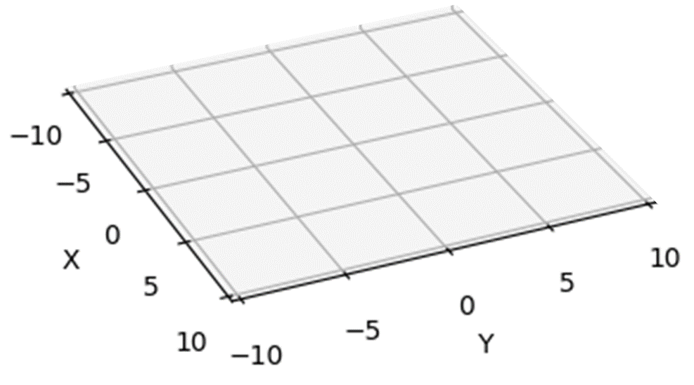
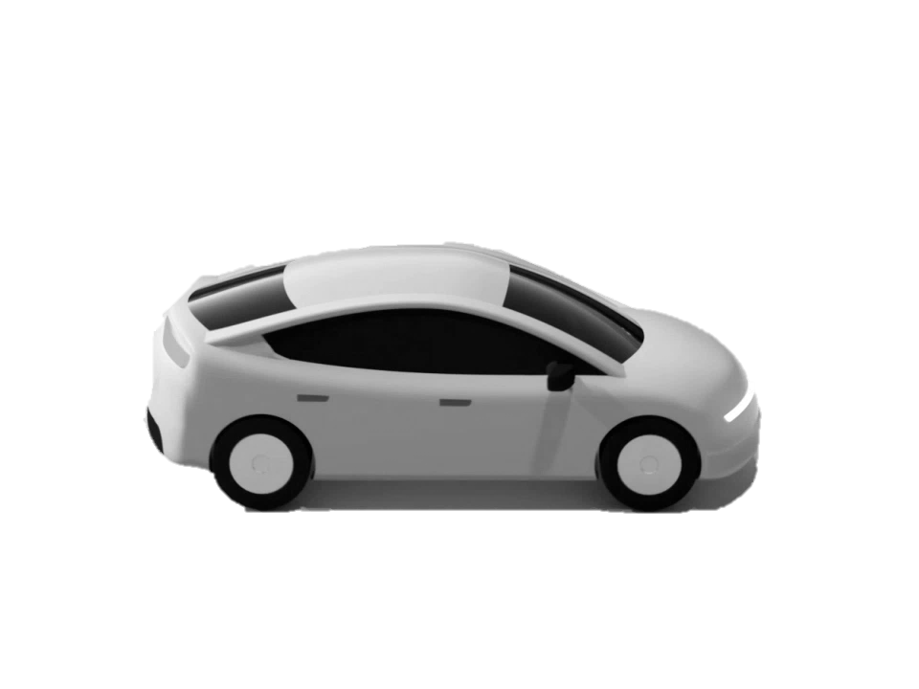
Collision
Sudden
lane
change

Slide 17
Collision
Sudden
lane
change

Slide 18
Collision
Sudden
lane
change

Slide 19
Collision
Sudden
lane
change

Slide 22
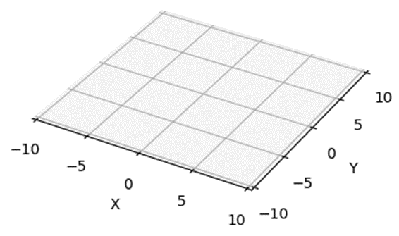

Slide 24
