Slide 1
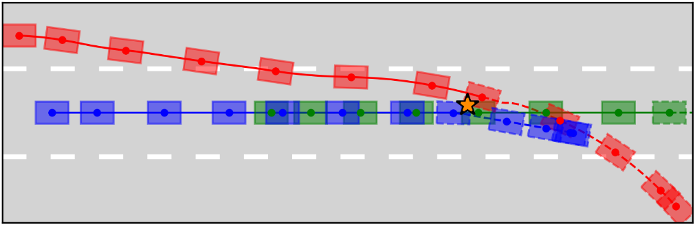
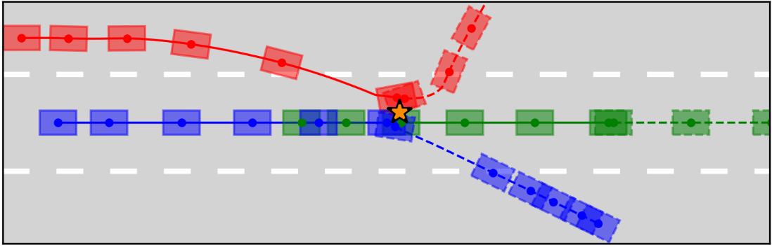
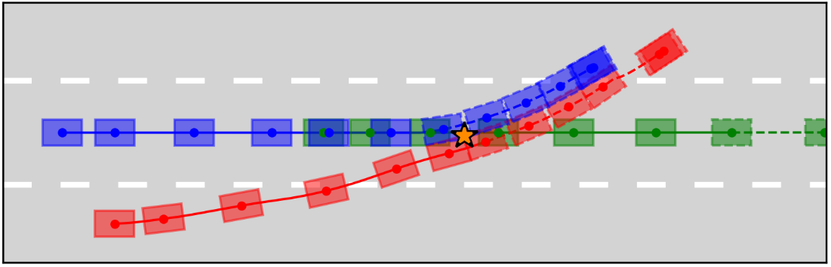
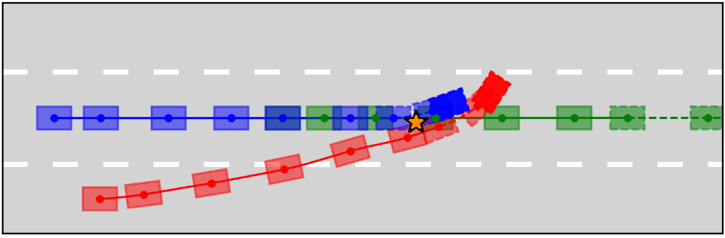
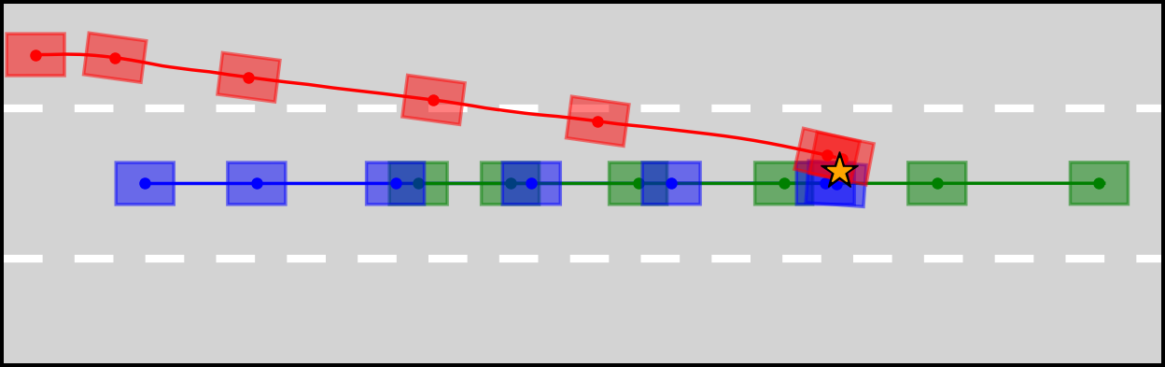
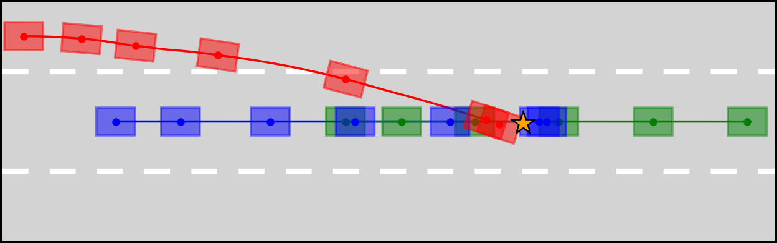
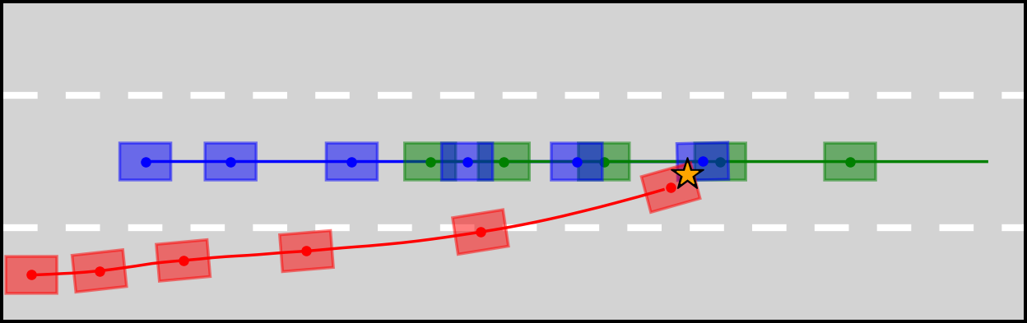
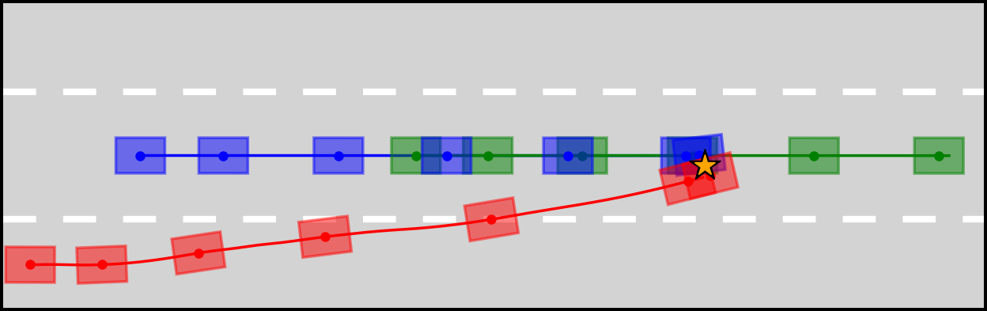
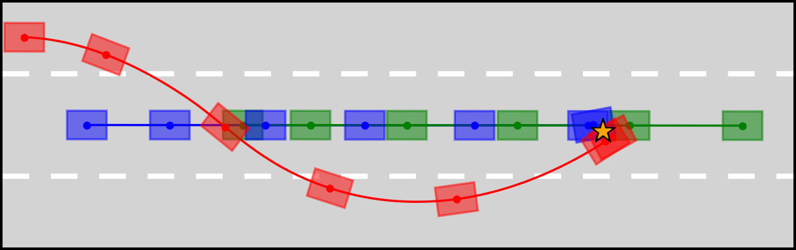
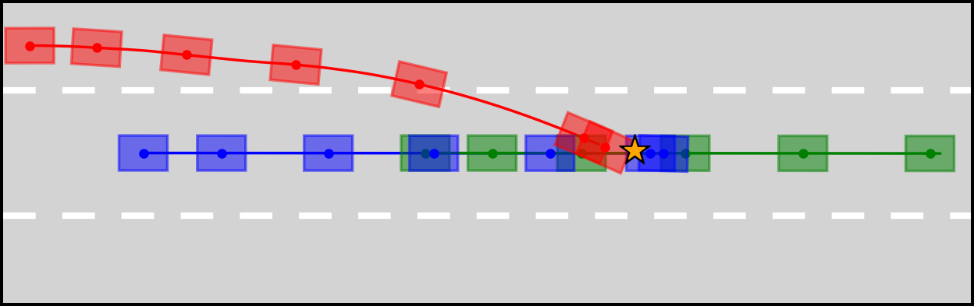
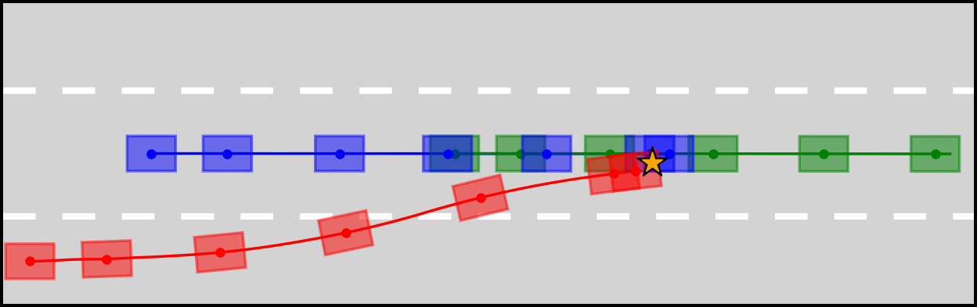
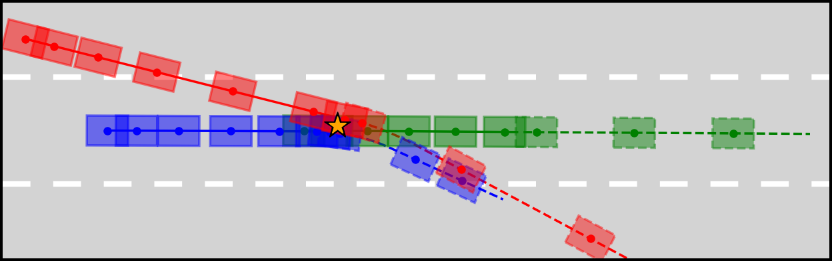
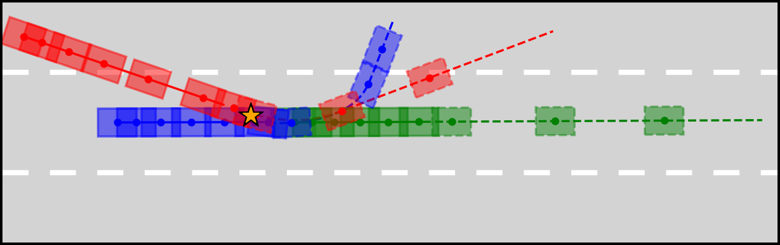
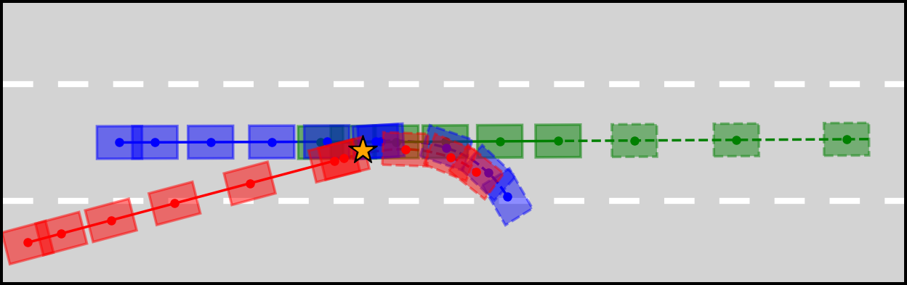
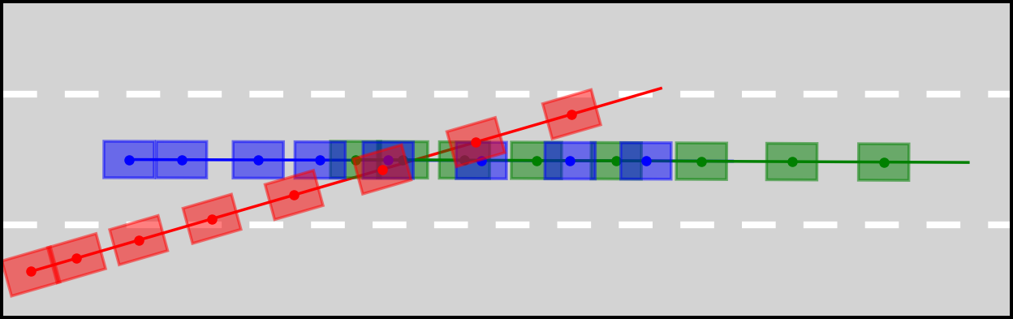
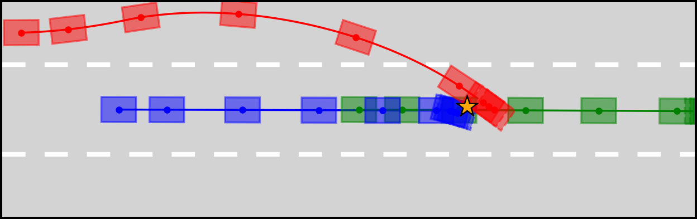
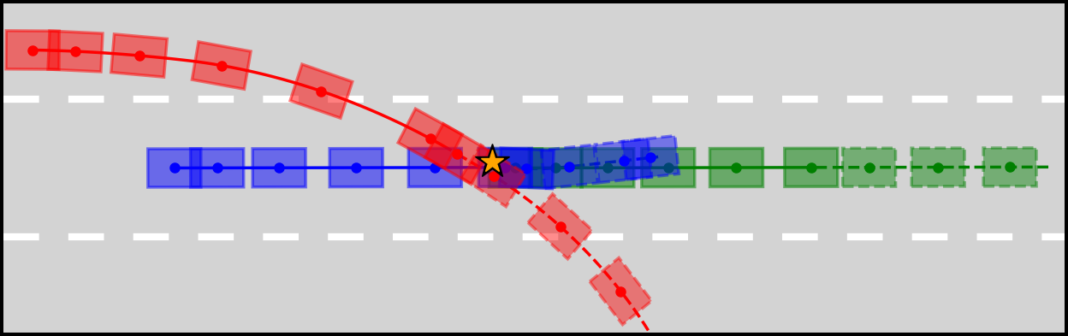
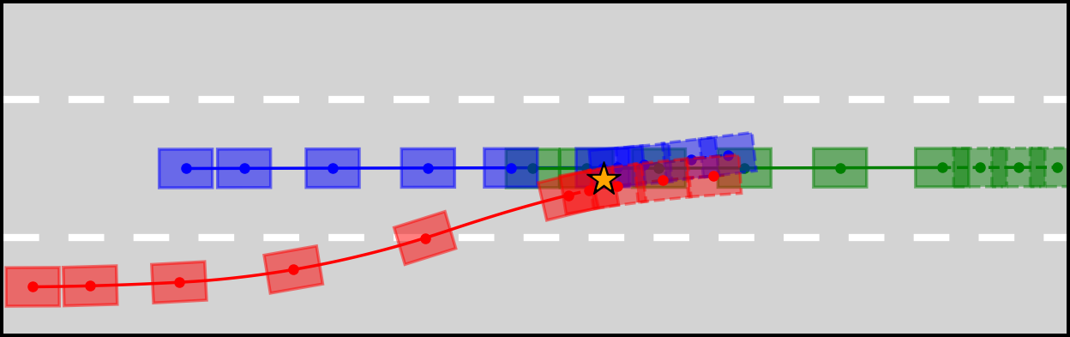
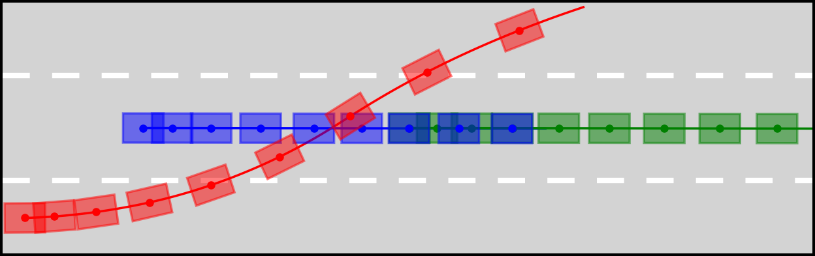

Adversarial agent
Ego agent
Front vehicle
Collision point
Path (b/ collision)
Path (a/ collision)
Ego agent_V1
Ego agent_V2
Ours
(w/ MDP)
Ego agent_V1
Ego agent_V2
(a1) Generation-ROI (left behind)
(a2) Generation-ROI (left behind)
(a3) Generation-ROI (right front)
(a4) Generation-ROI (right front)
Ours
(w/ POMDP)
(b1) Generation-ROI
(b2) Generation-NonROI
(b3) Generation-ROI
(b4) Generation-NonROI
Ours
(w/o $R_{c}$)
(c1) Generation-ROI
(c2) Generation-NonROI
(c3) Generation-NonROI
(c4) Generation-NonROI
Linear
adversary
[36]
(d1) Generation-ROI
(d2) Generation-NonROI
(d3) Generation-NonROI
(d4) Generation-Fail
B-spline
adversary
[37]
(e1) Generation-ROI
(e2) Generation-NonROI
(e3) Generation-NonROI
(e4) Generation-Fail

