Slide 1
service-catalog&broker 설치가이드
기술연구소
2024.03.

Slide 2
##이미지파일
Service-catalog-engine : registry.sysmasterk8s-v3.com:443/service_catalog/service_catalog:v0.01
Service-catalog : registry.sysmasterk8s-v3.com/helm-broker/service-catalog:v0.3.1
Helm-broker : registry.sysmasterk8s-v3.com/helm-broker/helm-broker:0.8
registry.sysmasterk8s-v3.com/helm-broker/etcd:v3.3.9
registry.sysmasterk8s-v3.com/helm-broker/helm-broker-webhook:0.8
4. CloudContainerBroker : registry.sysmasterk8s-v3.com/cloudcontainer-broker/cloudcontainerbroker:2.0
5. CloudVMBroker : registry.sysmasterk8s-v3.com/cloudvm-broker/cloudvmbroker:2.0
##헬름차트
https://github.com/JaeYeo/catalog-broker

Slide 3
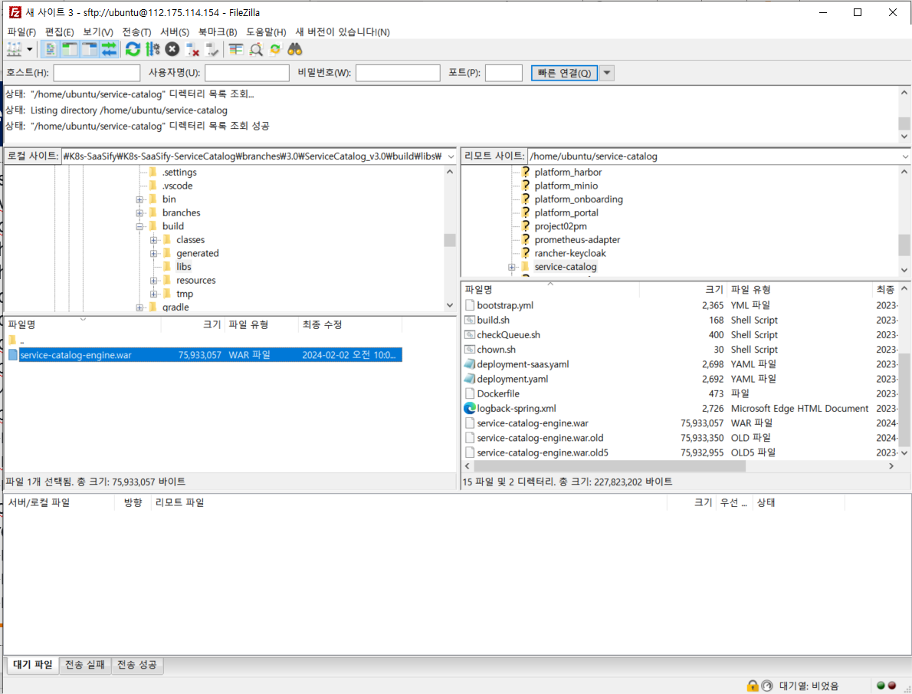
1. Service-Catalog-Engine 배포
0. service-catalog-engine.war파일 전송

Slide 4
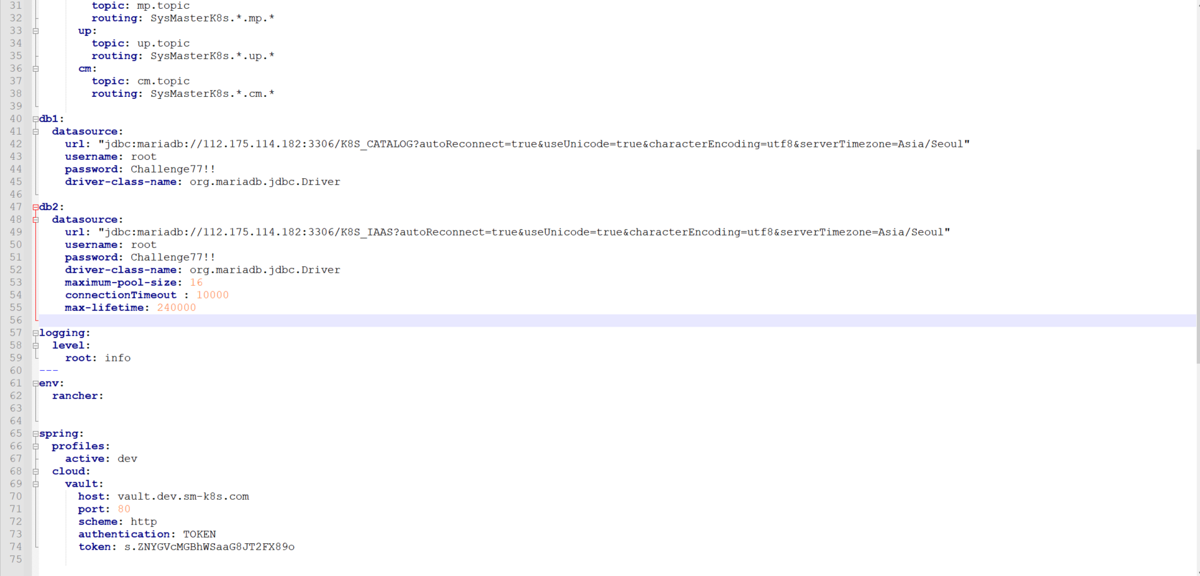
1. Service-Catalog-Engine 배포
1. vm의 service-catalog폴더 수정
bootstrap.yml수정
(DB정보, Vault 정보 등 수정)

Slide 5
1. Service-Catalog-Engine 배포
2. harbor 웹에 프로젝트 생성
3. harbor에 service-catalog-engine 이미지추가
docker build -t registry.sysmasterk8s-v3.com/service_catalog/service_catalog:v0.01 .
docker push registry.sysmasterk8s-v3.com/service_catalog/service_catalog:v0.01
4. deployment.yaml 배포
kubectl apply -f service-catalog-deployment.yaml
5. 시크릿 추가
kubectl create secret generic service-catalog --from-literal=db1="jdbc:mariadb://112.175.114.188:3306/K8S_CATALOG?autoReconnect=true&useUnicode=true&characterEncoding=utf8&serverTimezone=Asia/Seoul" --from-literal=db2="jdbc:mariadb://112.175.114.188:3306/K8S_IAAS?autoReconnect=true&useUnicode=true&characterEncoding=utf8&serverTimezone=Asia/Seoul" --from-literal=db_id=root --from-literal=db_pw=sm@rt78!! --from-literal=rabbitmq_password='uocYoYvV2OSIGLiw8MJQ' --from-literal=vault_key='s.5Ujpw4YhmwaA7lmrAaMWVpKI' --from-literal=vault_url="vault.sysmasterk8s-v3.com" -n portal-dev

Slide 6
2. service-catalog 배포
##service-catalog 배포
$ helm install catalog charts/catalog --namespace catalog --set asyncBindingOperationsEnabled=true --set podLabels.app=monitoring-collector,podLabels.platform=platform_service,podLabels.taskse=service_catalog,podLabels.taskcl=backend_service --wait --create-namespace
NAME: catalog
LAST DEPLOYED: Mon Mar 11 16:31:31 2024
NAMESPACE: catalog
STATUS: deployed
REVISION: 1
TEST SUITE: None

Slide 7
3. helm-broker 배포
##helm-broker 배포
$ helm install helm-broker charts/helm-broker --namespace helm-broker --set global.containerRegistry.path="registry.sysmasterk8s-v3.com/" --set global.helm_broker.dir="helm-broker/" --set global.helm_broker.version=0.8 --set global.helm_controller.dir="helm-broker/" --set global.helm_controller.version=0.8 --set debug.enabled=true --create-namespace
NAME: helm-broker
LAST DEPLOYED: Mon Mar 11 16:32:36 2024
NAMESPACE: helm-broker
STATUS: deployed
REVISION: 1
## clusteraddonconfiguration 등록
$ kubectl apply –f addons-configuration.yaml

Slide 8
4. helm chart로 cloudvmbroker 배포
##cloudvmbroker 배포
$ cat values.yaml (Ingress_host 수정)
ingress:
enabled: true
hosts:
- host: cloudvmbroker.saas.sysmasterk8s.com
paths:
- path: /
pathType: ImplementationSpecific
$ helm install cloudvmbroker --version 0.1.0 charts/cloudvmbroker -n cloudvmbroker -f ./values.yaml
NAME: cloudvmbroker
LAST DEPLOYED: Tue Mar 14 02:03:52 2023
NAMESPACE: cloudvmbroker
STATUS: deployed
REVISION: 1
NOTES:
1. Get the application URL by running these commands:
http://cloudvmbroker.saas.sysmasterk8s.com/

Slide 9
5. helm chart로 cloudcontainerbroker 배포
## cloudcontainerbroker 배포
$ cat values.yaml ( Ingress_host 수정 )
Ingress:
enabled: true
hosts:
- host: cloudcontainerbroker.saas.sysmasterk8s.com
paths:
- path: /
pathType: ImplementationSpecific
$ helm install cloudcontainerbroker --version 0.1.0 charts/cloudcontainerbroker -n cloudcontainerbroker -f ./values.yaml
NAME: cloudcontainerbroker
LAST DEPLOYED: Mon Apr 17 02:37:48 2023
NAMESPACE: cloudcontainerbroker
STATUS: deployed
REVISION: 1
NOTES:
1. Get the application URL by running these commands:
http://cloudcontainerbroker.saas.sysmasterk8s.com/

