Slide 1
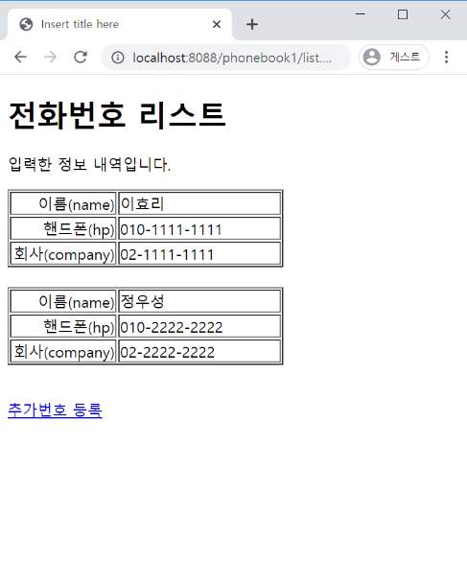
phonebook2 개요 및 분석
01
Rqeust(요청)
분석-수정폼
Request header
파라미터: action=uform
Request body
Tomcat
phonebook2
http://localhost:8088/phonebook2/pbc?action=uform
contoller(servlet)객체
phoneDao 객체
rquest
Uform일때
phoneDao
insert일때
delete일때
..
getPerson ()
Response(응답)
response
Response header
Response body
(html)
*포워드
rquest
updateForm.jsp
객체
response
Rqeust(요청)
Request header
파라미터: action=uform
Request body
어트리뷰트: “pVo”,personVo
DB
Response(응답)
Response header
Response body
(html)

Slide 2
phonebook2 개요 및 분석
01
Rqeust(요청)
분석-수정
Request header
파라미터: action=update
Request body
Tomcat
phonebook2
http://localhost:8088/phonebook2/pbc?action=update
contoller(servlet)객체
phoneDao 객체
rquest
update일때
phoneDao
insert일때
delete일때
..
personUpdate();
Response(응답)
response
Response header
Response body
(Redirect)
http://localhost:8088/phonebook2/pbc?action=list
DB

Slide 3
phonebook2 개요 및 분석
01
Rqeust(요청)
분석-삭제
Request header
파라미터: action=delete
Request body
phonebook2
Tomcat
http://localhost:8088/phonebook2/pbc?action=delete
contoller(servlet)객체
phoneDao 객체
rquest
delete일때
phoneDao
insert일때
delete일때
..
personDelete()
response
Response(응답)
Response header
Response body
(Redirect)
http://localhost:8088/phonebook2/pbc?action=list
DB

