Slide 1
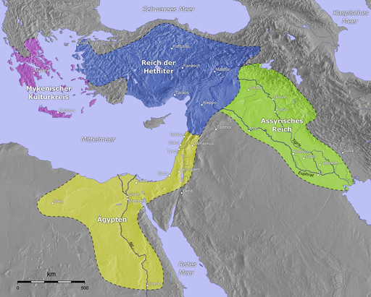
Hitties civilization
1680–1220 BC

Slide 2
Origin and development of civilizations
The first civilizations origin in the places under mountains, thanks for their fertile lands
The process of state’s originating is long, and depend on different factors
Thanks for geographic factor different useful inventions(like wheel) can transfer in all area from China to Europe

Slide 3
Minor Asia
Mountains, which lead to fertile lands
It lead to origin of the most ancient proto-cities like Çatalhöyük (7500 BC to 5700)
However, This good conditions lead to not having to develop more

Slide 4
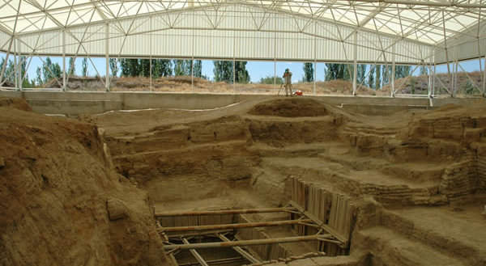

Slide 5
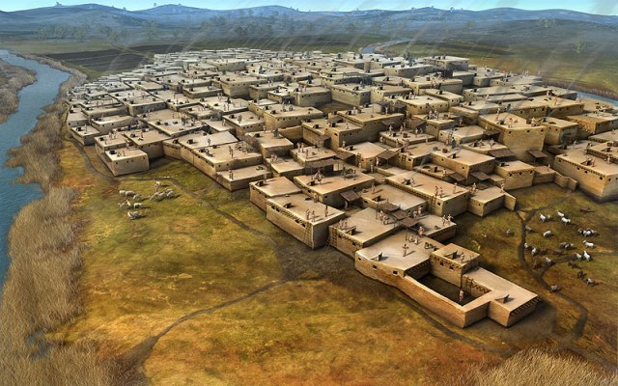
Hatties civilization

Slide 6
Hattians
The land of Hatti and their main city Hattusa were named after them
Their language probably is North Caucasian
They have a cult of Mother – Godness
They are first mentioned in accadians texts in time of Sargon I 2350–2150 BC

Slide 7
Hitties
They came to Minor Asia near 2000–1700 BC and absorbed hattians
They were Indo-european And their civilization is the most ancient known Indo-european civilization
They named themselves after place they were living, so we do not know how they called themselves before coming to Minor Asia
They are mentioned in the Book of Genesis and Book of Kings, both times in positive context

Slide 8
Their religion also was partly Indo-european, even if they have adopted a great variety of different cults. Tarhunt, the chief god was a storm god, like chief gods in other Indo-european cultures, Zeus and Indra, for example. Like Indra, he also had conflict with serpent, Illuyanka.
They also have god Apaliunas, whose name is form of Apollo
They also worshipped Ishtar and Mother Godness

Slide 9
Ancient Hitiies period XX-XVIII BC
Primarily, their state was much a confederation of cities, then a regular state. Pankus – the people/military counsel and tulia were great deals of power. However, they have some supreme king – Labarna
Their heritage law also was unique. The first in line of succession was son of the sisiter.
Try to guess why

Slide 10
Labarna I conquered West Asia Minor, made a kingdom from sea to sea. His wife was Tawannanna
Hattusili I, his nephew, conquered Siria, tried to change line of succession
Mursili, his adopted grandson, ransacked Babylon itself in 1531 BC (short chronology), destoyed the dynasty of Hammurapi. However, he was killed by his own people
Finally, Telepinu(1530-1500) had to give tulia right to judje and execute kings(!), but he made a stirct line of sucession, there own son of the king was first

Slide 11
Midlle Hitties (first half of XV BC)
New Hitties (XV-XII BC)
By the time of Suppiluliuma I, Hitties succesfully fought with Aheians on West, Assirians on South and conquer Syria, thanks for Egypt weakness. Ankhesenamun, widow of Tutankhamen was seeking an alliance by marriage of another of his sons, but this son was murdered

Slide 12
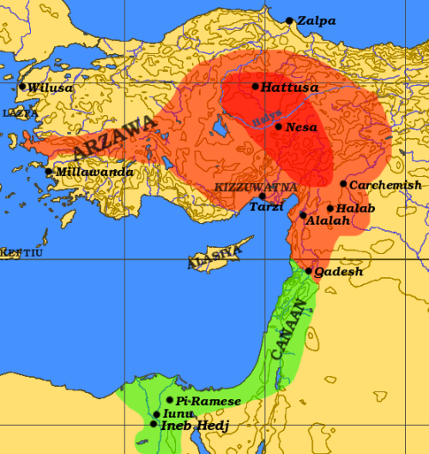

Slide 13
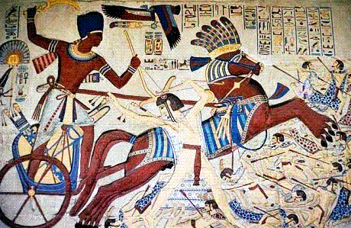
Ramzes II in the battle of Kadesh, 1274 BC
Won only thanks for relief
Muwatalli II

Slide 14
Supiluliuma III usurped throne and happily have peace and alliance by marriage with Ramses, who married Hittie princess. However, it still could not save empire, which was too big. It died in XII century BC under attacks by assirians from South and men of sea from West

