Slide 1


Increasing GPU Computation Efficiency with CUDA Streams
Research question: Can overlapping memory transfer and kernel computation reduce total GPU runtime?
Core takeaway: CUDA streams can improve throughput by reducing idle time through overlap.
NVIDIA Developer Blog, 2021

Slide 2
Roadmap
01
02
03
Why normal GPU workflow wastes time
What CUDA streams do
Implementation using
add-matrices.cu
Ordered queues enabling overlap
Implementation details and chunking strategy
Understanding serialized execution bottlenecks
04
05
06
Benchmark results
Profiling with Nsight Systems
Dot-matrices extension
Add-matrices performance gains
Visual proof of overlap
Realistic workload testing
07
Limitations and conclusion
Key findings and recommendations

Slide 3




The Problem: Serialized GPU Work
Copy data CPU → GPU
Memory transfer to device
Run kernel on GPU
Computation execution
Copy result GPU → CPU
Results transfer back
Problem: The workflow is correct, but serialized. Each stage must complete before the next begins, leaving the GPU idle during transfers.
Goal: Turn the workflow into a pipeline where memory operations and computation overlap.
NVIDIA Developer Blog, 2017

Slide 4
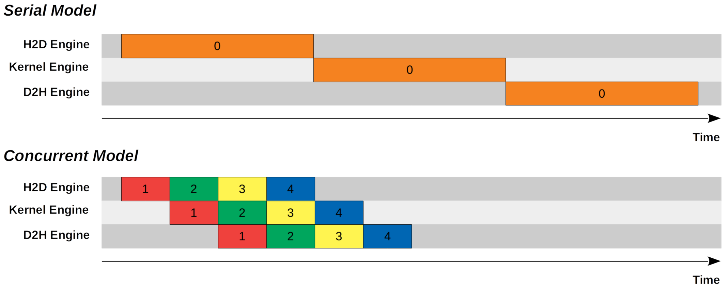

CUDA Streams: The Key Idea
CUDA stream = ordered queue of GPU work
Inside one stream:
copy → kernel → copy back
Across streams: operations may overlap
Important tools
cudaMemcpyAsync for asynchronous transfers
Non-default streams for parallel queues
Pinned host memory for faster transfers
Lei Mao, CUDA Stream blog, 2020
Key insight: Ordered inside a stream, possible overlap across streams

Slide 5
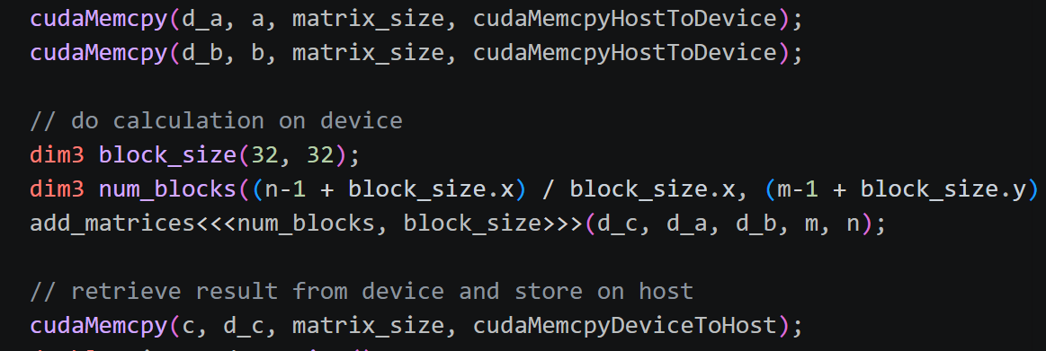
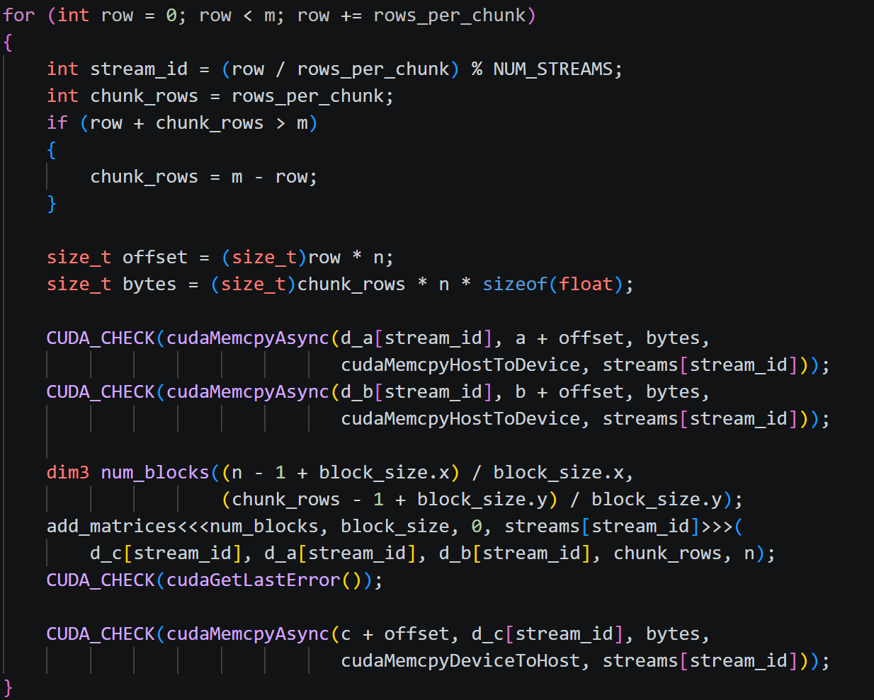
Implementation using add-matrices.cu
Baseline version (add-matrices-cuda.cu)
Streamed version (add-matrices-stream.cu)
Full copy → one kernel → full copy back
Split matrix into chunks. Each stream handles: copy in → kernel → copy out

Slide 6
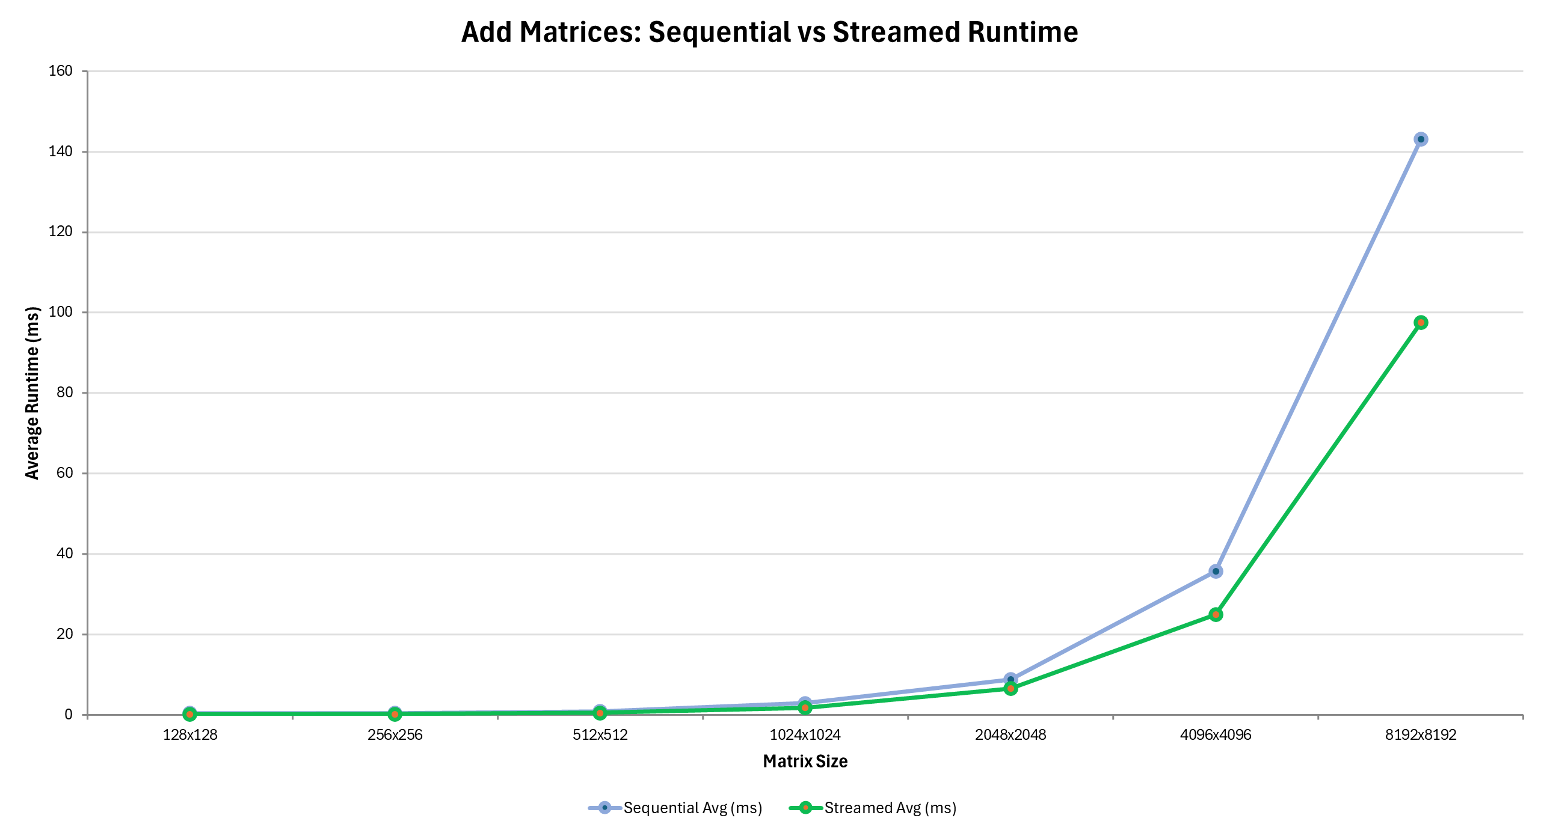
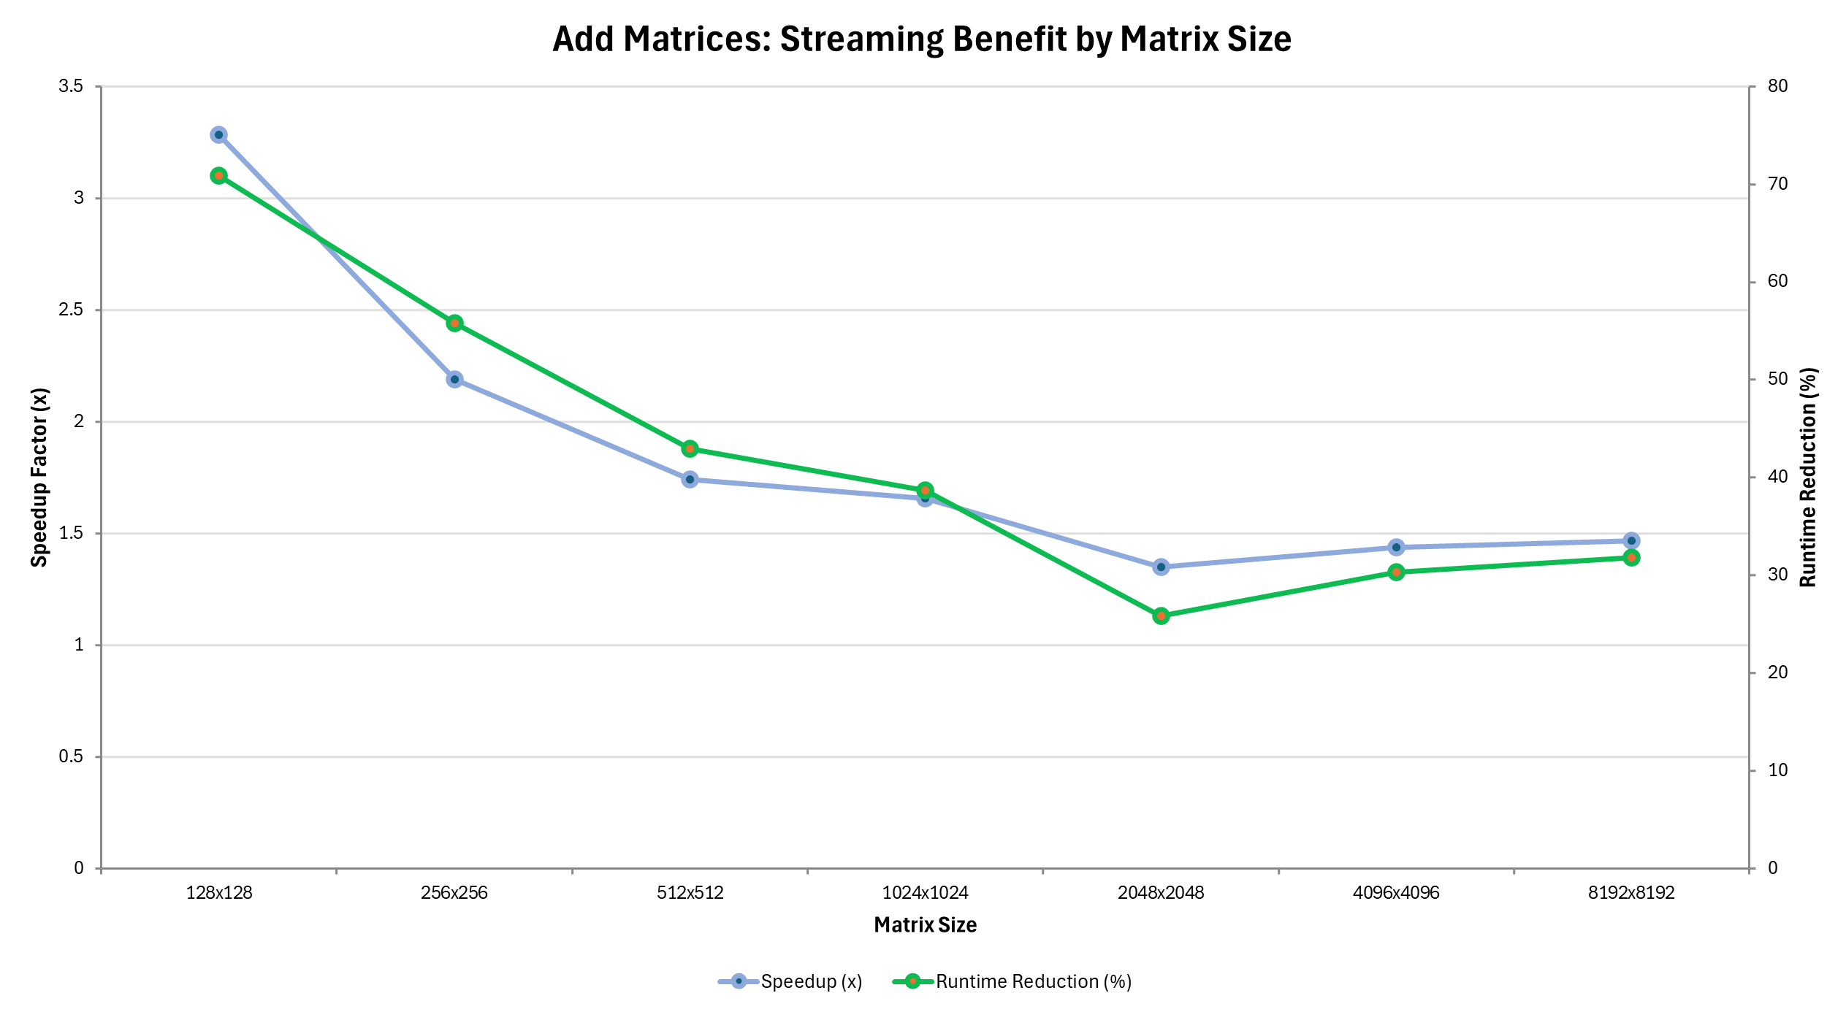

Add-Matrices Benchmark Results
Streamed version was faster for most larger tests
1.66×
1.44×
1.47×
1024×1024
4096×4096
8192×8192
Speedup achieved
Speedup achieved
Speedup achieved
Overlap reduces idle time — less waiting between copy and compute operations

Slide 7

Stream Count Matters
More streams ≠ always faster
1
2
3
1 stream can be slower
2–4 streams often performed best
8 streams was not always helpful
Single stream overhead without benefit
Optimal balance of overlap and overhead
Resource contention and diminishing returns
Reason: Streams add overhead and compete for hardware resources. Best performance came from tuning, not maximizing streams.

Slide 8
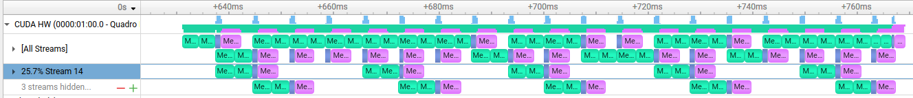
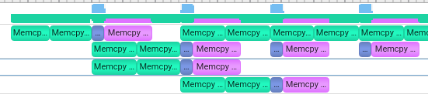
Profiling with Nsight Systems
Sequential timeline
copy → kernel → copy back
Large idle gaps between operations
Streamed timeline
Copy, kernel, and copy-back are interleaved
Operations overlap across multiple streams
H→D
Kernel
Result: Less idle space in the GPU workflow
D→H
Results from running code with 10000x10000

Slide 9
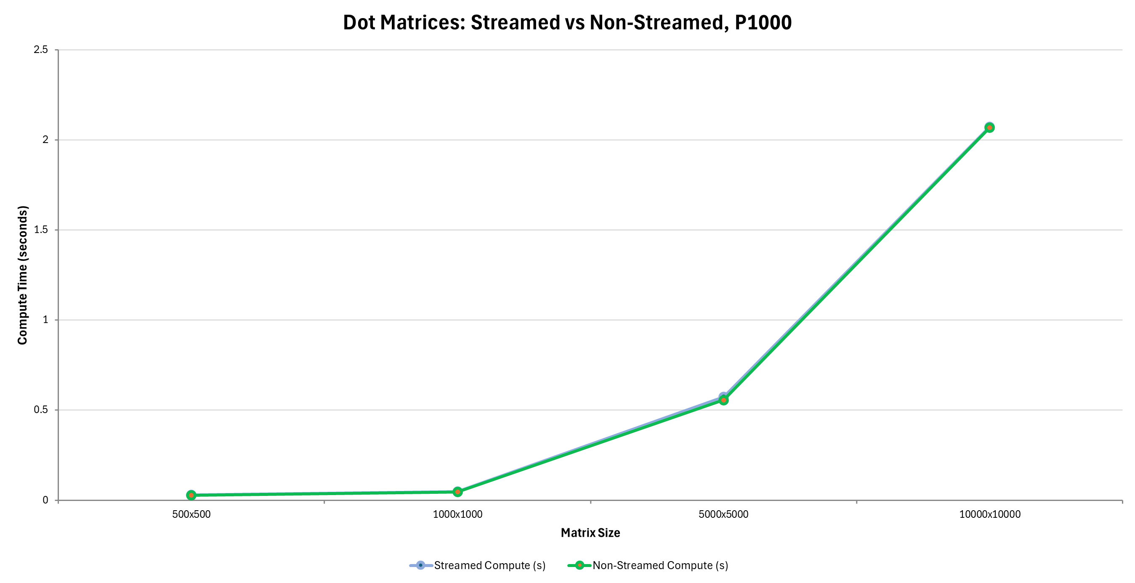
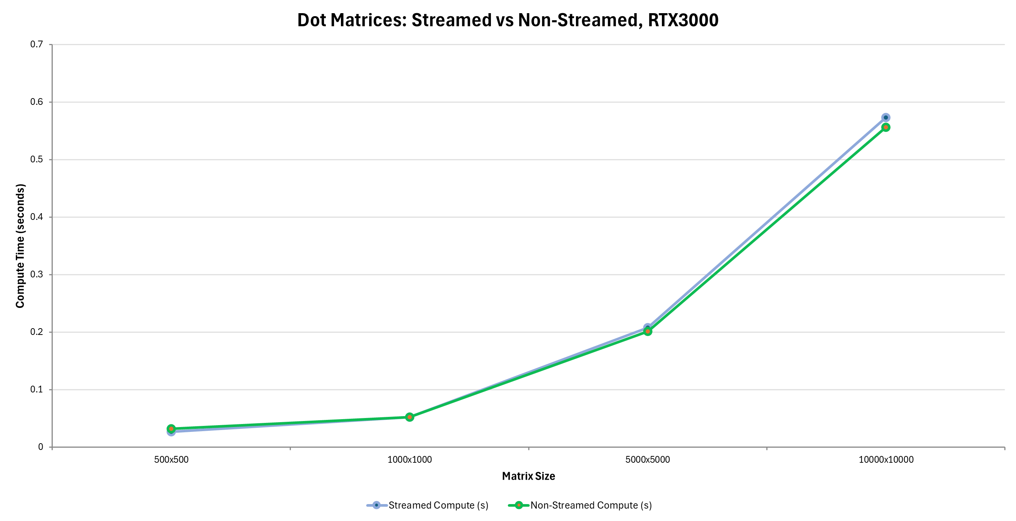
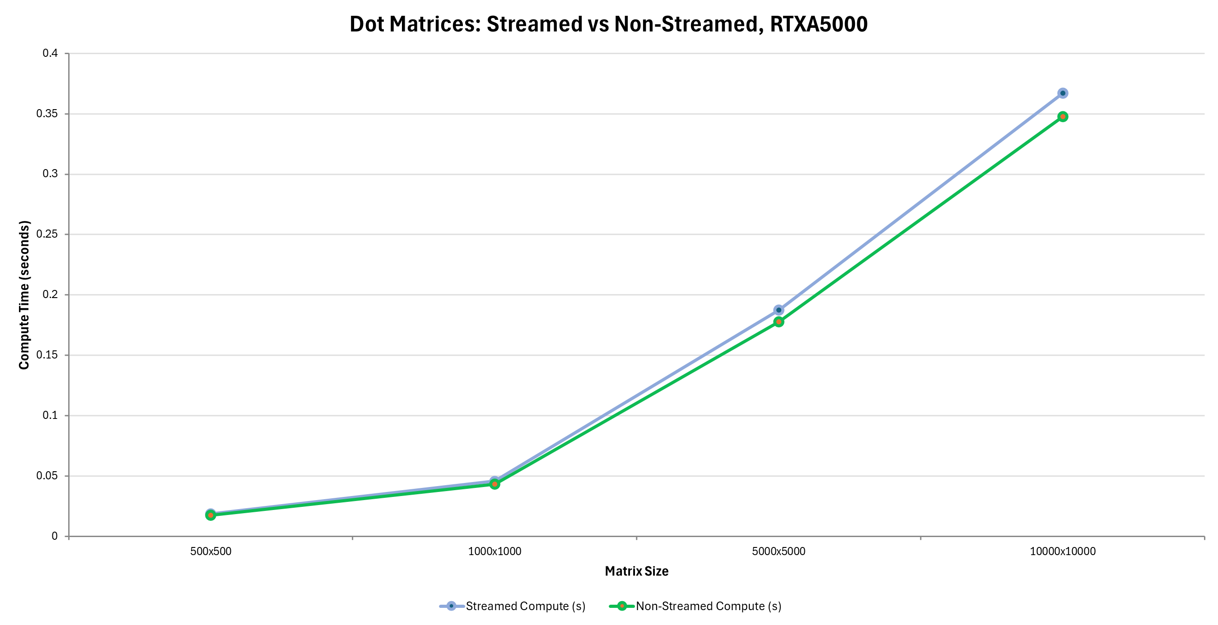
Dot-Matrices Extension: Realistic Workload
Streams tested on larger iterative workload ( codes from project 4)
At 10000×10000 streamed compute time:
2.071
0.573
0.367
2.071
0.573
P1000
RTX3000
RTXA5000
P1000
RTX3000
RTXA5000
Seconds
Seconds
Seconds
Seconds
Seconds
Seconds
Main finding:

Slide 10



Conclusion
CUDA streams can improve throughput by overlapping memory transfer and computation.
Runtime improved
Profiler showed overlap
Add-matrices benefited clearly
Visual proof in Nsight Systems
Real workloads vary
Hardware and problem-dependent
Final takeaway: Asynchronous execution is a performance tool, not a guarantee.

Slide 11
Works Cited
[1] NVIDIA, “CUDA C++ Programming Guide: Asynchronous Execution.” docs.nvidia.com
[2] NVIDIA, “CUDA C++ Programming Guide.” docs.nvidia.com
[3] Lei Mao, “CUDA Streams Guide.” leimao.github.io
[4] NVIDIA Developer Blog Images. developer.nvidia.com
[5] NVIDIA GPU Computing Image. developer.nvidia.com
[6] Jaechang Lee, “CPS343 Final Project Repository.” GitHub Repository
[7] CUDA benchmark data, Nsight Systems profiler results, and experimental implementations from course project files.

