Slide 1
Introduction to Artificial Intelligence
Topic 1. A Brief History to Artificial Intelligence
  Why we focus on “weak AI”?
  Who is Turing?
Topic 2. Uses and Limitations
  What is “weak AI”?
  AI world will be changed, When?
Topic 3. Knowledge Representation
  How we do with “weak AI”?

Slide 2
Turing Machine
輸入
算術與邏輯
記憶體
輸出
控制
I/O
中央處理器(CPU)
Truth Table + Logic Gate → Adder/Multiplier/Mover…→Click → …Binary Code
Notes:
到底是我們正在叫電腦做它不擅長的事，還是我們以前不擅長叫電腦做事？

Slide 3
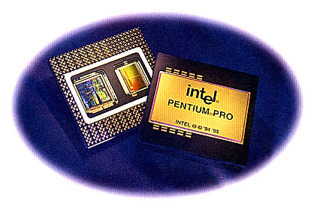
指令的編碼格式
OP 碼
定址模式
位移量
立即
<<number>>

Slide 4
指令的運作 (複雜指令型)
m₂
m₃
int a, b, c;
…..
a=b+c;
ADDM
a → m₁ (3F55C2)
b → m₂ (3F55C4)
c → m₃ (3F55C6)
ADDER
m₁
CPU
ADDM m₁, m₂ , m₃
可以直接定址 16M 記憶體
的複雜指定集(CISC)處理器
e.g. 3B-22-A0-00-3F-55-C2-3F-55-C4-3F-55-C6
<<number>>

Slide 5
指令的運作 (精簡指定型)
int a, b, c;
a=b+c;
MOV
ADD
BX
a → m₁ (4EF55C2)
b → m₂ (4EF55C4)
c → m₃ (4EF55C6)
ADDER
CX
m
AR
CPU
MOV BX, m₂
MOV CX, m₃
ADD BX, CX
MOV m₁, AR
精簡指令型(RISC) 或是
以有限狀態機或微程式工作的
複雜指定型之實際分解動作
<<number>>

Slide 6
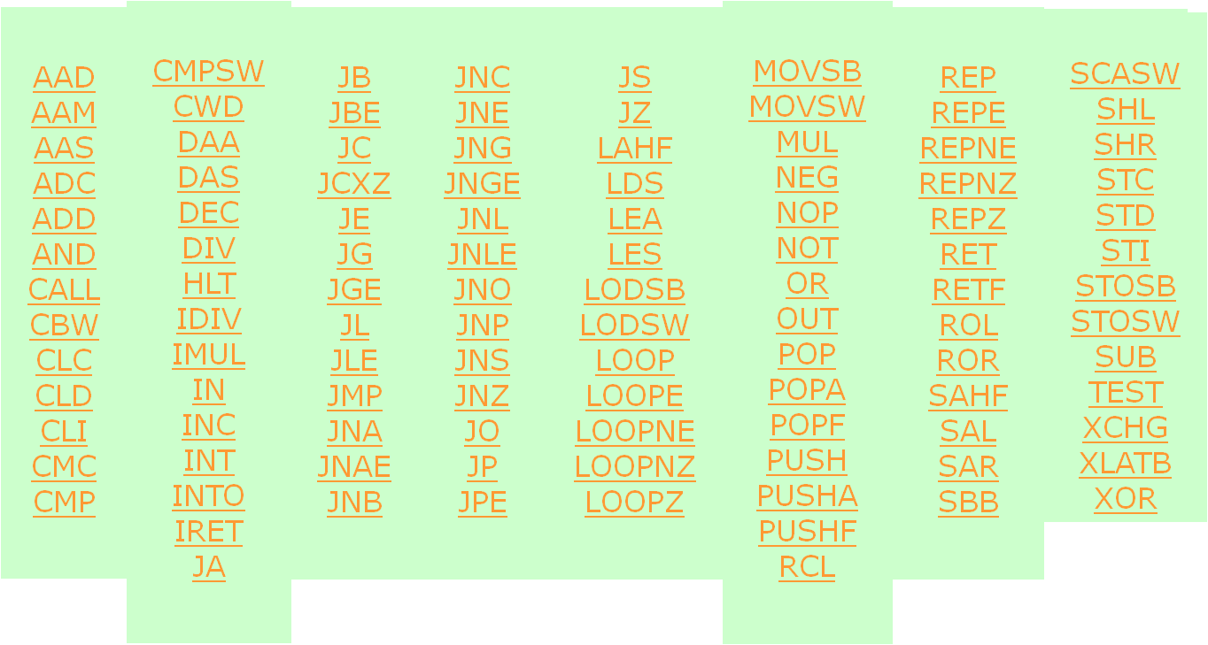
80x86 指令集(精簡指令集)

Slide 7
組合語言
#MAKE_COM# ; instruct compiler to make COM file.
ORG 100h ; directive required for a COM program.
MOV AX, 0B800h ; set AX to hexadecimal value of B800h.
MOV DS, AX ; copy value of AX to DS.
MOV CL, 'A' ; set CL to ASCII code of 'A', it is 41h.
MOV CH, 01011111b ; set CH to binary value.
MOV BX, 15Eh ; set BX to 15Eh.
MOV [BX], CX ; copy contents of CX to memory at B800:015E
RET ; returns to operating system.

Slide 8
Introduction to Artificial Intelligence
Topic 1. A Brief History to Artificial Intelligence
  Why we focus on “weak AI”?
  Who is Turing?
Topic 2. Uses and Limitations
  What is “weak AI”?
  AI world will be changed? When?
Topic 3. Knowledge Representation
  How we do with “weak AI”?

Slide 9
Topic 1
A Brief History of Artificial Intelligence

Slide 10
Brief History
What is Artificial Intelligence?
Alan Turing and the 1950s
Strong AI and Weak AI
Examples: Prolog, LISP

Slide 11
What is Artificial Intelligence?
A more difficult question is: What is intelligence?
This question has puzzled philosophers, biologists and psychologists for centuries.
Artificial Intelligence is easier to define, although there is no standard, accepted definition.
(weak/sub/strong…)
星艦戰將與
蝸蟲的學習
In my opinion:
weak
sub?
strong
記憶
評判
解題
棋局
邏輯推理
控制
學習
創作
(1) 什麼是電腦已經具備的能力?
(2) 如何提升效能，使電腦更近似人類心智活動?
Fuzzy,NN,GA

Slide 12
What is Artificial Intelligence?
A more difficult question is: What is intelligence?
This question has puzzled philosophers, biologists and psychologists for centuries.
Artificial Intelligence is easier to define, although there is no standard, accepted definition.
(weak/sub/strong…)
星艦戰將與
蝸蟲的學習
In my opinion:
weak
sub?
strong
記憶
評判
解題
棋局
邏輯推理
控制
學習
創作
已具備
加入 f(x)
from “<>=“ to “evaluation”
Algorithms
Fuzzy,NN,GA

Slide 13
What is Artificial Intelligence?
A more difficult question is: What is intelligence?
This question has puzzled philosophers, biologists and psychologists for centuries.
Artificial Intelligence is easier to define, although there is no standard, accepted definition.
(weak/sub/strong…)
星艦戰將與
蝸蟲的學習
In my opinion:
策略
直覺
靈感
記憶
評判
解題
棋局
邏輯推理
控制
學習
創作
(1)深度學習提高分類/辨識/評分的評判效能
(2)學習收斂後的標本可記錄下來以供參考與利用
(3)自己找目標
(4)自己找方法

Slide 14
What is Artificial Intelligence?
A more difficult question is: What is intelligence?
This question has puzzled philosophers, biologists and psychologists for centuries.
Artificial Intelligence is easier to define, although there is no standard, accepted definition.
(weak/sub/strong…)
星艦戰將與
蝸蟲的學習
In my opinion:
weak
sub?
strong
記憶
評判
解題
棋局
邏輯推理
控制
學習
創作
Fuzzy,NN,GA
請電腦講一個笑話 e.g. 打獵的笑話?

Slide 15
Alan Turing and the 1950s
Alan Turing is often seen as the father of Artificial Intelligence.
  Computing machinery and intelligence, Mind magazine, October, 59:433 – 460, 1950
  Turing Test: A computer system can be called intelligent or not is based on whether it can fool a human into thinking it is human too.
No system passed the Turing Test
UNTIL 2014/6/8 (Eugene Goostman @ Univ. Reading)
Systems were technically developed that could play checkers, engage in conversation and solve other problems.
The term “AI” was coined in 1956 by John McCarthy.
Machine translation was considered to be a solvable problem.
Weak AI
Turing Test
?
Strong AI

Slide 16
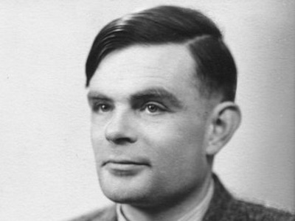
英女王平反數學家圖靈
被譽為計算機科學之父的英國數學家圖靈(Alan Turing)在死後近60年後，終於獲得平反，英國女王伊莉莎白二世(Queen Elizabeth II)於2013年12月23日赦免圖靈。
圖靈是電腦科學奠基人，二戰期間幫助破譯了德國的Enigma密碼系統。他是一位同性戀者，因為當時的反同性戀法律而於1952年被判「嚴重猥褻罪」，遭強制實施化學閹割、賀爾蒙治療、並遭到監視。兩年後圖靈食用浸過氰化物溶液的蘋果自殺死亡，年僅四十二歲。

Slide 17
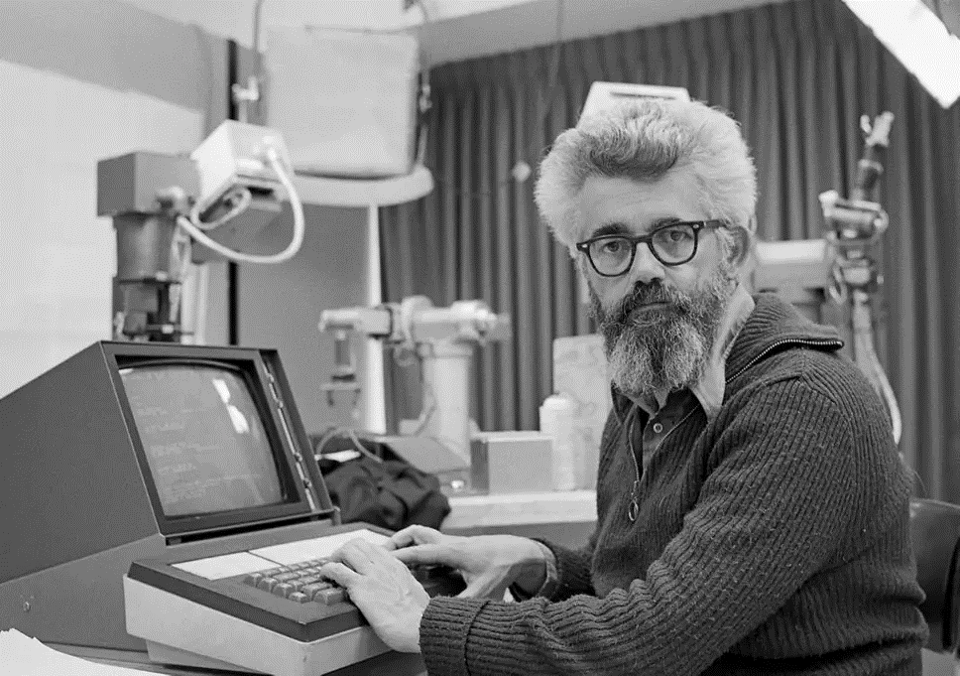
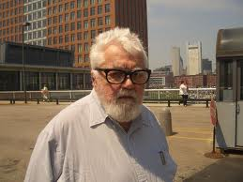
約翰·麥卡錫
約翰·麥卡錫，生於美國麻薩諸塞州波士頓，計算機科學家。他因在人工智慧領域的貢獻而在1971年獲得圖靈獎。實際上，正是他在1955年的達特矛斯會議上提出了「人工智慧」這個概念。
維基百科
出生： 1927 年 9 月 4 日，美國麻薩諸塞州波士頓
逝世： 2011 年 10 月 24 日，美國加利福尼亞州斯坦福
學歷： 普林斯頓大學 (1951 年)， 加州理工學院 (1948 年)
獲獎紀錄： 圖靈獎

Slide 18
Strong AI and Weak AI
There are two entirely different schools of Artificial Intelligence:
Strong AI:
  This is the view that a sufficiently programmed computer would actually be intelligent and would think in the same way that a human does.
Weak AI:
  This is the use of methods modeled on intelligent behavior to make computers more efficient at solving problems.
This course is concerned with Weak AI.
Strong AI is currently the stuff of science fiction, although there are many that believe that machines will indeed be capable of real thought at some point in the future.

Slide 19
Prolog
Example
PROLOG (PROgramming in LOGic):
  A language designed to build databases of facts and rules, and then to have the system answer questions by a process of logical deduction using the facts and rules in the database.
Facts:
  tasty (cheese).
  made_from (cheese, milk).
Rules:
  contains (X, Y) :- made_from (X, Z), contains (Z, Y).
Prolog is not an efficient language like C++, but it is the language of choice when building systems based on logic.

Slide 20
LISP
Example
LISP (LISt Programming):
  A language which more closely resembles the imperative programming languages such as C++ than does PROLOG.
  As its name suggests LISP is based around handling of lists of data. A list in LISP is contained within brackets, such as:
(A B C)
Lists represent data and also programs, meaning LISP programs can manipulate other programs, and it is even possible to write self-modifying LISP programs.

Slide 22
Introduction to Artificial Intelligence
Topic 1. A Brief History to Artificial Intelligence
  Why we focus on “weak AI”?
  Who is Turing?
Topic 2. Uses and Limitations
  What is “weak AI”?
  AI world will be changed? When?
Topic 3. Knowledge Representation
  How we do with “weak AI”?

Slide 23
In my opinion:
weak
sub?
strong
記憶
評判
解題
棋局
邏輯推理
控制
學習
創作
Fuzzy,NN,GA
Topic 2
Uses and Limitations

Slide 24
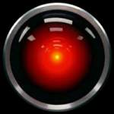
Uses and Limitations
The Chinese Room
HAL – Fantasy or Reality?
AI in the 21st Century
Weak AI
Application-oriented Research (weak + sub)
Turing Test
Strong AI

Slide 25
The Chinese Room
A thought experiment used to argue against strong AI.
A non-Chinese speaker is in a room with a set of cards with Chinese characters, and a set of instructions in English.
(我要一把椅子)
(1. Move a chair to the front door.
2. Open the door. 3. Give me the chair.)
Questions in Chinese are fed into the room, and by following the instructions, the human is able to produce answers.
The room appears to understand Chinese – it can answer questions in the language – but the human inside cannot.
Weak AI

Slide 26
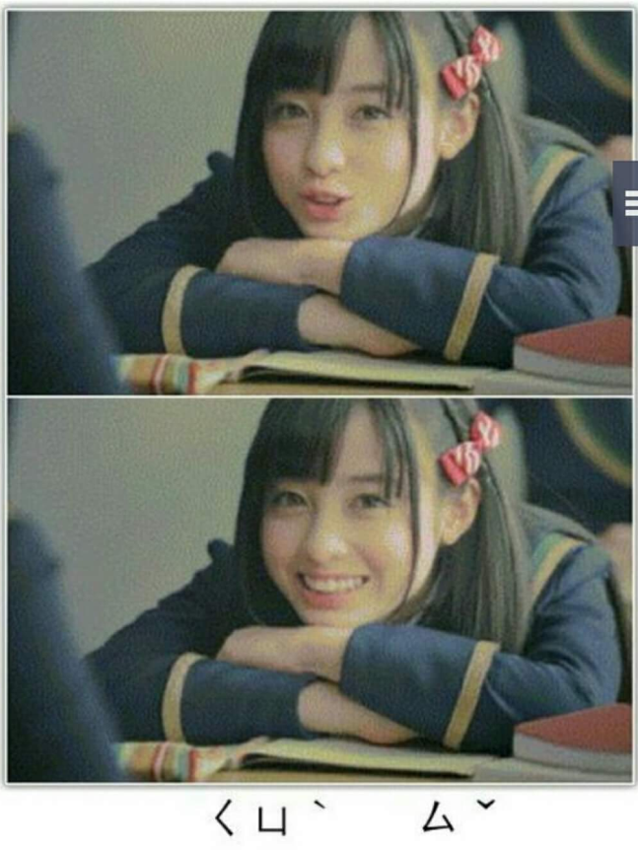
HAL – Fantasy or Reality
HAL – the computer in the film 2001:
A Space Odyssey (2001太空漫遊) by Arthur Clarke
  Plays chess with humans (and wins).
  Reads people’s lips.
  Engages in conversation with humans.
Computers can play chess, and beat most players.
Reading lips is very hard to automate.
The conversational skills of the best systems are (were?) very weak.
Strong AI
H. A. L. → I.B.M. ?

Slide 27
AI in the 21st Century
Application Oriented
Research
AI is everywhere.
Fuzzy logic is used in elevators, washing machines and cars.
Intelligent agents are used in many software applications.
Robots explore other worlds, and toy robots play with children (and some adults).
Expert systems diagnose diseases and recommend remedies.
Computer games use AI.
Weak AI
+
Sub AI

Slide 28
Modern AI Development
Deep Learning
  Google Brain @ Google X Lab
  10 million pictures → face, body, cat
AlphoGo
  DeepMind Co., Google
  30 million states (over 10^170)
  Defeated 樊麾(2014/2015歐洲冠軍) @ Oct., 2015
  AlphaGo v.s. 李世石 @ Mar., 2016
  Master v.s. 60 Professional Players @ Dec. 2016
  AlphoGo Zero Appeared @ 10/19, Dec. 2017

Slide 29
Topic 3
Knowledge Representation

Slide 30
Introduction to Artificial Intelligence
Topic 1. A Brief History to Artificial Intelligence
  Why we focus on “weak AI”?
  Who is Turing?
Topic 2. Uses and Limitations
  What is “weak AI”?
  AI world will be changed? When?
Topic 3. Knowledge Representation
  How we do with “weak AI”?

Slide 31
Knowledge Representation
The need for a good representation
Semantic nets
  by tables?
Object oriented
programming
  Inheritance
  Frames
Search trees
  Combinatorial explosion
  Problem reduction
  by linked lists?
Note:
(1)人腦與電腦底層結構不同，
但上層是否可形成類似的
表達方式?
eg.1.資料結構…
eg.2.圍棋的勢…
(2)藉由高階的表達方式，我們
或能以演算法實作出所謂
具有智慧的活動。
(3)實作越複雜的智慧活動越
需要創意--人或電腦自身的
創意。

Slide 32
The Need for a Good Representation
A computer needs a representation of a problem in order to solve it.
A representation must be:
  Efficient – not wasteful in time or resources.
  Useful – allows the computer to solve the problem.
  Meaningful – really relates to the problem.

Slide 33
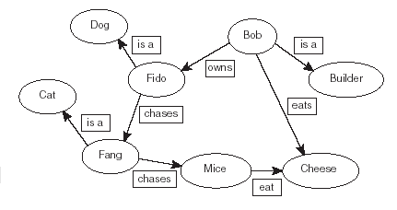
A Simple Semantic Nets (&tables)

Slide 34
Object Oriented Programming
Object oriented programming languages such as Java, C++.
Use ideas such as:
  inheritance
  multiple inheritance
  overriding default values
  procedures and demons
Languages such as IBM’s APL2 use a frame based data structure.

Slide 35
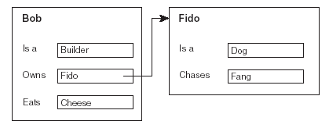
Frames and Inheritance
Inheritance:
  Mammals give birth to live young.
  Fido is a mammal.
  Therefore fido gives birth to live young

Slide 36
Search Trees
Semantic trees – a type of semantic net.
Used to represent search spaces.
Root node has no predecessor.
Leaf nodes have no successors.
Goal nodes (of which there may be more than one) represent solutions to a problem.

Slide 37
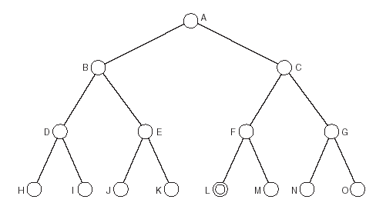
Search Trees: An Example
A is the root node.
L is the goal node.
H, I, J, K, M, N and O are leaf nodes.
There is only one complete path:
  A, C, F, L

Slide 38
Example: Missionaries and Cannibals
Three missionaries and three cannibals
Want to cross a river using one canoe.
Canoe can hold up to two people.
Can never be more cannibals than missionaries on either side of the river.
Aim: To get all safely across the river without any missionaries being eaten.

Slide 39
A Representation
The first step in solving the problem is to choose a suitable representation.
We will show number of cannibals, missionaries and canoes on each side of the river.
Start state is therefore:
  3,3,1 0,0,0

Slide 40
A Simpler Representation
In fact, since the system is closed, we only need to represent one side of the river, as we can deduce the other side.
We will represent the finishing side of the river, and omit the starting side.
So start state is:
  0,0,0

Slide 41
Operators
Now we have to choose suitable operators that can be applied:
  Move one cannibal across the river.
  Move two cannibals across the river.
  Move one missionary across the river.
  Move two missionaries across the river.
  Move one missionary and one cannibal.

Slide 42
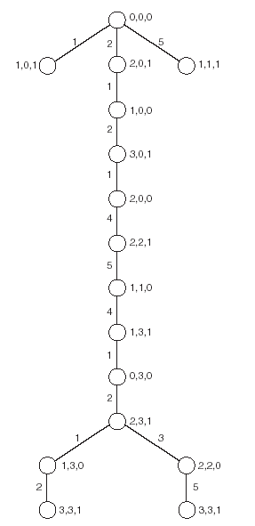
The Search Tree
Cycles have been removed.
Nodes represent states, edges represent operators.
There are two shortest paths that lead to the solution.

Slide 43
Hanoi Tower (e.g. 2 of search tree)
(A,B,C)()()
(B,C)(A)()
(B,C)()(A)
(C)(A)(B)
(C)(B)(A)
(A,C)()(B)
(C)()(A,B)
(A,C)(B)()
(C)(A,B)()
(C)()(A,B)
()(C)(A,B)
(C)(A,B)()
()(A,B)(C)

Slide 44
Combinatorial Explosion
Problems that involve assigning values to a set of variables can grow exponentially with the number of variables.
This is the problem of combinatorial explosion.
Some such problems can be extremely hard to solve (NP-Complete, NP-Hard).
Selecting the correct representation can help to reduce this, as can using heuristics

Slide 45
Problem Reduction
Breaking a problem down into smaller sub-problems (or sub-goals).
Can be represented using goal trees (or and-or trees).
Nodes in the tree represent sub-problems.
The root node represents the overall problem.
Some nodes are and nodes, meaning all their children must be solved.

Slide 46
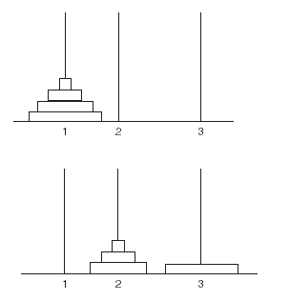
Problem Reduction: Example
E.g. to solve the Towers of Hanoi problem with 4 disks, you can first solve the same problem with 3 disks.
The solution is thus to get from the first diagram on the left, to the second, and then to apply the solution recursively.

Slide 47
Hanoi Tower (goal tree, i.e., and-or tree)
Move A,B,C,D from 1 to 3
Move D from 1 to 3
Move A,B,C from 2 to 3
Move C from 2 to 3
Move A,B from 1 to 3
Move B from 1 to 3
Move A from 2 to 3

