Slide 1
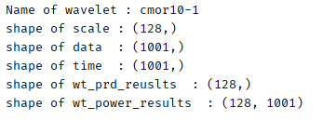
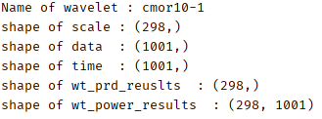
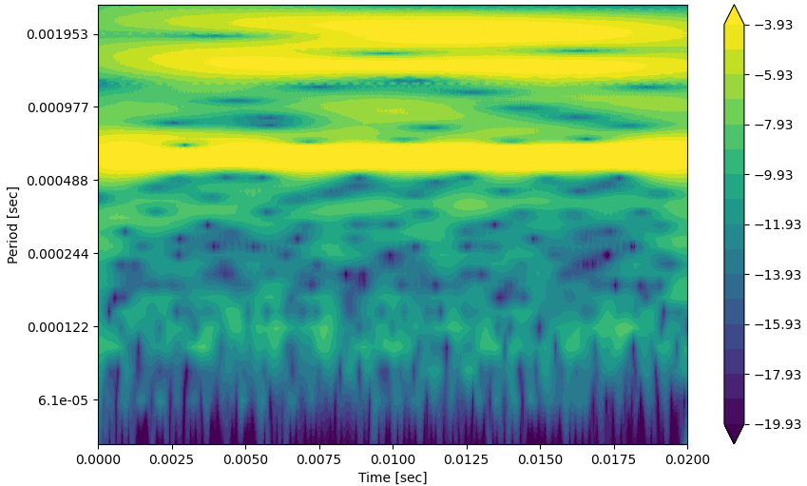
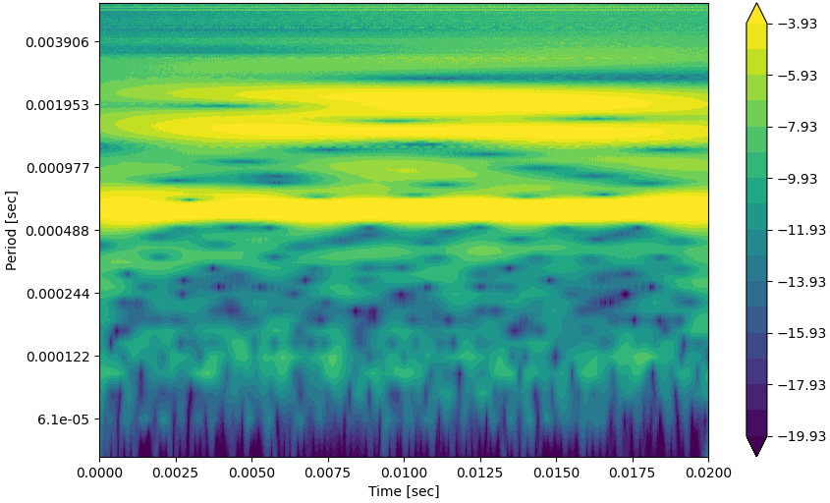
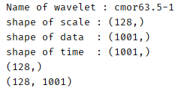
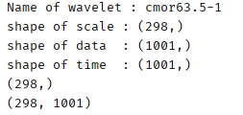
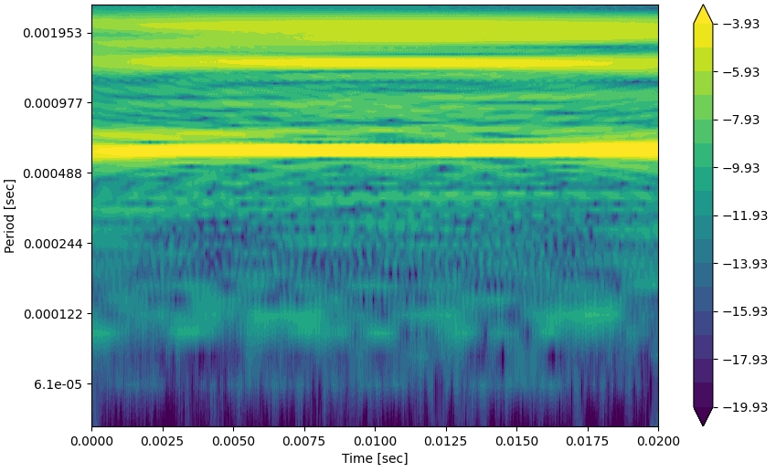
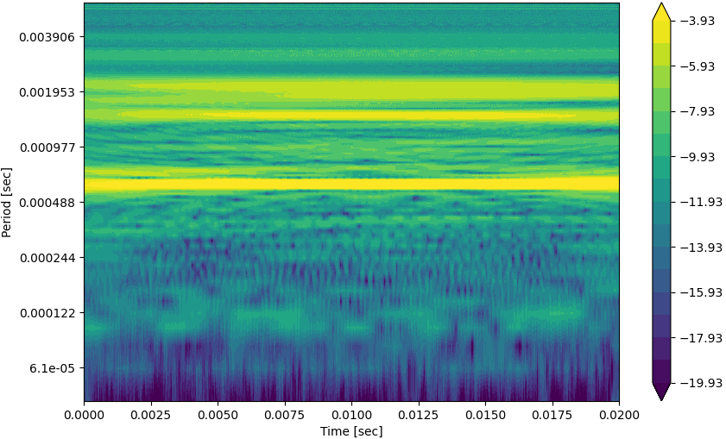
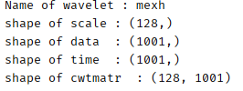
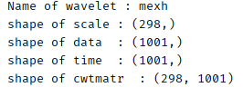
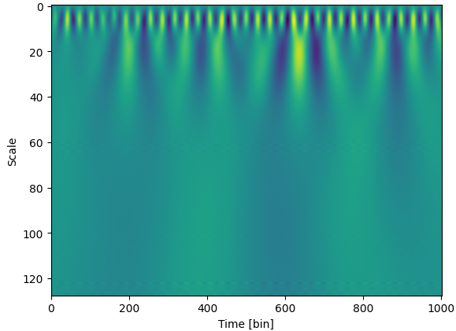
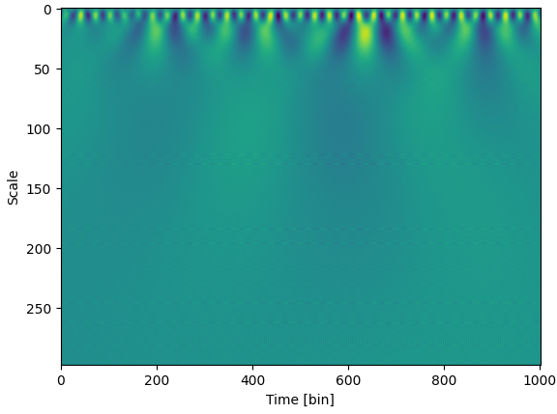
wavelet_cmor10-1_scale_min_2_max_130
wavelet_cmor10-1_scale_min_2_max_300
Low freq (=long prd)
Low freq (=long prd)
High freq (=short prd)
High freq (=short prd)
wavelet_cmor63.5-1_scale_min_2_max_130
wavelet_cmor63.5-1_scale_min_2_max_300
Low freq (=long prd)
Low freq (=long prd)
High freq (=short prd)
High freq (=short prd)
wavelet_mexh_scale_min_2_max_130
wavelet_ mexh _scale_min_2_max_300
High freq (=short prd)
High freq (=short prd)
Low freq (=long prd)
Low freq (=long prd)

