Slide 1
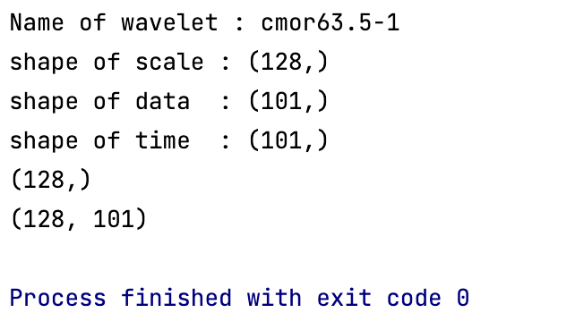
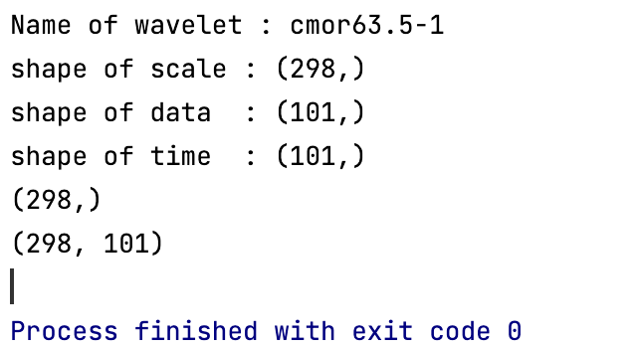
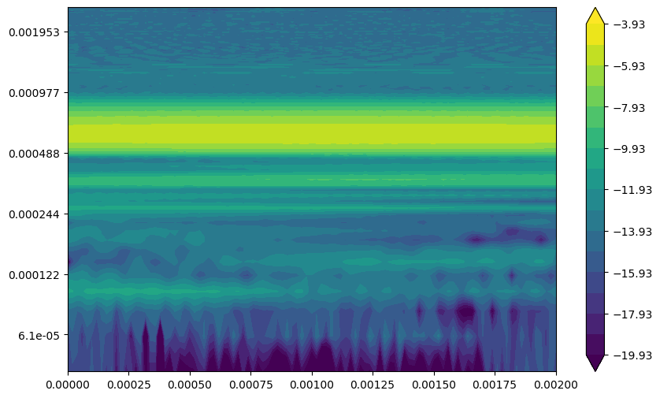
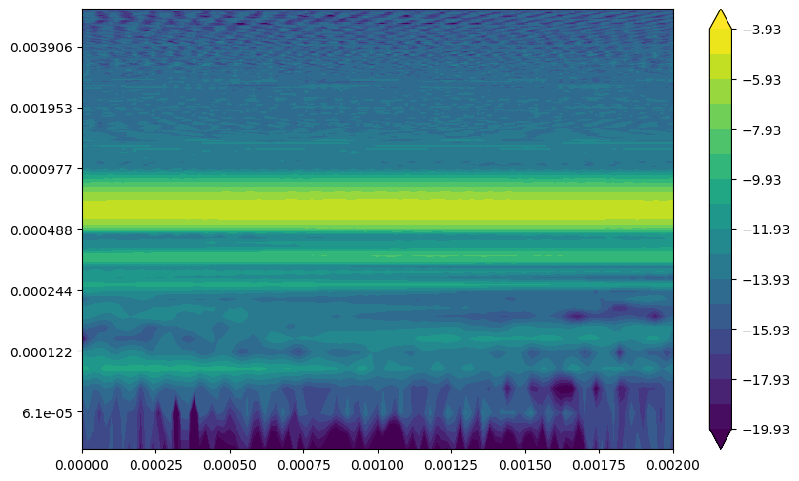
wavelet_cmor10-2_scale_min_2_max_130
wavelet_cmor10-1_scale_min_2_max_300
wavelet_cmor10-1_scale_min_2_max_130
Low freq (=long prd)
Period
Period
High freq (=short prd)

Slide 2
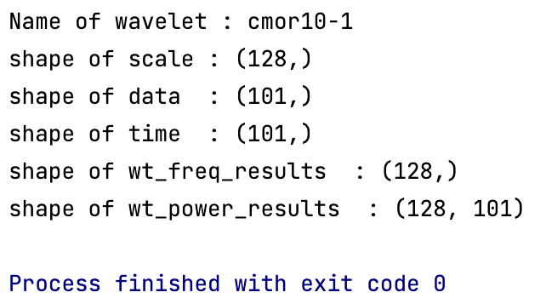

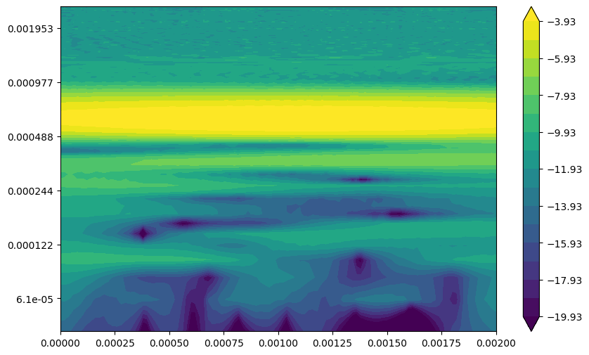
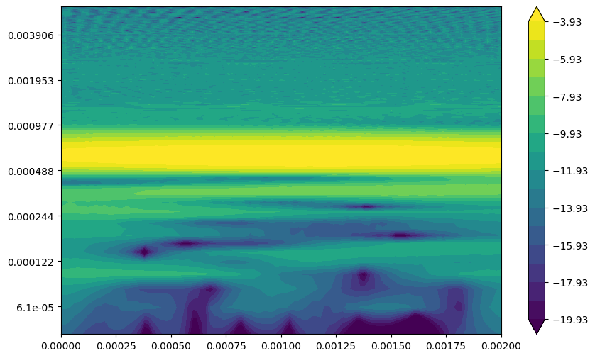
wavelet_cmor63.5-1_scale_min_2_max_130
wavelet_cmor63.5-1_scale_min_2_max_300
Period
Period

Slide 3
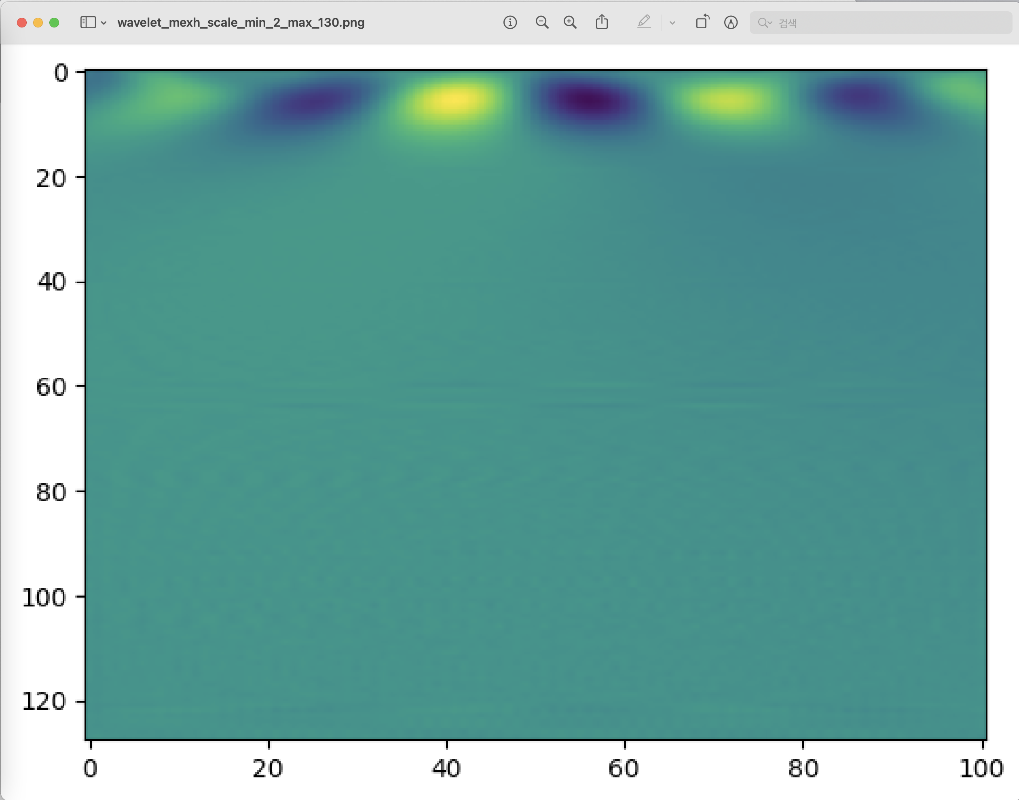
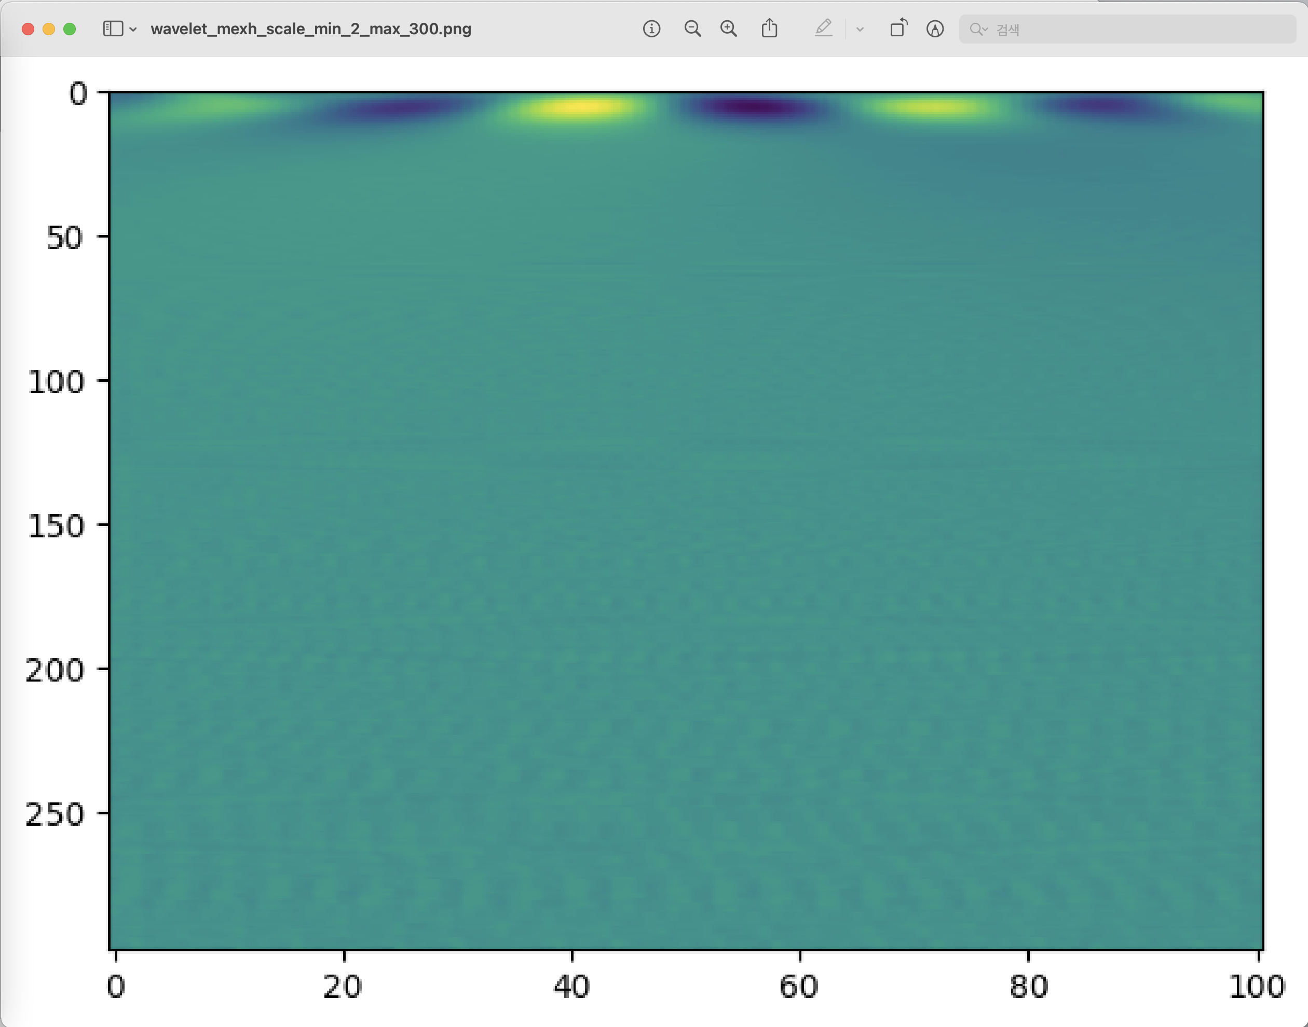
wavelet_mexh_scale_min_2_max_130
wavelet_ mexh _scale_min_2_max_300
Low freq (=long prd)
Idx
Idx
High freq (=short prd)

