Slide 1

join

Slide 2
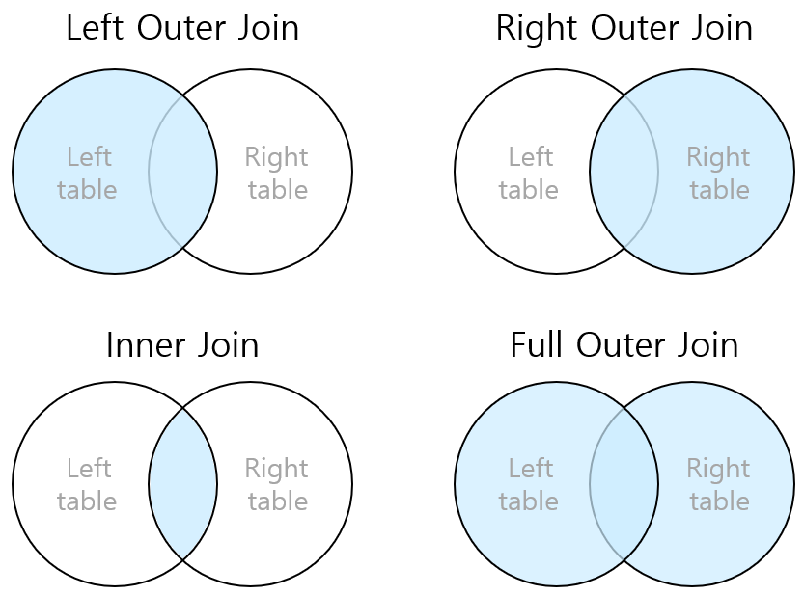
join

